Slide 1
ASP Vision: Optically Computing the First Layer of CNNs using Angle Sensitive Pixels
Huaijin (George) Chen*, Suren Jayasuriya*, Jiyue Yang, Judy Stephen, Sriram Sivaramakrishnan, Ashok Veeraraghavan, Alyosha Molnar
CVPR 2016, Las Vegas, USA
* = equal contribution

Slide 2
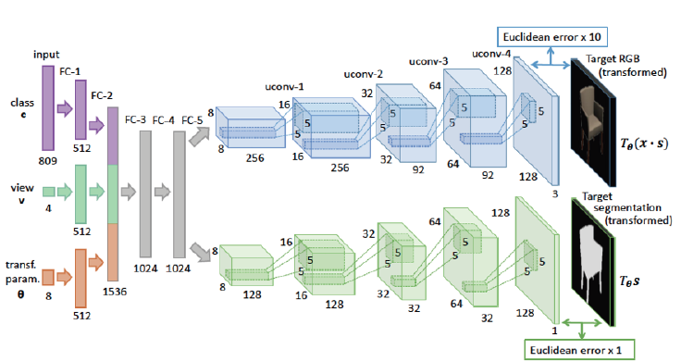
Motivation: Challenges for Energy-efficient Deep Learning
Deep learning is the state-of-the-art in visual recognition
[Dosovitskiy et al. CVPR 2015]

Slide 3
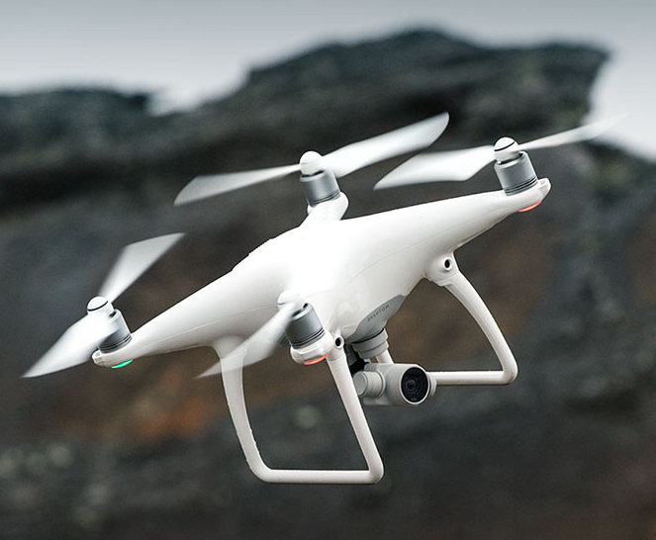
Motivation: Challenges for Energy-efficient Deep Learning
Deep learning is the state-of-the-art in visual recognition
However, energy consumption at inference is high, limiting embedded vision applications
[Dosovitskiy et al. CVPR 2015]

Slide 4
Motivation: Challenges for Energy-efficient Deep Learning
Deep learning is the state-of-the-art in visual recognition
However, energy consumption at inference is high, limiting embedded vision applications
Current research aims at reducing energy costs through network compression and custom ASIC accelerators
[Dosovitskiy et al. CVPR 2015]

Slide 5
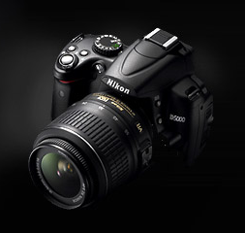
Our Approach: Optical Computation
We focus on the imaging system from optics/camera to CNN
+ CNN

Slide 6
Our Approach: Optical Computation
We focus on the imaging system from optics/camera to CNN
We explore optical computation to reduce image sensing energy for a deep learning pipeline
+ CNN

Slide 7
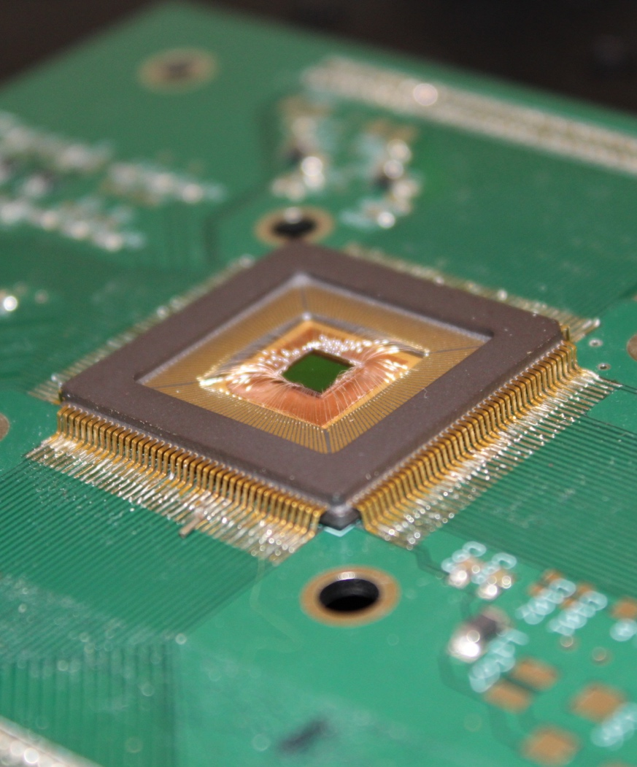
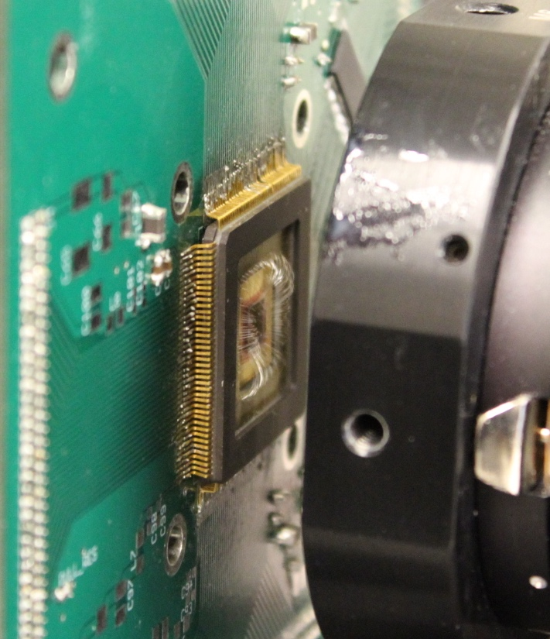
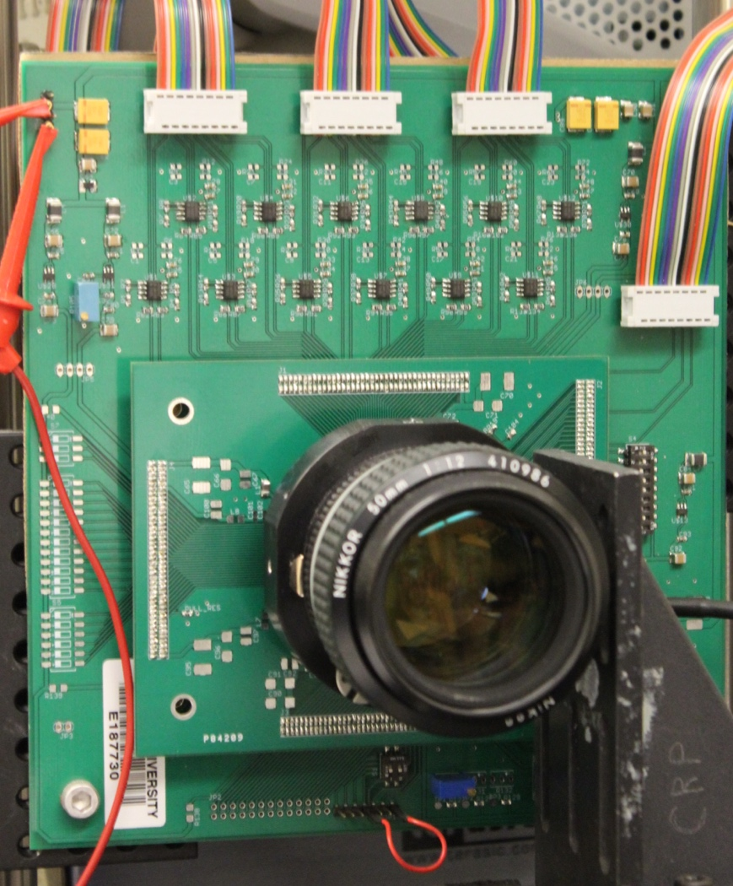
Our Approach: Optical Computation
We focus on the imaging system from optics/camera to CNN
We explore optical computation to reduce image sensing energy for a deep learning pipeline
We leverage existing computational cameras called Angle Sensitive Pixels (ASPs) in order to do so
+ CNN

Slide 8
Our Contributions
We show the optical response of Angle Sensitive Pixels emulates the first layer of CNNs
Analysis of the energy/bandwidth of this optical computation
Evaluation of system performance on standard datasets
Real digit and face recognition utilizing an operational prototype ASP camera

Slide 9
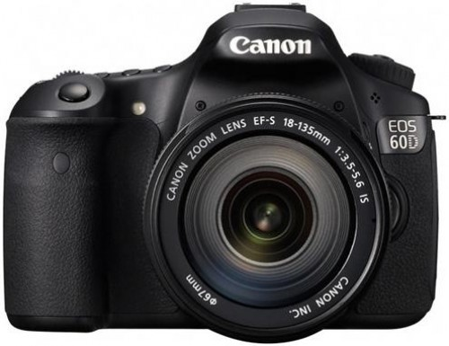
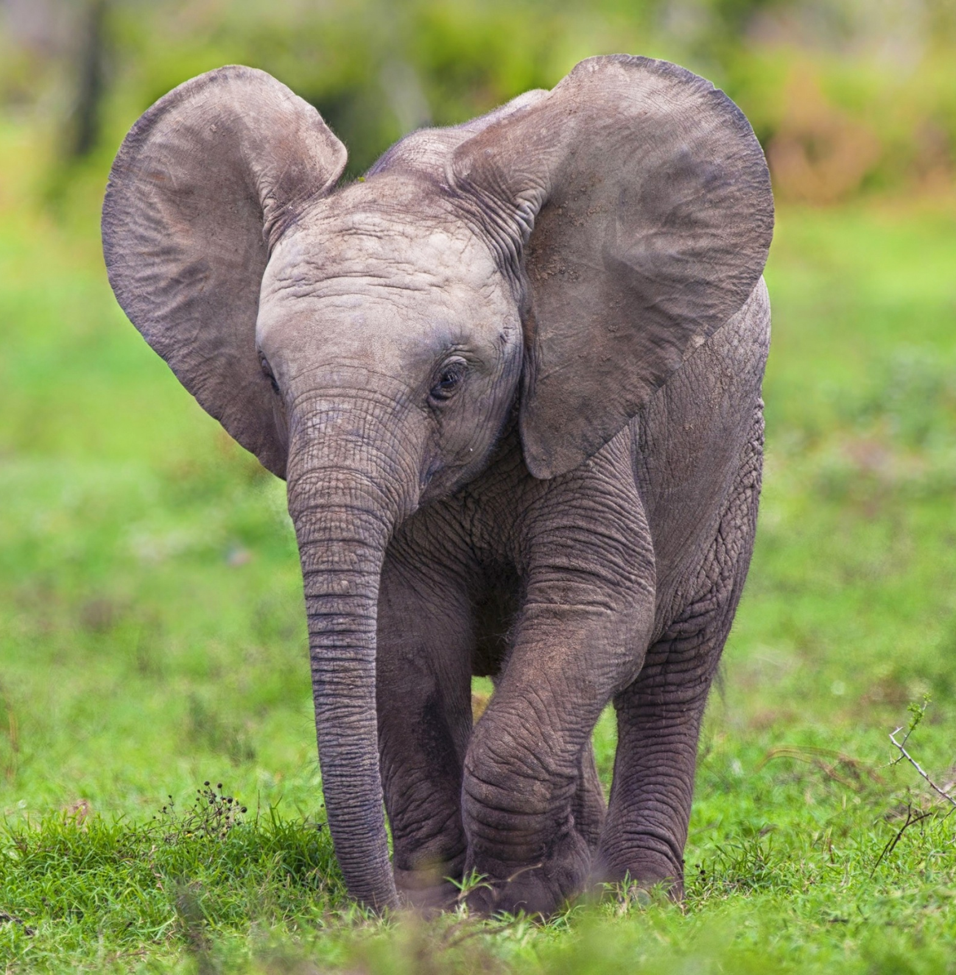
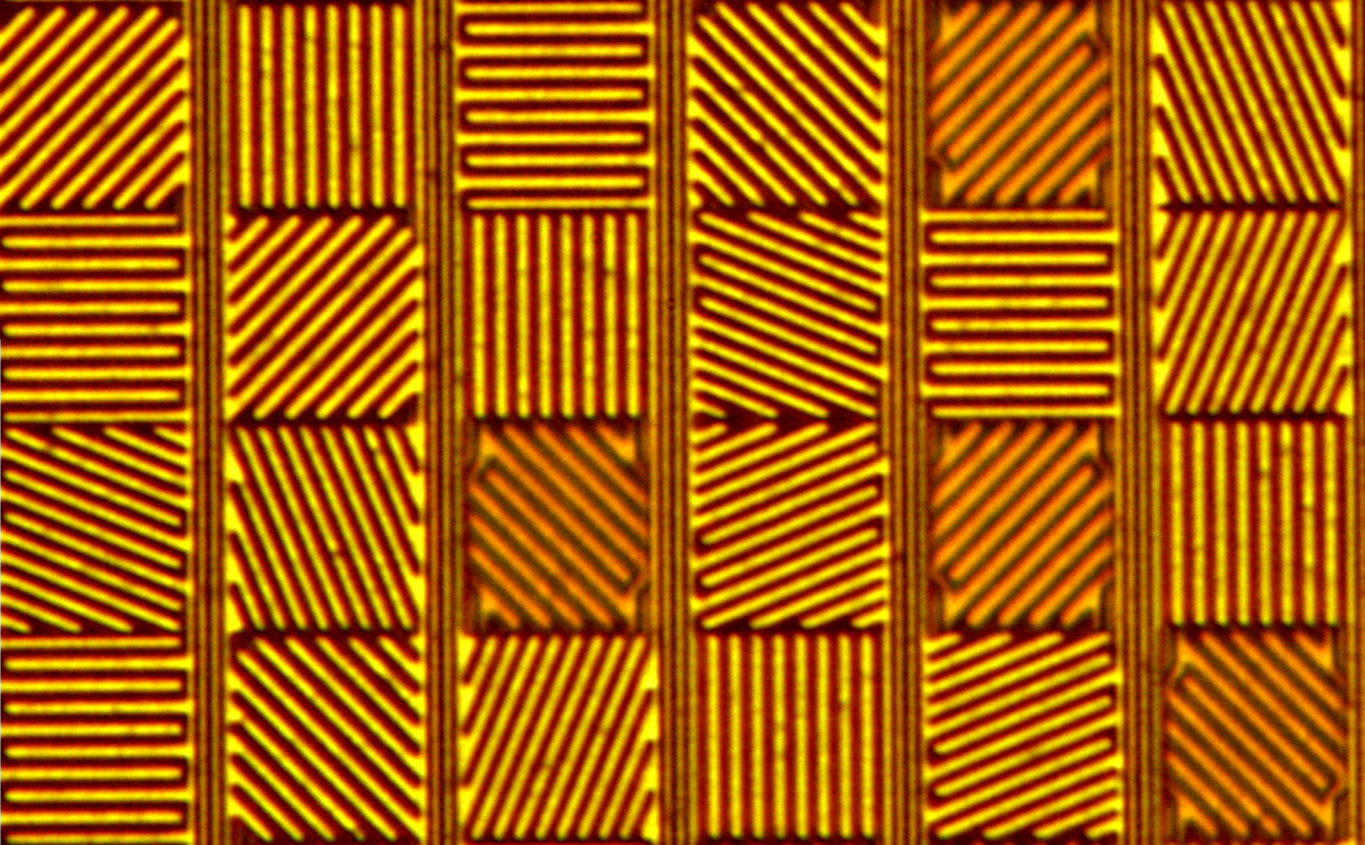
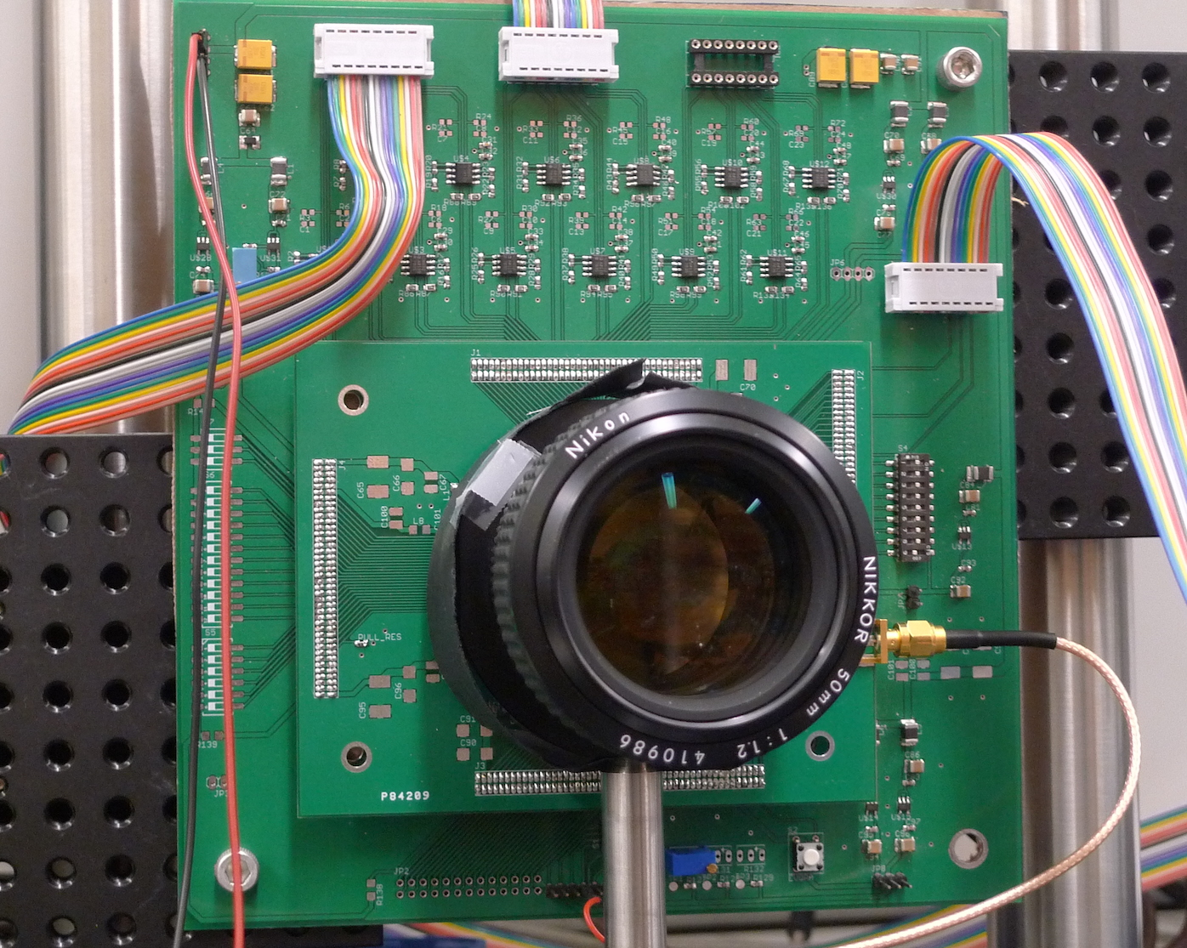
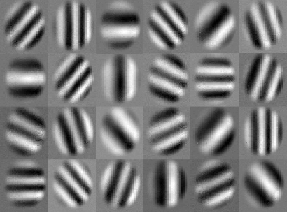
ASP Vision
Conventional Deep Learning Pipeline
Sensing
Computation
L₁
L₂
L₃
L_{N}
Output
···
···
Scene
Traditional Camera
CNN
“Elephant”
ASP Vision : Sensor + Deep Learning Co-Design
ASP Camera
L_{N}
Output
L₁
L₂
L₃
···
···
Optically computed
Reduced CNN

Slide 10
Optically Computing the First Layer of CNNs
First layer is application-independent and transferable
V1 neurons have been shown to perform sparse coding of natural edges
ASP optical response = Gabor edge filters
[Yosinski et al NIPS 2014]
[Olshausen and Field, Nature 1996]

Slide 11
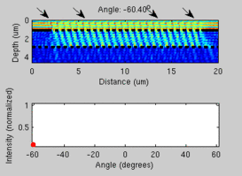
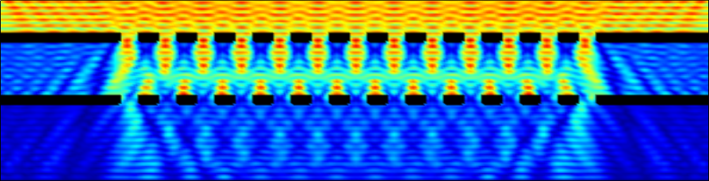
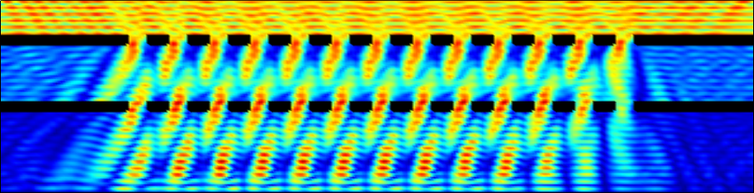
Angle Sensitive Pixels (ASPs)
ASPs are CMOS image sensors that have two diffraction gratings over photodiodes
They have been shown to capture dimensions of the plenoptic function
Diffraction Gratings
0 degrees
A
B
10 degrees
CMOS Active Area
[Wang and Molnar, JSSC 2012]
[M. Hirsch et al., ICCP 2014]
Notes:
On top of each pixel there are two layers of diffraction grating, which will give you the Talbot effect shown in the animation. Basically the output pixel intensity of the each ASP is a function of not only the intensity of the incident light, but also the angle of the incident light. We have 24 ASPs with different orientation and spatial frequencies inside each super pixel, and we tile up 96x64 super pixels across the sensor area to perform optical convolution of multiple Gabor wavelets.
1. You can't see the two pixels, the first grating blocks them. They are underneath the two images. You can read one of the other ASP papers, they show the pixels underneath the gratings. So every "pixel" in the 4x6 tile actually has two pixels underneath it for the differential phase.
2. I guess its a misnomer: defocused edges have angle information, and an ASP will have high intensity when it correlates with the proper angle/edge distribution. The resulting output from ASP at the tile/macro-pixel resolution are edge filtered images, so its equivalent to taking the optical response of that ASP pixel and convolving it with the scene as a whole (at the macro-pixel resolution).

Slide 12
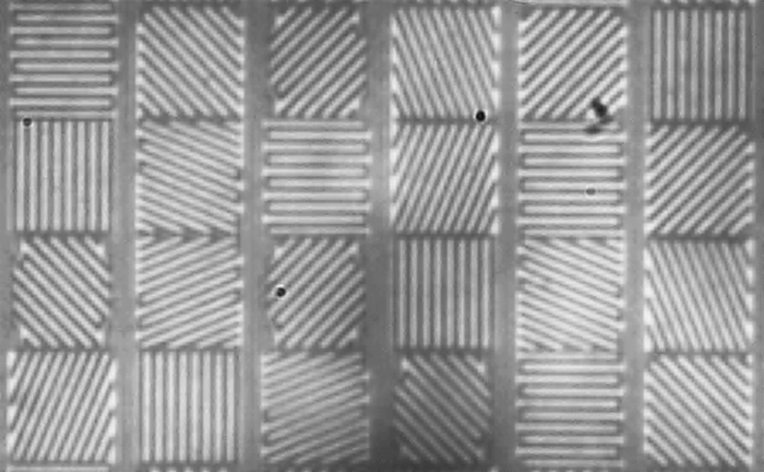
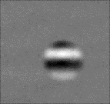
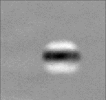
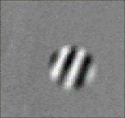
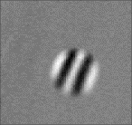
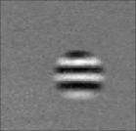
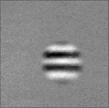
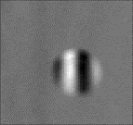
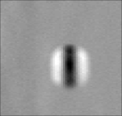
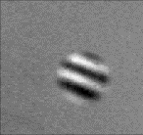
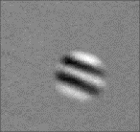
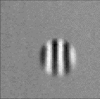
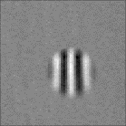
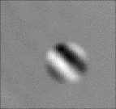
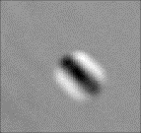
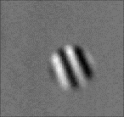
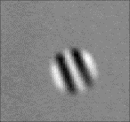
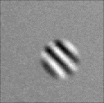
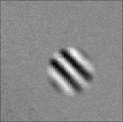
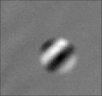
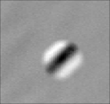
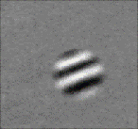
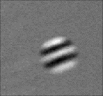
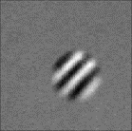
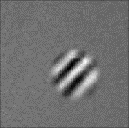
Optical Edge Filtering using ASPs
60µm
Low frequency
Mid frequency
High frequency
In particular, we leverage the optical impulse response of ASPs
Each ASP pixel is tiled across the array like a Bayer pattern
40µm
f_{y}
f_{x}
[A. Wang, S. Sivaramakrishnan, and A. Molnar, CICC 2012]

Slide 13
Optical Edge Filtering using ASPs
60µm
Low frequency
Mid frequency
High frequency
In particular, we leverage the optical impulse response of ASPs
Each ASP pixel is tiled across the array like a Bayer pattern
The sub-image for each pixel = optical convolution of scene with edge filter
40µm
f_{y}
f_{x}
=
*
[A. Wang, S. Sivaramakrishnan, and A. Molnar, CICC 2012]

Slide 14
ASP sensors save energy with edge-only digitization
90% savings in image sensing
90% savings in bandwidth
[A. Wang, S. Sivaramakrishnan, and A. Molnar, CICC 2012]
Notes:
In the sensing stage, the ASP sensor saves tremendous amount ( 90%) of energy and (90%) required bandwidth than a modern compact image sensor, as it only capture and transmit only edge information.

Slide 15
ASP Vision
We then send the resulting ASP output through the rest of the CNN layers
Conventional Deep Learning Pipeline
Sensing
Computation
L₁
L₂
L₃
L_{N}
Output
···
···
Scene
Traditional Camera
CNN
ASP Vision : Sensor + Deep Learning Co-Design
“Elephant”
ASP Camera
L_{N}
Output
L₁
L₂
L₃
···
···
Optically computed
Reduced CNN
Notes:
In the computing stage, ASP Vision also save energy by reducing the FLOPS in the CNN through optically computing the first layer of a given CNN.

Slide 16
Results

Slide 17
ASP Vision performs comparably to CNNs on datasets
Notes:
We simulated ASP Vision to perform common visual recognition tasks, including digit recognition on MNIST, object classification on CIFAR-10 and 100, and face identification on PF-83.
We compared the ASP Vision results with baseline CNNs such as VGG, network-in-network and LeNet. We analyzed the effect of both the size of the first layer and hard-coding this first layer with ASPs. We note that ASP Vision results in a minimal degradation of 0.1-5% across the datasets.

Slide 18
How many FLOPs can we save by skipping the first layer?
 | VGG-M |  | NiN |  | LeNet
# of Conv. Layers | 8 |  | 9 |  | 4
Input Image Size | 224 ⨉ 224 ⨉ 3 |  | 32 ⨉ 32 ⨉ 3 |  | 28 ⨉ 28 ⨉ 1
# of First Layer Filters | 96 (Original) | 12 (Prototype) | 192 (Original) | 12 (Prototype) | 20 (Original) | 12 (Prototype)
First Layer Conv. Kernel | 7 ⨉ 7 ⨉ 96 | 7 ⨉ 7 ⨉ 12 | 5 ⨉ 5 ⨉ 192 | 5 ⨉ 5 ⨉ 12 | 5 ⨉ 5 ⨉ 20 | 5 ⨉ 5 ⨉ 12
FLOPS of First layer | 708.0M | 88.5 M | 14.75M | 921.6K | 392 K | 235 K
Total FLOPS | 6.02G | 3.83 G | 200.3M | 157 M | 10.4 M | 8.8 M
First Layer FLOPS Saving | 11.76% | 2.3% | 7.36% | 0.6% | 3.77% | 2.67%
Notes:
We also analyzed the FLOPS saved by optically computing the first layer. This savings does not correlate directly to depth/number of layers, but is dependent on size of the first layer and input image size. For example, we see savings varying from 3-12% in doing optical computation for different networks. However, we note that hardware-constraints for ASP Vision will have reduced number of first layer filters, so we see only modest savings up to 2% in prototype systems.

Slide 19
Prototype
Chip Package
Prototype Setup
ASP Sensor
Main Lens
Existing setup from [A. Wang, S. Sivaramakrishnan, and A. Molnar, CICC 2012]
Notes:
Here is a photo of the prototype setup with ASP image sensor mounted behind a lens in the lab

Slide 20
Real digit and face datasets collected from prototype
Sample ASP sub-image responses
Notes:
We performed real-world experiments on digit recognition and face recognition using the prototype. Here are some sample results we collected in the experiments.

Slide 21
ASP Vision performs comparable to baselines on real data after dataset augmentation
Notes:
Training ASP Vision on these small datasets collected in the lab, we used dataset augmentation involving linear shifts and rotations to increase dataset size. We also performed 20 trials with 85/15 training/validation split, and show the average and variance of these results. We note that ASP Vision performed comparably to these baselines after dataset augmentation, showcasing the end-to-end system operating in the lab.

Slide 22
Limitations
Can compute only the first layer of CNNs optically with ASPs
ASPs have lower spatial resolution and light efficiency compared to regular sensors
Optical edge response is depth-dependent (but could be a potential advantage to incorporate depth)
Notes:
Our proposed system has some limitations. ASPs can only compute the first layer of CNNs optically, and computing subsequent layers optically would require different technologies. In addition, ASPs sensors have reduced spatial resolution and light efficiency due to metal gratings compared to other sensors. Finallly, the optical edge response is depth dependent as we require our scenes to be slightly out of focus. However, this could be a potential advantage to incorporate depth as a prior to future deep learning algorithms.

Slide 23
ASP Vision Summary
Proposed an end-to-end deep learning pipeline utilizing ASPs
ASP Vision saves up to 90% energy in image sensing and bandwidth
We hope that computer vision pipelines are co-designed with sensors in the future
Notes:
To summarize, we proposed ASP Vision, an end-to-end computer vision framework, leveraging Angle sensitive pixels to perform optical computation. We show that ASP Vision saves 90% in image sensing and bandwidth while performing comparably to state of the art algorithms. We hope that future computer vision pipelines are co-designed with sensors and deep learning backends in the future. Thank you.

Slide 24
Thank you
Come see our poster to learn more about ASP Vision!

Slide 25
Backup Slides

Slide 26
Title that summarizes point of graph
Noise: Gaussian white noise added. SNR varies from 9-28 dB, tested on MNIST/LeNet
  At low SNRs: ASP Vision suffers more from accuracy degradation.
  Above 15 dB SNR: both methods have high accuracy and are comparable.
ASP Parameters: No significant impact on performance – following layers seem to learn to adapt.

