Slide 1
Competition under Cumulative Advantage
Bo Jiang
UMass
MURI Ithaca
October 1, 2013
Notes:
Hello, everyone. I’m going to talk about our work on competition under cumulative advantage.

Slide 2
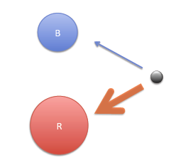
Competition w/ cumulative advantage
Competition
  # citations for scientific papers
  # customers for wireless service providers
  Population infected by different viruses
Cumulative advantage
  “rich gets richer”
  Simplest form of network effects
  Known to generate power laws
Notes:
Competition is ubiquitous. It arises naturally in many social phenomena. For example, we can talk about scientific papers competing for citations, wireless service providers competing for customers, and different kinds of viruses competing for susceptible population. The second ingredient is cumulative advantage. It refers to the rich gets richer phenomenon. For example, here’s a blue community and a red community. The new arrival, represented by the black node here, is more likely to joint the red community because it has a larger size. This is the simplest form of network effect, and is also known under various other names such as preferential attachment. It is know to generate power laws under some conditions.

Slide 3
Questions
Is there a winner?
Duration of competition?
  Time taken for winner to emerge
Intensity of competition?
  Total # changes in leadership
Impact of inherent fitness?
Impact of initial wealth?
Notes:
The general questions we are interested in about competitions are: Is there a winner? How long does the competition last?

Slide 4
Model
Two competitor case
State (R,B) in 2D lattice
  Each time, R increases by 1 or B increases by 1
  Transition rule, relative fitness
  for B
  Generalized Pólya’s urn model
w/o CA
GPU
RW
Notes:
For this talk, we will focus on the two competitor case. We will call the two competitors blue and red. We also assume the quantity of interest in the competition is measured in discrete units, so the state space is the first quadrant of the 2D lattice. At each time, We will refer to this quantity as the wealth of the competitor.

Slide 5
Results – equal fitness case
Relation to Random Walk
  Prob. of any path connecting states and is
  In general, fix initial wealth , for any event ,
  CA equivalent to beta mixture of RW
Results for RW easier to obtain
RW
is beta func.
Beta density with parameters and

Slide 6
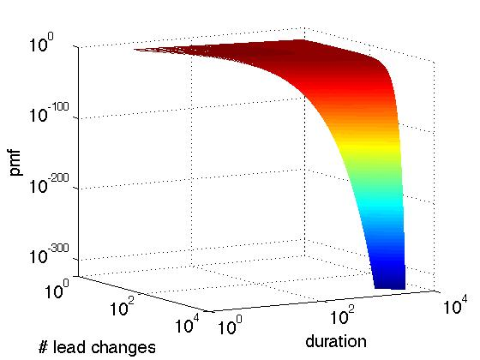
Results – equal fitness case
Joint PMF for duration and # lead changes
  Similarly for

Slide 7
Results – equal fitness case
Duration has power-law distribution
  Initial wealth not affect tail exponent
  Infinite mean
  Can take very long for leadership to stabilize

Slide 8
Results – equal fitness case
Intensity has power-law distribution
  Initial wealth not affect tail exponent
  Infinite mean
  Leadership can alternate large # of times

Slide 9
Results – diff. fitness case
Intensity has exponential tail
Duration remains power law
  Discontinuity in tail exp. from to
  When slightly > 1, tail heavier than case
  When , tail similar to case

Slide 10
Discontinuity demystified,
Non-negligible prob. to reach state
When , unlikely to change again
When , guaranteed to change again, only much later

Slide 11
Other results
diff. fitness, lower bound on tail exponent of duration distr.
eq. fitness, between M=3+ individuals
where is Dirichlet density w/ param. ;
is (M-1)-dim simplex.

Slide 12
Ongoing work
exact tail exponent, diff. fitness
exact asymptotics, diff. fitness
joint PMF for duration and # lead changes, diff. fitness (leverage Gena’s recent work?)
correlation between duration and # lead changes
competitions between 3+ individuals
parameter estimation (with Davis)

