Slide 1

Analysis and Design of Complex Systems with Multivariate Heavy Tail Phenomena
MURI Meeting
October 1st, 2013
Ness B. Shroff
Depts. ECE & CSE, The Ohio State University
E-mail: shroff@ece.osu.edu
Collaborators Yoora Kim, Irem Koprulu, R. Srikant, and Y. Zheng

Slide 2


Three Research Directions
Direction I Analyzing statistical metrics of Lévy mobility: first exit time, contact time, and inter-contact time
Direction II Exploiting opportunities (node mobility, channel variation, predictibility) for resource allocation in wireless nets.
Direction III Developing scheduling algorithms for data center/cloud computing systems
Notes:
In the first year of this MURI, I have focused on three main research directions

Slide 3
Progress Overview
Direction I Analyzing statistical metrics of Lévy mobility: first exit time, contact time, and inter-contact time
  First exit time analysis for Lévy flight model (Submitted to AAP)
  Extension to Explore/Return model for more detailed human mobility modeling (ongoing work)
Direction II Exploiting various opportunities (node mobility, channel variation, user predictibility) for resource allocation in wireless networks
  Optimal scheduler design for content sharing (IEEE INFOCOM’13)
  Design of data off-loading schemes: A coupled queueing problem with bi-variate heavy tailed on/off service time distribution
  Analysis of reneging probability and expected waiting time (Submitted to IEEE INFOCOM’14)

Slide 4
Progress Overview (cont’d)
Direction III Developing scheduling algorithms for data center/cloud computing systems
  Analysis and design of MaP/Reduce type scheduling algorithms with multi-variate heavy tailed dependency for minimizing the total flow time in the system
  Prove that the flow time minimization problem is strongly NP-hard and does not yield a finite competitive ratio (IEEE INFOCOM’13)
  Developed 2-approximation probabilistic competitive ratio pre-emptive scheduler that is independent of the nature of job size distributions (IEEE INFOCOM’13)
  Low-latency algorithms in the large-system limit for both pre-emptive and non-pre-emptive schedulers (ongoing work)
  Characterization of the auto-correlation function of the number of servers (ongoing work)
Notes:
We are working on analyzing and deisigning for these ubiquitous Map/Reduce types of scheduling algorithms with ….

Slide 5
Collaborations/Synergistic Activities
R. Srikant (UIUC)
  Jointly supervise OSU PhD student Yousi Zheng via weekly (Thu. 11AM Eastern) Skype meetings on data center scheduling problems
  UIUC PhD student Siva Theja Maguluri visited OSU to collaborate on autocorrelation characterization in cloud computing. Pursuing collaboration with Anantharam Swami at ARL.
  Visit to OSU, kickoff, and Columbia meetings, plus phone conferences to discuss mobility modeling and coupled queuing problems
Yoora Kim (Math dept., University of Ulsan)
  Weekly Skype meetings with OSU PhD student Irem Koprulu via weekly (Tue. 10AM Eastern) on Lévy flight analysis and explore/return model
  Joint investigation of data-off loading problem
Anantharam Swami (ARL)
  E-mail and phone discussions on works on Lévy mobility and data center problems.
  Planned Monthly meetings to investigate Lévy mobility analysis for modeling drone behavior, and developing efficient proactive/reactive routing protocols.

Slide 6
Collaborations/Synergistic Activities
Lang Tong (Cornell)
  Visits to OSU and Cornell, and meetings during kickoff/Columbia, plus phone/email discussions on problems involving cloud computing and data center systems
Zhi-Li Zhang (University of Minnesota)
  Kickoff and Columbia meetings + phone/email conferences to discuss human mobility modeling
  Provided important new references on human mobility
Gennady Samordinitski (Cornell)
  N. Shroff visited G. Samordinitski at Cornell in May 2013 to discuss issues regarding use of large deviation techniques for heavy tailed distributions and inference problems in social networks.

Slide 7
Direction I Analyzing statistical metrics of Lévy mobility: first exit time, contact time, and inter-contact time

Slide 8
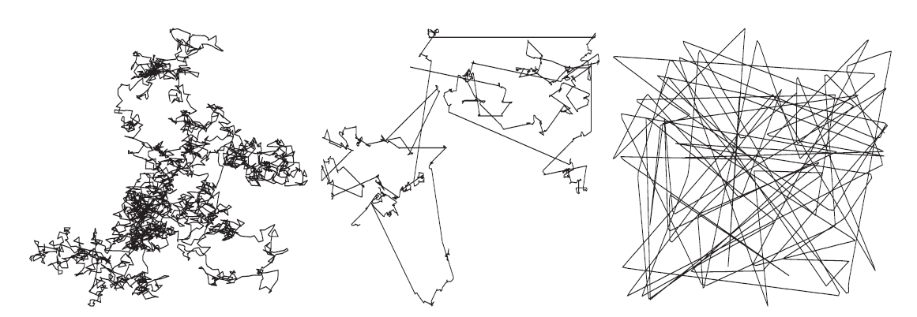
What is Lévy Mobility?
A class of random walks that is characterized by a heavy-tailed jump-length distribution
Due to the heavy-tailed jump-length, the sample path consists of many short jumps and occasional long jumps with length |V|=S
(a) Brownian motion
(b) Lévy mobility
(c) Random waypoint
Notes:
Where V is a sided jump that can take positive and negative values.

Slide 9
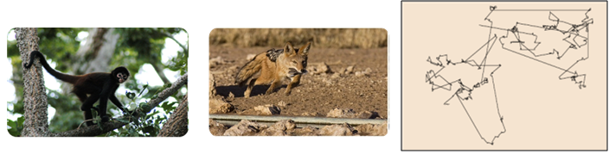
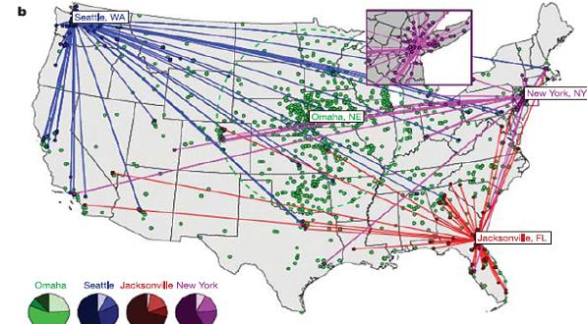

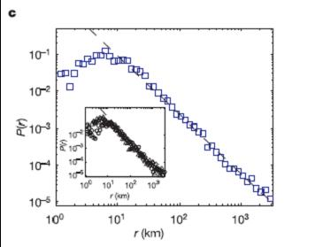
Why Lévy Mobility?
Observed in ecology for different animal species
Travel: Analysis of the circulation of bank notes in the US
  The distribution of human travelling distances decays as a power law [Brockmann et al. in Nature’06]
Notes:
http://gandhiviswanathan.wordpress.com/2012/04/25/levy-flights-of-wandering-albatrosses-fact-or-fiction/

Slide 10
Lévy Mobility Models in the Literature
Human mobility
[1] I. Rhee, et al. On the Lévy-walk nature of human mobility, IEEE/ACM Trans. on Netw., 2011. (Received the IEEE ComSoc William R. Bennet Prize of 2013).
[2] K. Lee, et al. SLAW: Self-similar least-action human walk, IEEE/ACM Trans. on Netw., 2012
[3] D. Brockmann, L. Hufnagel, and T. Geisel, The scaling laws of human travel, Nature, 2006 (Dollar-Bill Tracking)
Animal trajectories:
[4] G. M. Viswanathan, et al. Lévy flight search patterns of wandering albatrosses, Nature, 1996.
[5] G. Ramos-Fernandez, et al. Lévy walk patterns in the foraging movements of spider monkeys (Ateles geoffroyi), Behav. Ecol. Sociobiol., 2004.
[6] D. W. Sims, et al. Scaling laws of marine predator search behaviour, Nature, 2008.
[7] J. Klafter, M. F. Shlesinger, and G. Zumofen, Beyond brownian motion, Phys. Today, 1996.
[8] R. N. Mantegna and H. E. Stanley, Stochastic process with ultraslow convergence to a gaussian: the truncated Lévy flight, Phys. Rev. Lett., 1994.
Notes:
In fact, there are lots of papers in the literature in which data is analyzed and shown to approximate some form of Levy mobility
Info on the datasets of [1] - On the Levy-walk nature of human mobility
Data set
226 daily GPS traces from 101 participants in five different outdoor sites (NCSU, KAIST, New York City, Disney World, and one state fair in Raleigh, NC)
GPS records at every 10s with accuracy of 3 m
Analysis (key observations)
Similar statistical features to Levy walks moving within a confined area:
Flight and pause-time distributions: heavy-tailed (Weibull, lognormal, Pareto, and truncated Pareto)
MSD: supper-diffusion (up to 30 min to an hour) followed by sub-diffusion (Why transit? confined area & tendency to return home)
5 datasets based on GPS – 2 campuses, 1 urban area, 2 amusement parks
(D1) North Carolina State University Campus
(D2) KAIST Campus
(D3) Manhattan, NYC
(D4) Disney World Orlando FL
(D5) State Fair, Raleigh NC

Slide 11
Lévy Mobility Models in the Literature
Foraging behavior:
[9] G. M. Viswanathan, E. P. Raposo, and M. G. E. da Luz, Lévy flights and superdiffusion in the context of biological encounters and random searches, Phys. Life Rev., 2008.
[10] C. T. Brown, L. S. Liebovitch, and R. Glendon, Lévy flights in Dobe Ju/'hoansi foraging patterns, Hum. Ecol., 2007.
Epidemics:
[11] N. Valler, B. A. Prakash, H. Tong, M. Faloutsos, and C. Faloutsos. Epidemic spread in mobile ad hoc networks: Determining the tipping point. NETWORKING, 2011.R.
[12] Potharaju, E. Hoque, C. Nita-Rotaru, S. S. Venkatesh, and S. Sarkar, Closing the Pandora's Box: Defenses for Thwarting Epidemic Outbreaks in Mobile Adhoc Networks, IEEE MASS 2012….

Slide 12


Two-subclasses of Lévy Mobility
Lévy flight: consumed time per jump = constant for each jump
Lévy walk: consumed time per jump jump-length
Focus for this talk: Lévy flight
Same sample path, but different elapsed time
Time
Z₄
Z₂
Lévy walk
Lévy flight
Z₁
Z₃
Z₀
Jump
Z₀
Z₁
Z₂
Z₃
Z₄
…
Location
Sample trace in

Slide 13
Lévy Flight
S_{k} : the length of the k-th jump
θ_{k} : the direction of the k-th jump
Z_{k} : location after the kth jump
Lévy flight is described by
  jump-length model (S_{k})
  direction model (θ_{k})
Z₄
Z₂
Z₁
Z₃
Z₀
Jump
Notes:
We describe both these models in our next few slides

Slide 14
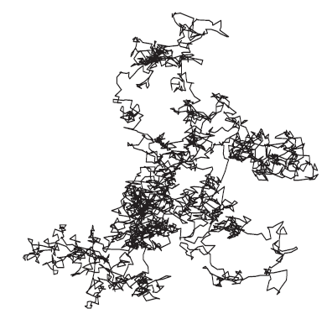
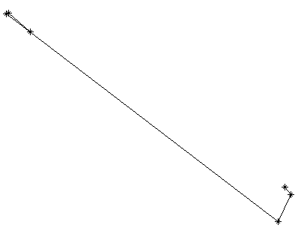
Jump-Length Model
S_{k} is i.i.d. across k ( S := the generic random variable for S_{k})
  With different values of α, mobility patterns are widely different.
  Smaller α induces a larger number of long jumps.
0 α 2
Heavier (Heavy-tail degree) Lighter
Notes:
S_k the jump length at time k is iid across k

Slide 15
Direction Model
θ_{k} is i.i.d. across k
θ := the generic random variable for θ_{k}
The distribution of θ determines the dependence between the x and y coordinates along the trajectory
θ is uniformly random over [0, 2π) → no directional preference
θ is concentrated along a direction → strong directional preference
Isotropic Lévy flight
Lévy flight with directional drift

Slide 16
Relation to the Project
Remember:
  projection of the jump onto x-axis
  projection of the jump onto y-axis
X_{k} and Y_{k} are dependent and have heavy tailed marginal distributions whose degree of dependency depends on the distribution of θ.
  → otherwise Y_{k} = 0 almost surely
  → otherwise X_{k} = 0 almost surely
Since the jump length has distribution then
Bivariate heavy tailed
same exponent as S_{k}
Notes:
Recall that for the Levy flight, the position of the motion after the k-th jump Z_k can be written by this equation

Slide 17


Metrics of Interest (1/2)
First exit time
  Minimum time to escape a certain (bounded) region
Distance from the center
Radius of the circle
First exit time
Notes:
Now I will talk about the metrics of our interest.
The first one is the first exit time of a node.
The concept is as follows. Let’s say there is a node moving around, and let’s plot the distance from the initial position over time.
As this figure shows, the first exit time is the minimum time that takes to escape a circle of a certain radius R.

Slide 18

Metrics of Interest (2/2)
First-meeting, contact, and inter-contact times
Distance between soldiers
“Communication” Range
contact inter-contact contact inter-contact
First meeting time
Notes:
The next metrics of our interest are defined from the movements of two nodes.
As two nodes move around, the distance between them changes over time.
When the distance is below a certain threshold R at a time t, then we can interpret that two nodes are in contact at that time.
Based on this concept, the first meeting time is defined to be the minimum time that takes for two nodes to contact with each other.
In addition, the contact time is the duration that two nodes maintain the connection.
Finally, the inter-contact time is the time duration after two nodes are disconnected until they get connected.

Slide 19
Why are they important?
For human mobility model
  Estimate time until humans leave a (potentially hazardous) region
  Characterize the time and frequency of human contacts
  Analyze the total moving distance until devices carried by human reach a place for network access (e.g. WiFi area) or energy replenishment (e.g. battery charge)
Mobile ad-hoc networks
  Critical in determining the delay and capacity of a network
  Important in choosing various scheduling and forwarding algorithms
  Inter-contact time: end-to-end delay in MANET
Epidemic models
  Virus spread in nature: contact pattern of living organism is a major component for characterizing virus spreading time and spreading behavior.
  Rumor spread in human social networks: spreading time and distance are determined by social contact of humans.

Slide 20
First Exit Time
Bounded region : 2-ball of radius R
  The first exit time τ_{R} is defined as:
  where |Z_{k}| denotes the Euclidean distance of Z_{k} from the origin
  Goal: Characterize the distribution and the moments of τ_{R} for the range of values of α in (0,2)
0
2
Heavier Heavy-tail degree (α) Lighter
Notes:
So, now let’s focus on the first exit time.

Slide 21
Related Work (1/2)
For one-dimensional symmetric Lévy flights
  [1,2] studies the distribution and mean of the first exit time from a finite interval.
  [3] points out that non-local boundary conditions have to be considered due to the heavy-tailed jump-lengths of a Lévy flight, and hence the analytical results in [1, 2] are incorrect.
  [3] provides only a numerical study, no analytical solution.
  An analytic solution for the distribution and the mean of the first exit time of a one-dimensional Lévy flight is known only for the diffusion limit. The distribution and the moments of the first exit time are derived in [4, 5] by solving a fractional diffusion equation.
[1] M. Gitterman, Mean first passage time for anomalous diffusion, Phys. Rev. E, 2000.
[2] S. V. Buldyrev et al., Properties of Lévy flights on an interval with absorbing boundaries. Physica A, 2001.
[3] B. Dybiec et al., Lévy-Brownian motion on finite intervals: mean first passage time analysis. Phys. Rev. E, 2006.
[4] E. Katzav et al., The spectrum of the fractional Laplacian and first-passage-time statistics. EPL 83, 2008.
[5] A. Zoia et al., Fractional Laplacian in bounded domains. Phys. Rev. E, 2007.

Slide 22
Related Work (2/2)
For one-sided 1-D Lévy flights
  [6] gives mean first exit time scaling as E[τ_{R}] = Θ(R^{α}) for 0 < α < 2.
  [7] provides a closed-form formula for the pmf of the first exit time and shows that P(τ_{R} = t) ~ exp(- ct^{1/(1-α)}) for 0 < α < 1.
For two-dimensional isotropic Lévy flights
  No analytic results for either the distribution or moments of the first exit time from a bounded region.
  [8] provides numerical results on the mean first exit time.
First Exit Time analysis for isotropic Lévy flights is still unsolved and remains open
[6] I. Eliazar and J. Klafter, On the first passage of one-sided Lévy motions, Physica A, 2004.
[7] T. Koren et al., Leapover lengths and first passage time statistics for Lévy flights, Phys. Rev. Lett. 2007.
[8] M. Vahabi et al., Area coverage of radial Lévy flights with periodic boundary conditions. Phys. Rev. E, 2013.
Notes:
For one-dimensional symmetric Lévy flights
Taking the diffusion limit of a Lévy flight in such a way that both the Fourier variable for space and the Laplace variable for time approach zero results in a fractional diffusion equation.
By solving a fractional diffusion equation, the distribution and the moments of the first exit time are derived in [4, 5] .
For two-dimensional isotropic Lévy flights
There are no analytic results for either the distribution or moments of the first exit time from a bounded region.
There is a very recent study (in year 2013), which provides numerical results on the mean first exit time [6].

Slide 23
Distribution of First Exit Time
Theorem 1 (Distribution of the first exit time) [Submitted to AAP]
For an isotropic Lévy flight, the first exit time from a ball of radius R is geometrically bounded, i.e., there exist 0 < l_{R} ≤ u_{R} < 1 such that
, for all n = 1,2,…,
where l_{R} and u_{R} are given as
Note: S denotes the jump-length.
z_{R}= 2R for the 1-D Lévy flight
z_{R}= R for the 2-D Lévy flight
Notes:
Here’s a summary of our first main analytical result
The complementary first exit time distribution decreases to zero geometrically fast from above and below.
- The upper bound is relatively easy to obtain and relies on the fact that the jump length distribution is concave… but the lower bound relies on fairly technical lemmas and takes up most of the paper.

Slide 24

Numerical Result
1-dimensional Lévy Flight ( α = 0.5, R = 20)
n
Simulations verify upper/lower bounds.
The formula in related work [1] does not match the simulation result.
Notes:
This is a numerical result for 1D levy flight. We set alpha to 0.5 and R to 20.
The black line indicates simulation result and it shows exponential decay.
The red and green lines indicate our upper and lower bounds in Lemma 2 respectively, and we can see that our result gives a valid bound on the simulation result.
The blue line indicates the formula in reference [1], which does not match the simulation result.

Slide 25
Mean First Exit Time
Theorem 2 (Mean first exit time) [Submitted to AAP]
The mean first exit time of a Lévy flight is bounded by
From the bounds, the scaling behavior of E[τ_{R}] with respect to R is given as
Remarks
  For α = 1, we have E[τ_{R}] = Ω(R/log(R)) and E[τ_{R}] = O(R).
  For 1 < α < 2, we have E[τ_{R}] = Ω(R) and E[τ_{R}] = O(R^{α}).
  Future work is to fill the gap for 1≤ α < 2.
  We conjecture E[τ_{R}] = Θ(R^{α}) for 0 < α < 2.
for 0 < α < 1
Notes:
For a simple symmetric random walk (+1 or -1 with a constant with probability ½) the exact mean first exit time = R^2.

Slide 26
Direction Model Revisited
Distribution of θ determines dependence between X and Y
  Reminder
    X = S cos θ (movement along x-axis for a single jump) ~ Heavy-tailed
    Y = S sin θ (movement along y-axis for a single jump) ~ Heavy-tailed
We introduce a simple directional drift model
  A model to exploit the full range between (A) & (B) above
  Parameterize the dependence between X and Y
(A) tan⁻¹(Y/X) ~ Uniform[0, 2π]
(B) Since θ is a constant, we have linear relationship between X and Y
(less directional, weak dependency)
(more directional, strong dependency)
Notes:
Consider a simple directional drift model where the directionality is greater in only one direction

Slide 27
Directional Drift Model
Drift – tendency to move in a certain direction
  WLOG, we examine the specific direction θ =0. For any other direction, a rotation of the coordinate system makes the model apply.
  Drift model using the CDF of θ
  Drift index d (0 ≤ d ≤ 1)
    Parameter representing the degree of dependence between X and Y
    When d = 0, we have isotropic Lévy flight.
    When d = 1, we have one-sided Lévy flight.
1
d
0 2π

Slide 28
Parameter Set (α, d)
Tail index α for jump-length S
Drift index d for direction θ
Solve the problem for parameter set (α, d) in (0,2)×[0,1]
0 α 2
Heavier (Heavy-tail degree) Lighter
0 d 1
Weaker (Dependence) Stronger
Stronger
Dependence (d)
Weaker
Parameter Set (α , d)
0
2
Heavier Heavy-tail degree (α) Lighter
Notes:
So, as in the case of the jump length distribution, where alpha determines the degree of heaviness, the drift index determines the degree of dependence, and ideally, we’d like to solve for all values of alpha and d.

Slide 29
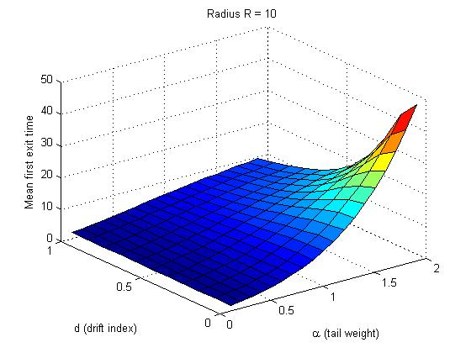
Empirical Results (1/2)
Heavier jump and larger directional drift results in shorter mean first exit time.
As the directional drift decreases, the mean first exit time is more sensitive to the heavy-tail degree of the jump-length.
As the jump-length becomes lighter, the mean first exit time is more sensitive to the directional drift.
One-sided Lévy flight
Lighter tail
Isotropic Lévy flight
Heavier tail
Notes:
For heavier jump length distributions the first exit mode from the region is dominated by single large jumps, hence the directional model has little effect on the first exit time.
As the jump length distribution gets lighter, first exit via several constructively aligned smaller jumps starts to dominate the first exit mode. A higher directional drift makes sequences of aligned steps more likely, hence first exit time is low. In the isotropic case consecutive steps in the same direction become less likely, hence first exit takes longer.

Slide 30
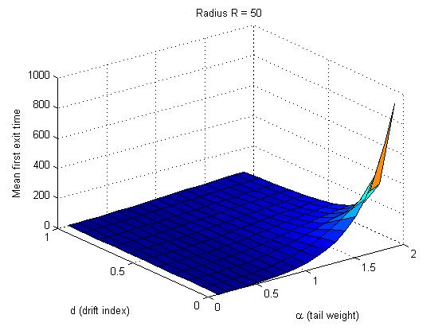
Empirical Results (2/2)
We increased the radius from R = 10 to R = 50, and we can observe similar results.
One-sided Lévy flight
Lighter tail
Isotropic Lévy flight
Heavier tail

Slide 31
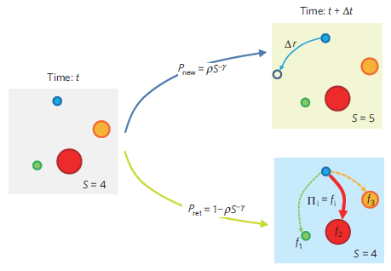

Refined Human Mobility Model (1/2)
Explore/Return mobility model [Song et al. in Nature Physics’06]
  Evaluated for a very large dataset (trajectories of over 3M mobile users for a 1 year period)
Explore: with jump-length S and random direction θ
Return: return to one of the K_{t} previously visited locations
Explore
with probability
P_{explore} := ρK_{t}^{-γ}
Explore
K=5
K=4
Return
Return
with probability
P_{return} :=1-P_{explore}
K_{t} := number of visited distinct points (e.g. K_{t} = 4)
K=4
[Song. et. al] C. Song, T. Koren, P. Wang, and A.-L. Barabási, “Modeling the Scaling Properties of Human Mobility”, Nature Physics, 2010.
Notes:
After conversations with Zhi-Li at the meetings, and some email discussions, we looked into another model for human mobility that has been published in nature.
Detailed info on the two datasets used in the analysis:
(D1) trajectories of 3 million mobile phone users over a one-year period. Each time a user initiated or received a phone call the tower that routed the communication was recorded for billing purposes. users' locations were recorded with the resolution that is determined by the local tower density. (a few hundred to a few kilometres).
(D2) location record of 1,000 users who signed up for a location based service. users' locations were recorded every hour for a two week period.

Slide 32
Refined Human Mobility Model (2/2)
Simplified Explore/Return mobility model
  The probability to explore/return does not depend on the number of previously visited locations (i.e. γ = 0).
  Hence, at each step an individual acts one of the following:
    either explore with probability P_{explore} = ρ
    or return with probability P_{return} = 1 − ρ
Location after the nth step
Note
  The return probability need not be uniform over Z_{k} (k=1,2,…,n-1) i.e., one could give preference to certain locations.
with probability ρ
with probability 1- ρ

Slide 33
Our Analytic Results on the E/R model
Theorem 3 (Distribution of the first exit time).
For an Explore/Return Lévy flight, the first exit time from a ball of radius R is geometrically bounded as
Where u_{R} and l_{R} are given as in Theorem 1.
Theorem 4 (Mean first exit time).
The mean first exit time is bounded by
and the scaling behavior of E[τ_{R}] with respect to R is given as
for 0 < α < 1.

Slide 34
Future Work
Complete our analysis on the first exit time
  Fill the gap between the lower and upper bounds for α in [1, 2)
  Analysis for Explore/Return human mobility model and direction mobility models
  Analysis for various direction mobility models
    E.g., One to multiple directional drift (vector of d_{i}’s for each direction i)
Large Deviation analysis
  The exact decay rate of first exit time distribution for a fixed radius R (i.e., beyond bounds and scaling analysis as R goes to infinity)
Other statistical metrics
  Contact time
  Relation between contact time & first exit time (preliminary results here --- still under verification)

Slide 35
Future Work (cont’d)
Extensions to Lévy walk
  One-dimension as well as two-dimension
  Challenges due to spatio-temporal dependency
    Time depends on size of the jump, hence dependency between space and time
Work with ARL to apply results to problems of interest
  Levy mobility analysis for UAV and communications (3-D?)
  Development of new proactive Routing protocols
Analyze contact patterns if data is available from Army? (talks with ARL)
  Distribution of the first-meeting time
  Distribution of the contact time
  Distribution of the inter-contact time

Slide 36
Progress Overview
Direction I Analyzing statistical metrics of Lévy mobility: first exit time, contact time, and inter-contact time
  First exit time analysis for Lévy flight (Submitted to AAP)
  Extension to Explore/Return model for more detailed human mobility modeling (ongoing work)
Direction II Exploiting various opportunities (node mobility, channel variation, user predictibility) for resource allocation in wireless networks
  Optimal scheduler design for content sharing (IEEE INFOCOM’13)
  Design of data off-loading schemes: A coupled queueing problem with bi-variate heavy tailed on/off service time distribution
  Analysis of reneging probability and expected delay (Submitted to IEEE INFOCOM’14)

Slide 37
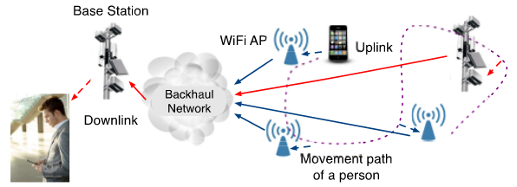

Exploiting double opportunities by data off-loading
Mobile data offloading
  Cellular networks are highly constrained (esp. in military settings)
  Use WiFi LANs, mmWave or direct contact opportunities for delivering data originally targeted for cellular networks (WiFi and cellular network interworking)
Sketch of delayed offloading system (through WiFi only)
  Traffic generated by a device first seeks WiFi APs.
  If the device fails to meet WiFi APs until timeout expires, then cellular network takes care of the delivery.
Notes:
Another promising problem that exploits double opportunities is the Mobile data offloading problem. Here both mobile opportunities and channel can be exploited.
on the use of aforementioned double opportunities in WiFi and cellular networks together in order to provide a solution of mobile data offloading problem
(the use of WiF network technologies for delivering data originally targeted for cellular networks)

Slide 38

Reminder: Delayed Offloading System
Coupled (upload) queuing structure at each user
Server state in WiFi queue - alternating on/off process
  On period (in WiFi coverage) ~ heavy tailed
  Off period (out of WiFi coverage) ~ heavy tailed
  Relationship to the project: bivariate heavy-tailed on/off periods
  K. Lee et. al, “Mobile data offloading: How much can WiFi deliver?” IEEE/ACM Trans. on Networking, 2013.
WiFi queue
Traffic arrivals
Served by WiFi networks
Cellular queue
Timeout expires (“Reneging event”)
Served by 3G/4G networks
out (off) in (on) out (off) in (on)

Slide 39






Preliminary Results (Kickoff)
Simplifying assumptions
  A1. (X_{n},Y_{n}) : i.i.d. across n, but X_{n} and Y_{n} could be dependent.
  A2. WiFi service rate (fixed): c [bits/slot]
  A3. Bernoulli arrival process
  A4. Packet size (fixed): c [bits]
Performance metrics
  Reneging probability (that a packet leaves the WiFi queue)
  Average waiting time at the WiFi queue
Server state in WiFi queue - alternating on/off process
  On period (in WiFi coverage) ~ heavy tailed
  Off period (outof WiFi coverage) ~ heavy tailed
  Goal: analyze impact of HT and dependency on network performance
on
on
on
(service rate)
  Generalization: A2, A3, and A4
Notes:
We had some preliminary results at the kickoff under some restrictive assumptions

Slide 40
Generalized System Model
Assumptions
  A1. (X_{n},Y_{n}) : i.i.d. across n, but X_{n} and Y_{n} could be dependent.
  A2. WiFi service rate (fixed): c [bits/slot] Variable service rate (General distribution)
  A3. Bernoulli arrival process Arrival process is renewal process.
  A4. Packet size (fixed): c [bits] Variable packet size (General distribution)
on
on
on

Slide 41
Summary of Our Analytic Results
We obtain a formula for the queue length distribution at the WiFi queue at an arbitrary point in time
Performance metric I: Reneging probability
  From the queue length distribution, we can obtain the formula for the reneging probability.
  The reneging probability determines the offloading efficiency.
Performance metric II: Average waiting time in the WiFi queue
Extensive numerical study
  Understand the impact of time-out on the performance of mobile delayed offloading system

Slide 42
Future Work
Joint queue length distribution (WiFi and cellular queue)
  Impact of on/off WiFi channel dependency on performance
  Guideline for WiFi deployment strategy
Exploit direct contact opportunities
  Further offloading gain
  Delay and throughput tradeoff
    BS could transmit to a larger group at lower throughput
    BS could transmit to a smaller group at a higher throughput but more delay
    Delay can be further controlled by predicting user needs in advance
Analyze other coupled queueing systems
  Networks with replenishment
  Networks with secret communication

Slide 43
Thank You

Slide 44
Backup Slides

Slide 45
Backup: Directional Drift Model
Directional drift - tendency to move to a certain direction
Two extreme cases
  Isotropic Lévy flight
    θ ~ Uniform[0, 2π]
    Most weak dependence between X and Y
  One-sided Lévy flight
    θ = c (constant, i.e., deterministic)
    Most strong dependence between X and Y
    Linear relationship between X and Y
      Y = η X where η = tan(c) is a constant.

Slide 46
Backup: Related Work (1/2)
Distribution of the first exit time τ
P(τ = t) ~ exp(- ct^{1/(1-α)}) [Koren et al.’07]
1
Drift index (d)
Parameter Set (α, d)
0
1
2
Tail weight (α)
P(τ > t) is bounded above and below by exponential functions [Shroff et al.’13]

Slide 47
Backup: Related Work (2/2)
Mean first exit time E[τ]
E[τ] = Θ(R^{α}) [Eliazar et al.’04]
1
We provide simulation study for entire (α, d).
Drift index (d)
Parameter Set (α, d)
0
2
Tail weight (α)
E[τ] = Θ(R^{α}) [Shroff et al.’13]

Slide 48
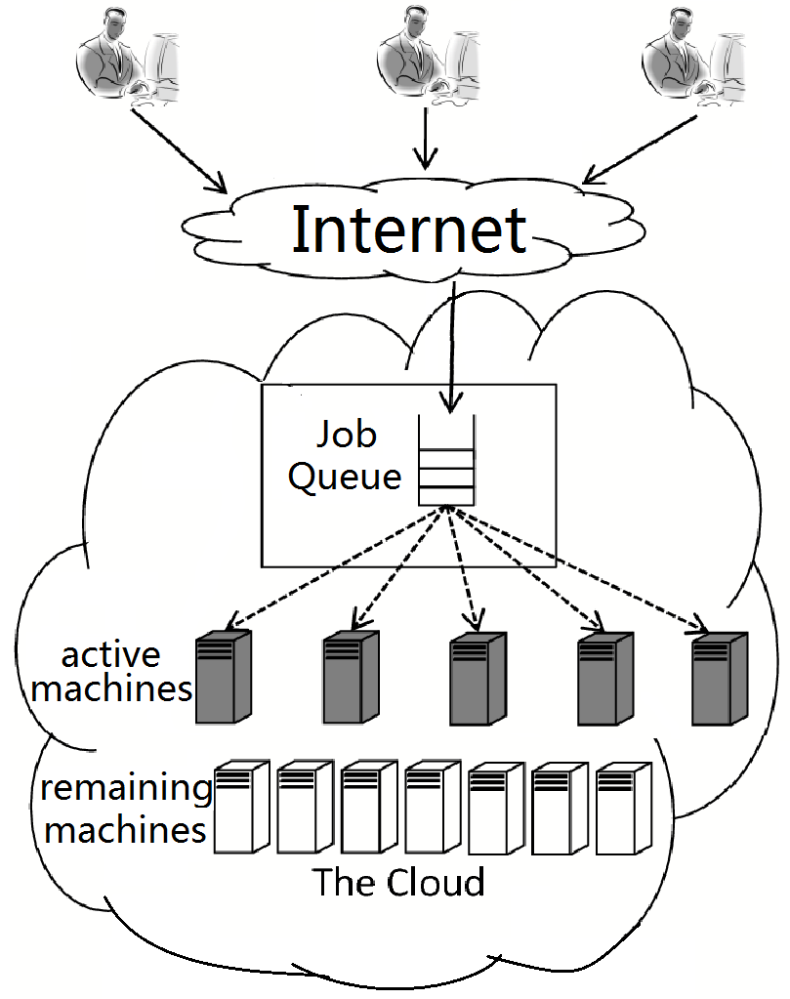
II: Scheduling Algorithms for Data Center Systems
Facility containing a very large numbers of machines
  Has roots in huge computer rooms of the early ages!
Process very large datasets
  Use MapReduce programming Model
  Framework for processing highly parallel jobs
MapReduce
  Developed (popularized) by Google
  Nearly ubiquitous
    Google, IBM, Facebook, Microsoft, Yahoo, Amazon, eBay, twitter…
  Used in a variety of different applications
    Distributed Grep, distributed sort, AI, scientific computation, Large scale pdf generation, Geographical data, Image processing…
Notes:
IaaS: Infrastructe as a Service; PaaS: Platform as a Service; SaaS: Software as a Service
Power: 1 Google: Energy consumption: 260 million watts.
2 Google: Annual energy costs > server costs.
Green: 1 Use renewable energy; consider utility of renewable energy when scheduling.
2 Natural cooling: use natural wind and sea water to cool, directly related to the data center location choice.
Ma-duce:
Programming model for processing large datasets
Popular: Google, Yahoo, …
Tasks Dependency
Data Locality
Delay, Fairness, …

Slide 49
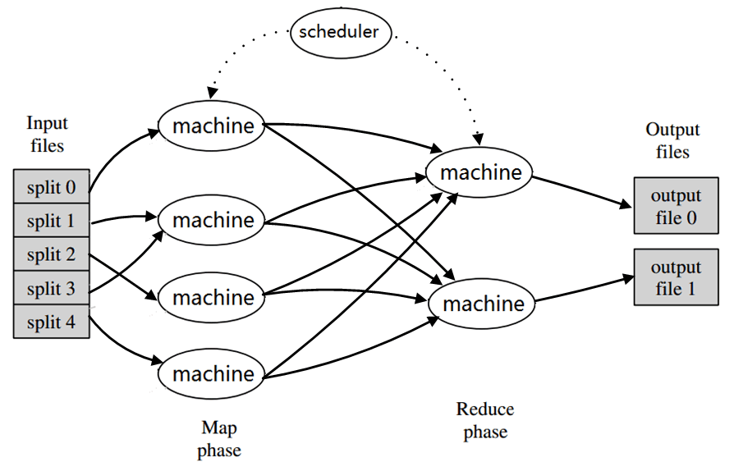
MapReduce
Map phase
  Takes an input job and divides into many small sub-problems (tasks)
  Map tasks can run in parallel on potentially different “machines”
Reduce phase
  Combines the output of Map
  Occurs after the Map phase
  is completed
  Runs on parallel machines…
Goal: Schedule these Map and Reduce jobs in order to
minimize the total flow time in the system
Notes:
MapReduce has two elemental processes: Map and Reduce.
For the Map tasks, the inputs are divided into several small sets, and processed by different machines in parallel. The
output of Map tasks is a set of pairs in <key, value> format.
The Reduce tasks then operate on this intermediate data, possibly running the operation on multiple machines in parallel to generate the final result.
Each arriving job consists of a set of Map tasks and Reduce tasks. The scheduler is centralized and responsible for making
decisions on which task will be executed at what time and on which machine.
The key metric considered in our work is the total flow time (delay) in the system.
For a job, the flow time includes the time it takes for a job, since it arrives, until it is fully processed. This includes both the delay in waiting before the first task in the job begins to be processed, plus the time for processing all tasks in the job.
MapReduce is Inspired by the Map and Reduce phases commonly used in functional programming, although their purpose is not the same as their original forms.

Slide 50
Relationship to Project/Collaboration
Relationship to Project
Number of Map tasks in a job could be heavy tailed (or truncated heavy tailed)
Size of each reduce task could be heavy tailed (or truncated heavy tailed)
Map and Reduce jobs are dependent
Bivariate heavy tails and coupled queues
Collaboration
Weekly Skype (Thu. 11AM) meetings with R. Srikant (co-PI, UIUC) and Y. Zheng (PhD student at OSU)
Developed optimal strategies for scheduling in Map-Reduce framework in the large-system limit.

Slide 51
III. Resource Allocation in Wireless Networks
Wireless resources are highly stressed
Need ways to off-load data from traditional cellular networks to other networks (e.g., WiFi zones, mmWave, etc.)
Observed times spent in and out of WiFi zones are dependent and distributed according to heavy tailed distributions.
For each user, the system can be modeled as a coupled WiFi and cellular queue, where the cellular queue serves traffic only after its time-out period has expired in the WiFi queue (reneging event)
Goal: Characterize the reneging probability and waiting time in the WiFi queue
Relationship to the project: bivariate heavy-tailed on/off periods

Slide 52
Key Results
Derived the queue length distribution at the WiFi queue at an arbitrary point in time
Performance metric I: Reneging probability
  From the queue length distribution, obtained an explicit formula for the reneging probability.
  The reneging probability determines the offloading efficiency.
Performance metric II: Average waiting time in the WiFi queue
Extensive numerical study
  Characterized the impact of time-out on the performance of mobile delayed offloading system

Slide 53
Keeping it just in case. Remove if you like.
Our contribution in [9]
  We consider both the one-dimensional symmetric Lévy flights and the two-dimensional isotropic Lévy flights.
  We show that P(τ_{R} > t) is bounded above and below by exponentially decreasing functions for 0 < α < 2.
  From the bounds, we prove that E[τ_{R}] = Θ(R^{α}) for 0 < α < 1.
[ [9] Y. Kim, I. Koprulu, and N. Shroff, First exit time of a Lévy flight from a bounded region, submitted, 2013.
Notes:
I am keeping this slide just in case.

Slide 54
Related Work (1/2)
For one-dimensional symmetric Lévy flights
  [1,2] studies the distribution and mean of the first exit time from a finite interval.
  [3] points out that non-local boundary conditions have to be considered due to the heavy-tailed jump-lengths of a Lévy flight, and hence the analytical results in [1, 2] are incorrect.
  [3] provides only a numerical study, no analytical solution.
  An analytic solution for the distribution and the mean of the first exit time of a one-dimensional Lévy flight is known only for the diffusion limit. The distribution and the moments of the first exit time are derived in [4, 5] by solving a fractional diffusion equation.
[1] M. Gitterman, Mean first passage time for anomalous diffusion, Phys. Rev. E, 2000.
[2] S. V. Buldyrev et al., Properties of Lévy flights on an interval with absorbing boundaries. Physica A, 2001.
[3] B. Dybiec et al., Lévy-Brownian motion on finite intervals: mean first passage time analysis. Phys. Rev. E, 2006.
[4] E. Katzav et al., The spectrum of the fractional Laplacian and first-passage-time statistics. EPL 83, 2008.
[5] A. Zoia et al., Fractional Laplacian in bounded domains. Phys. Rev. E, 2007.

Slide 55
Numerical Result 2-D
2-dimensional Lévy Flight ( α = 0.5, R = 20)
n
Notes:
This is a numerical result for 2D levy flight. We set alpha to 0.5 and R to 20 as in the 1-D case on the previous slide.
The black line indicates simulation result and it shows exponential decay.
The red and green lines indicate our upper and lower bounds in Theorem 1 respectively.

