Slide 1
Cloud Computing and Multivariate Heavy Tails
R. Srikant
Electrical and Computer Engineering
and
Coordinated Science Lab
University of Illinois at Urbana-Champaign
Joint work with Siva Theja Maguluri (UIUC), Ness Shroff (OSU), Yousi Zheng (OSU)

Slide 2
Outline
A Taxonomy of Cloud Computing Problems
  Examples of coupled queue problems in the proposal
  Map-Reduce framework
  Vector packing problems
  Where are the heavy tails?
  Relevance to the Army (discussions with Ananthram Swami, ARL)
Collaboration enabled by the MURI
Results:
  Scheduling Algorithms for the Map-Reduce Problem
  Relationship between multivariate heavy tails and autocovariance functions (discussions with Ananthram Swami, ARL)
  Scheduling in the vector packing problem

Slide 3
Taxonomy I
The Map-Reduce Framework
A large job broken into many parallel tasks (Map phase)
Results from the parallel tasks are reassembled to provide the final answer (Reduce phase)
  Many variations:
    When can the reduce phase start?
    How many Map phases and how many reduce phases?
    How does data locality with respect to servers influence the service-times of tasks?
  Army relevance: Data-to-decisions

Slide 4
Taxonomy II
Infrastructure as a Service or IaaS:
  Users request virtual machines (VMs) to execute jobs, i.e., a certain amount of CPU, a certain amount of memory, a certain amount of disk space
  A number of servers available
  Many assignment (of jobs to servers) problems:
    Job duration known upon arrival
    Jobs durations are unknown and random
    Preemption vs nonpreemption
  Army relevance: Battlefield cloud, tactical cloudlets

Slide 5
Multivariate Heavy Tails
The number of map tasks and the duration of the reduce tasks are both heavy-tailed; the duration of the reduce task depends on the number of map tasks
Job durations are heavy-tailed; a number of simultaneous VM requests of correlated durations
Collaboration enabled by the MURI
  Four-day visit to the Ohio State University; combine expertise on MapReduce framework and large-systems limits to derive simple schedulers that perform optimally in large systems
  Discussions with Ananthram Swami on Army relevance, and the connection between long-range dependence and multivariate heavy tails
  Discussions with Lang Tong on scheduling problems in coupled queues
  Continuing work with recently graduated PhD student Javad Ghaderi (Assistant Professor, Columbia University) on coupled queues that arise in massive data-to-decision problems

Slide 6

Map-Reduce Model
Time is slotted
N “Machines”: Each machine runs 1 unit of workload per slot
Scheduling Constraint: Reduce job starts
after all tasks in the Map job are completed.
Each Reduce task can have multiple units of workload
R_{i} ^{(k)} units of workload for task k for job i
Each job i consists of Map tasks and Reduce tasks
units of workload for Reduce job i
R_{i} ^{(k)}
Each Map task has 1 unit of workload
Total M_{i} tasks for Map job i
n jobs over T slots
Reduce
1
job i
Map
M_{i}
…
…
Data Center with N machines

Slide 7

Types of Schedulers: Treatment of Reduce Tasks
Machines
Preemptive
  Reduce tasks can be interrupted
  at the end of a slot
  Remaining workload in the task can be
  executed on any machine(s)
  Reasonable if overhead
  of data-migration is small
Non-preemptive
R2
Machine C
Machine B
Machine A
R1
R1
0 1 2 3 4 5 6 7
Time

Slide 8

Types of Schedulers: Treatment of Reduce Tasks
Machines
Preemptive
  Reduce tasks can be interrupted
  at the end of a slot
  Remaining workload in the task can be
  executed on any machine(s)
  Reasonable if overhead
  of data-migration is small
Non-preemptive
  Once a Reduce task is started, it can’t
  be interrupted till the end of the task
  An individual Reduce task cannot be completed on different machines
  But different tasks from same job can be assigned to different machines
Note: Since Map tasks have unit workload, they cannot be interrupted.
  In practice Map tasks may be > 1 unit, but small
R2
R2
Machine C
Machine B
Machine A
R1
R1
0 1 2 3 4 5 6 7
Time

Slide 9
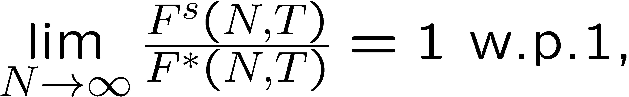
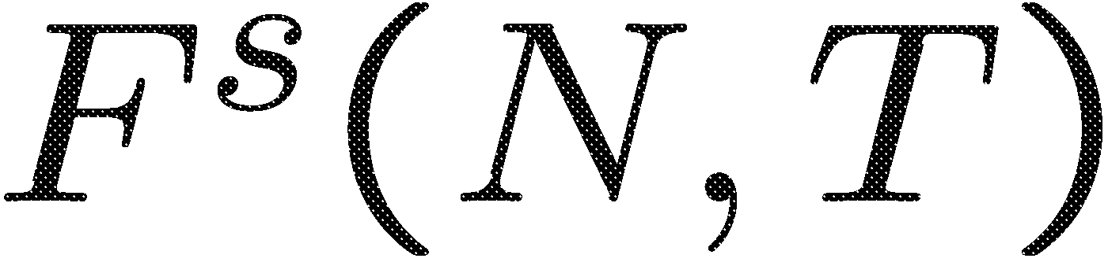
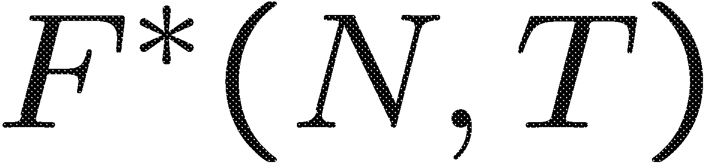
Asymptotically Optimal Schedulers
The number of machines in a data center is N
In a data center, there are a large number of machines:
.
Try to find asymptotically optimal schedulers in MapReduce framework.
A scheduler S is asymptotically optimal, if
where N is the number of machines, is the total flow time of the scheduler S (in total time T), and is the minimum total flow time (in total time T) over all schedulers.

Slide 10
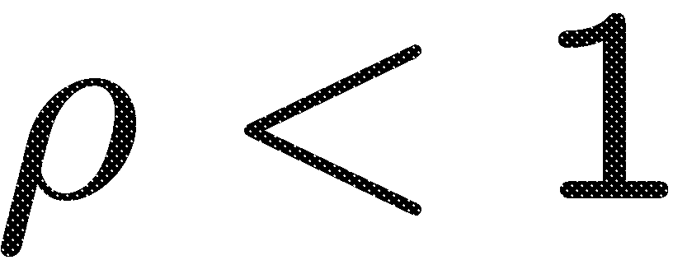
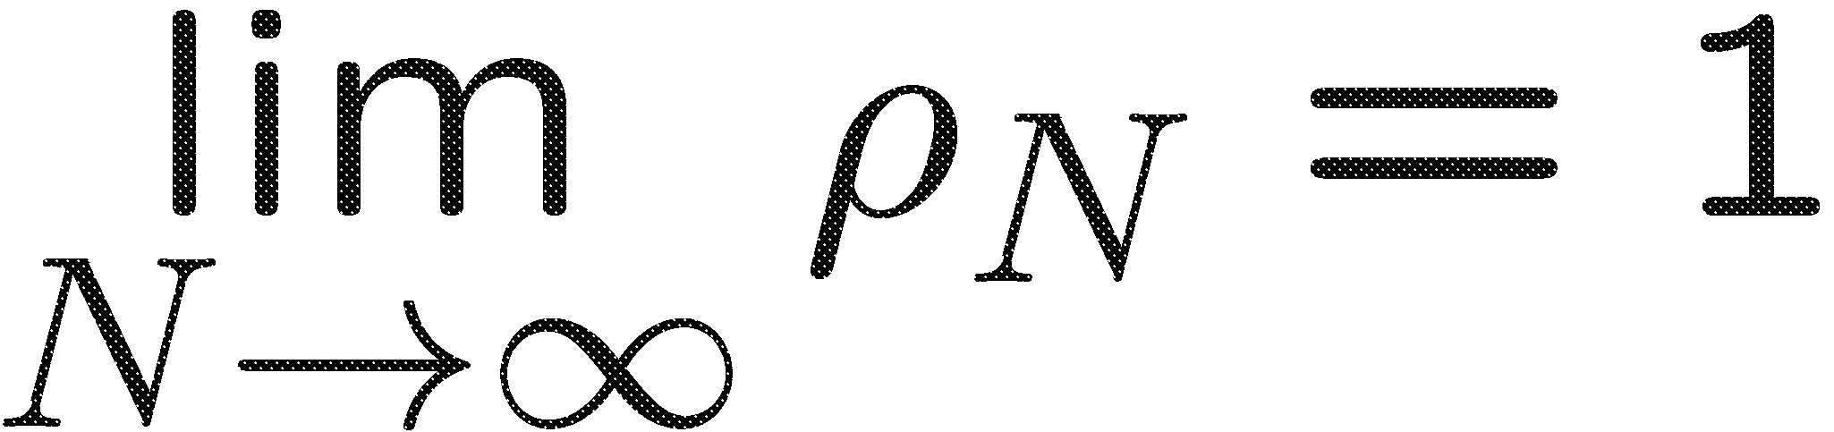
Asymptotically Optimal Schedulers
Two scenarios based on the property of Reduce tasks: Preemptive and non-preemptive
Two scenarios based on the load of traffic:
Fix traffic intensity ( ) and heavy traffic scenario
.
Two scenarios of total number of time slots:
Given finite T and infinite T.

Slide 11

When $ρ<1$: Preemptive Scenario
First moments of number of Map tasks and size of Reduce jobs are finite
The number of jobs is proportional to the number of machines. In each time slot t,
Main Result: Over any time window of size T (could be infinite), any working-conserving scheduler is asymptotically optimal
Can be extended to multiple (but finite) phases (Not limited to Map and Reduce phases).
Notes:
The intuition of the asymptotically optimal when \rho<1 is that, there is always enough space for jobs, such that the probability of waiting is vanishing.

Slide 12
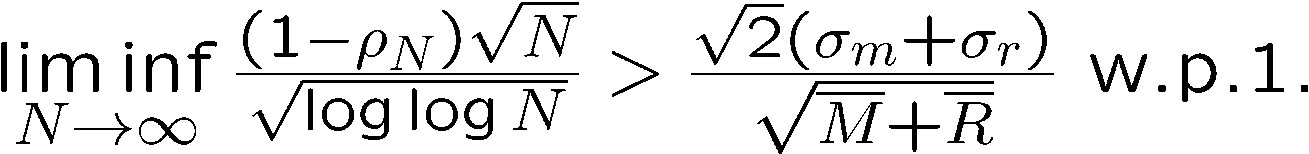
Heavy Traffic Case: Preemptive Scenario
Assumptions:
  Heavy Traffic
  Second moments of both Map and Reduce are finite
The number of jobs is proportional to the number of machines. In each time slot t,
  Also, the load ρ scales as follows:
Main Result: For any number of time slots T (could be infinite), any working-conserving scheduler is asymptotically optimal
Notes:
When \rho_N -> 1 and (1-\rho_N)\sqrt{N} -> \infty, the space between workload and available resources (machines) is much smaller than the fixed \rho <1 case. Thus, the first moment cannot guarantee the probability of waiting will vanish. So the second moments are introduced, such that the available space is small, but the variance of workload is also relative small, such that the probability of waiting will vanish, too.

Slide 13
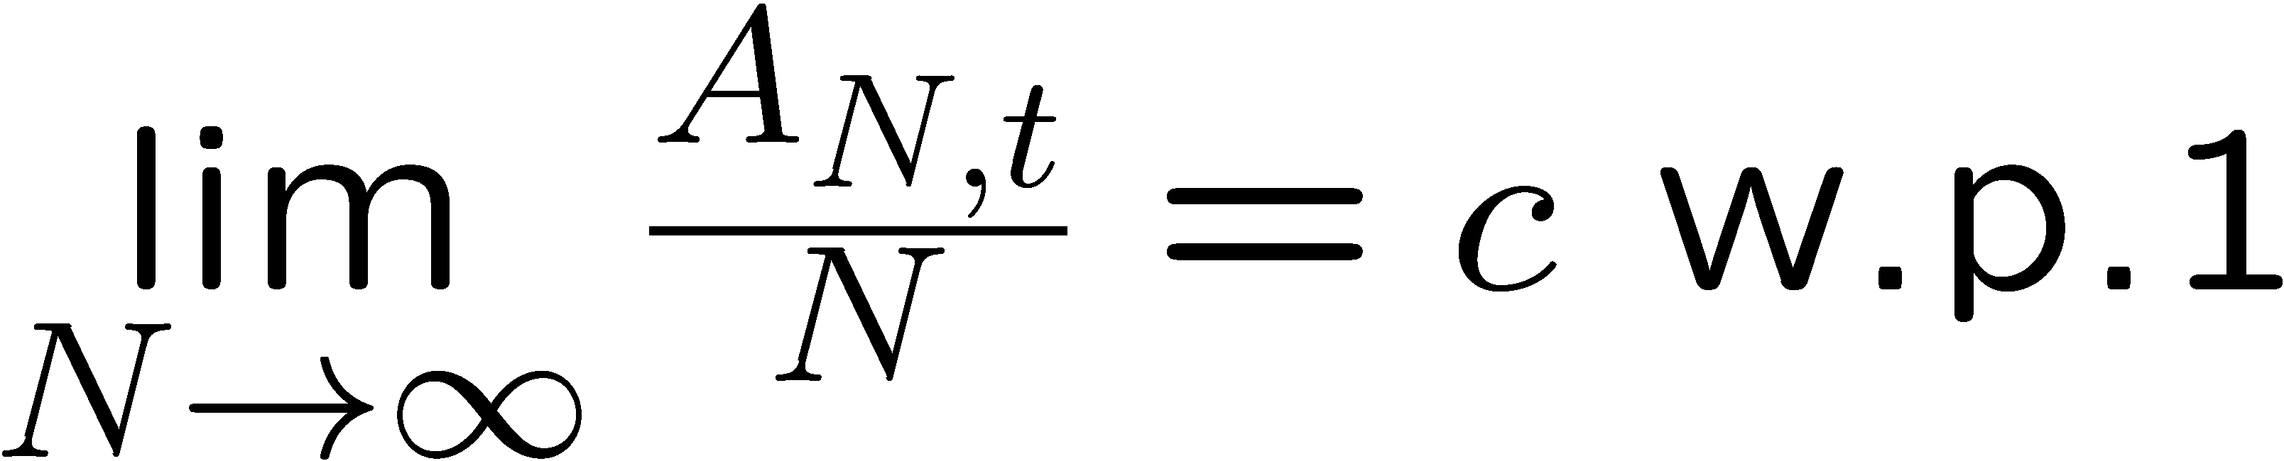
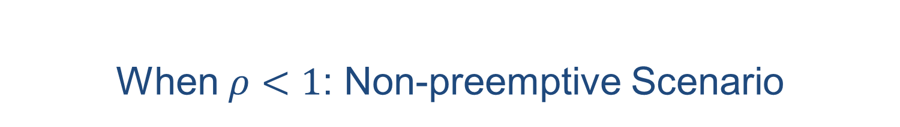
When $ρ<1$: Non-preemptive Scenario
First moments of number of Map tasks and size of Reduce jobs are finite
The number of jobs is proportional to the number of machines. In each time slot t,
Main Result: Over any time window of size T (could be infinite), the schedulers with adaptive threshold between Map and Reduce are asymptotically optimal
Can be extended to multiple (but finite) phases (Not limited to Map and Reduce phases).

Slide 14
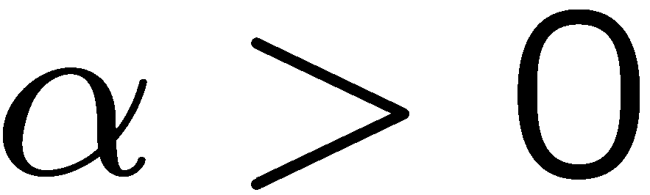
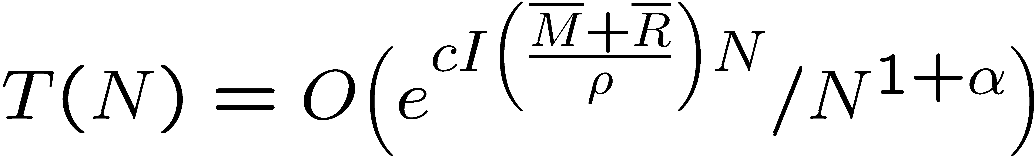
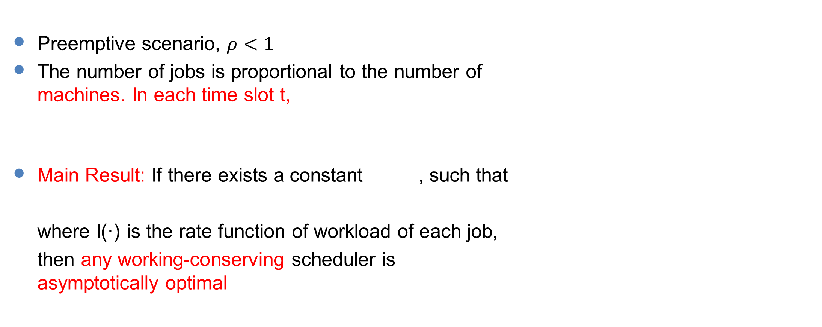
T(N) instead of T
Preemptive scenario, $ρ<1$
The number of jobs is proportional to the number of machines. In each time slot t,
Main Result: If there exists a constant , such that
where I(·) is the rate function of workload of each job,
then any working-conserving scheduler is asymptotically optimal

Slide 15
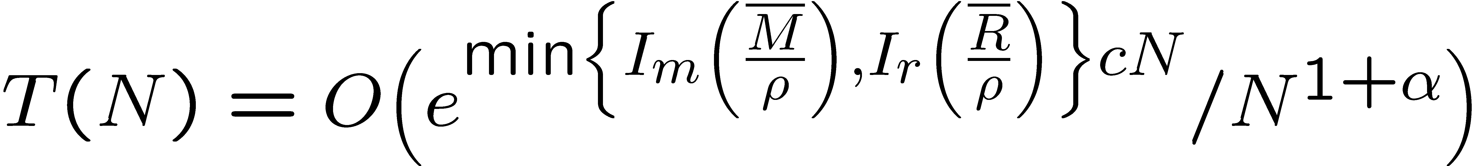
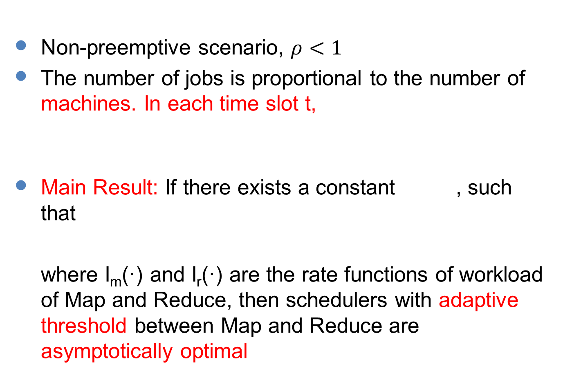
T(N) instead of T
Non-preemptive scenario, $ρ<1$
The number of jobs is proportional to the number of machines. In each time slot t,
Main Result: If there exists a constant , such that
where I_{m}(·) and I_{r}(·) are the rate functions of workload of Map and Reduce, then schedulers with adaptive threshold between Map and Reduce are asymptotically optimal

Slide 16
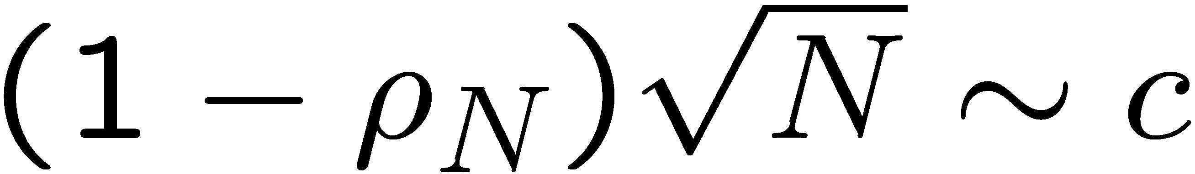
Ongoing Work
What happens when ?
  That is traffic is heavier than currently assumed scenario of:
What happens in non-preemptive scenarios without threshold?
  T(N) instead of N under heavy-tailed distributions
Find simple schedulers with highest rate of convergence to optimal.

Slide 17












An $M/G/∞$ Queue
Poisson Arrivals $λ$, General job size distribution $f\left(.\right)$
Geometric Representation
  Poisson Measure - $Poi(λdtf\left(y\right)dy)$
$N_{t }$- Number of jobs in service at time $t$
  Autocovariance function $Cov(N_{t_{1} },N_{t_{2} })$
  Heavy tailed jobs → Long Range Dependence
$$y+dy$$
$$λdtf\left(y\right)dy$$
$$Cov\left(N_{t},N_{t+τ}\right)$$
Job Size
Job Size
$$N_{t}$$
Job Size
$$y$$
$$t$$
$$t$$
$$t+τ$$
Arrival Time
$$t+dt$$
Arrival Time
Arrival Time
$$t$$

Slide 18
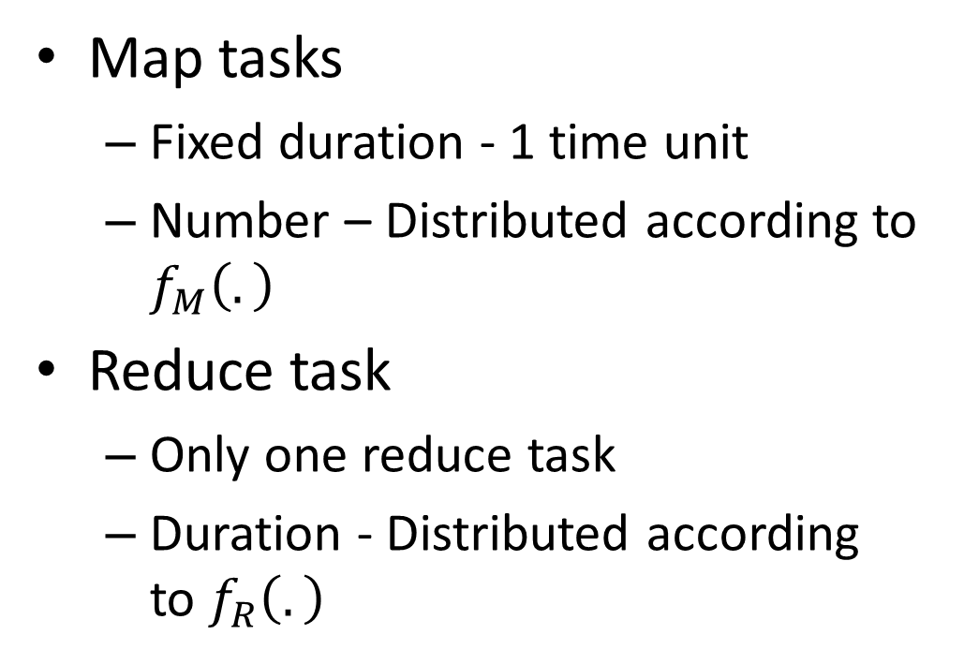
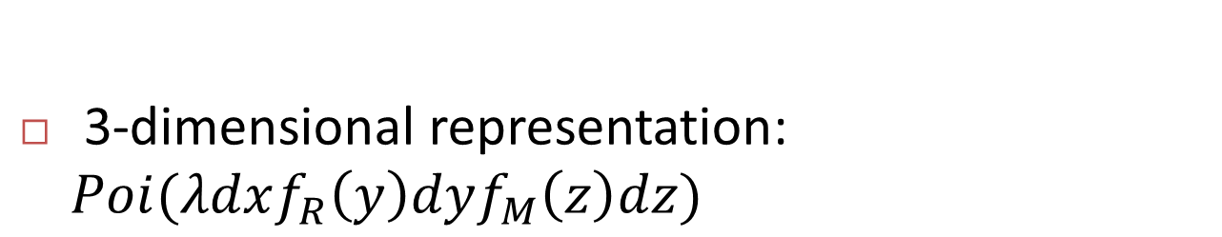



A simple model for Map-Reduce
Map tasks
  Fixed duration - 1 time unit
  Number – Distributed according to $f_{M}\left(.\right)$
Reduce task
  Only one reduce task
  Duration - Distributed according to $f_{R}\left(.\right)$
$$z$$
Number of Map tasks
Arrival Time
Reduce Task Duration
$$y$$
3-dimensional representation: $Poi(λdxf_{R}\left(y\right)dyf_{M}\left(z\right)dz)$
$$x$$

Slide 19


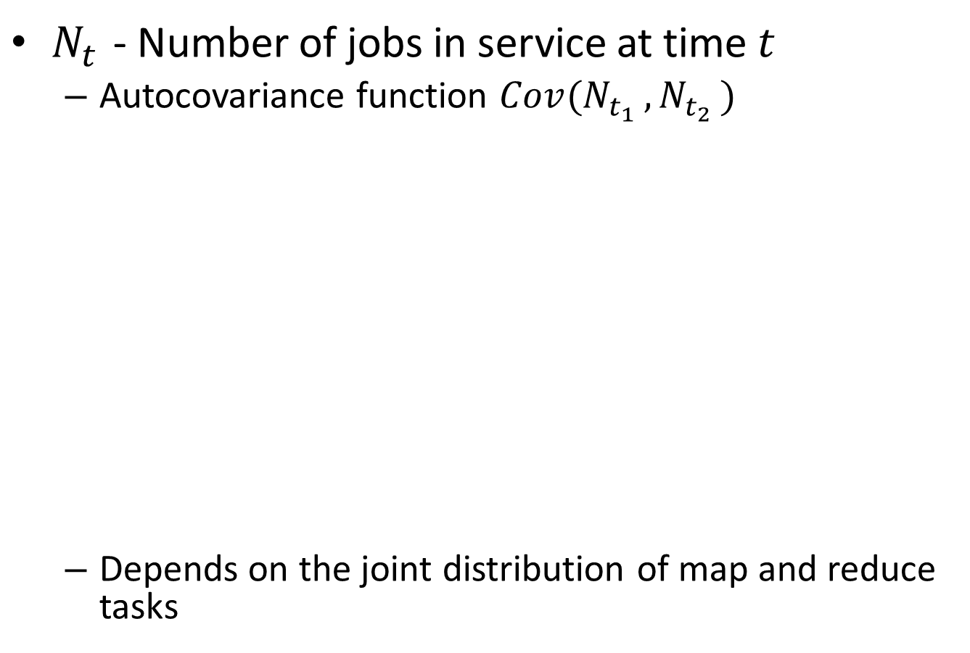









Covariance Calculation
$N_{t }$- Number of jobs in service at time $t$
  Autocovariance function $Cov(N_{t_{1} },N_{t_{2} })$
  Depends on the joint distribution of map and reduce tasks
$$N_{t}$$
$$y$$
$$y$$
$$Cov\left(N_{t},N_{t+τ}\right)$$
Reduce Task Duration
Reduce Task Duration
$$x$$
$$x$$
$t$-1
$$t$$
$$t+τ$$
Arrival Time
$t$-1
$$t$$
Arrival Time

Slide 20
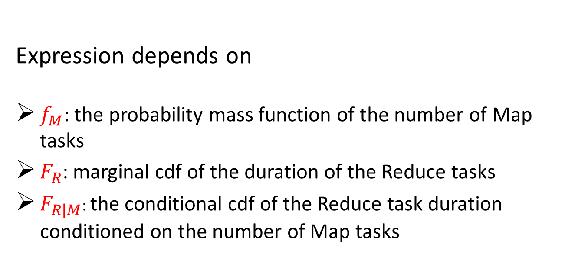
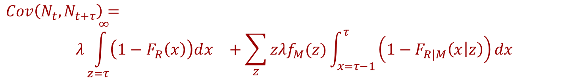
Autocovariance Function
$$Cov\left(N_{t},N_{t+τ}\right)=$$
$$λ\int_{z=τ}^{∞}{\left(1−F_{R}\left(x\right)\right)dx^{}+\sum_{z}{zλf_{M}(z)\int_{x=τ−1}^{τ}{\left(1−F_{R|M}\left(x | z\right)\right)dx}}}$$
Expression depends on
$f_{M}$: the probability mass function of the number of Map tasks
$F_{R}$: marginal cdf of the duration of the Reduce tasks
$F_{R|M}$: the conditional cdf of the Reduce task duration conditioned on the number of Map tasks

Slide 21
Ongoing Work
Power usage is significant in such systems
Study total power over consumed a certain period
  Mean and Variance – using similar techniques
Control Strategies to minimize power consumption
  How to optimally turn servers ON and OFF?

Slide 22
Recap of IaaS Problem Setting
A cloud of servers with limited capacities for different resources like processing power, memory, disk space etc.
Jobs (Virtual Machines) require certain amount of these resources and certain time for service
Jobs need to be routed to one of the servers and queued
Schedule jobs on each server meeting the resource constraints
Router
Server 1
Server 2
Server 3
Notes:
Iaas – VMs
------------------------------------
Existing approaches based on solving a bin packing problem
We model it as a dynamic problem with job arrivals and departures and provide a much simpler solution

Slide 23
JSQ Routing and MaxWeight Scheduling
Assume
  Job sizes are known
  Jobs can be preempted
Route to the server with the smallest queue for that job type
MaxWeight Scheduling at each server
  Workloads as weights
  Or a function of workload
Throughput Optimal
Router
Server 1
Server 2
Server 3
Notes:
-----------------------------------------------
MaxWeight – Can use a wide class of weight functions. Polynomial, log etc. linear is popular
Assume Job sizes are known. Explain meaning of workload

Slide 24
Non Preemptive Scheduling
Cannot preempt jobs in practice
  Can be expensive and difficult to save the state of the VM to resume later
Cannot use MaxWeight Schedule in every time slot
(2,0,0)
Weight = 4
(1,0,1)
Weight = 3
(0,1,1)
Weight = 5
Notes:
Non preemption – couples the system between time slots
Refresh times – two reasons – all finish simultaneously or queue lengths empty
--------------------
Maximal Schedules (2,0,0), (1,0,1), (0,1,1) – Same as the earlier Amazon example

Slide 25
Unknown Job sizes
Job sizes are not known upon arrival or at the beginning of service
  Known only at departure
Only the queue length is known and not workload
Job sizes could be heavy-tailed
  General tails are allowed if jobs can be interrupted
  Currently, we require truncated versions of these distributions if jobs cannot be interrupted
Notes:
Certain assumptions on the distribution –
-------------------------
‘Continuous’ support in discrete time
Inf of conditional prob of departure in next time slot is non zero

Slide 26
A throughput Optimal Policy
Choose MaxWeight Schedule only at Refresh times
  Use log(1+q) as weights
At other times, don’t change the schedule [Marsan et al ‘02]
Throughput Optimal
  Refresh Times occur often enough
A more natural approach
  Greedily add schedules
(2,0,0)
Weight = 4
(1,0,1)
Weight = 3
(0,1,1)
Weight = 5
Notes:
Explain why log(.) is used
Emilio’s paper (Marsan et al) – in the context of switch – in complete (uses blackwell theorem, also incorrect assumption about queue lengths being infinite)
Also, here it is different with both routing and scheduling
Not clear which is better apriori because, with greedy refresh time may take longer time to happen than the fixed one

Slide 27
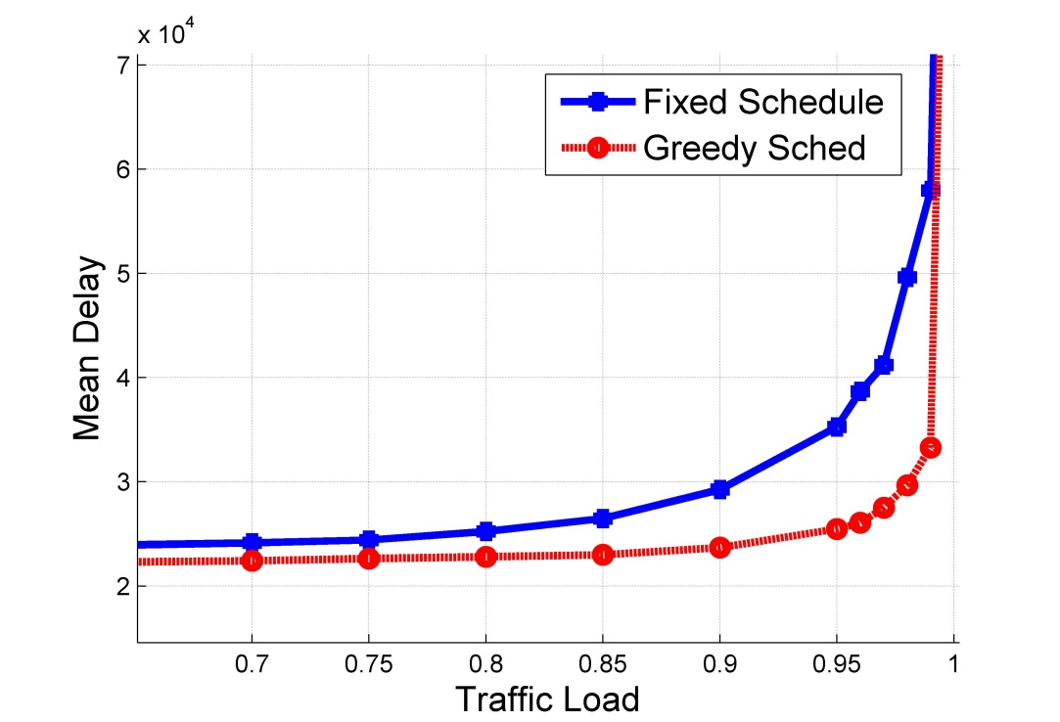
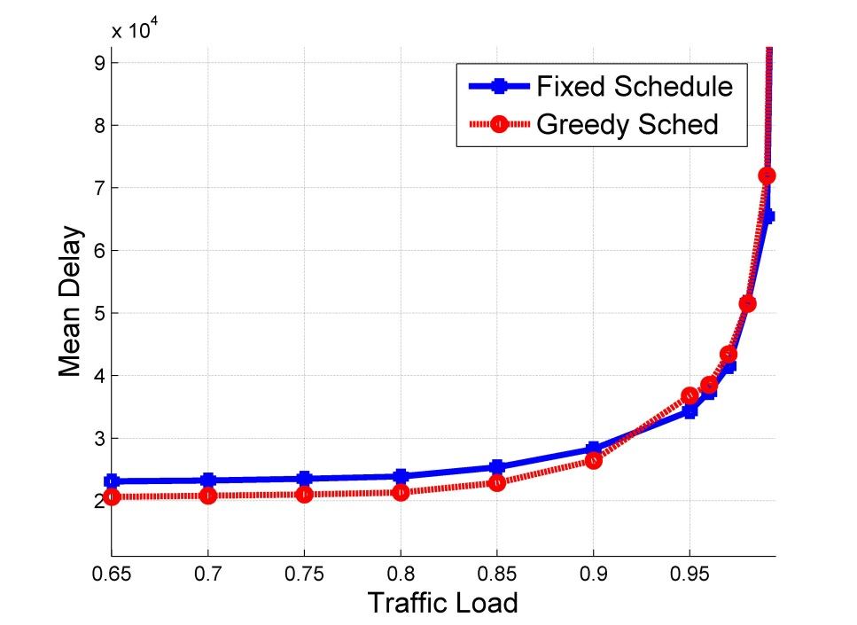
Comparison of the two policies
Don’t know if Greedy approach is throughput optimal
Both Algorithms seem to have similar throughput performance
Notes:
Diff points on the capacity region. Both seem to have similar throughput
-----------------------
Setup, - 100 identical servers three maximal schedules (2,0,0), (1,0,1), (0,1,1)
Diff points on the capacity region. Left fig (1,1/3,2/3) and right one (1,1/2,1/2)
Job size distribution w.p 0.7, unif [1,50]; w.p .15, unif [251,300] and w.p. .15, unif [451, 500]

Slide 28
Ongoing Work
Current proof techniques for the non-preemptive case require truncated versions of multivariate heavy-tailed distributions
  The variance of the service-time distribution can be arbitrarily large, but has to be finite
  We are currently working on removing this assumption for the non-preemptve case
  Understand the performance of greedy scheduling

