Slide 1
Deadline Scheduling and Heavy tailED distributions
Lang Tong
School of Electrical and Computer Engineering
Cornell University, Ithaca, NY 14850

Slide 2
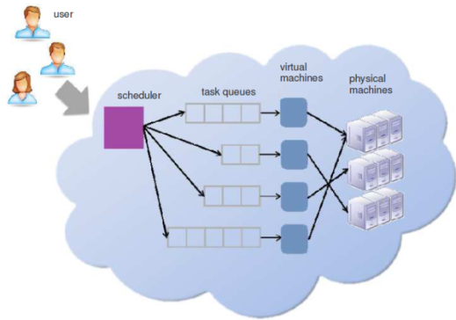
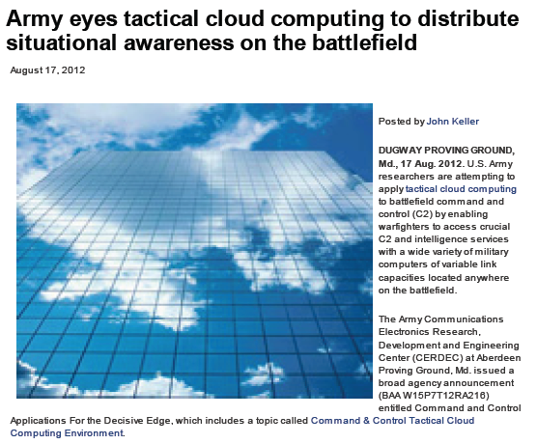
Overview
Objective
Develop design principles and tools for job scheduling problems with multivariate stochastic characteristics in a distributed and hierarchical computation system.
Characterize impact of heavy tailed distribution on system performance
Research problem and applications
Deadline scheduling with outsourcing options
Tactical cloud computing for battlefield situation awareness
Collaborations
N. Shroff, R. Srikant.
Ananthram Swami (ARL)
Yu Zhe and Shiyao Chen

Slide 3
Deadline scheduling and outsourcing
Key characteristics:
Jobs arrive randomly with different sizes, deadlines, and rewards
Multiple local inexpensive servers
Option of outsourcing to meet workload requirement and quality of service
Multivariate distributions: job size, inter-arrival, deadline.
Scheduling action space:
Admission: whether to take on a job
Scheduling: which job to process and on which server
Outsourcing: whether and when outsource

Slide 4
Outline
Problem formulation
Scheduling policy and optimality
Structure of optimal policy
TAGS (Threshold admission and greedy scheduling)
Stochastic TAGS and optimality
Performance analysis
An upper bound and a heavy traffic approximation
Numerical results and insights
Conclusions and future work

Slide 5
Jobs with deadlines

Slide 6
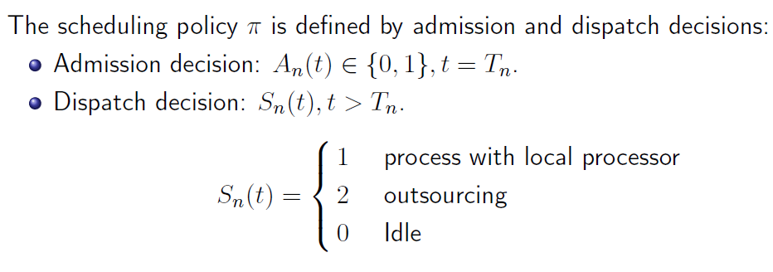
Scheduling actions

Slide 7
Performance measure:

Slide 8
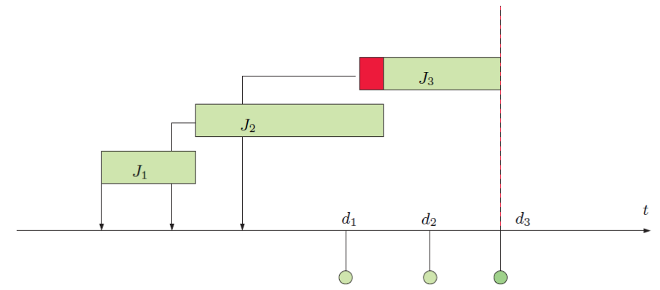
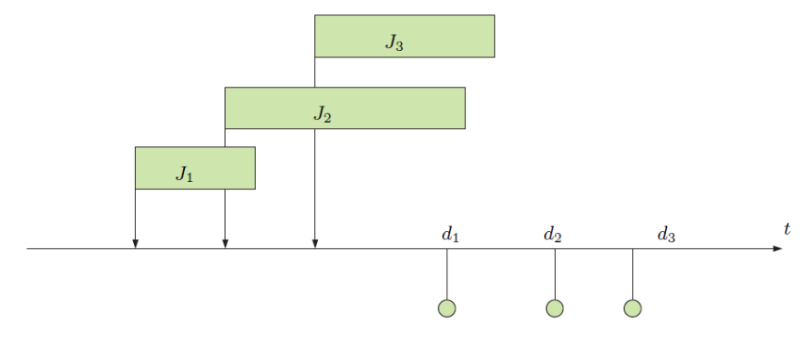
Optimality: post admission scheduling

Slide 9
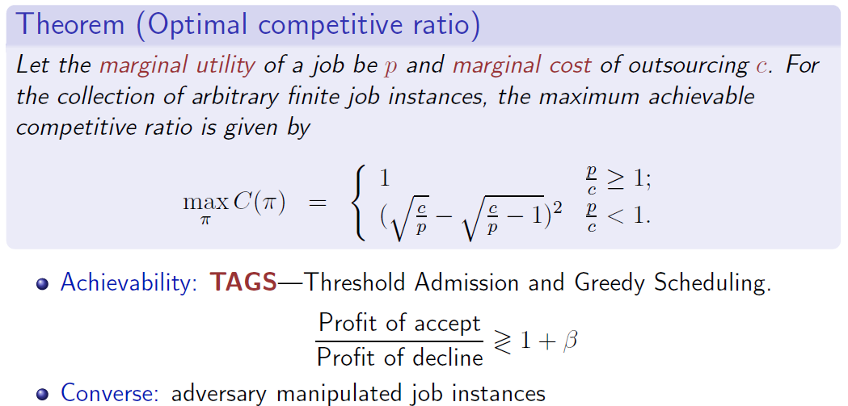
Optimality: competitive ratio optimality

Slide 10
Stochastic TAGS

Slide 11
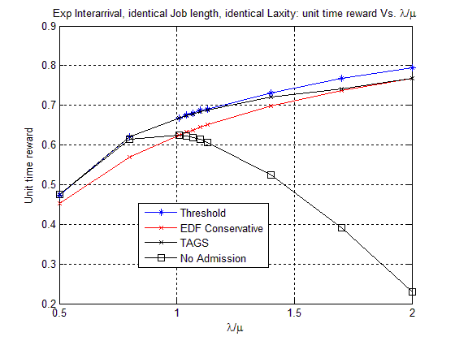
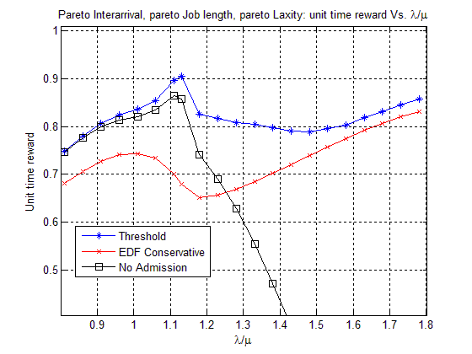
Performance examples
Poisson arrival, Identical job length, Identical laxity
Pareto arrival, Pareto job length, Pareto laxity, within light tail region (finite variance)

Slide 12
Outline
Problem formulation
Scheduling policy and optimality
Structure of optimal policy
TAGS (Threshold admission and greedy scheduling)
Stochastic TAGS and optimality
Performance analysis
An upper bound and a heavy traffic approximation of upper bound.
Numerical results and insights
Conclusions and future work

Slide 13
Performance upper bound

Slide 14
Heavy traffic approximation

Slide 15
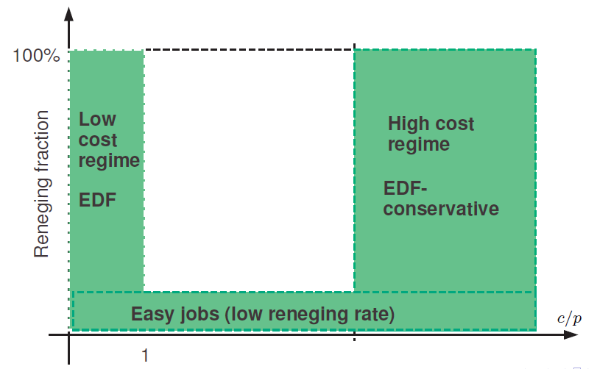
Performance evaluation

Slide 16
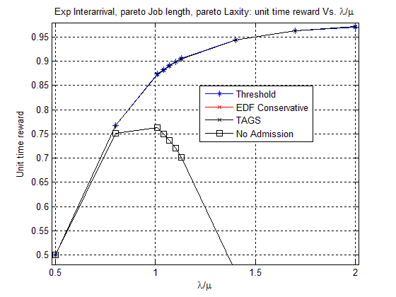
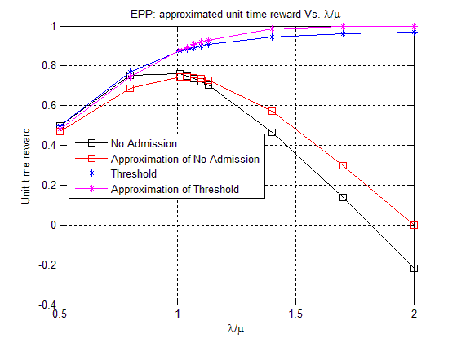
Performance examples: (easy jobs)
Poisson arrival, Pareto job length, Pareto laxity (EPP, alpha=4)

Slide 17
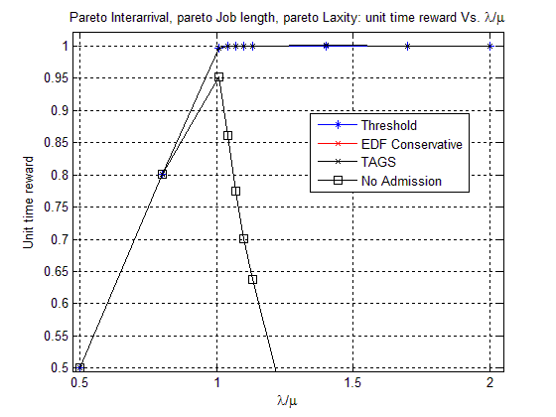
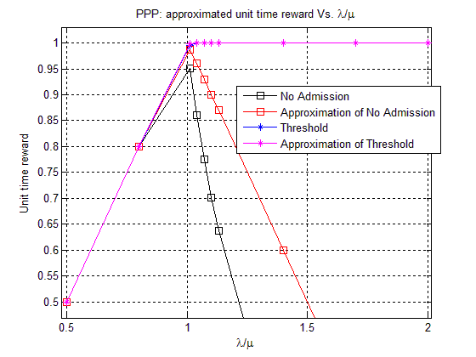
Performance examples: (easy jobs)
Pareto arrival, Pareto job length, Pareto laxity (PPP, alpha=4)

Slide 18
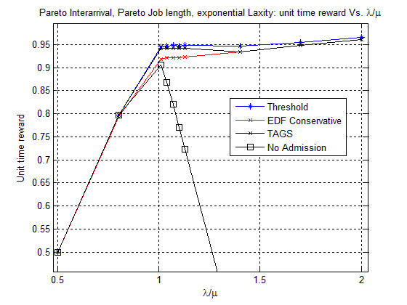
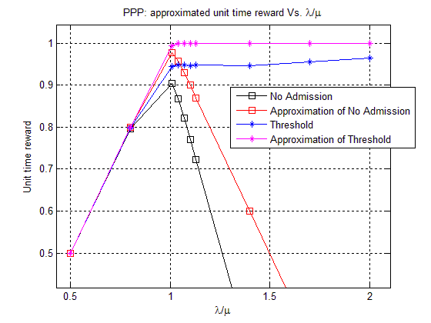
Performance examples: (tight jobs)
Pareto arrival, Pareto job length, Exponential laxity (PPE, alpha=4)

Slide 19
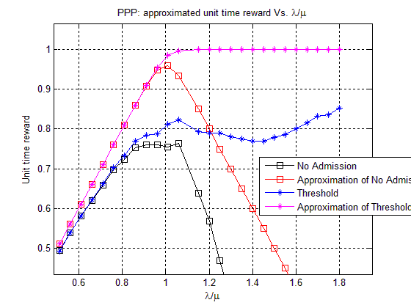
Clustered arrivals and tight deadlines
Pareto arrival (2), Pareto job length (2), Pareto laxity (0.5) (alpha=4)

Slide 20
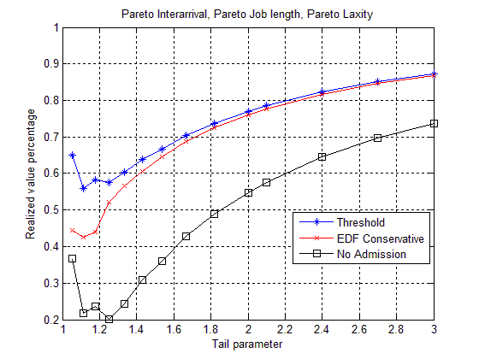
Effects of tail parameters
Pareto arrival, Pareto job length, Pareto laxity (PPP)

Slide 21
Summary and future work
Deadline scheduling with outsourcing options
TAGS (Threshold admission and greedy scheduling)
Simple online scheduling
Optimality
Performance
A performance upper bound and approximations
Simulation results:
accurate for jobs with low reneging fraction.
inaccurate approximation for tight jobs.
Current and future work
Multi-processor deadline scheduling problems
Large system asymptotic properties

