Slide 1
Multivariate Heavy Tails and Structural Properties of Networks
MURI Oct 1 Annual Review
Zhi-Li Zhang
zhzhang@cs.umn.edu
Qwest Chair Professor
Dept. of Computer Science & Eng.,
University of Minnesota

Slide 2
Outline
Center Questions & Overview
Network Structural Properties & Multivariate Heavy Tails
Generative Models for Recursively Constructing “Hierarchical” (or “Self-Similar”) Networks
beyond simply “heavy-tail” degree-based distributions
across multiple metrics, e.g., degree & clustering coeff.
Empirical Network Data Analysis: Some Examples
esp., applying Extremal Dependence Analysis by Resnick et al
On-going and Future Directions & Collaborations
apply observations/insights obtained thus far to answer some fundamental questions
Summary: Key Results from Collaborations

Slide 3
Central Questions
Networks are “by nature” multivariate entities
formed by n nodes and m edges connected in various manners
edges may be directed, and/or have weights, signs, …
Objective: bring a “multivariate analysis” perspective to study structural properties of networks
In particular, understand roles and impact of multivariate heavy tails
What are (possible) manifestations of multivariate “heavy tail” phenomena in complex networks?
beyond (univariate or multivariate) “heavy-tailed” degree distributions
And what can they tell us about the structural properties of networks?

Slide 4
Quest for Multivariate “Heavy Tails” in Complex Networks: Three-Pronged Approach
Empirical analysis of real-world networks & “descriptive” models
compute & plot various metrics of interest to look for “heavy tails”
multivariate extremal dependence analysis using Resnick’s EDM
Key challenges: computational expensive for large datasets; finite instances => based on plots of metrics, hard to interpret & extrapolate; less rigorous
Constructive, analytical methods to develop “generative” models for growing networks
explicit construction of growing networks with “interesting” properties
analytical models & proofs for existence of (multivariate) “heavy-tails”
Q: structural properties (e.g., “hierarchical structure”) thus constructed “essential” or “universal” for networks with multivariate “heavy tails”?
Graph-theoretical, structural analysis of networks via random walks, algebraic and other tools, and develop efficient computational methods
attempt to answer some fundamental questions & lay rigorous foundations
what is a hierarchical network, or a network w/ (multivariate) heavy tails? when is a network “cluster-able”? how to decompose a network?

Slide 5
Quest for Multivariate “Heavy Tails” : Generative Models for Degree-based Distributions
We know how to generate “scale-free” networks with power-law degree distributions, e.g., preferential attachment & its variants
By introducing different types of edges (e.g., directed, one-way/mutual, signed (+/-), or multi-colored), we can generalize these models to produce multivariate “heavy tails” distributions in various degree-based metrics.
e.g., joint in-degree/out-degree distributions, (tri-variate) bi-connected, in-degree, out-degree distributions, +/- sign distributions, etc.
Ongoing collaboration w/ Don et al: develop alternative generative models where we directly control “extremal dependence” structures
e.g, “heavy-tail” in-/out-degree distributions, w/ varying extremal dependence
However, degree-based distributions reveal primarily “local” relations
E.g., assortative mixing & homophily: nodes of similar characteristics tend to associate and make connections: high degree/in-degree (influential) nodes with other high degree/in-degree nodes; …
or “dual-roles” or reciprocity of nodes: both hub & authority, or stable/strong ties
……

Slide 6
Quest for Multivariate “Heavy Tails” in Complex Networks: Beyond Degree-based Distributions?
Going beyond degree distributions: are there complex networks which exhibit (multivariate) heavy tails in other network metrics, perhaps revealing more “interesting” network structural properties?
e.g., distance metrics, betweenness centrality, or clustering coefficients?
Generative models for constructing networks with (multivariate) “heavy-tail” distributions in terms of certain desired metrics of interest?
in particular, across different metrics, e.g, degree & clustering coefficient
Developed a general (recursive) recipe for generating “hierarchical” (& “self-similar”) growing networks with multivariate “heavy tails”
in terms of a number of different network metrics
start with a simple deterministic generative model to obtain key insights
easily extended to more complex & probabilistic models
reveal interesting structural properties, pose fundamental questions!
-- inspired by work by Don, Sid et al, benefited directly from discussions & collaborations w/ Don, Sid & Richard

Slide 7
Generative Models for Growing Networks with Multivariate “Heavy Tails”
First consider a simple deterministic network generative model: a recursive method for constructing growing networks
metrics of interest? e.g., distance metrics, betweenness, clustering coeff.?
how to generate networks with power-laws & multivariate heavy tails?
instead of adding one node/edge at a time, growing at network level
General Recursive Recipe for “Self-Similar” Growing Networks
Step 1 (t=1): start with a base network G₁
Step t (t=2, …): take c replicas of the network, G_{t-1}, constructed at step t-1, and “glue” them through a sequence of basic operations:
node identification: select one node from two replicas, identify them
edge addition: add an edge between two replicas
Depending on metrics of interest, we can generate “self-similar” growing networks with certain interesting structural properties
e.g., growing networks with “heavy-tailed” distance & betweenness metrics, “heavy-tailed” degree & clustering coefficient distr., …

Slide 8
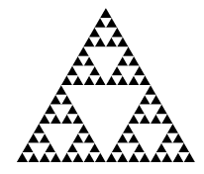
A Simple “Toy” Example: Sierpinksi Gaskets
Sierpinksi gaskets as a family of growing networks
start with a 3-node triangle (a triad)
self-similar structure: from t to t+1:
replicate itself three times, and
“merge” at two of the three corner nodes
O₁
O₁
O₁
O₂
O₃
O₂
O₃
O₂
O₃
t =1
t =2
t =3
O₁
Properties of Sierpinski Gasket of order t
can be derived analytically thru recursion
……
……
O₂
O₃
Sierpinksi gaskets of order t

Slide 9
A Simple “Toy” Example: Sierpinksi Gaskets
Sierpinksi gaskets as a family of growing networks
start with a 3-node triangle (a triad)
self-similar structure: from t to t+1:
replicate itself three times, and
“merge” at two of the three corner nodes
O₁
O₁
O₁
O₂
O₃
O₂
O₃
O₂
O₃
t =1
t =2
t =3
O₁
Properties of Sierpinski Gasket of order t
can be derived analytically thru recursion
…..
……
g₂
g₁
O₂
g₃
O₃
Sierpinksi gaskets of order t

Slide 10
Sierpinksi Gaskets & Multivariate Heavy Tails
Marginal (univariate) power laws or “heavy tails”
O₁
g₁
g₂
O₂
g₃
O₃
Sierpinksi gaskets of order t
Multivariate “heavy tails”

Slide 11
Variants of Sierpinksi Gasket Network Models
From the basic Sierpinksi gasket network construction, we can also construct growing networks with heavy-tail degrees/cluster coeff.’s
start with a 3-node triangle, but at step t (t=2, …), introduce edge additions
step t: take three replicas of the network at step t-1, “merge” at two of the three corner nodes; then add edges from o₁ to all nodes on the bottom line
O₁
O₁
O₁
O₂
t =1
O₃
O₂
O₃
t =2
O₂
O₃
t =3
……

Slide 12
Variants of Sierpinksi Gasket Network Models ...
Combining two constructions → growing networks with heavy-tail degree, cluster coeff, as well as distance metrics distributions
constructed from two replicas with edge additions and one replica without
edges are added from o₁ to bottom left half only
O₁
O₁
O₂
t =1
O₃
O₂
O₃
t =2
O₁
g₂
O₂
O₃
t =3
……

Slide 13
Generalized Deterministic/Probabilistic Models for Growing Networks w/ (Multivariate) Heavy Tails
Generalized Recursive Recipe for “Hierarchical” Growing Networks:
node identification: select one node from two replicas, identify them
edge addition: add an edge between two replicas
Metrics of interest determine how node identification and edge addition operations should be performed operations
e.g., using “preferential attachment” → power law degree distr.
step t from step t-1: conditionally independent; we can derive system “evolutional” equations for metrics of interest recursively
-- can also be applied to generate directed or signed growing networks

Slide 14
Key Observations/Insights: Whence come (Multivariate) “Heavy Tails”?
We need to ensure the following properties hold:
Emergence of (univariate & multivariate) “heavy tails”
Justification: “Characterization of Multivariate Heavy-tailed Distribution Families
via Copula” by Chengguo Weng & Yi Zhang

Slide 15
What are “Self-Similar” Networks? Or “Hierarchical” Networks?
Our recursive constructions generate growing networks that are “hierarchical” (and “self-similar” in a sense)
Are “hierarchical” or “self-similar” structures essential in emergence of (non-local) multivariate “heavy tails” in complex networks?
Barabasi et al define “hierarchical” networks as those with:
power law degree distribution:
power law clustering coefficients:
In general, preferential attachment generates “power law” degree distribution, but avg. clustering coefficient decays fast as network size N grows:

Slide 16
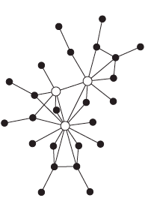
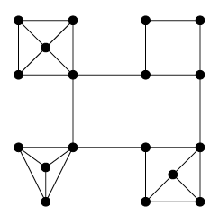
What are “Self-Similar” Networks? Or “Hierarchical” Networks?
Are “hierarchical” or “self-similar” structures essential in emergence of (non-local) multivariate “heavy tails” in complex networks?
Barabasi et al define “hierarchical” networks as those with:
power law degree distribution:
power law clustering coefficients:
In general, preferential attachment generates “power law” degree distribution, but avg. clustering coefficient decays fast as network size N grows:
mostly components are “tree-like”, not enough # of “triads”
many “real” networks have average clustering coefficients independent of N

Slide 17
What are “Self-Similar” Networks? Or “Hierarchical” Networks?
Are “hierarchical” or “self-similar” structures essential in emergence of (non-local) multivariate “heavy tails” in complex networks?
Barabasi et al define “hierarchical” networks as those with:
power law degree distribution:
power law clustering coefficients:
In general, preferential attachment generates “power law” degree distribution, but clustering coefficients decay rapidly:
mostly components are “tree-like”, not enough # of “triads”
many “real” networks have average clustering coefficients independent of N
Our constructions show that power-law degree or clustering coefficient distributions may not be essential for “hierarchical” networks
power-law or “heavy tail” in some form of “betweenness” metrics seems a more general & crucial property;
How do we formally define what is a hierarchical network? Define & test self-similarity of network structures?
-- this part of ongoing & future work

Slide 18
Empirical Network Data Analysis
Empirical analysis of real-world networks & “descriptive” models
compute & plot various metrics of interest to look for “heavy tails”
E.g., degree, joint degree, degree & clustering coefficient distributions
Key challenges: computational expensive for large datasets; finite instances => based on plots of metrics, hard to interpret & extrapolate; less rigorous
Apply (bivariate) extremal dependence analysis using Resnick’s EDM
provide empirical evidence about extremal dependence structure
e.g., extremal independent vs. extremal dependent (to a varying extent)
also extended to multivariate extremal dependence analysis
Have performed empirical data analysis to a variety of real-world (social & infrastructure) networks
undirected networks such as netsci, power grid, etc., as well as directed/signed networks such as Slashdot, etc.
As an Example: NetSci co-authorship network
joint node degree distr.; joint node degree & clustering coefficient distr.
compared w/ “power-law” degree Sierpinski gaskets (generative models)

Slide 19
Network Science: Co-Authorships

Slide 20
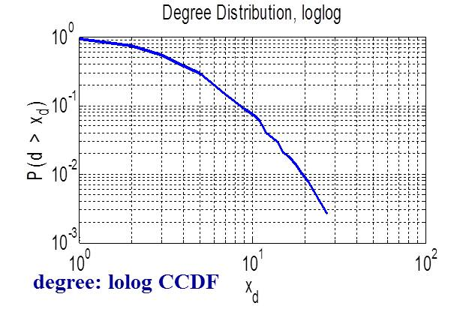
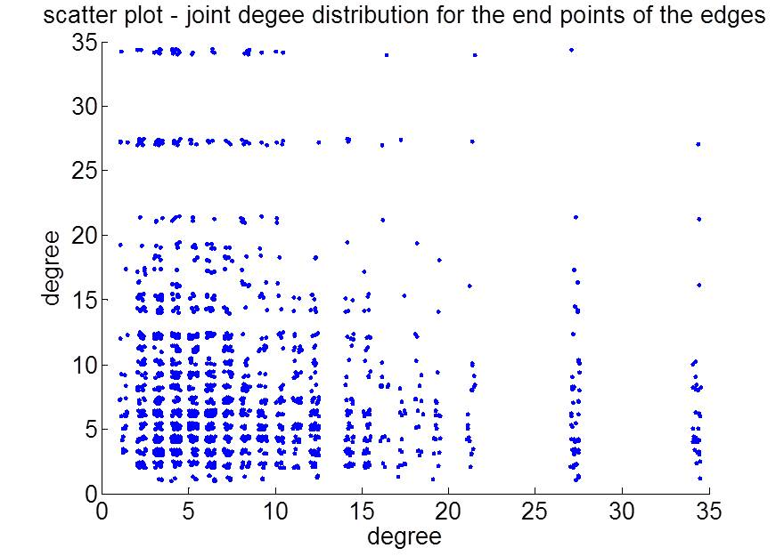
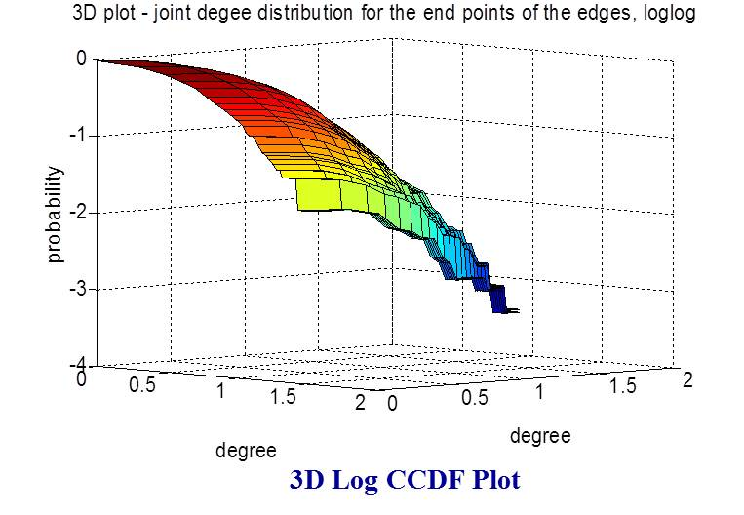
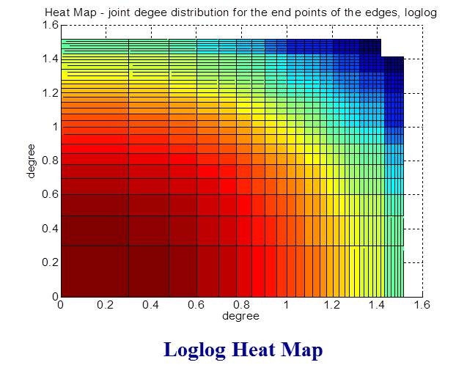
Degree & Joint Degree Distributions
Joint Degree: scatter plot

Slide 21
Extremal Dependence Analysis
See “Extremal Dependence: Internet Traffic Application” by Resnick et al
Represent them in terms of spherical coordinates
Apply extremal dependence analysis and define EDM
where parameter k is # of multivariate exceedences above a threshold
(e.g., when r_{ij} = sqrt(d²_{i} + d²_{j}) is large)
EDM ~ 0 → extremal independence (“axis hugging”)
EDM ~ 1 → extremal dependence (mostly along the diagonal)
EDM ~ 2/3 → angles nearly uniform distributed on [0, /2]
Extremal dependence analysis and EDM provide better metrics to capture joint node degree distribution than, say, S index (average of d_{i}d_{j})
In data analysis, we also apply ICRT (inverse complementary rank transform) or angular ranking method, if needed
EDM ~ 0 → extremal independence
EDM ~ 1 → extremal dependence
EDM ~ 2/3 → angles nearly uniform distributed on [0, /2]
Dependency among pair of nodes, X*_{i} and X*_{j} , can be represented in spherical coordinates
We can introduce an i. i. d. random process by randomly sampling pairs of nodes, randomly sampling edges from the network

Slide 22
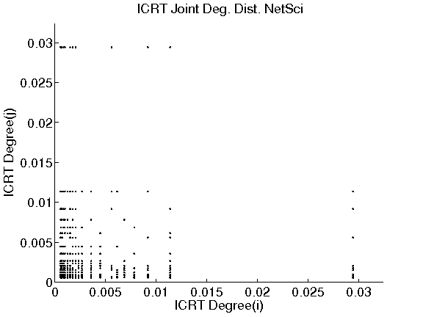
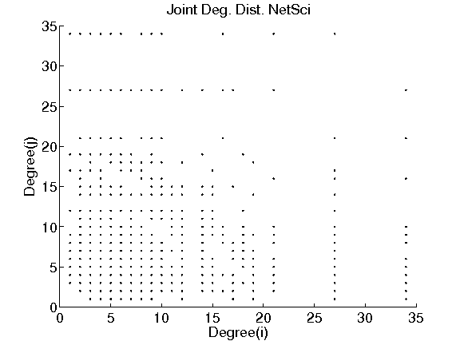
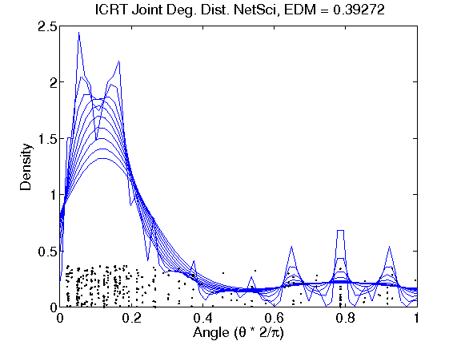
Bivariate Extremal Dependence Analysis: Joint Node Degree Distr. -- NetSci
Top 30%

Slide 23
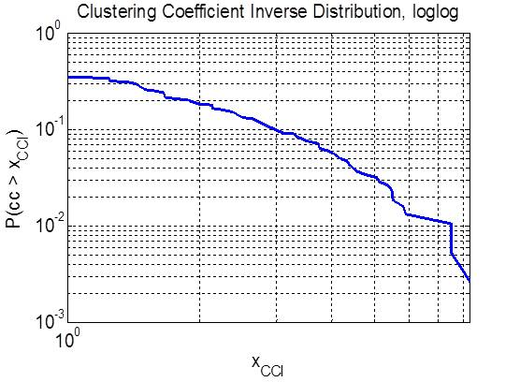
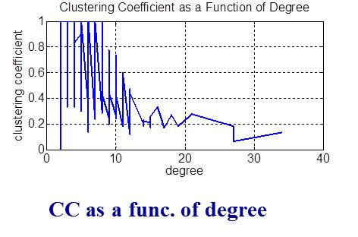
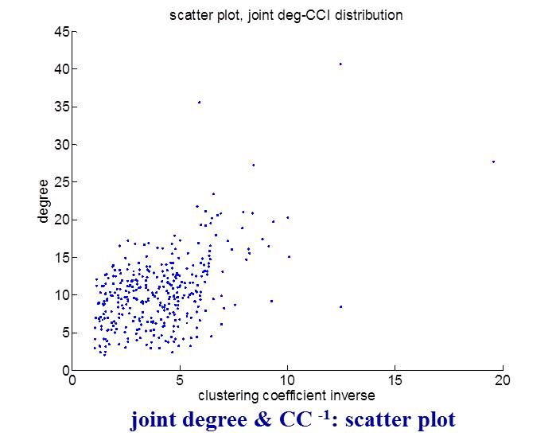
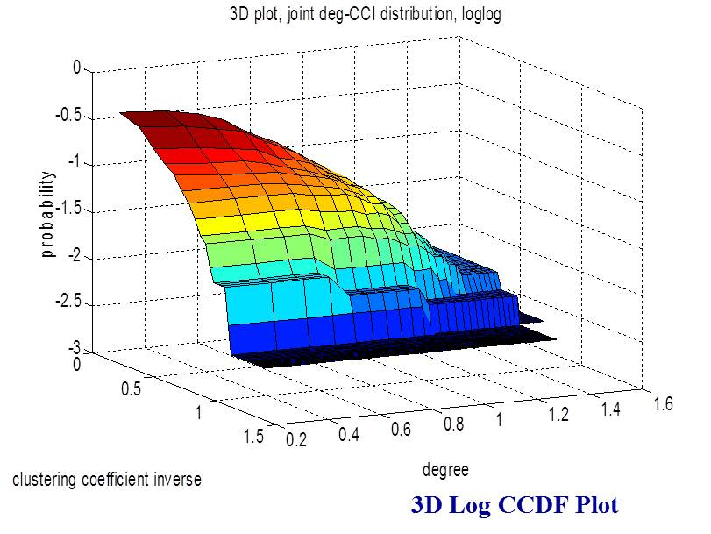
Degree, Clustering Coefficient (Inverse) & their Joint Distributions
CC ⁻¹: lolog CCDF

Slide 24
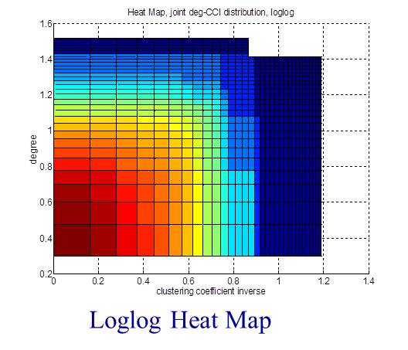
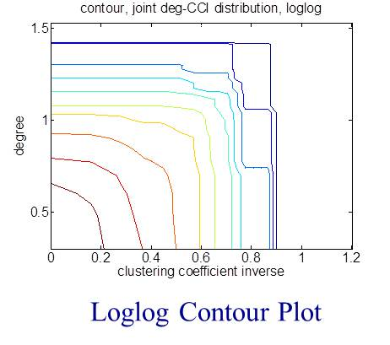
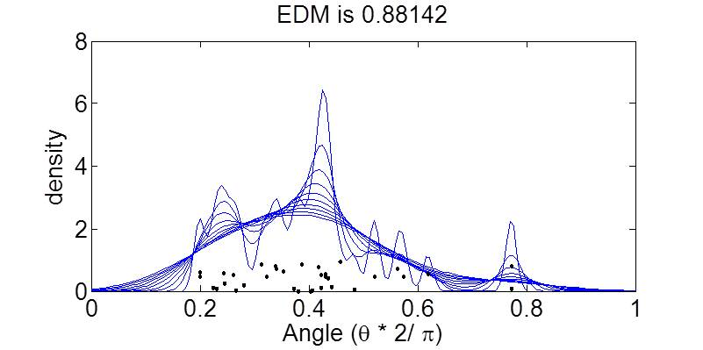
Joint Degree & Clustering Coeff. Inverse Distribution EDM Analysis

Slide 25
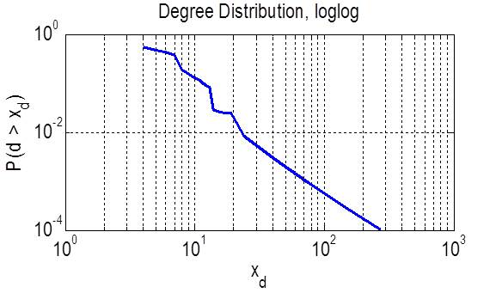
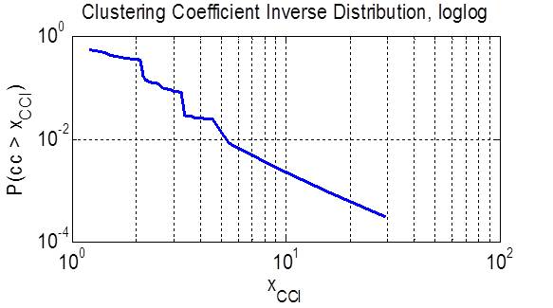
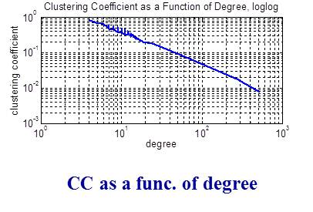
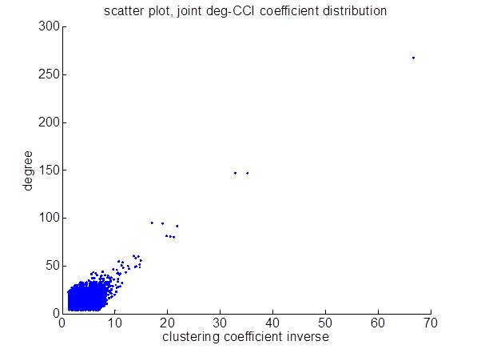
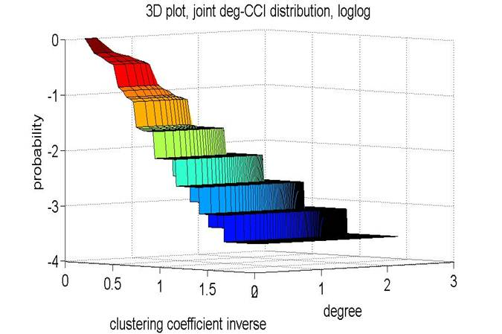
“Power-Degree” Sierpinski Gaskets: Degree & CC⁻¹ (t=9, n=9843)
O₁
O₂
O₃
t =3
CC ⁻¹: lolog CCDF

Slide 26
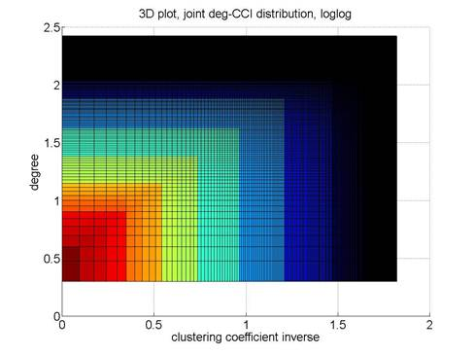
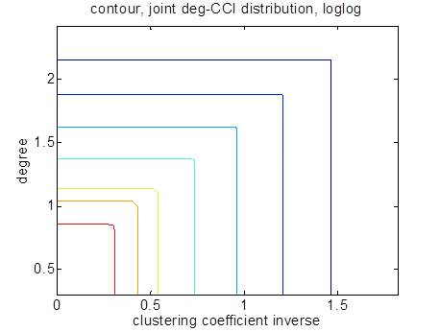
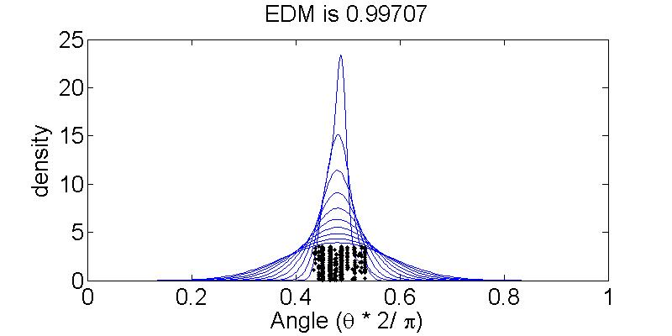
Joint Degree & Clustering Coeff. Inverse Distribution EDM Analysis

Slide 27
Ongoing/Future Directions & Collaborations
Continue our current investigation of generative models for “hierarchical” and “self-similar” networks
additional examples & numerical analysis
probabilistic models & “formal” proofs (help from Sid & Richard)
Alternative “generative” models for multivariate degree distributions, where we can directly control “extremal dependence” structures
ongoing collaboration with Don, et al
start with “scale-free” nets w/ power-law (in-/out-)degree distributions
introduce dependence through node identification and/or edge additions
analogous to impose a “copula” structure on marginal heavy tail distributions
Exploring the fundamental questions: what are “hierarchical” networks?
How to define/characterize them? What metrics?
Network formation process? generative vs. descriptive?
Given a network, how to decompose & test for hierarchy & self-similarity?
Goal: are “hierarchical” or “self-similar” structures essential in emergence of (non-local) multivariate “heavy tails” in complex networks?
Development of efficient computational tools

Slide 28
Alternative Generative Models for Networks with Multivariate “Heavy-Tail” Degree Distributions
Ongoing collaboration with Don, et al
We want generative models for growing networks, where we can directly control the resulting “extremal dependence” structures
Basic ideas:
start with “scale-free” nets w/ power-law (in-/out-)degree distributions
introduce dependence through node identification and/or edge additions
analogous to impose a “copula” structure on marginal heavy tail distributions
Example I: undirected “scale-free” networks with extremal independent vs. dependent joint degree distributions? (disassortative or assortative mixing)
start with a tree w/ power-law degrees, e.g., using PA, add one node at a time
if needed, randomly reshuffle/re-graft the branches to destroy any dependency
extremal independent joint degree distribution:
randomly pick two nodes, add an edge; repeat until a total of E(t) edges
extremal dependent joint degree distribution:
randomly pick two nodes, but add an edge with probability proportional to the product of their degrees

Slide 29
Alternative Generative Models for Networks with Multivariate “Heavy-Tail” Degree Distributions
Ongoing collaboration with Don, et al
We want generative models for growing networks, where we can directly control the resulting “extremal dependence” structures
Basic ideas:
start with “scale-free” nets w/ power-law (in-/out-)degree distributions
introduce dependence through node identification and/or edge additions
analogous to impose a “copula” structure on marginal heavy tail distributions
Example II: directed “scale-free” networks with extremal independent vs. dependent in-degree & out-degree degree distributions?
start with two independently generated networks (e.g., trees) of N(t) nodes, with power-law in-degree vs. out-degree distribution, respectively.
extremal independent in-degree & out-degree distribution:
pick a random mapping {1, N}->{1,N} & identify the nodes in two networks
extremal dependent in-degree & out-degree degree distribution:
map & identify the nodes in two networks in accordance with their degrees

Slide 30
Alternative Generative Models for Networks with Multivariate “Heavy-Tail” Degree Distributions
Ongoing collaboration with Don, et al
We want generative models for growing networks, where we can directly control the resulting “extremal dependence” structures
Basic ideas:
start with “scale-free” nets w/ power-law (in-/out-)degree distributions
introduce dependence through node identification and/or edge additions
analogous to impose a “copula” structure on marginal heavy tail distributions
Example III: other variants for both undirected or directed “scale-free” networks with extremal independent vs. dependent structures, e.g.,
triad creation: add an edge if two randomly selected nodes are incident on the same node
reciprocity: add a return edge v→ u if u→ v exists
or directly control bi-directed edge creation: add bi-directed edges randomly, or with probability proportional to their degrees

Slide 31
Network Structural Analysis via RWs & Hitting Times
A hierarchical network is formed via “merging” of sub-networks via a series of “anchor” nodes (in a recursive manner)
“anchor” nodes have high betweennesses, & likely hit by a random walker
Hitting time (HT): even for undirected networks in general,
intuitively, H(i,j)>H(j,i) means it is “easier” to go from node j to node i than vice versa; or it is harder to “escape” from node i.
HT ECs {V_{s}}of G have beautiful geometric characterizations!
–- in terms of L⁺ embedding
Structures of & relations among {V_{s}} reveal important structural properties of G → (hierarchical) decomposition of G

Slide 32
Structural Decompositions & Characterizations of Networks based on HT Equiv. Classes
Structures of and relations among {V_{s}} reveal important properties of G.
Provide formal (rigorous) characterizations/answers to questions such as:
Does a network G contain an (indecomposable) core?
Is a network separable or “cluster-able”? e.g., can it be partitioned into (nearly “equitable”) components, clusters or “communities”?
G is strongly regular if and only all nodes in G belong to the same HT equivalence class, i.e., V(G)=V₁.
hence, all nodes are isomorphic or “indistinguishable”
(non-strongly) regular graphs contain more than one HT ECs

Slide 33
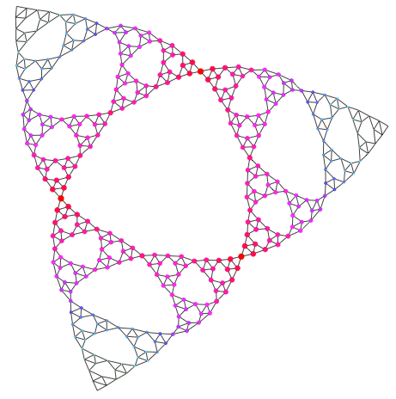
“Self-Similar” Networks
Sierpinksi Gaskets of order t=6

Slide 34
Avoidance Hitting Times & Betweeness Computation
S: a set of “absorbing” nodes
Hitting Time with Avoidance:
Applications:
Finding the set of core nodes (or gateways), C, of a network
Approximations to shortest paths & (shortest-path) betweenesses:
add an “absorbing node” (node 0) to a network, and
new random walk:
Then:

Slide 35
Summary: Key Results from Collaborations
Empirical network data analysis via Extremal Dependence Analysis
method and software tool from Sid
Discussions & direct help from Sid & Richard
Generative models for “hierarchical” and “self-similar” networks
inspired by the work of Don, Sid & Richard
discussions with Don, Sid & Richard
collaborative work still ongoing
Alternative “generative” models for multivariate degree distributions, where we can directly control “extremal dependence” structures
ongoing collaboration with Don, et al
Contributions to other team members’ research
provided network datasets
discussions/collaboration with Ness on mobility modeling
discussions/collaboration with Weibo & Don on graph similarity testing

Slide 36
Thank You!
Questions?

Slide 37
Backup Slides

Slide 38
Geometric Characterization of HT ECs
For undirected networks:
For directed networks, similar (but more complex) characterizations can be made in terms of (translated) left & right embedding spaces Y and X

Slide 39
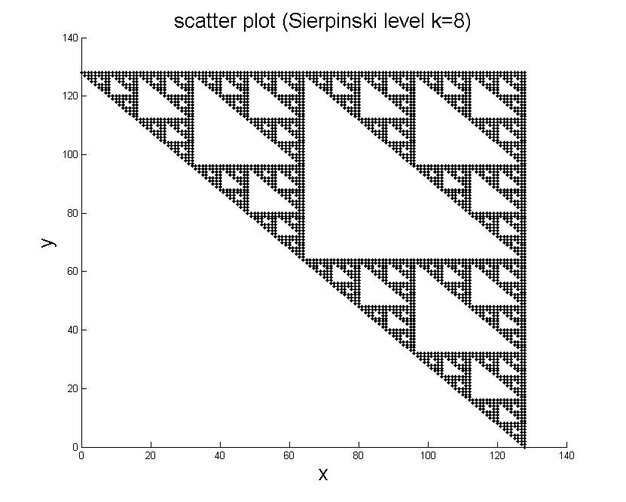
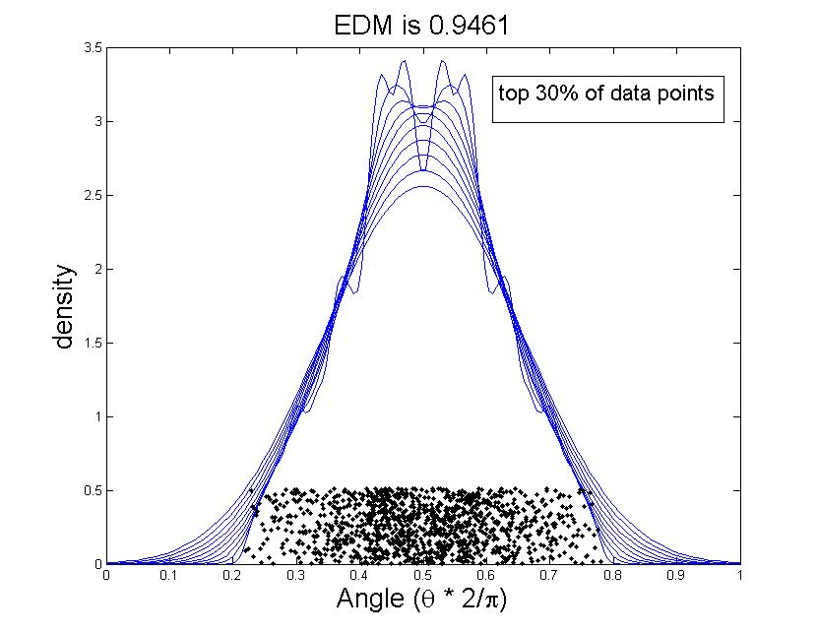
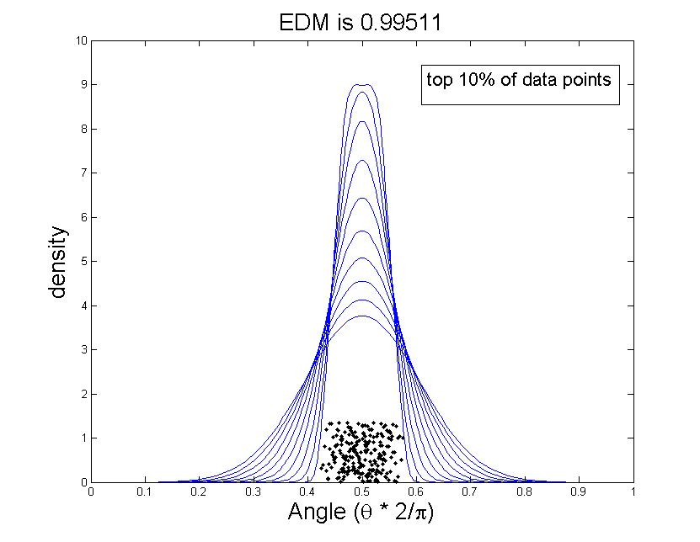
Extremal Dependence Analysis: Sierpinksi Gaskets (t=8)
P(dist(u,o₁)>x & dist(u,o₂)>y)

Slide 40
“Extended EDM” & Multivariate Dependence
EDM for d >2? Can be defined using spectral measure
See “Extremal Dependence Measure and Extremogram” [Larsson & Resnick]

Slide 41
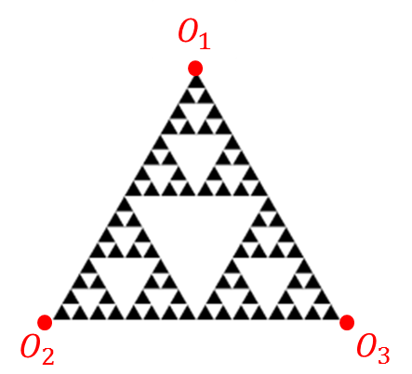
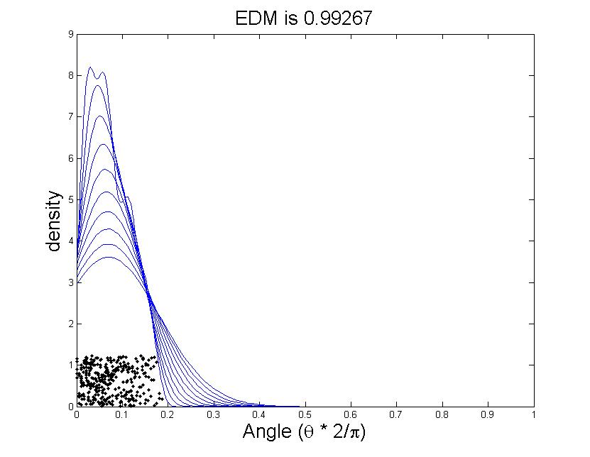
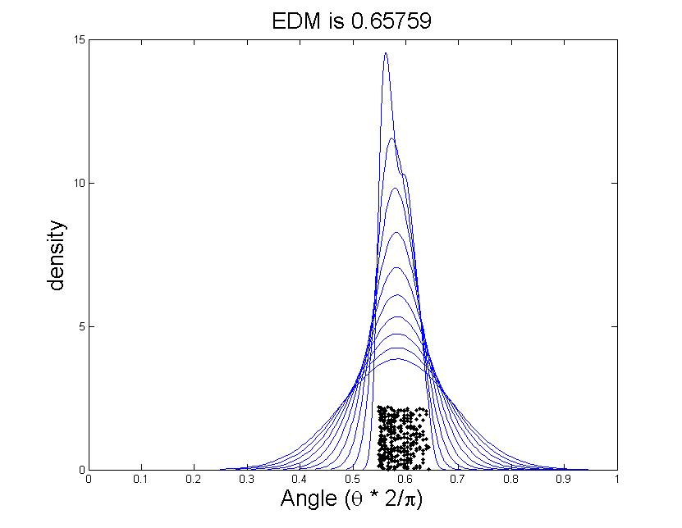
Extremal Dependence Analysis: Spierpinki Gasket (t=8)
EDMs for bivariate vs. trivariate cases:
Significant decrease in trivariate EDM: close to 2/3, uniform distr.

Slide 42
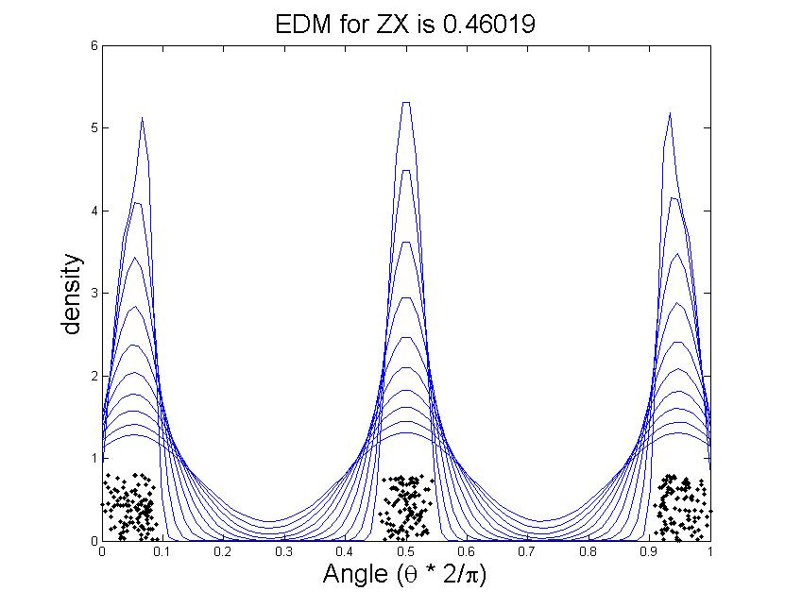
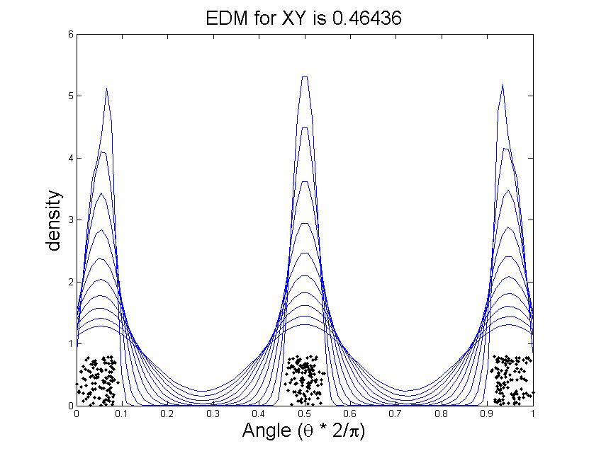
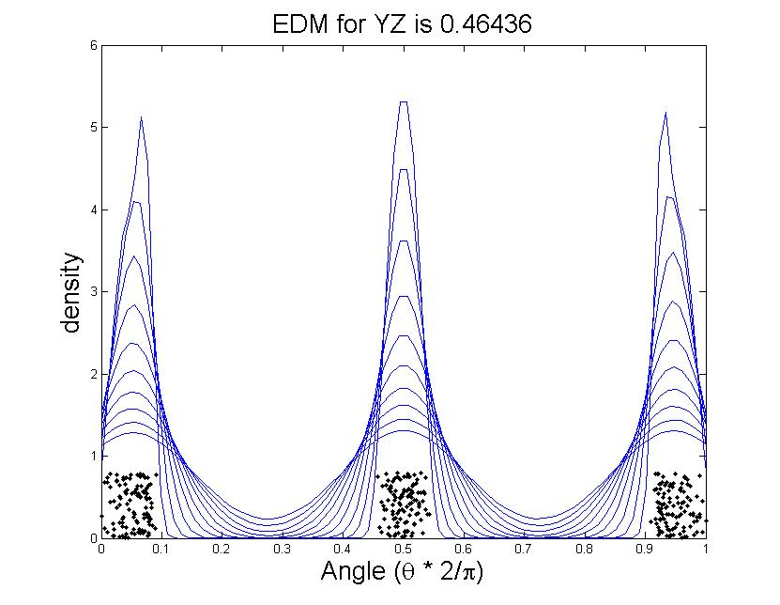
Extremal Dependence Analysis … P(dist(w,o₁)>x & dist(w,o₂)>y &dist(w,o₃)>z)
pair-wise extremal dependence analysis and EDMs
for trivariate case:
Pair-wise EDM hard to analyze & interpret
Impossible for higher dimensions

