Slide 1
Cloud ComPUTING and MultiVariate HEAVY-TaiLS
R. Srikant , University of Illinois at Urbana-Champaign
Joint work with Siva Theja Maguluri (UIUC), Ness Shroff (OSU), Yousi Zheng (OSU)
Discussions with Ananthram Swami (ARL)
MURI Meeting, Columbia University, NY
Notes:
Problem of Scheduling VMs in a Data Center
Extension of my earlier work that was presented in last year’s Infocom
Will quickly recap earlier results, present the new modified algorithm, and then present key ideas of the proof.

Slide 2
Outline
A Taxonomy of Cloud Computing Problems
More complicated examples of coupled queue problems in the proposal
Where do multivariate heavy tails occur?
Results for capacitated vector-packing
Topics for Discussion
Collaboration Efforts

Slide 3
Taxonomy I
The Map-Reduce Framework (Shroff’s talk)
A large job broken into many parallel tasks (Map phase)
Results from the parallel tasks are reassembled to provide the final answer (Reduce phase)
Many subproblems:
When can the reduce phase start?
How does data locality with respect of servers influence the service-times of tasks?
Preemptive vs Nonpreemptive models
Army relevance? Data-to-decision

Slide 4
Taxonomy II
Infrastructure as a Service or IaaS: this talk
Users request virtual machines (VMs) to execute jobs, i.e., a certain amount of CPU, a certain amount of memory, a certain amount of disk space
Service provider has a large number of servers
Many assignment (of jobs to servers) problems:
Job duration known upon arrival
Jobs durations are unknown and random
Preemptive vs nonpreemptive models
Army relevance? Battlefield cloud, tactical cloudlets

Slide 5
Heavy Tails
Map-Reduce:
the number of map tasks and the duration of the reduce tasks could be heavy-tailed
the duration of the reduce task could depend on the number of map tasks
IaaS
Job durations could be heavy-tailed
Large number of simultaneous VM requests

Slide 6
Recap of IaaS Problem Setting
A cloud of servers with limited capacities for different resources like processing power, memory, disk space etc.
Jobs (Virtual Machines) require certain amount of these resources and certain time for service
Jobs need to be routed to one of the servers and queued
Schedule jobs on each server meeting the resource constraints
Router
Server 1
Server 2
Server 3
Notes:
Iaas – VMs
------------------------------------
Existing approaches based on solving a bin packing problem
We model it as a dynamic problem with job arrivals and departures and provide a much simpler solution

Slide 7
A throughput Optimal Policy
Choose MaxWeight Schedule only at Refresh times
Use log(1+q) as weights
At other times, don’t change the schedule [Marsan et al ‘02]
Maximizes throughput
A more natural approach
Greedily add schedules
(2,0,0)
Weight = 4
(1,0,1)
Weight = 3
(0,1,1)
Weight = 5
Notes:
Explain why log(.) is used
Emilio’s paper (Marsan et al) – in the context of switch – in complete (uses blackwell theorem, also incorrect assumption about queue lengths being infinite)
Also, here it is different with both routing and scheduling
Not clear which is better apriori because, with greedy refresh time may take longer time to happen than the fixed one

Slide 8
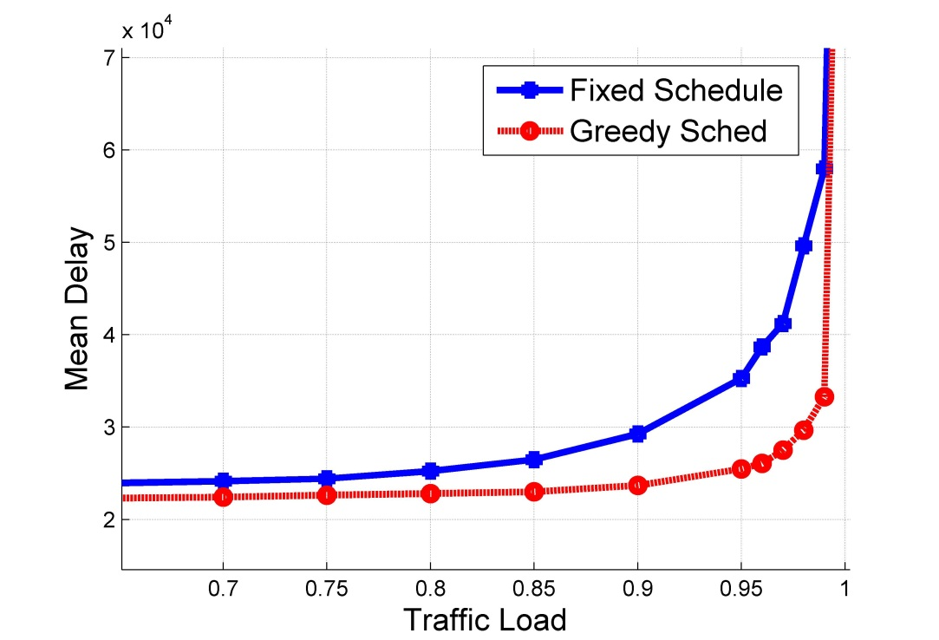
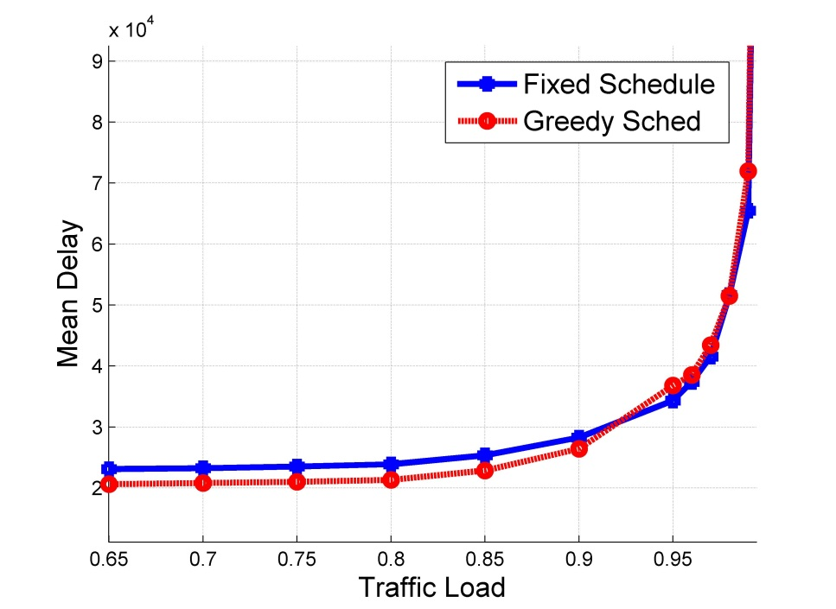
Comparison of the two policies
Don’t know if Greedy approach is throughput optimal
Both Algorithms seem to have similar throughput performance
Notes:
Diff points on the capacity region. Both seem to have similar throughput
-----------------------
Setup, - 100 identical servers three maximal schedules (2,0,0), (1,0,1), (0,1,1)
Diff points on the capacity region. Left fig (1,1/3,2/3) and right one (1,1/2,1/2)
Job size distribution w.p 0.7, unif [1,50]; w.p .15, unif [251,300] and w.p. .15, unif [451, 500]

Slide 9
Discussion Question I
Current proof requires the following
The variance of the service-time distribution can be arbitrarily large, but has to be finite for the proofs to go through
Is this good enough from a practical perspective? Data sets?

Slide 10
Discussion Question II
Assume number of servers is infinite
Traditional infinite-server queueing models are used to capture the relationship between the tail of the service-time distribution and the autocovariance of the number of servers in use (LRD)
With multivariate distributions, do such calculations exist and if not, would such calculations be useful for performance analysis?

Slide 11
Collaboration Efforts
Skype conference calls every Thursday with Ness Shroff and student
Visit by Lang Tong to Illinois
Phone call and email exchanges with Ananthram Swami (ARL) which will be followed by a visit over the summer

