Slide 1
Learning to Generate Networks
James Atwood
UMass Amherst
4/26/2013

Slide 2
Elevator Pitch
Current state of the field: “We introduce algorithm A which generates graph family G exhibiting distribution D.”
Researcher’s task is to discover A which produces D over G.
Hypothesis: We can develop a general algorithm which takes D as input and produces both A and G.
Method: Reinforcement Learning
Question Answered: “How do we produce a graph that looks like X?”

Slide 3
State of the Field
Generation Model | Algorithm | Graph Type | Distribution
Price | Directed preferential attachment | Directed scale-free | Power-law over in-degree.
Barabasi & Albert | Undirected preferential attachment | Undirected scale-free. | Power-law over degree.
Watts & Strogatz | Rewire regular ring lattice | Small-world | Path length with small expectation.
Erdos-Renyi | Random edges | ER-Family | Binomial over degree.

Slide 4
Reinforcement Learning Approach
Input: Target distribution D, desired size n
Q-learning over graph actions (add / remove nodes, edges)
Reward: f(n, D)
Distribution representation: Bayesian networks
Arbitrary joint, well-defined distance functions

Slide 5
Reinforcement Learning In Brief
Frame the problem as an agent interacting with an environment to obtain reward.
Agent’s goal is to maximize reward. It learns the value function over actions and environment to accomplish this.
Exploration / Exploitation tradeoff.
Repeatable and episodic. The agent brings the knowledge gained by exploring and learning in the previous step to the next.

Slide 6
Tasks
Unconstrained Actions: Learn the optimal policy for generating a given network. Do not attempt to shape the policy’s distribution of actions.
Constrained Actions: Learn a policy which satisfies some constraint on the distribution of actions.
Homogenous distribution over time (scale-free)
Perform all node additions, then all edge additions, then all edge rewiring (small world)

Slide 7
Application to Multivariate-Heavy Tails
Implement general algorithm.
Set target distribution D to be joint power-law over in-degree, out-degree.
Learn a policy A for constructing graphs G which exhibit D.

Slide 8
Unconstrained Action Experimental Setup
Actions:
Add node with one edge, randomly connected to existing network.
Add edge with tail and head chosen uniformly at random.
Add edge with head chosen with probability proportional to in-degree and tail chosen uniformly at random.
Note: no deletion actions.
State Space:
Number of nodes
Number of edges
Average in-degree
Basis:
State-action space represented via a radial basis.
Each feature expanded via 13 RBFs.
Termination:
log-log linear fit slope between -1.75 and -2.25, and
log-log linear fit R² >= 0.8, and
number of nodes between 3900 and 4100.
Can also terminate if number of nodes >> target, or if 12,000 iterations have occurred.
Reward
-1 for each timestep.
0 for goal (termination).

Slide 9
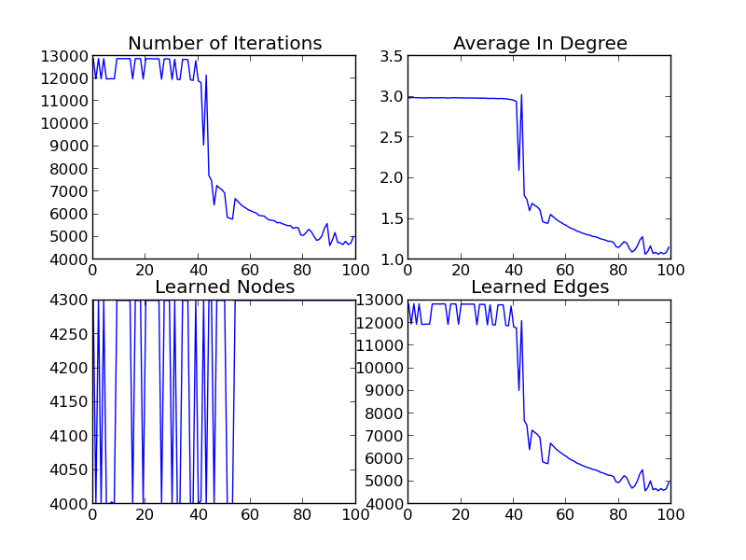
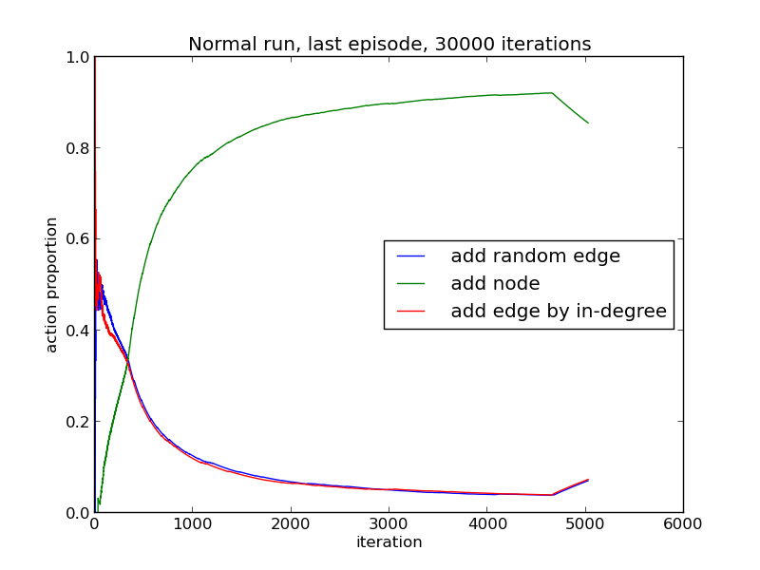
Preliminary Results: Unconstrained Actions
Dashboard
Learned Action Distribution

Slide 10
Constrained Action Experimental Setup
Actions:
Add node with one edge, randomly connected to existing network.
Add edge with tail and head chosen uniformly at random.
Add edge with head chosen with probability proportional to in-degree and tail chosen uniformly at random.
Note: no deletion actions.
State Space:
Number of nodes
Number of edges
Average in-degree
Basis:
State-action space represented via a radial basis.
Each feature expanded via 13 RBFs.
Termination:
After 10000 iterations
Reward
1 if
log-log linear fit slope between -1.75 and -2.25, and
log-log linear fit R² >= 0.8, and
0 otherwise

Slide 11
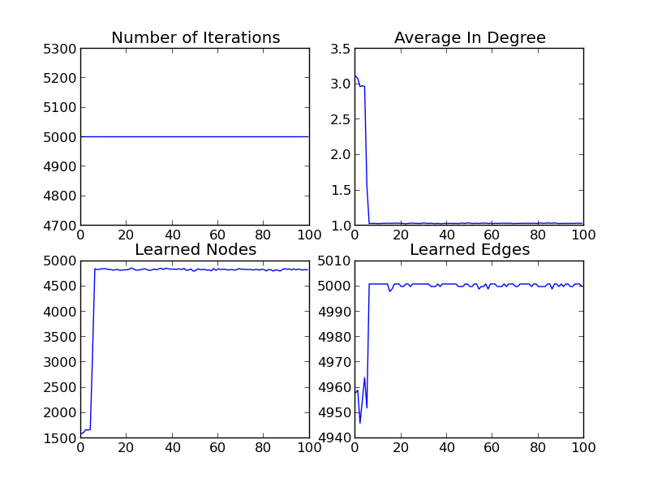
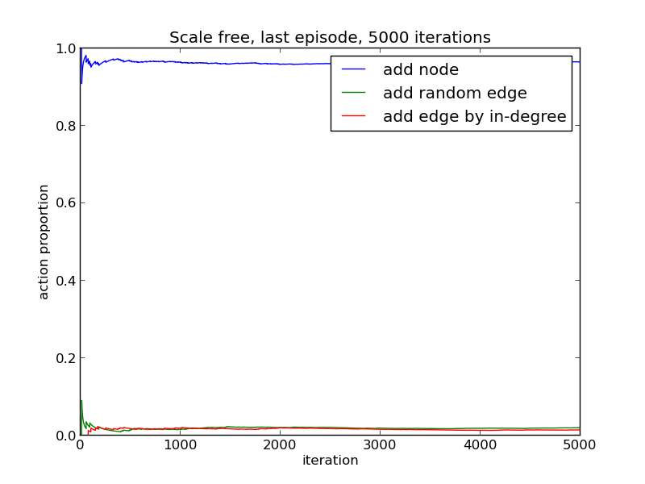
Preliminary Results: Constrained Actions
Dashboard
Learned Action Distribution

Slide 12
Takeaway
Unconstrained case appears successful. The learner can learn to generate a specific network.
Constrained case has proven difficult. Not currently able to learn a policy with a homogenous action distribution across all time.

Slide 13
Current Research
What should the learner be able to control? What should be considered a part of the environment?
Is it appropriate to treat the constrained case as a reinforcement learning problem? Can we identify better methods?
How does this model compare to probabilistic generative models, such as ERGM?
Exploring theoretical behavior of some relevant generative processes.
Working to apply to multivariate distributions.

