Slide 1
Deadline Scheduling and Heavy tail distributionS
Lang Tong
School of Electrical and Computer Engineering
Cornell University, Ithaca, NY 14850

Slide 2
Overview
What am I working on
Deadline scheduling with outsourcing options: algorithms and performance analysis
Worst-case optimal deadline scheduler
What do I intend to work on
Investigate impacts of multivariate heavy tail distribution on deadline scheduling performance

Slide 3
Deadline scheduling and outsourcing
Key characteristics:
Jobs with different sizes, deadlines, and rewards
Multiple local inexpensive servers with varying capacities
Expensive outsourcing options
Scheduling actions:
Admission: whether to take on a job
Scheduling: which server should be assigned
Outsourcing: whether and when to outsource

Slide 4
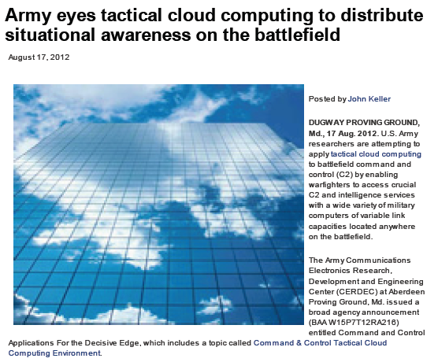
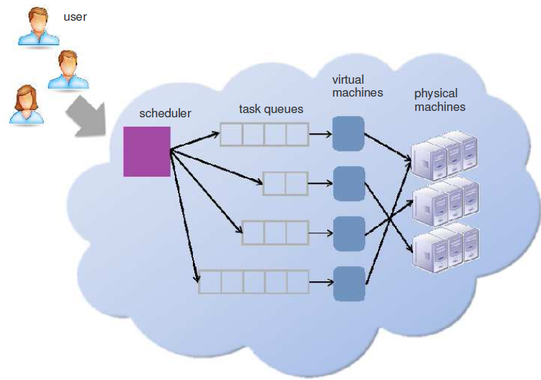
Applications
Scheduling for distributed resources in cloud

Slide 5
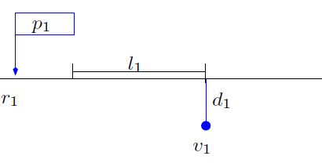
Jobs with deadlines

Slide 6
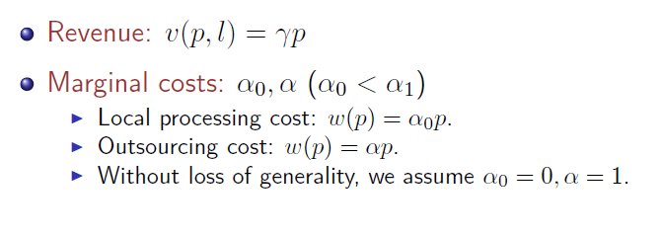
Profit = Revenue - Cost

Slide 7
Offline deadline scheduling

Slide 8
Online deadline scheduling

Slide 9
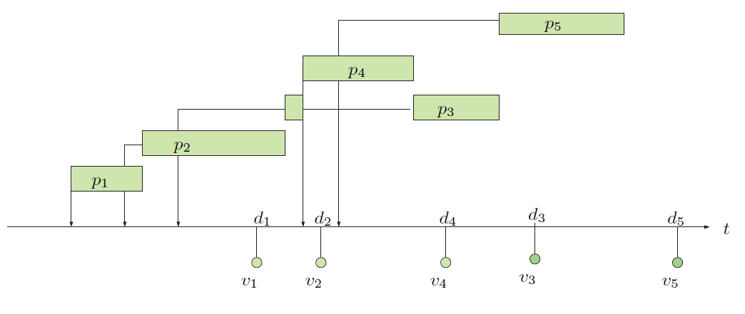
Example: earliest deadline first (EDF)

Slide 10
Competitive ratio: online vs. offline

Slide 11
Optimal competitive ratio

Slide 12
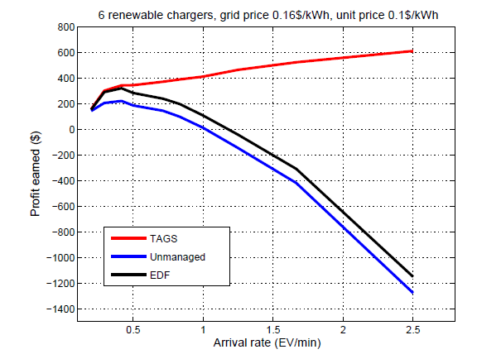
EDF under stress

Slide 13
Deadline scheduling with admission control

Slide 14
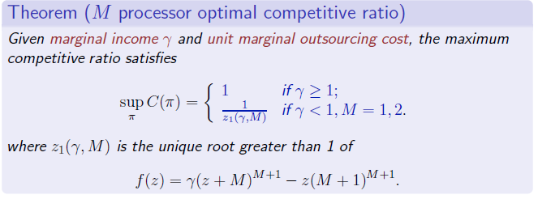
Maximum competitive ratio

Slide 15
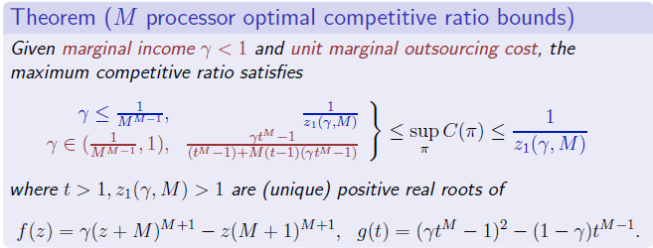
Maximum competitive ratio bounds

Slide 16
Maximum competitive ratio bounds

Slide 17
Insights and intuitions
Easy cases: lightly loaded traffic
Heavy tailed deadlines, heavy tailed interarrivals.
Worst cases:
Cascades of heavy tailed jobs.
Optimal deadline scheduling
Threshold admission control + EDF
Load balancing

Slide 18
Converse:

Slide 19
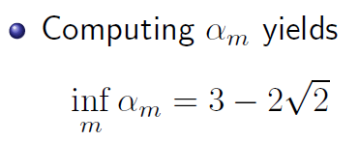
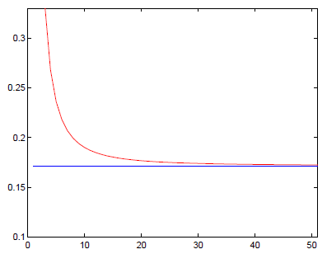
Converse:

Slide 20
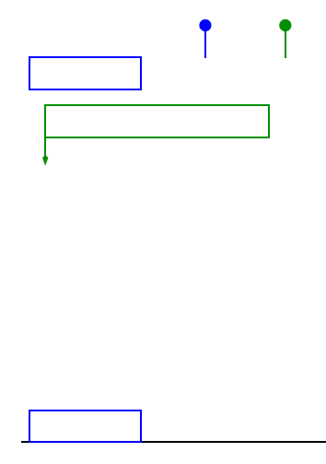
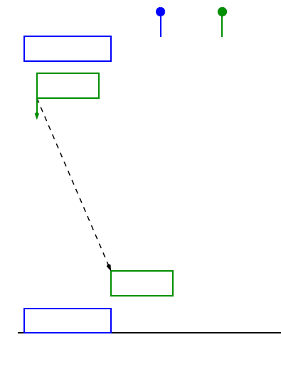
Achievability: TAGS
Easy job: accept + LLF
Difficult job: reward threshold test

Slide 21
Proof sketch:

Slide 22
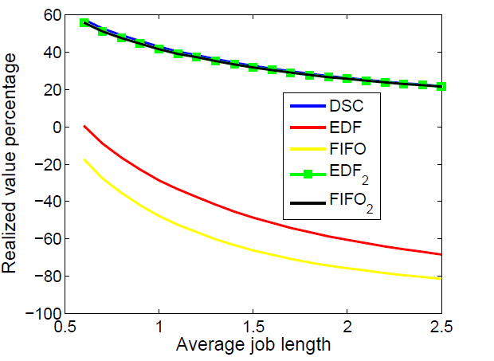
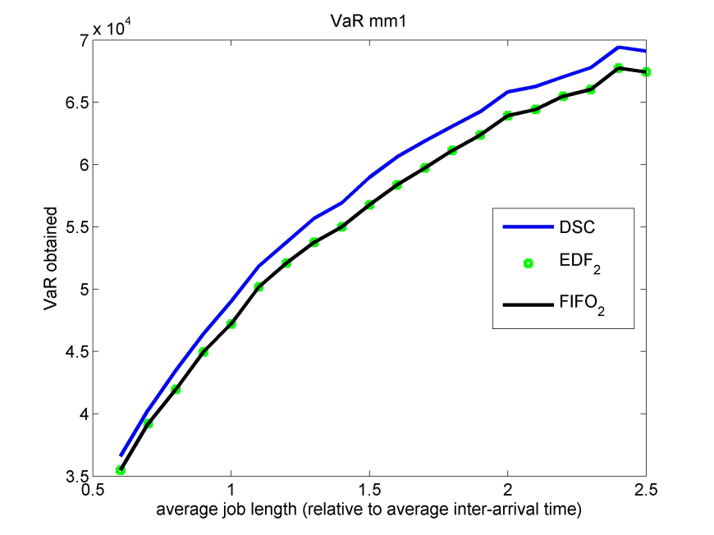
Some numerical results: light tail jobs
Exponential job length, Poisson arrival

Slide 23
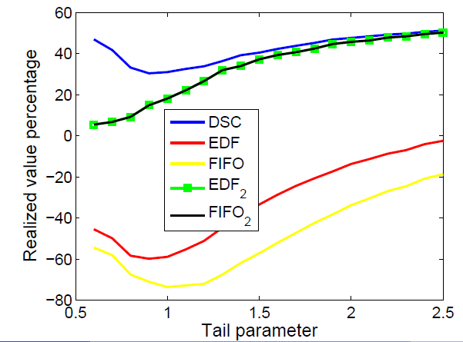
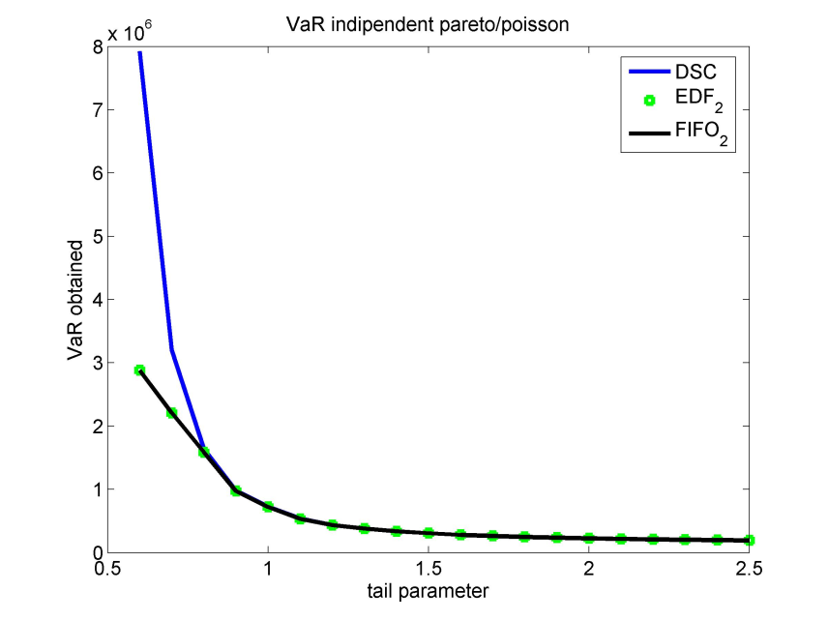
Effects of job size
Pareto job length, Poisson arrival

Slide 24
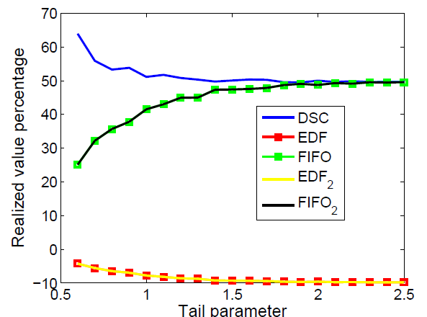
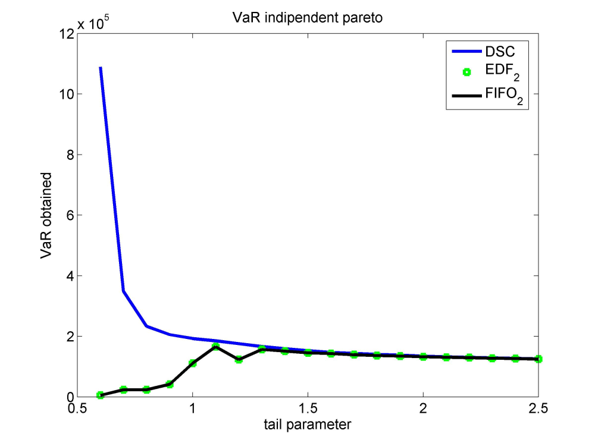
Effects of job size and arrival
Pareto job length and independent Pareto inter-arrival

Slide 25
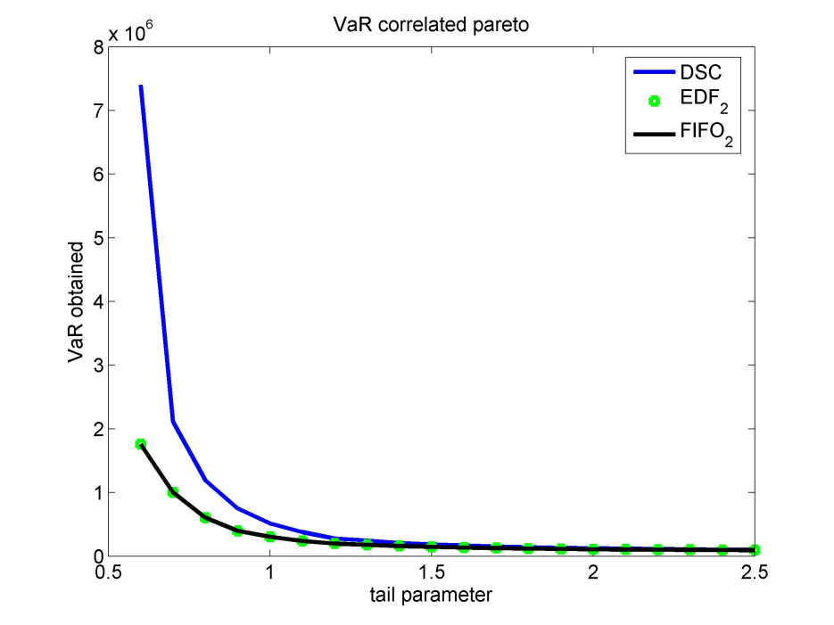
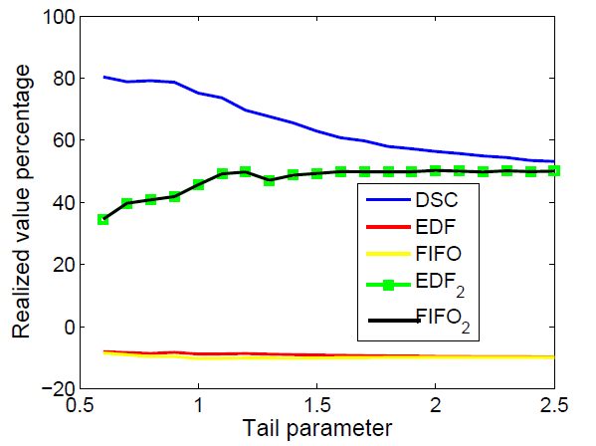
Effects of job size
Pareto job length and Markov dependent Pareto inter-arrival

Slide 26
Summary remarks
Deadline scheduling is a classical problem that arises in many applications with real-time operation constraints.
Very little is known about the impact of heavy tailed distributions on performance.
We have developed a simple but optimal online scheduling (in competitive ratio) with very good performance in simulations involving heavy tail distributions.

