Slide 1
Multivariate Heavy Tails and Structural Properties of Networks
MURI April Meeting
Zhi-Li Zhang
zhzhang@cs.umn.edu
Qwest Chair Professor
Dept. of Computer Science & Eng.,
University of Minnesota

Slide 2
Central Questions
Networks are “by nature” multi-variate entities
  formed by n nodes and m edges connected in various manners
  edges may be directed, and/or have weights, signs, …
Objective: bring a “multivariate analysis” perspective to study structural properties of networks
  In particular, understand roles and impact of multi-variate heavy tails
What are (possible) manifestations of multi-variate heavy tail phenomena in networks?
  beyond (univariate or bivariate) power law degree distributions
And what can they tell us about the structural properties of networks?

Slide 3
Outline
Geometry of Networks and Extremal Dependence Analysis using EDM (extremal dependence measure)
  L embedding: joint node degree distributions & EDM
  L⁺ embedding: structural centrality & extreme dependence
Multivariate Heavy Tails & (Extremal) Clustering
  Question: what can multivariate extremal dependence analysis tell us about structural properties of a network?
  A toy example: Sierpinski gasket & growing networks
  multivariate extremal dependence & (extremal) clustering
Extremal dependence analysis of a directed graph
  slashdot example
Discussions and Help Needed!

Slide 4
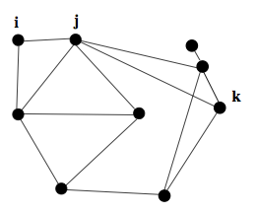
Geometry of Networks: Background
Networks modeled as undirected (weighted) graphs

Slide 5
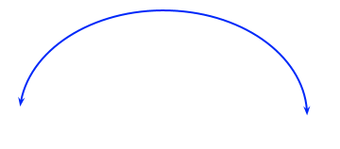
Geometry of Networks & Heavy Tails
L and L⁺ provide two dual geometric representations of a network
  L captures “local” properties while L⁺ “global” properties of network
= (where ) is a kernel matrix
Heavy-tailed node degree and joint node degree distributions can be represented using “radius” & “angular” spectrum measures
i
j
w
v
k

Slide 6
Extremal Dependence Analysis
  See “Extremal Dependence: Internet Traffic Application” by Resnick et al
Represent them in terms of spherical coordinates
Apply extremal dependence analysis and define EDM
where parameter k is # of multivariate exceedences above a threshold
(e.g., when r_{ij} = sqrt(d²_{i} + d²_{j}) is large)
EDM ~ 0 → extremal independence (“axis hugging”)
EDM ~ 1 → extremal dependence (mostly along the diagonal)
EDM ~ 2/3 → angles nearly uniform distributed on [0, /2]
Extremal dependence analysis and EDM provide better metrics to capture joint node degree distribution than, say, S index (average of d_{i}d_{j})
In data analysis, we also apply ICRT (inverse complementary rank transform) or angular ranking method, if needed
EDM ~ 0 → extremal independence
EDM ~ 1 → extremal dependence
EDM ~ 2/3 → angles nearly uniform distributed on [0, /2]
Dependency among pair of nodes, X*_{i} and X*_{j} , can be represented in spherical coordinates
  We can introduce an i. i. d. random process by randomly sampling pairs of nodes, randomly sampling edges from the network

Slide 7
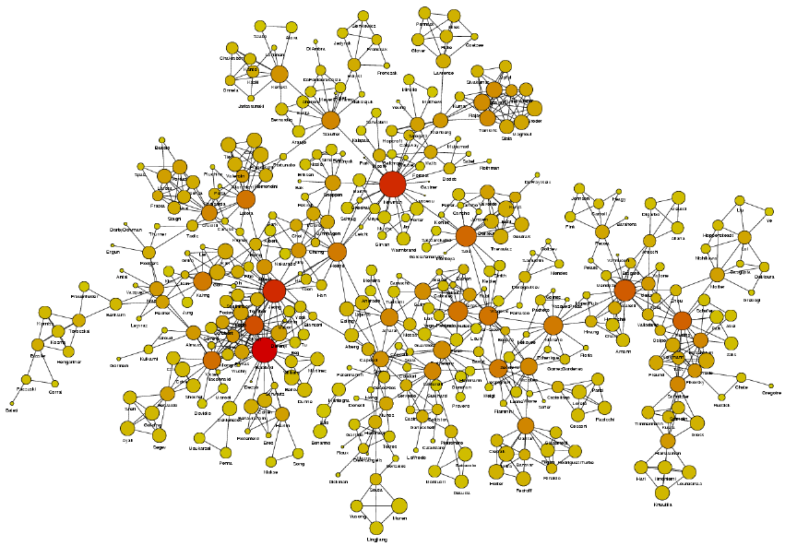
Network Science: Co-Authorships

Slide 8
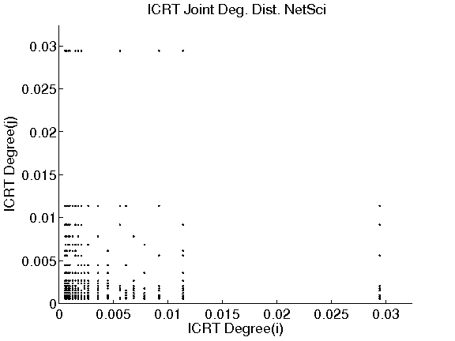
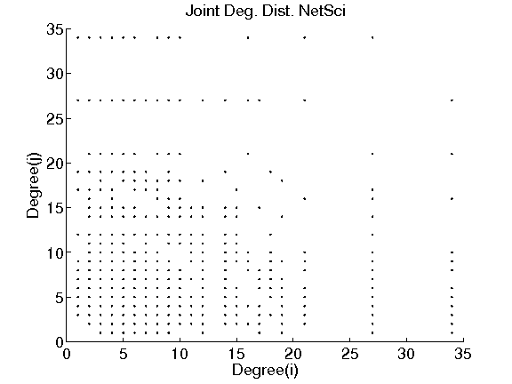
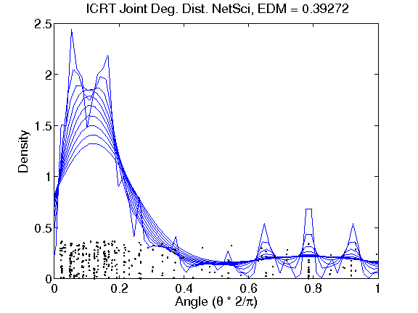
Bivariate Extremal Dependence Analysis:
Joint Node Degree Distr. -- NetSci
Top 30%

Slide 9
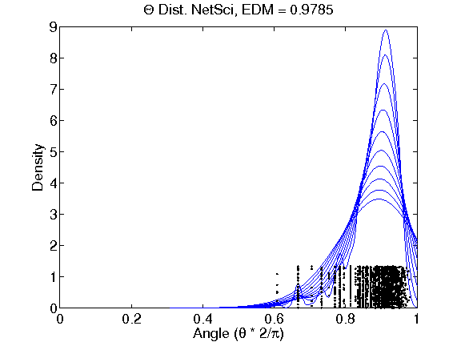
Bivariate Extremal Dependence Analysis:
Joint Node Degree Distr. – NetSci

Slide 10
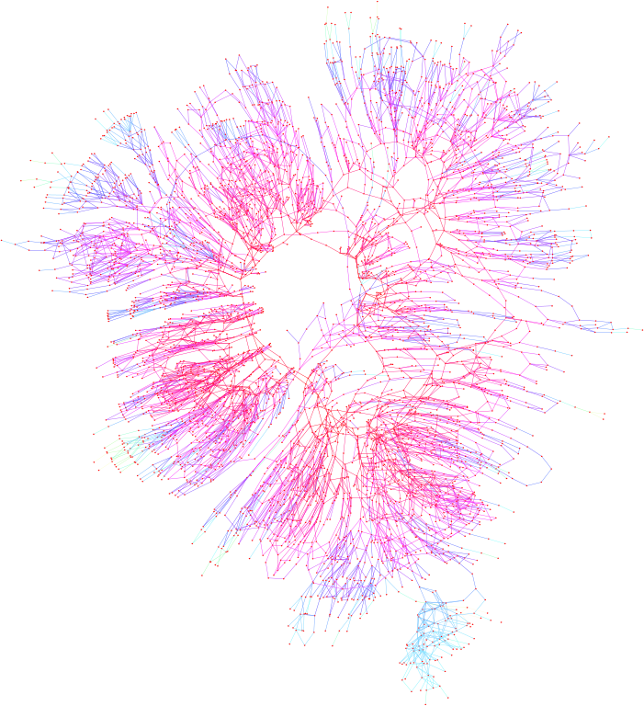
Western States Power Grid Net.

Slide 11
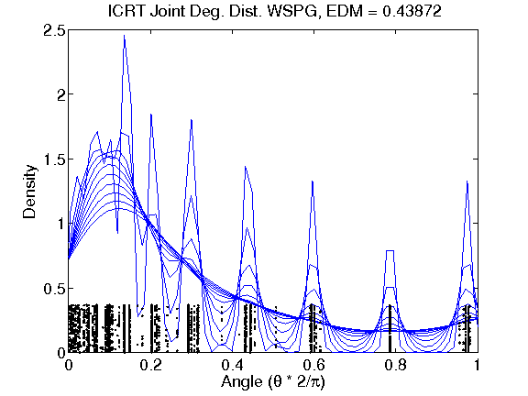
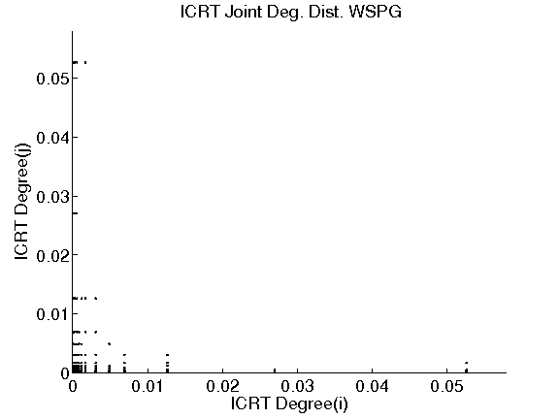
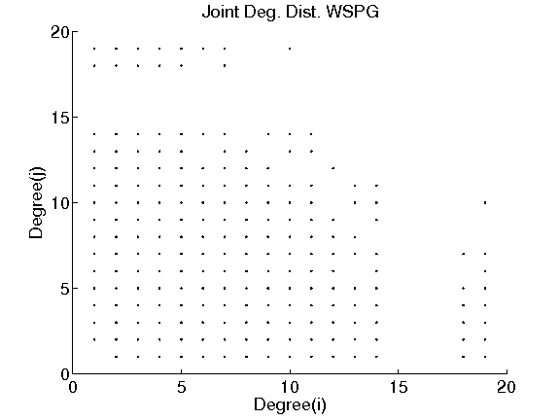
Bivariate Extremal Dependence Analysis:
Joint Node Degree Distr. – Power Grid
Top 30%

Slide 12
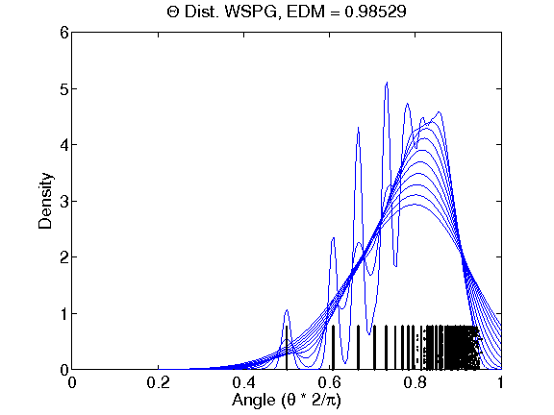
Bivariate Extremal Dependence Analysis:
Joint Node Degree Distr. – Power Grid
Angles scaled

Slide 13
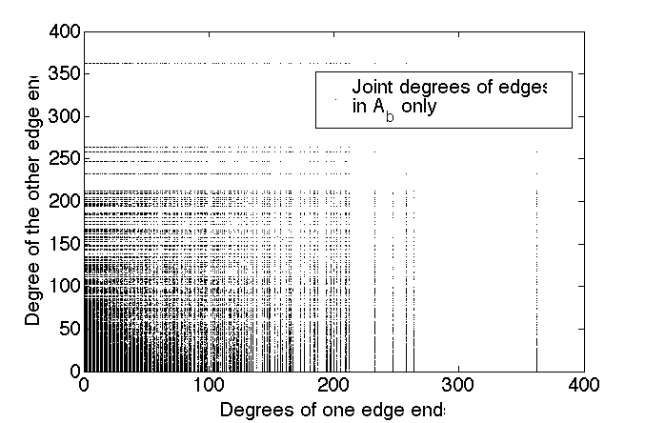
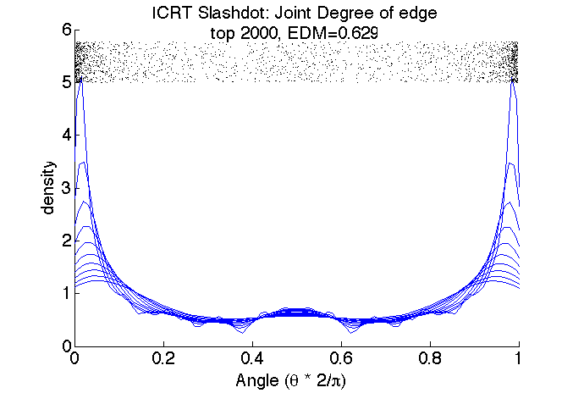
Bivariate Extremal Dependence Analysis:
Joint Node Degree Distr. of Bi-directed Edges (A_{b}) in Slashdot Network

Slide 14
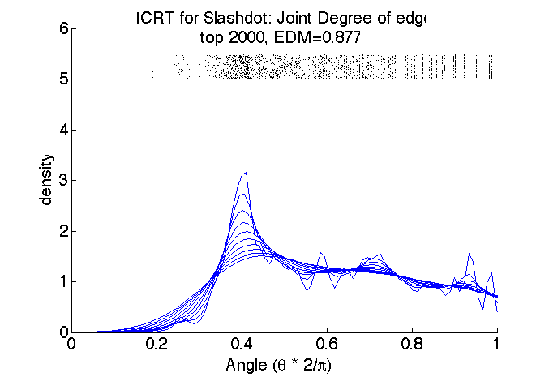
Bivariate Extremal Dependence Analysis:
Joint Node Degree Distr. of Bi-directed Edges (A_{b}) in Slashdot Network

Slide 15
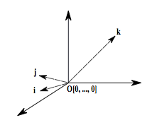
Geometric Embedding using L⁺
L⁺_{ii} : captures structural role of a node in a network (& better than
existing metrics, e.g., node degree, “shortest path” centrality)
(topologically) structural centrality measure
Extremal dependence among nodes with high C*(i) ?

Slide 16
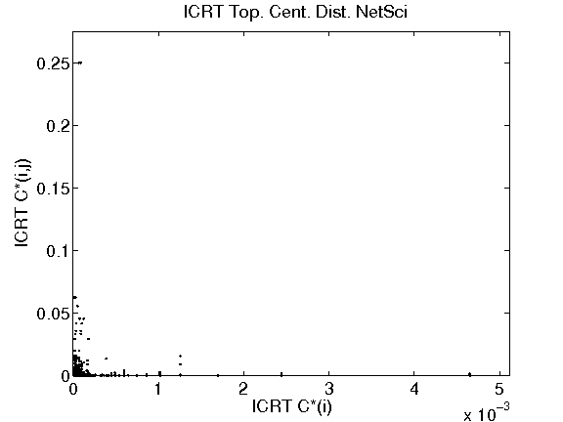
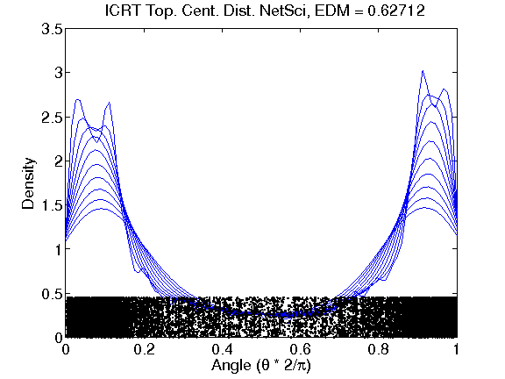
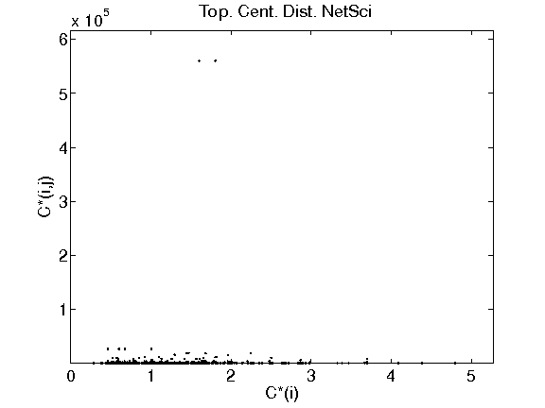
Bivariate Extremal Dependence Analysis:
L⁺ Distributions – NetSci [L⁺ _{ij} >0]
Top 30%

Slide 17
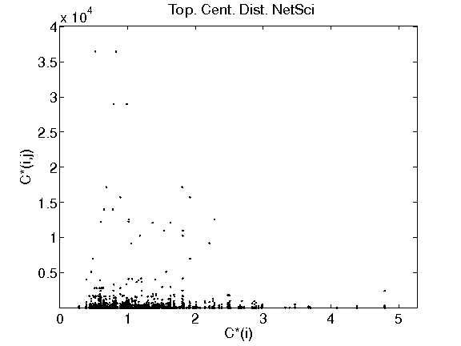
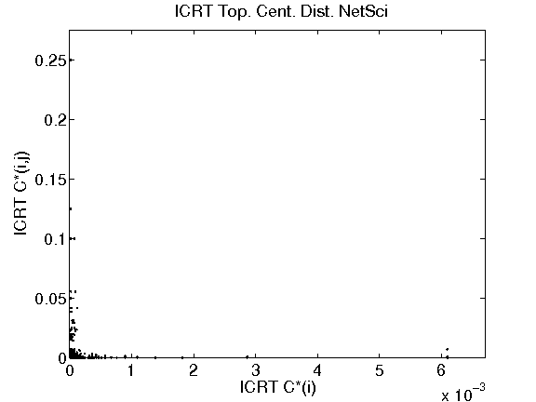
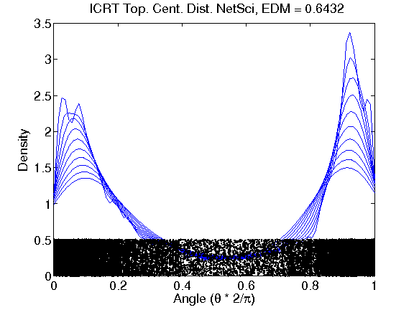
Bivariate Extremal Dependence Analysis:
L⁺ Distributions – NetSci [L⁺ _{ij} <0]
Top 30%

Slide 18
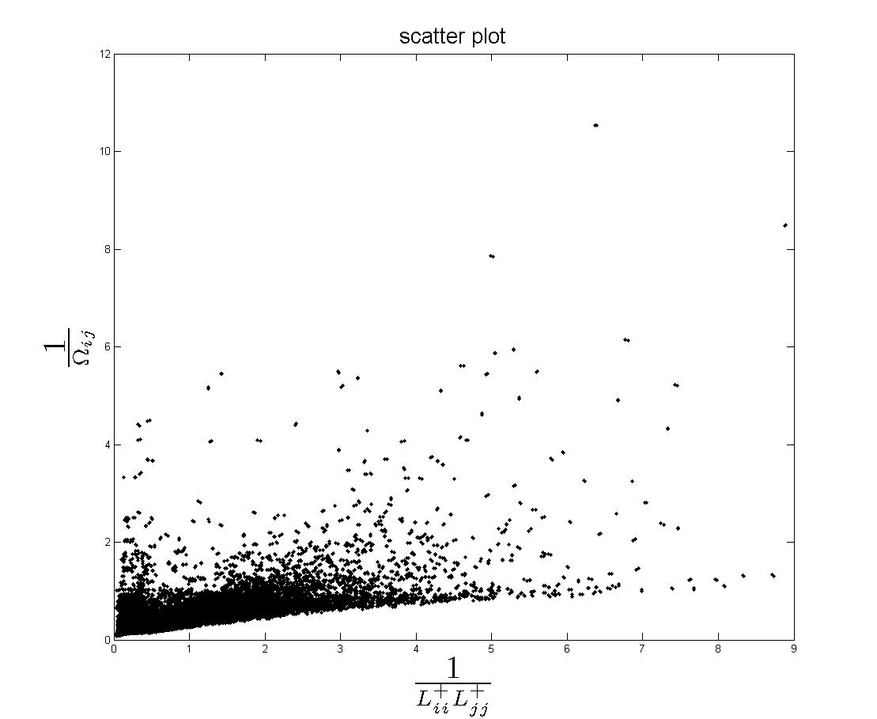

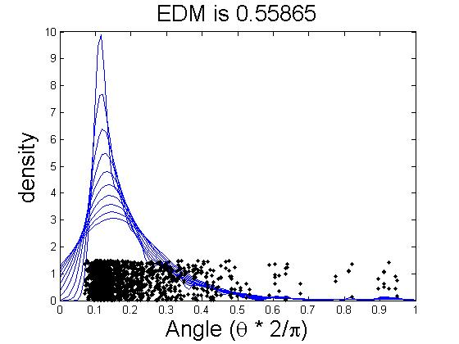
NetSci
379 number of nodes, 914 number of edges (weighted,undirected)
379x378 number of data points (all pairs)
Threshold: top 1%
Normalizing by max (no ICRT)

Slide 19
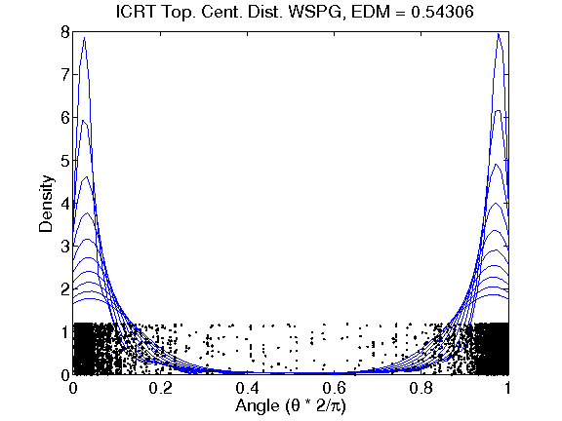
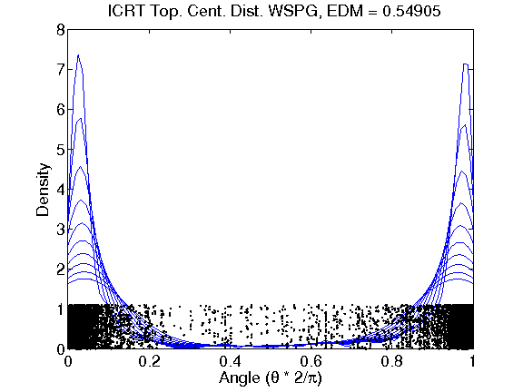
Bivariate Extremal Dependence Analysis:
L⁺ Distributions – Power Grid

Slide 20
Multivariate Extremal Dependence Analysis: Structural Properties?
Going beyond degree/joint degree distributions and bivariate (extremal) dependence analysis
  “distances” (a global property) among nodes perhaps reveal more information than simply node degrees (a local property)
  (BA-type) power-law networks → small diameter networks O(log N)
What can multivariate extremal dependence analysis can tell us about the structural properties?
  “geometry of networks” provide some insights/directions
  (extremal) clustering (“communities”) or core network structures?
  Questions: i) Is a network composed of k “communities” (or clusters)? And if yes, ii) how do we determine k?
  not necessarily a well-posed/defined problem?

Slide 21
Multivariate Extremal Dependence and (Extremal) Clustering
Looking at “distance” dependences among nodes in a network
Hypothesis:
If there exists k-variate (extremal) dependence, but no (k+1)-variate (extremal) dependence, there are k (extremal) clusters!
Intuition: Given a network is composed of k clusters (dense subgraphs), randomly pick m nodes repeatedly from the network, and measure the distances from one node to (m-1) nodes
  For m=1,…, k, we’ll likely see m-variate (extremal) dependence structures, i.e., sufficient # of samples with (m-1) “large” entries
  For m>k, likely no sufficient # of samples with m “large” entries
Issues: how to measure m-variate (extremal) dependenc structures for m>2? And how to decide the “exceedence” thresholds?
  Still a “gedanken” experiment at this point

Slide 22
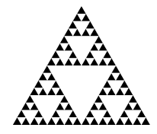
A Toy Example: Sierpinksi Gasket
Sierpinksi gaskets as a (family of) growing network(s)
  start with a 3-node triangle (sierpinksi gasket of order k=1)
  self-similar structure: from k to k+1:
  replicate itself three times, and merge at two of the three corner nodes
Properties of Sierpinski Gasket of order k (k=1,2, …)
Univariate and multivariate heavy-tailed distance distributions

Slide 23
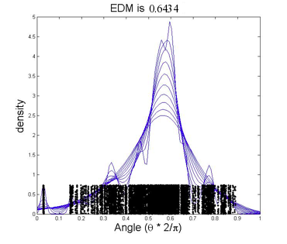
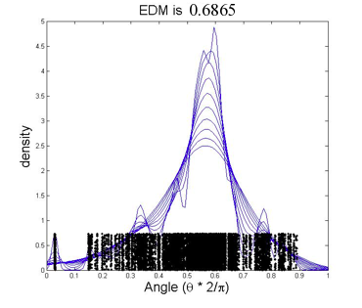
Bivariate Extremal Dependence Analysis:
L⁺ Distributions – SG (k=8)
Top 10%

Slide 24
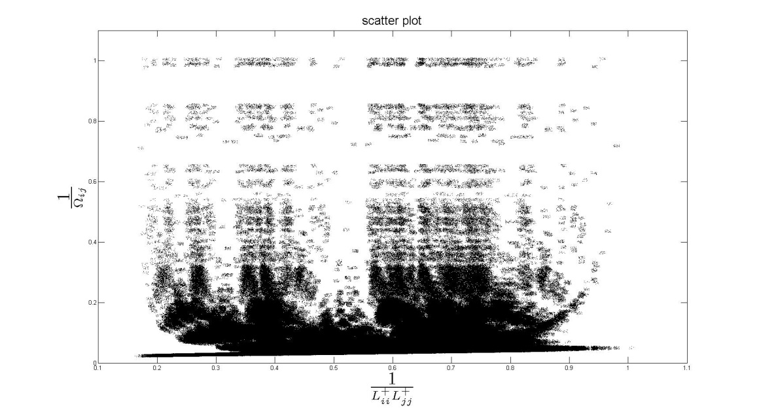
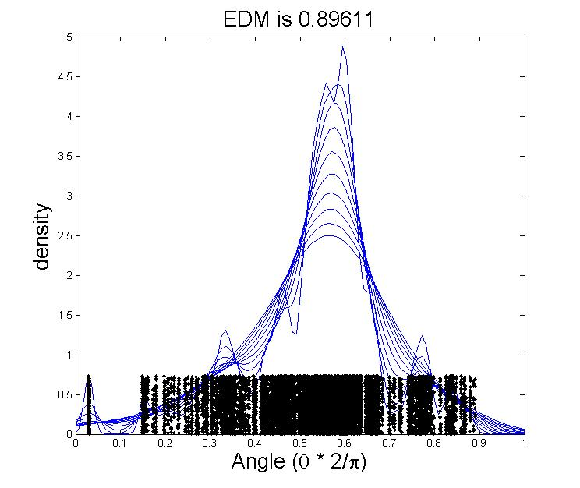
Sierpinski Gasket (k=8)
3282 number of nodes
3282x3281 number of data points (all pairs)
Threshold: top 0.1%
Normalizing by max (no ICRT)

Slide 25
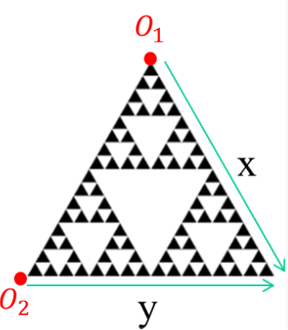
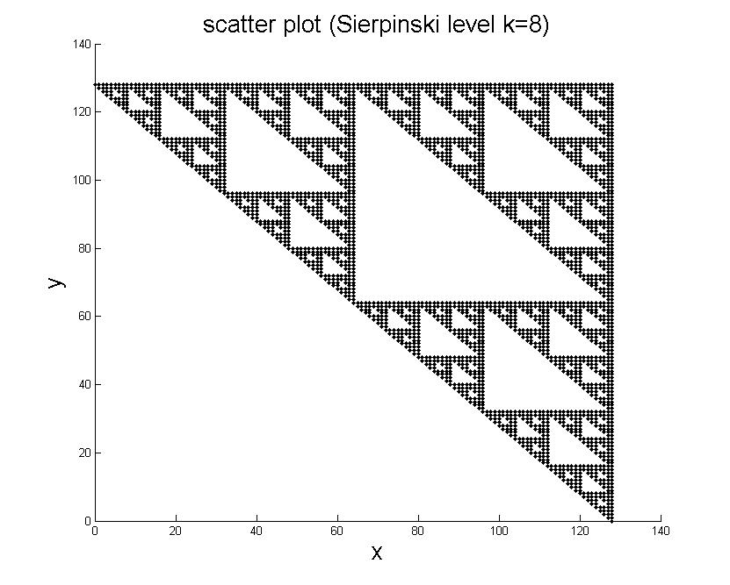
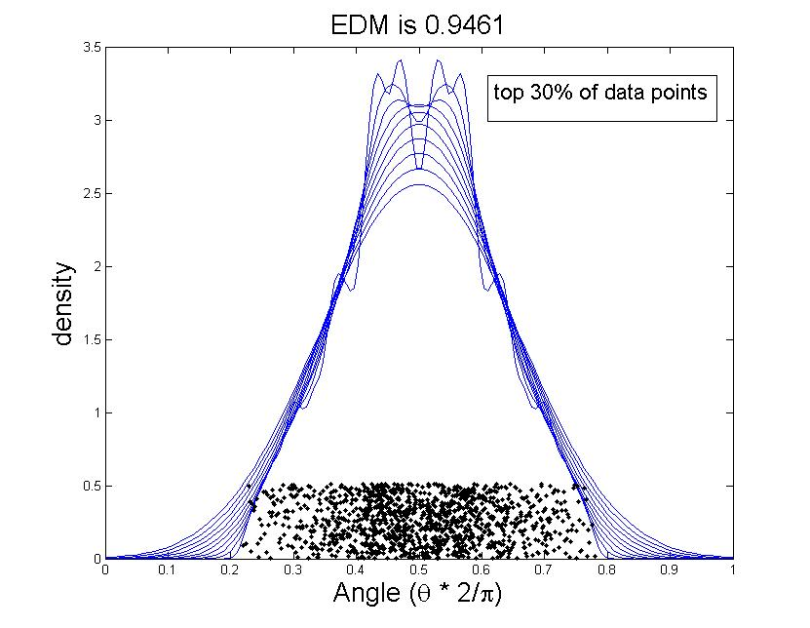
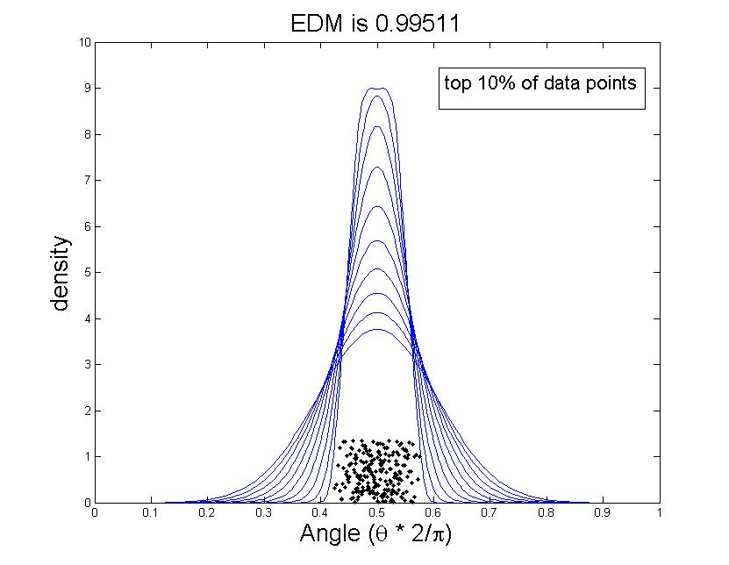
Extremal Dependence Analysis:
P(dist(w,o₁)>x & dist(w,o₂)>y)

Slide 26
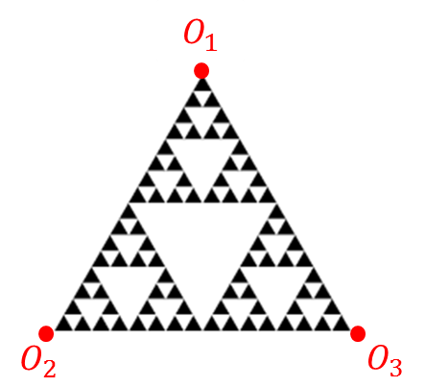
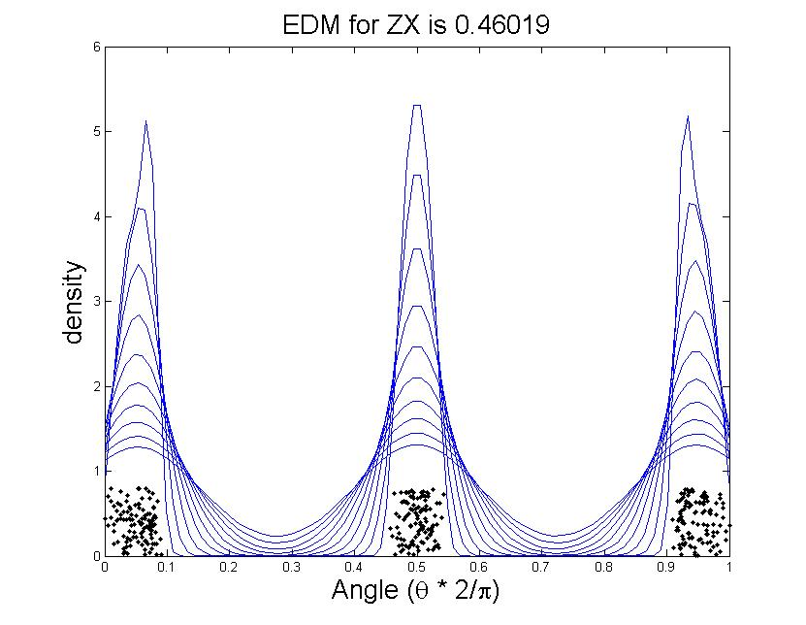
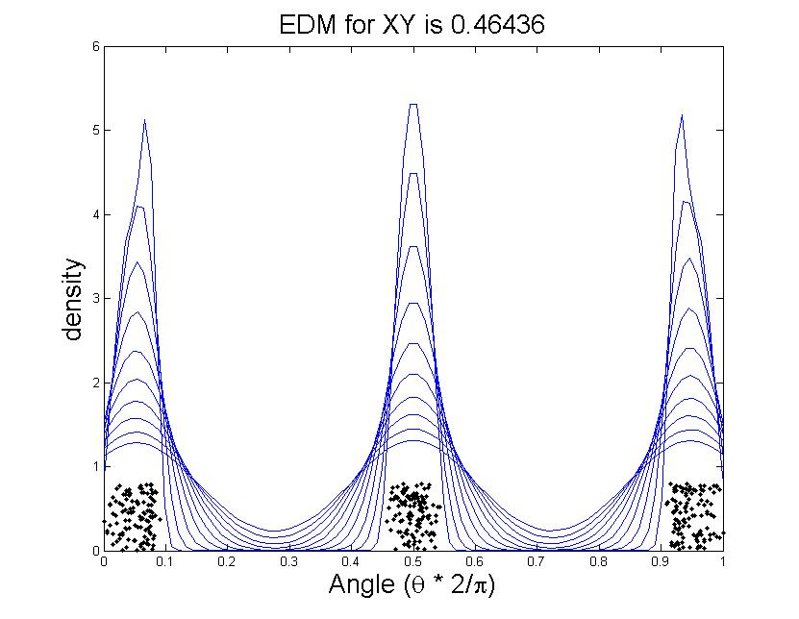
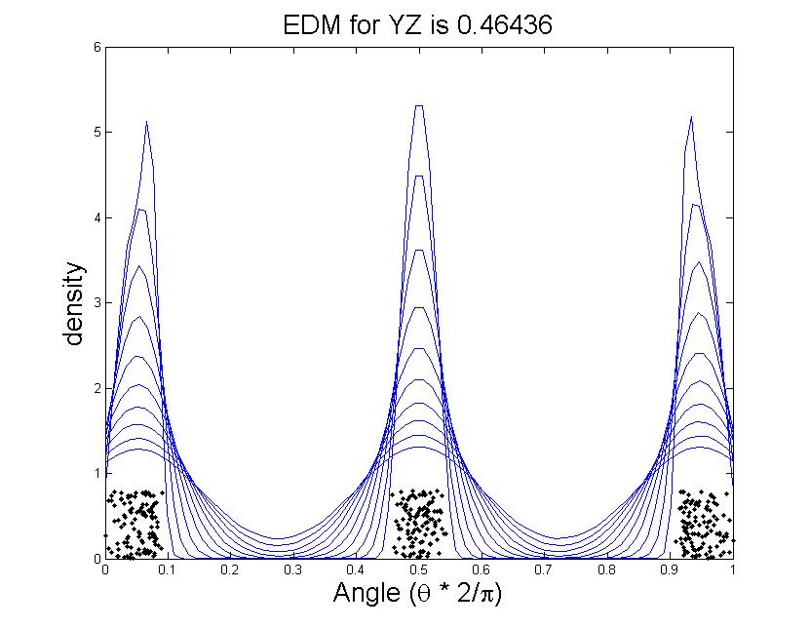
Extremal Dependence Analysis & Clustering P(dist(w,o₁)>x & dist(w,o₂)>y &dist(w,o₃)>z)
pair-wise extremal dependence analysis and EDMs
for trivariate case:
Pair-wise EDM hard to analyze & interpret
Impossible for higher dimensions

Slide 27
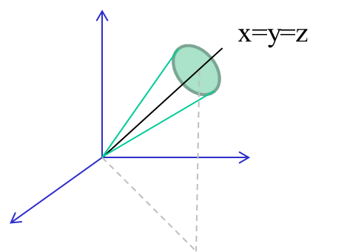
“Extended EDM” & Multivariate Dependence
EDM for d >2? Can be defined using spectral measure
See “Extremal Dependence Measure and Extremogram” [Larsson & Resnick]

Slide 28
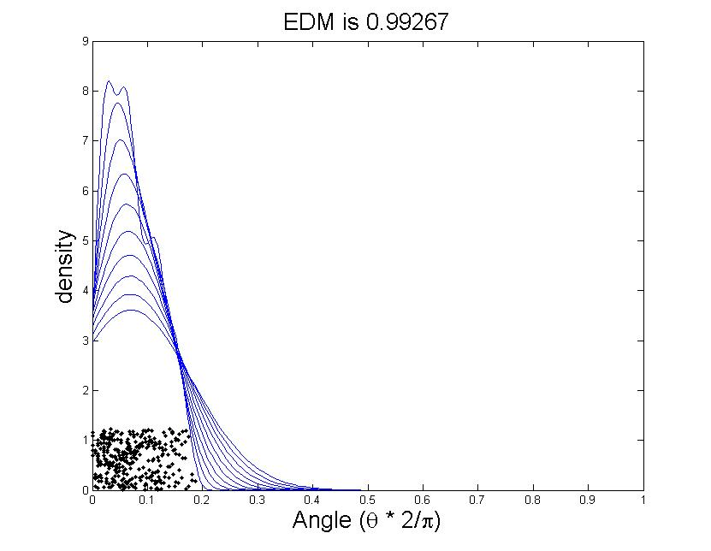
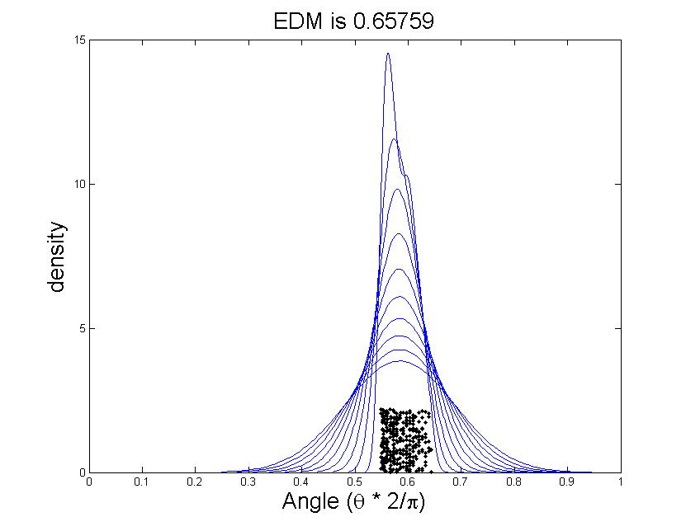
Extremal Dependence Analysis:
Spierpinki Gasket (k=8)
EDMs for bivariate vs. trivariate cases:
Significant decrease in trivariate EDM: close to 2/3, uniform distr.

Slide 29
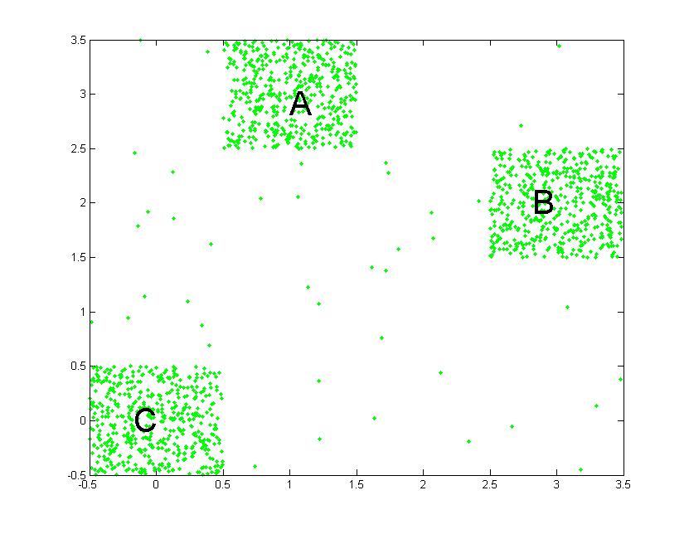
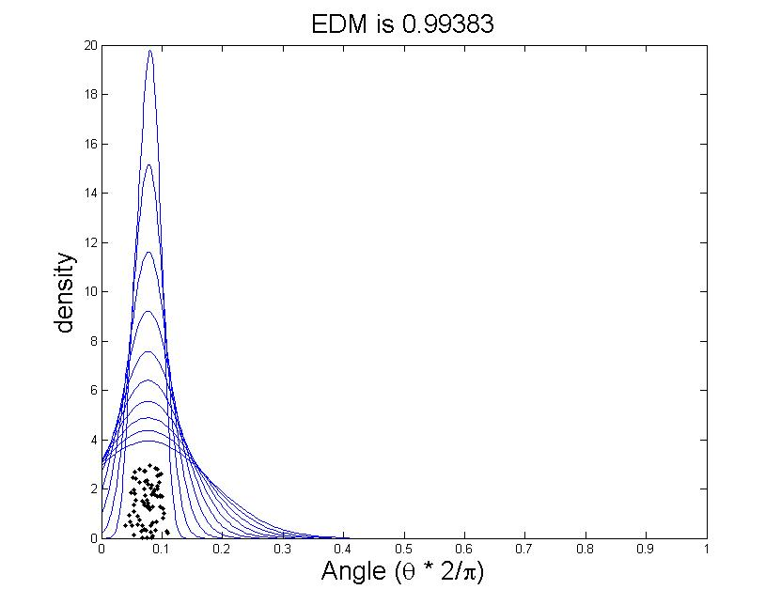
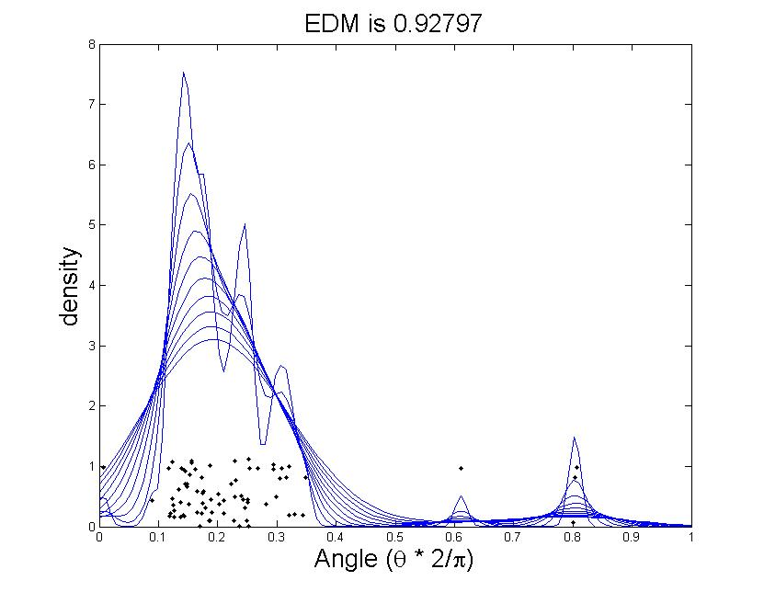
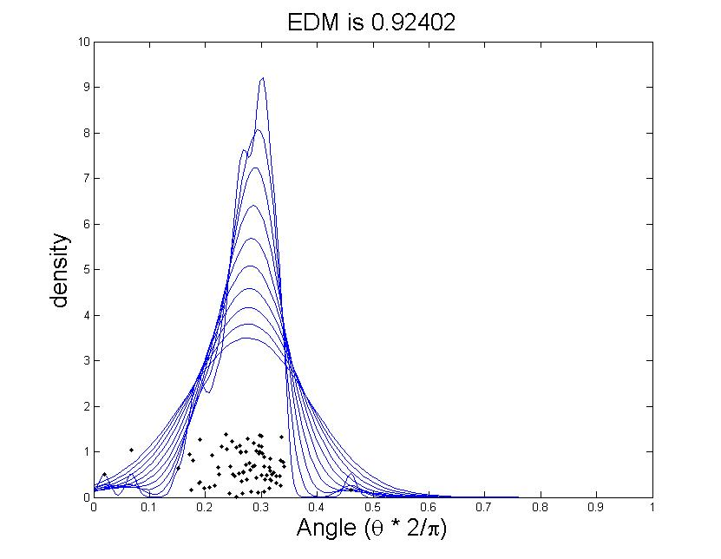
Another 3-Cluster Toy Example
EDMs for bivariate cases (not symmetric)

Slide 30
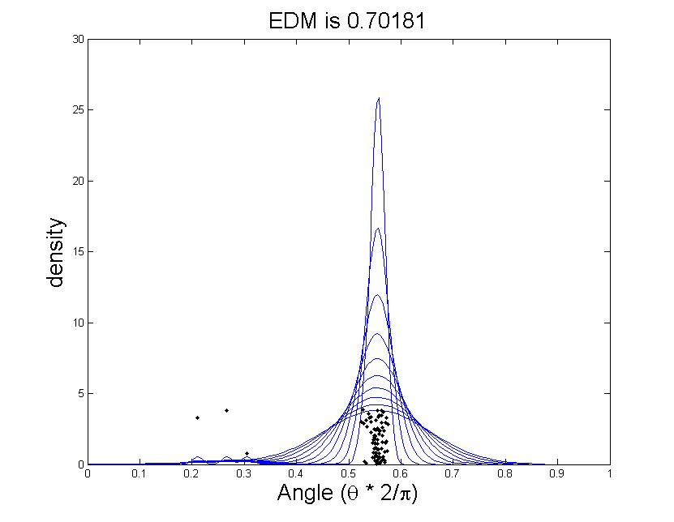
Another 3-Cluster Toy Example
EDMs for bivariate vs. trivariate cases:
Significant decrease in trivariate EDM: close to 2/3, uniform distr.

Slide 31
Directed (& Signed) Networks: An Example
Slashdot: technology-related news and blogging site
Slashdot social network: users can tag others as “friends” or “foes”
Slashdot datasets: Basic Statistics

Slide 32
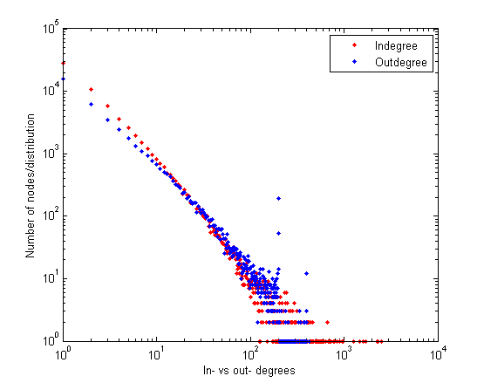
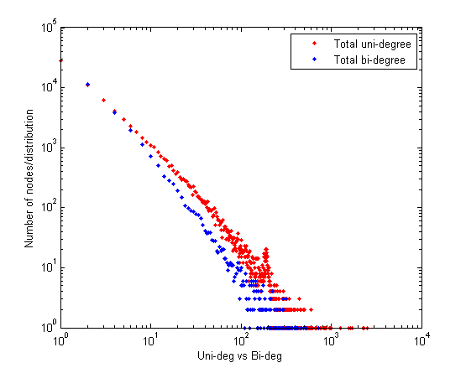
Slashdot: Univariate Degree Distributions
Slashdot social network:
uni- vs. bi-directional (edges) degree distributions
in-degree vs. out-degree
distributions
Notes:
32

Slide 33
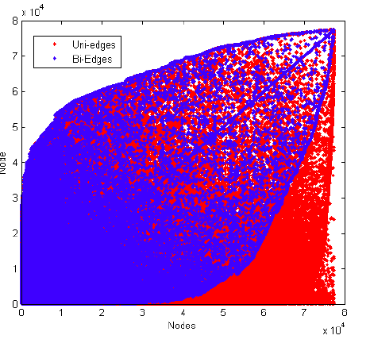

Slashdot: Bivariate Distributions (Copula Plots)
Slashdot social network:
Joint in-degree & out-degree copula plot
adjacency matrix

Slide 34


Bivariate Extremal Dependence Analysis:
Joint In- vs. Out-degree Distribution
(all edges in A) in Slashdot Network
Scatter Plot
ICRT Extremal Dependence Analysis

Slide 35

Bivariate Extremal Dependence Analysis:
Joint Node Degree Distr. of Bi-directed Edges (A_{b}) in Slashdot Network
Scatter Plot
ICRT Extremal Dependence Analysis

Slide 36


Bivariate Extremal Dependence Analysis:
Joint In- vs. Out-degree Distribution
(One-way edges in A_{u}) in Slashdot Network
Scatter Plot
ICRT Extremal Dependence Analysis

Slide 37
Discussions & Help Needed
Existence of Multivariate Regular Varying (MRV) Tails?
  More than existence of simply marginal heavy tails!
  E.g., conditions on copula & surviving copula
How to determine “extremal” values (the “tails”)?
  Issue with norm selection
    Ideally, we want each component of the “random” vectors to be simultaneously large? But min{X_{i}} is not a vector norm!
  Issue with selection of k → Sid: notoriously hard!
Difference between “MRV” tails vs. “outliers”
  “outliers”: tails with expo. decaying prob? Or “clusters” of size o(N^{c}) for any c>0
General definition of EDM (or extremogram) for d>2?
  How to interpret EDM or extremal value analysis in general?
  Decaying rate of EDM(k,d) as a function of k and d?
Theories for continuous cases: applications often discrete!

Slide 38
Thank You!
Questions?

Slide 39
Backup Slides

Slide 40



Zoom →
Scatter after ICRT
Scatters for the 3cluster case. Variables are distances from cluster A and B
Scatter without ICRT

Slide 41


Synthetic centered network (2 examples)
Example 1:
380 number of nodes, (19*20)/2+20*18=550 number of edges (unweighted,undirected)
380x379 number of data points (all pairs)
Threshold: top 380 data points (pairs of clique nodes)
Normalizing by max (no ICRT)
20-vertex clique
(ex. 1)
Each vertex in the clique is connected to 3 kinds of chains: 3-vertex chain, 5-vertex chain, 10-vertex chain

Slide 42


Example 2:
380 number of nodes, (19*20)/2+20*18=550 number of edges (unweighted,undirected)
380x379 number of data points (all pairs)
Threshold: top 380 data points (pairs of clique nodes)
Normalizing by max (no ICRT)
Each vertex in the clique is the center of a star of 19 vertices
20-vertex clique
(ex. 2)

Slide 43


L⁺ Matrix: L⁺_{ij} Heat Maps
Sierpinki Gasket (k=8)

Slide 44


Slashdot: Bivariate Distributions (Copula Plots)
Slashdot social network:
Joint uni-degree & bi-degree copula plot
Joint pos-degree & neg-degree copula plot

Slide 45

Bivariate Extremal Dependence Analysis:
Joint In- vs. Out-degree Distribution
(all edges in A) in Slashdot Network
Scatter Plot
(ICRT) Extremal Dependence Analysis

Slide 46
Bivariate Extremal Dependence Analysis:
Joint Node Degree Distr. of Bi-directed Edges (A_{b}) in Slashdot Network
Scatter Plot
ICRT Extremal Dependence Analysis

Slide 47

Bivariate Extremal Dependence Analysis:
Joint In- vs. Out-degree Distribution
(One-way edges in A_{u}) in Slashdot Network
Scatter Plot
(ICRT) Extremal Dependence Analysis

Slide 49
“Geometry” of Networks: An Overview
Uniqueness of approach: a “geometric” paradigm
  treat a network as a “geometric” structure/body instead of a “combinatorial” object
  basic idea: embed networks in a metric space (e.g., Euclidean space) and study its “geometric” properties
Initial study: characterize and quantify nodes and edges in the overall connectivity of a network
  node and edge topological centrality metrics
  better capture structural roles of nodes and edges (than existing metrics)
Applications/Implications:
  identify “influential” nodes/edge, extract core network structures, detecting community structures, …
Ongoing & Future Work:
  “geometric” analysis of networks & network structures
  roles of “multi-variate” correlations & multi-variate heavy tails in network structures
  extension to directed networks (and signed networks)

Slide 50

L⁺ and Random Walks (& Electric Networks)
Random Walks (Markov Chains) on Graphs
  if e = (i,j)  E, a random walker moves from node i to node j with probability p_{ij} = a_{ij} / d_{i}
  Hitting Time (from node i to node j): H_{ij}
    #steps until random walker (starting at node i) first visits node j
  Commute Time: where vol(G):= ∑ _{i} d_{i} = 2|E|
Forced Detour Cost in random walk from i → j via k :
k
Main Result:
Recurrence:
  voltage in electric resistive network (w/ resistance r_{ij}:=1/a_{ij}):
    voltage at node i when unit current injected at node i and grounded at node j
Recurrence in Forced Detour:
j
i

Slide 51
L⁺ Metrics and Bi-Partitions of Networks
(Connected) bi-partition represents a “reduced state” of network
“first point” of disconnectedness (after removing a minimal set of edges)
where does a node i or edge e lie after partition?
  the larger or smaller component of the partition?
Main Results:
are graph constants depending only on G.
S₁
S₂
Smaller L⁺_{ii} is, node i lies in the “larger” component
of many bi-partitions.
Larger is, edge e=(i,j) lies on more spanning trees!
(hence “isthmus” edges have higher !)

Slide 52
Not All Edges are “Created Equally”
Edge centrality metrics: roles of edges in overall network connectivity and network formation
Applications:
  better method to perform “k-core” decomposition
    generate a core “skeleton” network
  clustering or community detection

Slide 53
Topological Interpretation of L⁺ Metrics
In terms of (connected) bi-partitions of a graph or network
S₁
S₂

Slide 54


Edge Centrality in Toy Synthetic Networks
Re-Wiring I
Re-Wiring II

Slide 55

Edge Centrality in Toy Synthetic Networks
Original
Re-Wiring I

Slide 56

Wherein lies the Core
(b) net-science co-authorships
(a) Western states power grid

Slide 57
Geometry of Networks & Heavy Tails
L and L⁺ provide two dual geometric representations of a network
  L captures “local” properties while L⁺ “global” properties of network
= (where ) is a kernel matrix
power-law node degree distri. → distri. of node distances in L embedding
join node degree distri. → distri. of angles between node vectors
  degree or joint degree preserving re-wiring are distance-preserving (and angle-preserving) geometric transformations in L embedding space
  but they do not preserve distances or angles in the dual L⁺ embedding space
What about “higher-order” correlations?
  subspaces spanned by subsets of nodes may
  reveal more structural properties, e.g.,
  “separable” subspaces → “community” structures
  projections to lower dimensional spaces,
  e.g., space spanned by nodes w/ high degrees in L
  or spanned by nodes with low L⁺_{ii} in L⁺
  ……
i
j
w
v
k

Slide 58
Ongoing and Planned Future Work
Uniqueness and novelty of approach: a “geometric” paradigm
  treat a network as a “geometric” structure/body instead of a “combinatorial” object via geometric embedding of networks
Planned Research Activities:
“Geometric” analysis of networks & multi-variate heavy tails
  Characterize and understand roles of “multi-variate” correlations & multi-variate heavy tails in network structures
Extension to directed networks (and signed networks)
  Directed networks have unique properties (different from undirected ones)
  Asymmetry breaks down many existing theories, making analysis harder
Applications:
  Identify “influential” nodes/edge in social, human and other networks
  Extract core network structures, and implication in network robustness
  Detect community structures, and understand network formation
  Applications to network- & cyber-security:
    graph-based DNS traffic analysis for detecting botnets and identifying other malicious activities

