Slide 1
Research Update for MURI Project
Richard A. Davis
Columbia University
October 1, 2013
MURI-Cornell

Slide 2
Overview
Indegree/outdegree analysis for growth networks.
Current MURI collaborators: Sid, Bo Jiang, Don, Gena, Zhi-Li, and Columbia PhD student (TBD soon)
Further results on the extremogram, a measure of extremal dependence for stationary processes.
Comments on PCA for large heavy-tailed vectors

Slide 3
Indegree/outdegree
Indegree/outdegree analysis for growth networks
Krapivsky et al. 2001 model:
The model is recursively defined. If $V_{n}$ represents the nodes at time n, then
with prob p, a new node attaches to existing node v WP (indegree of v goes up by 1.)
with prob 1-p, a new edge $u→v$ is created between two existing nodes u and v with prob
$$\frac{in(v)+λ}{\sum_{v∈V_{n}}{(in(v)+λ) }}$$
$$\frac{(in(v)+λ)(out\left(u\right)+μ)}{\sum_{u≠v∈V_{n}}{\left(in\left(v\right)+λ\right)(out\left(u\right)+μ) }}$$

Slide 4
Indegree/outdegree
Results from Krapivsky:
Let
$$N_{i,j}=number of nodes with indegree i and outdegree j$$
$${ N}_{i,⋅}=number of nodes with ind i;$$
$N_{⋅,j}=number of nodes with out j;$
Defining the relative frequencies (assuming they exist) via,
$$f_{i,j}=\lim_{n→∞}\frac{N_{i,j}}{n}$$
Marginal distributions:
$f_{i,⋅}\sim {Ci}^{{−v}_{in}}$, $v_{in}=2+pλ$ and $f_{⋅,j }\sim {Cj}^{{−v}_{out}}$, $v_{out}=2+p(1+μ)/(1−p)$
Joint distributions:
If $v_{in}=v_{out},$then $f_{i,j}\sim C\frac{i^{λ−1}j^{μ}}{{\left(i+j\right)}^{2λ+1}}$

Slide 5
Indegree/outdegree
Similar results for reciprocity models (Bo and Don): At each step, new node v is added such that
with prob 1-p, it has an outgoing edge $v→u$ WP
with prob p, an edge $v→u$ is created and a reciprocal edge $u→v$ between two existing nodes u and v is created with prob
$$\frac{(in(u)+λ)}{\sum_{u∈V_{n}}{\left(in\left(u\right)+λ\right)}}$$
$$\frac{(in(u)+λ)}{\sum_{u∈V_{n}}{\left(in\left(u\right)+λ\right)}}$$

Slide 6
Estimation for network models—first steps
Krapivsky Model (work with Bo, Don, Sid + others?)
One-dimensional case (in-degree):
$${ N}_{i,⋅}=number of nodes with ind i$$
Defining the relative frequencies (assuming they exist) via,
$$f_{i,j}=\lim_{n→∞}\frac{N_{i,j}}{n}$$
Marginal distributions:
${ f}_{i,⋅}\sim Ci^{{−v}_{in}}$, $v_{in}=2+p+λ$ and $f_{⋅,j }\sim {Ci}^{{−v}_{out}}$, $v_{out}=?$
Now it is likely (need to prove using MG CLT?) that
$$\frac{N_{i}}{n} is AN\left(f_{i},\frac{σ_{i}^{2}}{n}\right),$$
for $n$ large (and $i$ large), where $σ_{i}^{2}\sim Kf_{i}\left(1−f_{i}\right)$.

Slide 7
Estimation for network models—first steps
Estimation strategies (for $c$ and $ν_{\left\{in\right\}}):$
Data: $X_{1}=\frac{N_{1}}{n}, X_{2}=\frac{N_{2}}{n}, …, X_{n}=\frac{N_{n}}{n}$
For $i$ large (greater than some threshold $m$):
1) nonlinear least squares: $\underset{c,ν}{arg min}{\sum_{i≥m}{{\left(X_{i}−ci^{−ν}\right)}^{2}}}$
2) weighted nonlinear least squares:
$\underset{c,ν}{arg min}{\sum_{i≥m}{\frac{{\left(X_{i}−ci^{−ν} \right)}^{2}}{{ci}^{−ν}(1−ci^{−ν})}}}$.

Slide 8
Estimation for network models—first steps
Estimation strategies (for $c$ and $ν_{\left\{in\right\}}):$
Data: $X_{1}=\frac{N_{1}}{n}, X_{2}=\frac{N_{2}}{n}, …, X_{n}=\frac{N_{n}}{n}$
3) Log-transform: $\log{X_{i} is AN(\log{f_{i}, (1−f_{i})/(f_{i}n))} }$
4) Arcsin$\sqrt{x}$transform---stabilizes the variance (promising but has not worked well for estimation). $\arcsin{\sqrt{X_{i}}) is AN(arcsin\sqrt{f_{i}}{ ,\frac{C}{n})} }$
$\underset{c,ν}{arg min}{\sum_{i≥m}{\frac{{\left(log X_{i}−\log{c+ν\log{i}}\right)}^{2}}{{c^{−1}i}^{+ν}(1−ci^{−ν})}}}$.

Slide 9
Estimation for network models—first steps
Simulation setup:
Choose $c$ and $ν$
Simulate network (n=1,000,000)
Estimate parameters $c$ and $ν$ using one of the above methods. Sum was truncated at M chosen such that $N_{i}>0$for all $i<M, i.e.,$
Compute residuals $R_{i}=\frac{X_{i}−\hat{f_{i}}}{{\left(\hat{f_{i}}\left(1−\hat{f_{i}}\right)\right)}^{1/2}}$ Also compute with true $f_{i}$ and for the transformed data.
$arg\min_{c,ν}{\sum_{i=30}^{M}{\frac{{\left(log X_{i}−\log{c+ν\log{i}}\right)}^{2}}{{c^{−1}i}^{+ν}(1−ci^{−ν})}}}$.

Slide 10
Weighted-NLS

Slide 11
Log-transform
arcsine-transform

Slide 13
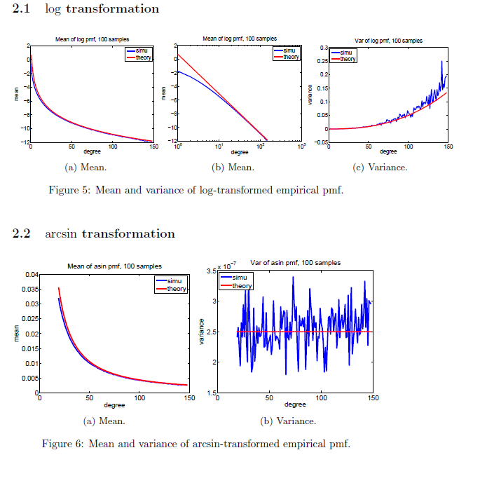

Slide 14
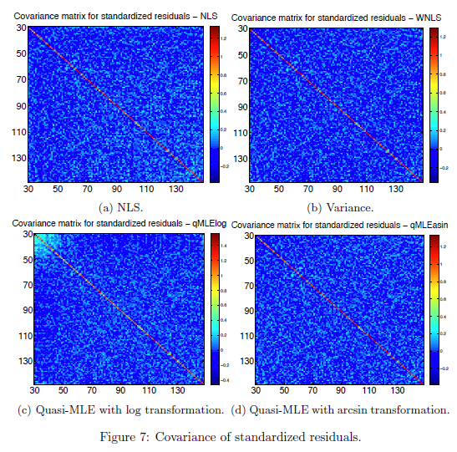

Slide 15
Estimation for network models—first steps
Two-dimensional case (in-degree, out-degree):
Estimation procedure the same as on dimensional case, but data are now
$$X_{i,j}=\frac{N_{i,j}}{n}→f\left(i,j\right)=\left(C\frac{i^{λ−1}j^{μ}}{{\left(i+j\right)}^{2λ+1}} in Krapivsky^{′}s model\right)$$
In some cases, we can choose $a_{n}$ and $b_{n}$ such that
$$na_{n}b_{n}f\left(ua_{n},vb_{n}\right)→c\left(u,v\right).$$
In Krapivsky’s example, assuming $v_{in}=v_{out},$we have with $a_{n}=b_{n}=n^{1/(1+pλ)}$, and since $μ−λ=−\left(1+pλ\right),$ ${ na}_{n}^{2}f\left(a_{n}u,a_{n}v\right)\sim C\frac{na_{n}^{2}a_{n}^{λ−1}a_{n}^{μ}u^{λ−1}v^{μ}}{a_{n}^{2λ+1}{\left(u+v\right)}^{\left(2λ+1\right)}}=C\frac{na_{n}^{μ−λ}u^{λ−1}v^{μ}}{{\left(u+v\right)}^{\left(2λ+1\right)}}$
$$=C\frac{u^{λ−1}v^{μ}}{{\left(u+v\right)}^{\left(2λ+1\right)}}=:c\left(u,v\right).$$

Slide 16
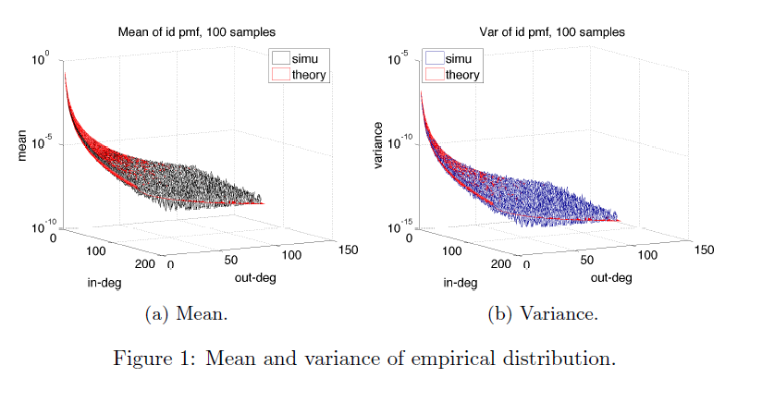

Slide 17
Log-transform

Slide 18
Future work
Attachment models:
Develop the theory to establish the convergences (double limit or single sequence limit).
Establish CLTs associated with the empirical and point process convergences.
Develop procedures for checking goodness of fit
How to deal with various types of censoring; i.e., at both end for large and small $i$or for a mixture of 2 levels as in the Slashdot data?
Apply to Slashdot data
Use ideas from extremogram to estimate the parameters
Use nonparametric procedures for more general dependence structures (estimating c(u,v)?)--many hurdles in this approach.
.

Slide 19
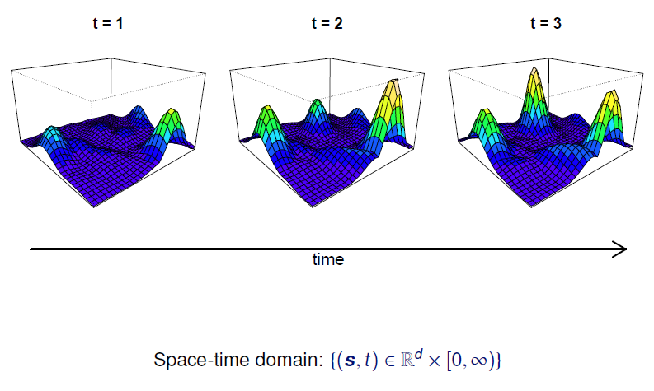
Extremogram in Space and Time
Notes:
The data in Figure 1 are the maximum flow rate (cubic feet per
second) for each week taken from a time series of flow rates recorded at 15 minute intervals for a
river in western Colorado.
(ˆμ, ˆ, ˆ) =
(0.21, 0.91, 0.072)

Slide 20
Estimating the spatial extremogram
Setup: Let $X\left(s\right)$ be a RV stationary (isotropic?) spatial process defined on $s∈ℝ^{2}$ (or on a regular lattice $s∈ℤ^{2}$). Consider the former—latter is more straightforward.
$$ρ_{A,B}\left(h\right)=\lim{x}→∞P\left(X\left(s+h\right) ε xB \right| X\left(s\right) ε xA), h∈ℝ^{2}$$
regular grid
random pattern

Slide 21
Random pattern
random pattern
h = 1; # of pairs = 0
h = 1 $±$.25

Slide 22
Random pattern
Zoom-in
buffer
Estimate of extremogram at lag h = 1 for red point: weight “indicators of points” in the buffer.
Bandwidth: half the width of the buffer.

Slide 23
Random pattern
random pattern
Note:
Expanding domain asymptotics: domain is getting bigger.
Not infill asymptotics: insert more points in fixed domain.

Slide 24
Estimating extremogram--random pattern
Setup: Suppose we have observations, $X\left(s_{1}\right),…, X\left(s_{N}\right)$at locations $s_{1},…,s_{N_{n}}$ of some Poisson process $N$with rate $ν$ in a domain $S_{n}↑ℝ^{2}$.
Here, $N_{n}=N\left(S_{n}\right)=$number of Poisson points in $S_{n},$ $N_{n}\sim Pois\left(ν\left|S_{n}\right|\right).$
Weight function $w_{n}(x)$: Let $w\left(⋅\right)$be a bounded pdf and set
$$w_{n}\left(x\right)=\frac{1}{λ_{n}^{2}}w\left(\frac{x}{λ_{n}}\right),$$
where the bandwidth $λ_{n}→0 and { λ}_{n}^{2}\left|S_{n}\right|→∞.$

Slide 25
Estimating extremogram--random pattern
$$ρ_{A,B}\left(h\right)=\lim{x}→∞P(X\left(s+h\right) ε xB,X\left(s\right) ε xA)/PX\left(s\right) ε xA), h∈ℝ^{2}$$
Kernel estimate of $ρ$:
$${\hat{ρ}}_{A,B}\left(h\right)=\frac{\frac{m_{n}}{ν^{2}|S_{n}|}\sum_{i≠j=1}^{N_{n}}{w_{n}\left(h−s_{i}+s_{j}\right)I\left(X\left(s_{i}\right)∈a_{m}B\right)I(X\left(s_{j}\right)∈a_{m}A)}}{\frac{m_{n}}{ν|S_{n}|}\sum_{j=1}^{N_{n}}{I\left(X\left(s_{j}\right)∈a_{m}A\right)}}$$
Asymptotic “unbiasedness”: ${\hat{ρ}}_{A,B}\left(h\right)$is a ratio of two terms;
$${\hat{ρ}}_{A,B}\left(h\right)=\frac{{\hat{τ}}_{A,B, m}(h)}{{\hat{τ}}_{A, m}}$$
both are asymptotically unbiased. Note: need local uniform negligibility condition (LUNC)

Slide 26
Limit Theory
Theorem: Under suitable conditions on $\left(X\left(s\right)\right),$ (i.e., regularly varying, mixing, local uniform negligibility, etc.), then
where $ρ_{A,B,m}\left(h\right)$ is the pre-asymptotic extremogram,
$${\left(\frac{\left|S_{n}\right|λ_{n}^{2}}{m_{n}}\right)}^{\frac{1}{2}}\left({\hat{ρ}}_{A,B}\left(h\right)−ρ_{A,B,m}\left(h\right)\right)→N\left(0,Σ\right),$$
$$ρ_{A,B,m}\left(h\right)=P(X\left(s+h\right) ε a_{m}B,X\left(s\right) ε a_{m}A)/PX\left(s\right) ε a_{m}A), h∈ℝ^{2},$$
($a_{m}$ is the $1−1/m$ quantile of $\left|X\left(s\right)\right|$).
Remark: The formulation of this estimate and its proof follow the ideas of Karr (1986) and Li, Genton, and Sherman (2008).

Slide 27
Simulation Example with B-R Process
Extremogram for one realization of B-R process
(function of level)
Note: black dots = true; blue bands are permutation bounds
Lattice
Non-Lattice

Slide 28
Estimation—semi-parametric approach
Space-time extremogram: For sets $A$ and $B$ bounded away from 0,
$$ρ_{A,B}(h,u) =lim⁡xP(Y(s+h,t+u) ε xB | Y(s,t) ε xA)$$
For the special case, $A=B=(1,∞)$,
$$χ\left(h,u\right)=\lim{x}→∞P\left(Y\left(s+h,t+u\right)>x \right| Y\left(s,t\right)>x)$$
For a standard Brown-Resnick process $χ\left(h,u\right)$ $=2(1−Φ\left(\sqrt{θ_{1}h^{α_{1}}+θ_{2}u^{α_{2}}}\right)),$ we find that
$2\log{(Φ^{−1}(1−\frac{1}{2}}χ\left(h,0\right)$) $=\log{θ_{1}+α_{1}\log{h}}$and
$2\log{(Φ^{−1}(1−\frac{1}{2}}χ\left(0,u\right)$) $=\log{θ_{2}+α_{2}\log{u}}$

Slide 29
Estimation—semi-parametric approach
Semi-parametric: Use nonparametric estimates of the extremogram and then regress function of extremogram on the lag.
Regress:$2\log{(Φ^{−1}(1−\frac{1}{2}}\hat{χ}\left(h,0\right)))$ $on 1{ and \log{h}}$
$2log{(Φ^{−1}(1−\frac{1}{2}}\hat{χ}\left(0,u\right)))$ $on 1{ and \log{u}}$,
The intercepts and slopes become the respective estimates of $\log{θ_{i}}$ and $α_{i}.$ Asymptotic properties of spatial extremogram derived by Cho et al. (2013).
Note: Use weighted least squares.
Notes:
The data in Figure 1 are the maximum flow rate (cubic feet per
second) for each week taken from a time series of flow rates recorded at 15 minute intervals for a
river in western Colorado.
(ˆμ, ˆ, ˆ) =
(0.21, 0.91, 0.072)

Slide 30
PCA for large heavy-tailed vectors
Does PCA work for heavy-tailed random vectors?
PCA is a tried and true method for data reduction in large dimensional problems. Usually, one assumes light-tailed data (having at least finite fourth moments).
Large dimensional data sets appear in many quantitative fields like finance, environmental sciences, wireless communications, fMRI, and genetics.
Structure in this data can often be analyzed via sample covariances. PCA is used to transform data to a new set of variables, the principal components, ordered such that the first few retain most of the variation of the data.
Goal: First study largest eigenvalues from the sample covariance matrix and then try to say something about the eigenvectors.

Slide 31
PCA for covariance matrices large heavy-tailed vectors
Setup (simplified version for this talk):
Let $\left\{Z_{i,t}\right\}$ be a doubly indexed array of $iid$ rvs Pareto tails and index $α∈\left(0,2\right)$ and let $\left\{X_{i,t}\right\}$ be a p-variate time series with components
$$X_{i,t}=\sum_{k=0}^{∞}{\sum_{l=0}^{∞}{h_{k,l}Z_{i−k,t−l}}}$$
Let $λ_{1}≥λ_{2}≥⋯≥λ_{p}$ be the ordered eigenvalues of $\hat{Γ}=\frac{1}{n}\sum_{t=1}^{n}{X_{t}X_{t}^{T}}$

Slide 32
PCA for covariance matrices large heavy-tailed vectors
Classical results: Assume the vector consists of IID N(0,1) rvs.
For $n→∞$ and p fixed, Anderson (1963) proved that
$${\left(\frac{n}{2}\right)}^{1/2}{(\hat{λ}}_{\left(1\right)}/n−1)\underset{→}{d}N(0,1),$$
where ${\hat{λ}}_{\left(1\right)}$ is the largest eigenvalue of the empirical covariance matrix$n\hat{Γ.}$
Johnstone [2001] showed that for $p,n→∞,\frac{p}{n}→γ∈\left(0,2\right),$ then $\frac{\sqrt{n}+\sqrt{p}}{\sqrt[3]{\frac{1}{\sqrt{n}}+\frac{1}{\sqrt{p}}}}\left({\frac{{(\hat{λ}}_{\left(1\right)}}{{\left(\sqrt{n}+\sqrt{p}\right)}^{2}}}_{}−1\right)\underset{→}{d}$Tracy-Widom distribution.

Slide 33
Theorem: For certain sequences $p_{n}→∞$, there exists eigenvalues of an infinite dimensional matrix $v_{1}≥v_{2}≥⋯,$ then
${\left(np\right)}^{−\frac{2}{α}}{\hat{λ}}_{(1)}\underset{→}{d}{v_{1}Γ}_{1}^{−\frac{α}{2}},$
${\left(np\right)}^{−\frac{2}{α}}{\hat{(λ}}_{\left(2\right)}\underset{→}{d}{{max\{v}_{2}Γ}_{1}^{−\frac{α}{2}}, v_{1}Γ_{2}^{−\frac{α}{2}} \}$
where $Γ_{i}=E_{1}+⋯+E_{i},$ $E_{1},E_{2},…,$ are iid unit exponentials.
In particular,
$$\frac{λ_{1}}{λ_{1}+⋯+λ_{p}}\underset{→}{d}\left(\frac{v_{1}}{v_{1}+v_{2}+⋯}\right)\frac{Γ_{1}^{−\frac{α}{2}}}{Γ_{1}^{−\frac{α}{2}}+Γ_{2}^{−\frac{α}{2}}+⋯+}$$
The LHS is the proportion of the sample variance explained by the
variance of the largest principal component.

Slide 34
Future work
PCA related topics:
Extend to a nonlinear dependence structure within the components--can even assume independence. We have done this for independent rows for nonlinear models, but not the other way around.
How do the principle eigenvectors behave?
How to apply these results in practice?
The case $α∈\left(2,4\right)$still offers us some challenges and major hurdles which we have not yet.

Slide 35
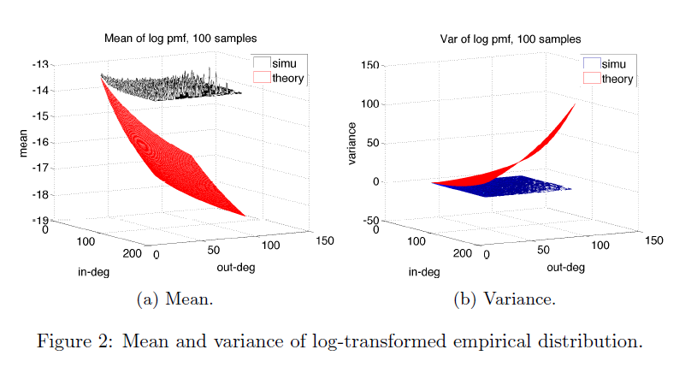

Slide 36
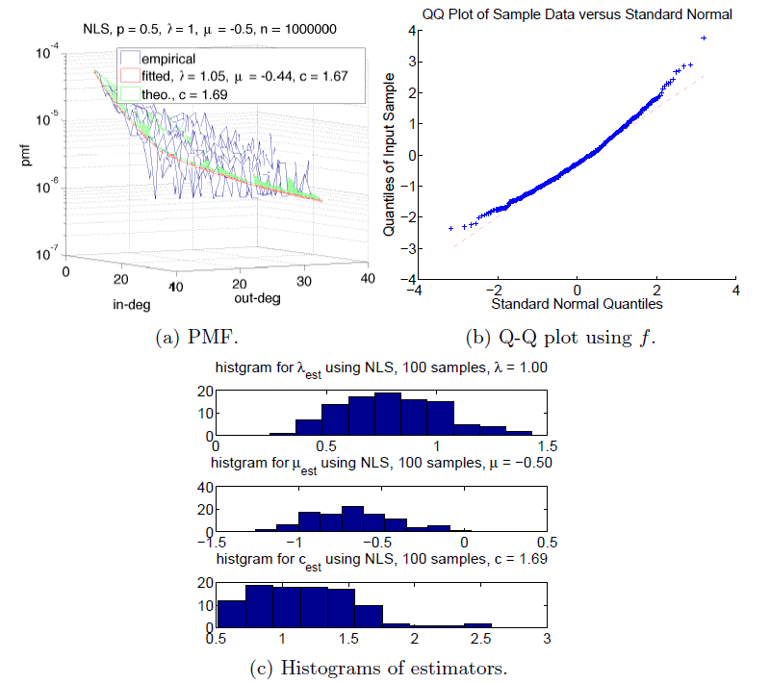

Slide 37
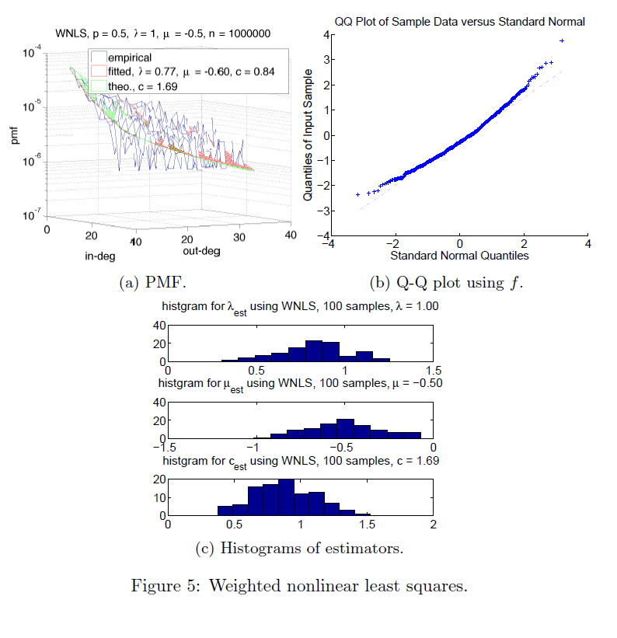

Slide 39
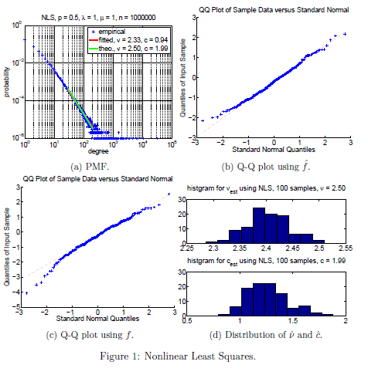

Slide 40
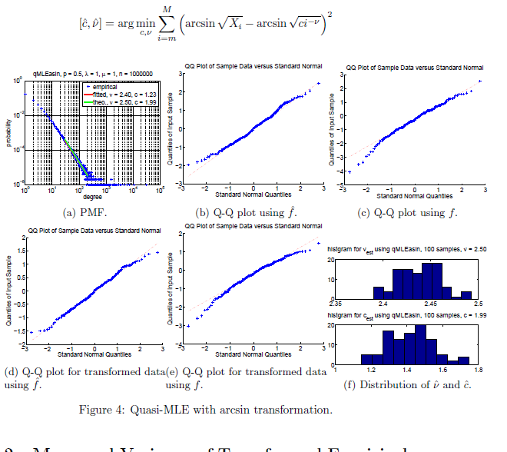

Slide 41
NLS

Slide 42
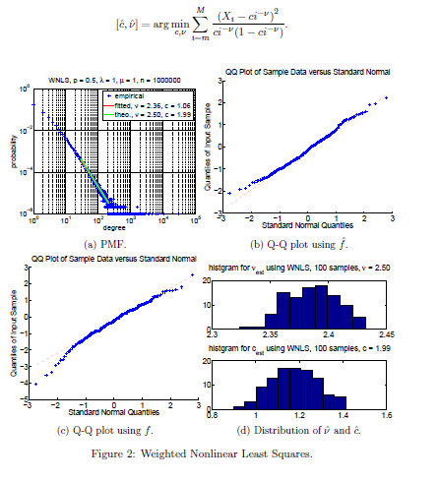

Slide 43
Log-transform
Arcsine-transform

