Slide 1
Complex Graph Similarity Testing and Multivariate Distribution Comparison Using Random Walks
Shan Lu, Jieqi Kang, Weibo Gong, Don Towsley
UMASS Amherst

Slide 2
Outline of the approach
Small-time asymptotic results for diffusion on manifold
Analogues on graphs
Analyzing graphs with 1d distributions
Analyzing graphs with 2d distributions
Future work and collaborations

Slide 3
Consider diffusion on Riemannian manifold :
with initial condition
and boundary conditions
Using the spectral resolution ,
The Dirichlet heat kernel for is
and the heat content
Note is the Fourier coefficient of the
initial condition in the eigen space spanned by !

Slide 4
random walk on graph

Slide 5
Notations
Laplacian matrix:
Normalized Laplacian:
Random walk Laplacian:
Let be the eigenvalues of and
the corresponding eigenvectors. With
and ,
where .

Slide 6
Notations
Partition vertex set into two subsets, the set of all interior nodes and the set of all boundary nodes .
Label the interior vertices and the boundary vertices
. The normalized can be partitioned into:
Let the boundary vertices be absorbing in the heat equation in next page. Use for for convenience henceforth.

Slide 7
Heat Equation and Heat Content
Heat Equation is associated with the normalized graph Laplacian
with a given initial condition.
Heat Content:

Slide 8
Heat Equation and Heat Content
Time derivatives of the heat content:
When ,

Slide 9
Lazy Random Walk Approximation
Transition matrix .
2. Lazy random walk .
3. For any given time , take the limit with ( ),

Slide 10
Graph Similarity Testing
Undirected Graphs
Barabási–Albert model vs. Erdős–Rényi model
Directed Graphs
Krapivsky’s model (2001)
Multivariate power law degree distribution
Krapivsky’s model vs. Erdős–Rényi model

Slide 11
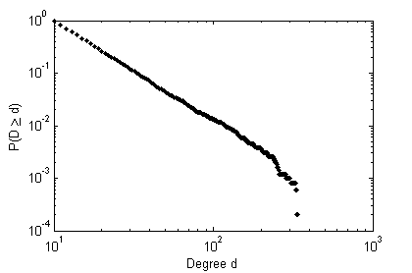
Barabási–Albert vs. Erdős–Rényi Model
Barabási–Albert model: starts with nodes; each new node is connected to existing nodes with a probability proportional to the degree of the existing nodes.
Degree distribution follows .
Erdős–Rényi model : , each edge is included in the graph with probability independent from other edges.

Slide 12
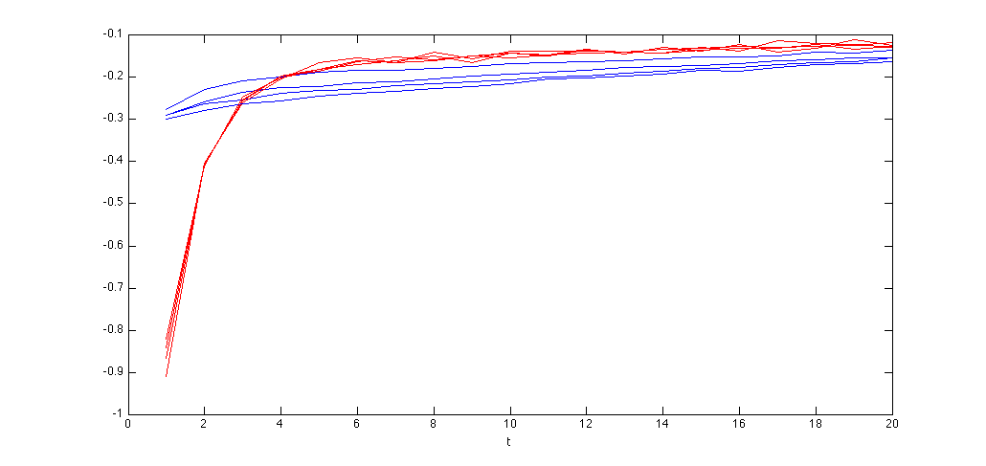
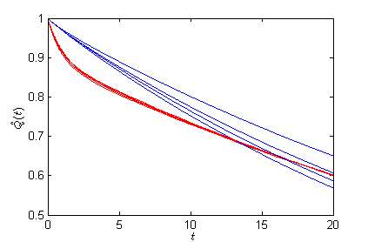
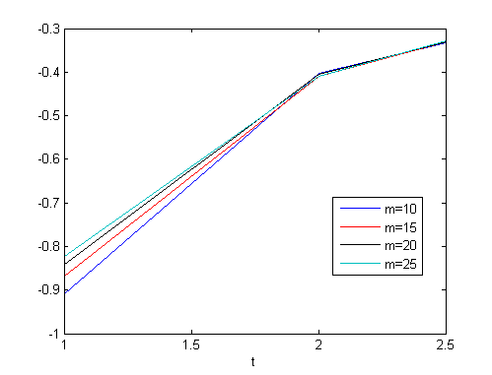
Barabási–Albert vs. Erdős–Rényi Model
Two groups of graphs: power law graphs generated by B-A model and random graphs generated by E-R model. Average degree varies from 20 to 50. Heat content in each group are plotted in the same color.
Boundary selection: nodes with the smallest degrees.
The time derivatives of the heat contents for the two groups of graphs
Power Law graphs generated by B-A model
The initial time derivative of the heat contents for power law graphs with different mean degrees
Random graphs generated by E-R model

Slide 13
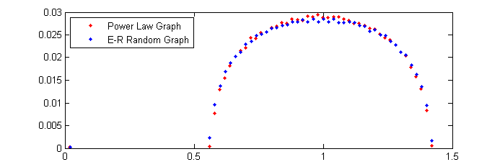
Barabási–Albert vs. Erdős–Rényi Model
The eigenvalues of the normalized Laplacian satisfy the semicircle law under the condition that the minimum expected degree is relatively large. (Chung et. al. 2003)
Laplacian Spectrum of two graphs with mean degree 20
Laplacian eigenvalues

Slide 14
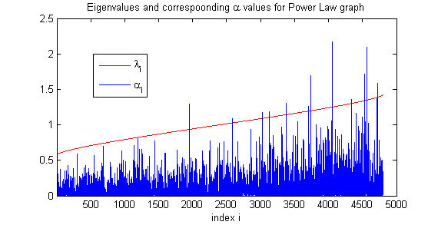
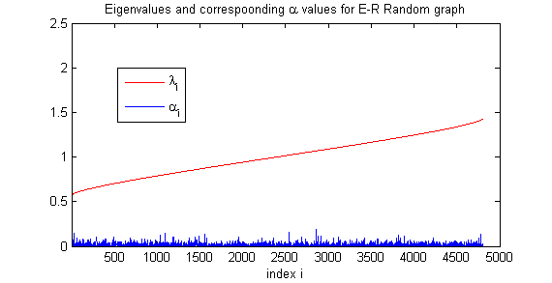
Barabási–Albert vs. Erdős–Rényi Model
Power Law graph generated by B-A model
Random graph generated by E-R model

Slide 15
Krapivsky vs. Erdős–Rényi Model
Krapivsky’s Model (‘Degree distributions of growing networks’ , 2001)
With probability , a new node is introduced and attached to a target node with probability proportional to .
With probability , a new link from node to node is created with probability proportional to .
Degree distribution
Average in-degree and out-degree:

Slide 16
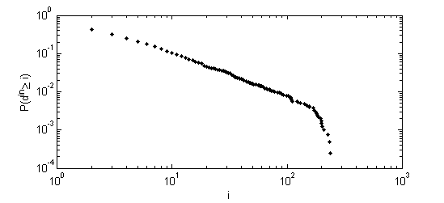
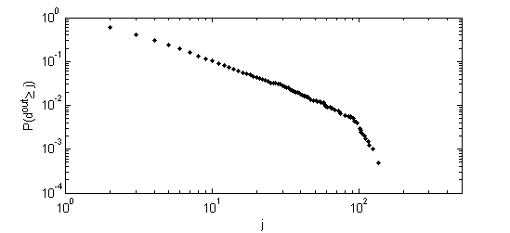
Krapivsky vs. Erdős–Rényi Model
Generated a 2000 nodes’ directed graph using Krapivsky’s model with and . CCDF of the in-degrees and out-degrees of the generated graph:

Slide 17
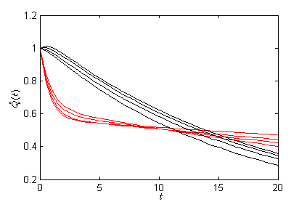
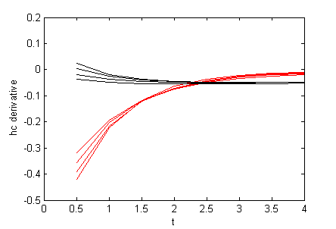
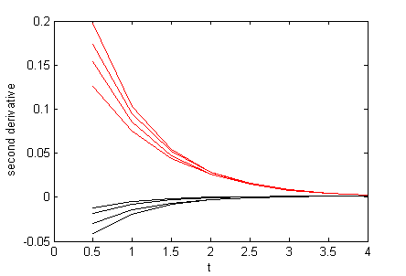
Krapivsky vs. Erdős–Rényi Model
Generated four 2000 nodes’ directed graphs using Krapivsky’s model with p=0.1 , 0.15, 0.2 and 0.25 , respectively. Also generated four directed graphs using E-R model with the same average degrees. Heat contents in each group are plotted in the same color.
Directed graphs with bivariate power Law degree distributions
Directed E-R random graphs

Slide 18
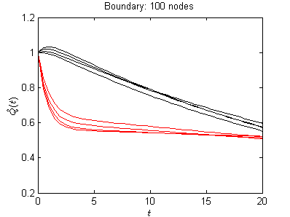
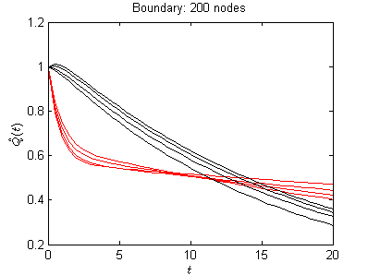
Krapivsky vs. Erdős–Rényi Model
Boundary selection : nodes with smallest values of
The number of boundary vertices impacts the heat contents of directed E-R random graphs more.
Notes:
The vertices with zero in-degrees are avoided to be selected as boundaries.
This result reflects the different structures of the two types of graphs.
For power law graphs, there is a large proportion of vertices with small in-degrees and out-degrees. Most of the selected boundary vertices have very small degrees and contribute little to the main graph structure despite their number increases.
But for the E-R random graphs, the chance for a random walker reaching the boundary would increase with more boundary vertices.

Slide 19
Multivariate Distribution Comparison
Multivariate Normal Distributions
Compare bivariate normal distributions with different covariance matrices
Multivariate Power Law Distributions
Krapivsky’s model, 2002
Correlated bivariate power law degree distributions
Correlated distributions vs. independent distributions

Slide 20
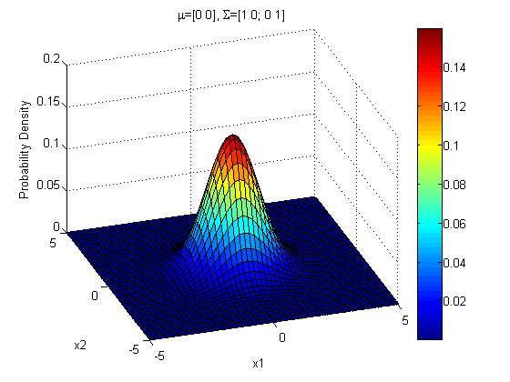
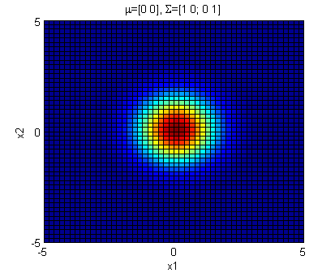
Multivariate Normal Distribution
Probability density function of the 2-dimensional bivariate normal distribution

Slide 21
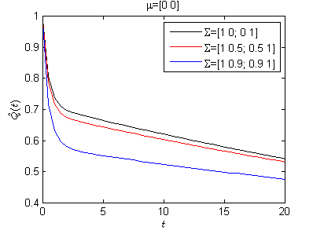
Multivariate Normal Distribution
vs. ( ) |  |  | Symmetrised divergence
vs. | 0.1438 | 0.1895 | 0.3333
vs. | 0.4199 | 1.2082 | 1.6281
vs. | 0.8304 | 3.4328 | 4.2632

Slide 22
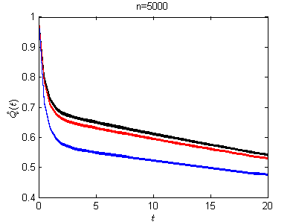
Multivariate Normal Distribution
20 samples for each distribution with 5000 random numbers in each sample.
Histogram is used for density estimation.
Heat contents for samples of the same distribution are plotted in the same color.

Slide 23
Multivariate distribution with power law marginal
Krapivsky’s Model (‘A statistical physics perspective on web growth’, 2002) :
A new node is introduced as isolated for webnet reality.
Degree distribution
Marginal distribution
Joint Distribution (when )
In-degree and out-degree of a node are correlated

Slide 24
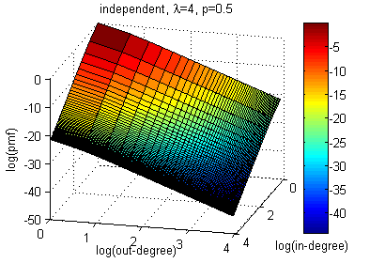
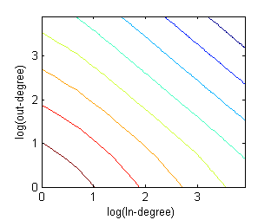
Independent bivariate power law distribution with the same marginal distributions as in Krapivsky’s model ( in the figures below)
Multivariate distribution with power law marginal
level curves

Slide 25
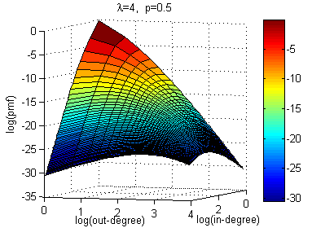
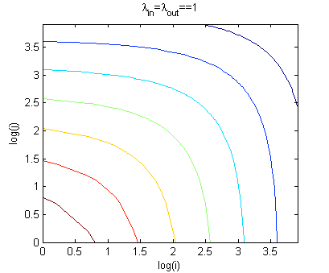
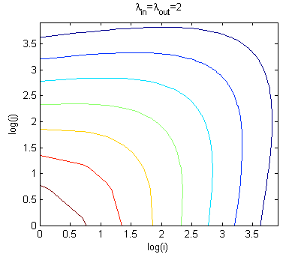
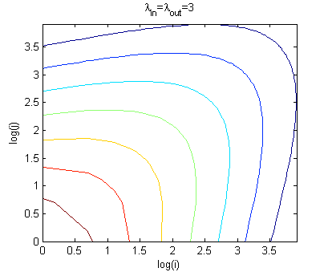
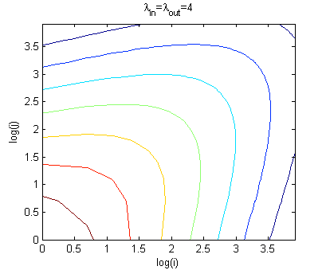
The joint degree distribution generated by Krapivsky’s model ( in the figure on right)
Multivariate distribution with power law marginal
The level curves for Krapivsky’s distribution with different values

Slide 26
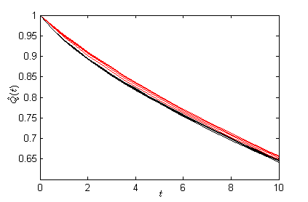
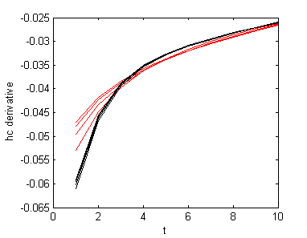
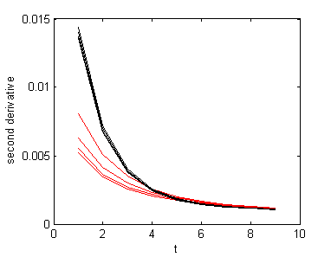
Multivariate distribution with power law marginal
Heat contents and time derivatives of the two groups of distributions: distributions generated by Krapivsky’s model with different values and the corresponding independent ones.
Distributions generated by Krapivsky’s model
Independent bivariate power law distributions

Slide 27
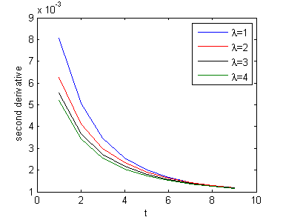
Multivariate distribution with power law marginal
Heat content derivatives of the distributions generated by Krapivsky’s model with different values.

Slide 28
Ongoing Work
Graph Similarity Testing
Consider other graph generative models
Consider real world network datasets
Multivariate Distribution Comparison
Use kernel density estimation instead of simple histogram for multi-dimensional data matching problems
Compare the degree distributions of generated graphs
Collaborations
UMASS-Cornell
UMASS-UMN

Slide 29
Thanks!

