Slide 1
Multivariate Heavy Tailed Distribution Generator Using Poisson Processes
UMASS Team and Cornell Team
Presenter: Shan Lu
10/7/2014

Slide 2
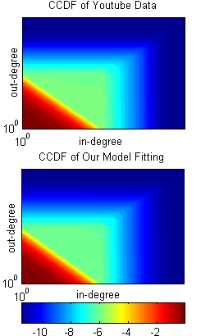
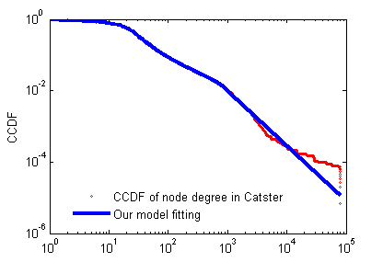
Outline
Stochastic Differential Equation Models for Power Law Behavior
SDE Model and Network Generative Models
Real Data Fitting

Slide 3
Outline
Stochastic Differential Equation Models for Power Law Behavior
SDE Model and Network Generative Models
Real Data Fitting

Slide 4
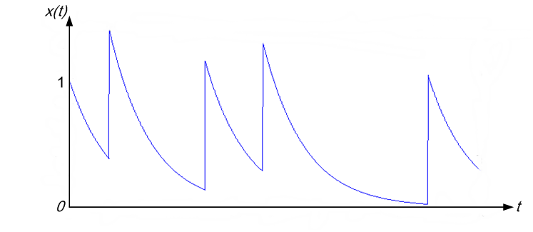
Stochastic Differential Equation Models for Power Law Behavior
Grows exponentially and killed at an exponentially distributed time [Reed and Hughes, 2002]
SDE model with Poisson resetting process
Lower tail power law [Brockett, 2007]

Slide 5
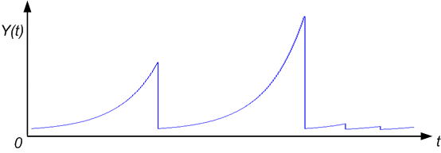
Upper tail power law generator
Convert it to upper tail power law
drops to

Slide 6
Upper tail power law generator
A simpler model: restore to a fixed value
Fokker Planck equation:
Steady state distribution:

Slide 7
Upper tail power law generator
What if is non-constant?
and

Slide 8
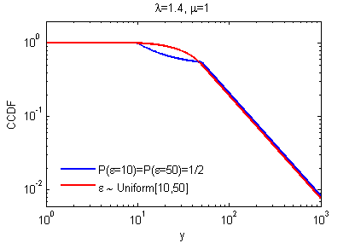
Upper tail power law generator
Smoother transition (example)

Slide 9
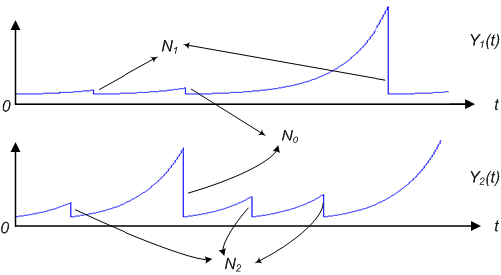
2D model with sharing Poisson counter
Sharing Poisson Counter

Slide 10
2D model with sharing Poisson counter
Correlated bivariate power law distribution
CCDF:
Asymptotically independent:

Slide 11
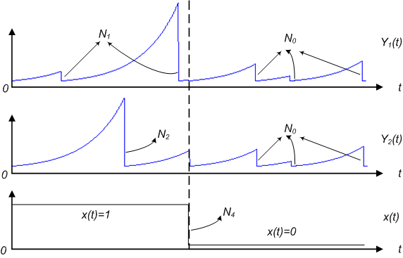
2D model with sharing Poisson Counter and Markov on-off Modulation
Modulated model

Slide 12
2D model with sharing Poisson Counter and Markov on-off Modulation
Modulated model
With :

Slide 13
2D model with sharing Poisson Counter and Markov on-off Modulation
Modulated model
Go to 1 or 0 when a parameter is perturbed?
Notes:
But we will show that the conditional probability goes to 1 or 0 continuously as a function of value y. When there is a small offset for the value of \lambda, the corresponding offset for the conditional probability is growing as a function of y with a bound min{p_on, p_off}y^delta

Slide 14
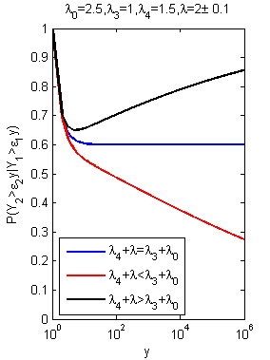
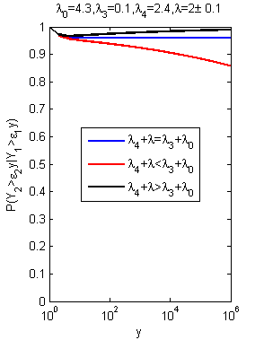
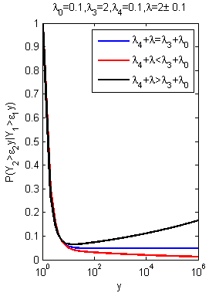
2D model with sharing Poisson Counter and Markov on-off Modulation
Notes:
Here we plot the conditional probability as a function of y given a small offset for lambda under three different p_off values. The conditional probabilities go to 1 or 0 gradually and slowly, especially for the case when p_on or p_off is quite small. Therefore our model could be used to fit the real data where infinity values do not happen and suggests future conditional probability when the network gets even bigger;

Slide 15
Outline
Stochastic Differential Equation Models for Power Law Behavior
SDE Model and Network Generative Models
Real Data Fitting

Slide 16
SDE Models for Expected Degree Growth in Generative Models
Preferential attachment
Growing network
Expected number of nodes added at each step
Expected degree (or in-degree, out-degree) added at each step
Add to the new nodes
Add to the nodes in original network with preferential attachment

Slide 17
SDE Models for Expected Degree Growth in Generative Models
Number of nodes grows exponentially
Exponentially distributed life time:
Total degree in network
Preferential attachment
A node with degree :
Exponential growth :

Slide 18
SDE Models for Expected Degree Growth in Generative Models
Undirected generative models
With probability add a new node to the graph and the new node is connected with existing nodes in the graph;
With probability append to the graph undirected edges between two existing nodes.
Distribution:
Barabási–Albert model :

Slide 19
SDE Models for Expected Degree Growth in Generative Models
Directed model by Bollobás et al. (2003)
With probability append to the graph with a new node and an edge leading from to an existing node ;
With probability append to the graph with a new node and an edge leading from existing node to the new node ;
With probability append to the graph a directed edge between two existing nodes and .

Slide 20
Outline
Stochastic Differential Equation Models for Power Law Behavior
SDE Model and Network Generative Models
Real Data Fitting

Slide 21
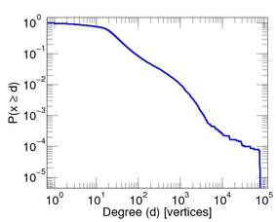
1D data fitting
Dataset
Catster friendship, 149,700 vertices, 5,449,275 edges
KONECT: http://konect.uni-koblenz.de/networks/

Slide 22
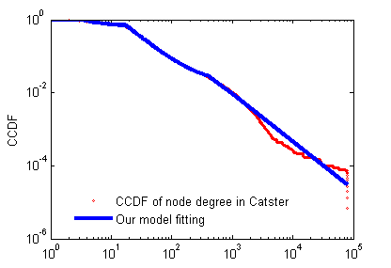
1D data fitting
Our model fitting
Discrete probability distribution
Uniform distribution
mse: 3.2120e-007
mse: 1.2897e-007
(mse: mean squared error)

Slide 23
1D data fitting
Fitting parameters
Discrete probability distribution
Uniform distribution
3.211 | 0.3350
17.019 | 0.6475
404.79 | 0.0164
981.6 | 0.0011
[3.3e-14, 26.39) | 0.9594
[26.39, 211.05) | 0.0233
[211.05, 912.78) | 0.0173
Discrete:
Uniform:

Slide 24
2D data fitting
8 datasets, directed
arXiv’s hep-ph citation network, 34,546 vertices, 421,578 edges
CiteSeer citation network, 384,413 vertices, 1,751,463 edges
Flickr social network, 2,302,925 vertices, 33,140,017 edges
Github user network, 6667591 vertices, 4,032,331 edges
Livejournal social network, 4,847,571 vertices, 68,475,391 edges
TREC WT10g hyperlinks, 1,601,787 vertices, 8,063,026 edges
US patent citation network, 3,774,768 vertices, 16,518,947 edges
Youtube friendship links, 1,138,499 vertices, 4,942,297 edges
KONECT: http://konect.uni-koblenz.de/networks/

Slide 25
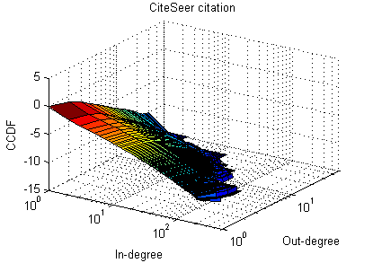
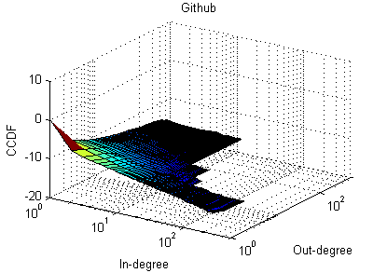
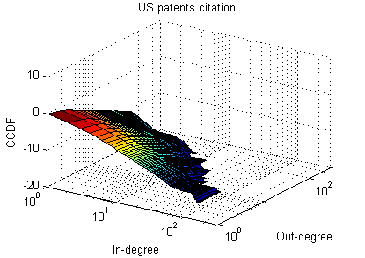
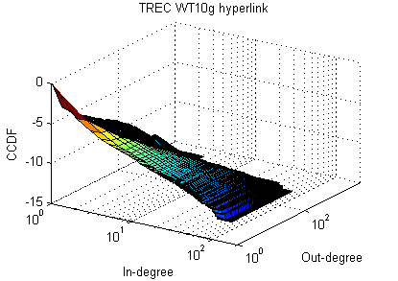
2D data fitting
8 networks with empirical correlation
0.0381
0.0541
0.0505
0.098

Slide 26
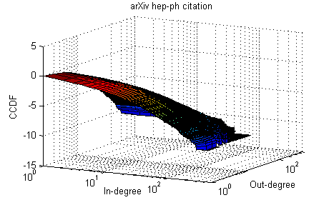
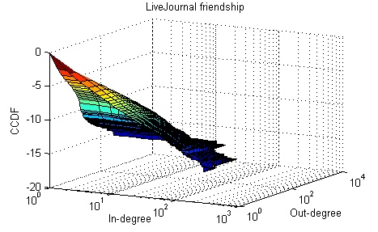
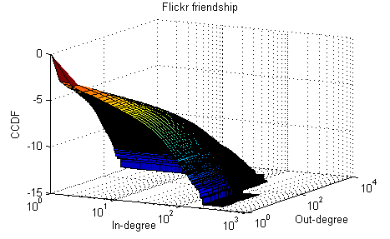
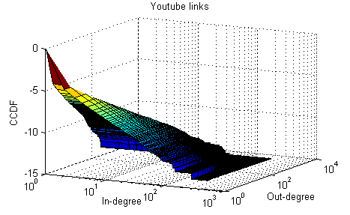
2D data fitting
8 networks with empirical correlation
0.1055
0.6478
0.7558
0.9492

Slide 27
2D data fitting
“Tail” behavior
Top 10 users’ IDs ranked by in-degree and out-degree
Rank |  | Youtube |  | Flickr |  | arXiV |  | Live Journal
 |  | In-degree | Out-degree | In-degree | Out-degree | In-degree | Out-degree | In-degree | Out-degree
1 |  | 381 | 381 | 377 | 784 | 8181 | 837 | 327609 | 242623
2 |  | 41 | 24429 | 390 | 3160 | 2537 | 840 | 4693 | 1974
3 |  | 32 | 32 | 994 | 3169 | 6439 | 2054 | 4363 | 1936
4 |  | 374 | 2137 | 657 | 185034 | 4806 | 52 | 349651 | 49560
5 |  | 2137 | 2601 | 3160 | 3191 | 16322 | 496 | 329319 | 4469
6 |  | 2601 | 374 | 786 | 110435 | 18863 | 3382 | 595341 | 303397
7 |  | 31228 | 41 | 784 | 67 | 18237 | 157 | 591622 | 49567
8 |  | 24429 | 3156 | 1467 | 1277 | 16335 | 863 | 5448 | 299222
9 |  | 6136 | 31228 | 844 | 54 | 4851 | 2720 | 329289 | 49
10 |  | 9561 | 151859 | 376 | 5158 | 7494 | 2726 | 4663 | 5452
 |  | Number of common IDs in the N IDs with the largest in-degree and out-degree
N | 10 | 8 |  | 2 |  | 0 |  | 0
 | 20 | 15 |  | 6 |  | 0 |  | 0
 | 100 | 78 |  | 32 |  | 2 |  | 5

Slide 28
2D data fitting
“Tail” behavior v.s. Experiment result
(1)
The tail behavior of the four networks and fitting results
 |  | Number of common IDs in the N IDs with the largest in-degree and out-degree
Dataset |  | Youtube | Flickr | arXiv | Live Journal
N | 10 | 8 | 2 | 0 | 0
 | 20 | 15 | 6 | 0 | 0
 | 100 | 78 | 32 | 2 | 5
 |  | 95.3% | 27.8% | 2.05% | 5.19%
rmse (root mean squared error) |  | 8.1225e-008 | 1.5681e-005 | 8.2747e-005 | 1.7906e-006

Slide 29
2D data fitting
“Tail” behavior v.s. Experiment result
(2)
The tail behavior of the four networks and fitting results
 |  | Number of common IDs in the N IDs with the largest in-degree and out-degree
Dataset |  | Youtube |  | Flickr |  | arXiv |  | Live Journal
N | 10 | 8 |  | 2 |  | 0 |  | 0
 | 20 | 15 |  | 6 |  | 0 |  | 0
 | 100 | 78 |  | 32 |  | 2 |  | 5
Asymptotic Conditional Probability |  | 1 |  | 0 |  | 0 |  | 0
rmse (root mean squared error) |  | 9.6720e-008 |  | 1.2940e-005 |  | 8.2306e-005 |  | 1.7599e-006

Slide 30
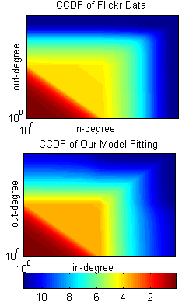
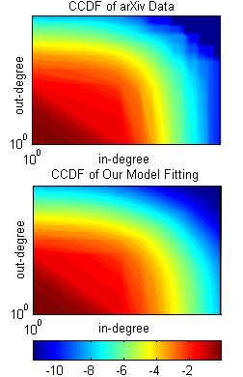
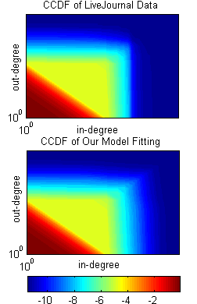
2D data fitting
Heat map comparison

Slide 31
Conclusions
Conclusions
Propose a multivariate power law generator with asymptotic fractional conditional probability.
Model can be used to fit real data and suggest future conditional probability.
Suggest generative mechanism for multivariate distributions with asymptotically fractional conditional probability. Provide possible generative explanations for distributions seen in the real data.
Future work- (without resetting as Markov on-off transition?)
Conjecture: Asymptotic independent?

Slide 32
Thank you!

