Slide 1
Control ISSUES IN Cloud Computing: Heavy Traffic Optimality
R. Srikant
In collaboration with
Ness Shroff (OSU), Yi Lu (UIUC), Lei Ying (ASU)

Slide 2
Work on Cloud Computing
Map/Reduce Framework
PhD student: Zheng (OSU)
Infrastructure as a Service
PhD Student: Maguluri (UIUC): This talk, answers a question posed by Harry Chang at the last MURI meeting
PhD Student: Qiaomin Xie, MS Student: Xiaobo Dong (UIUC)
Zero-delay service

Slide 3
Setting
A cloud of identical servers with limited capacities for different resources like processing power, memory, disk space etc.
Jobs (Virtual Machines) require certain amount of these resources and certain time for service
Schedule jobs on the cloud meeting the resource constraints on the servers
Type 2 job
Type 1 job
Type 3 job
Server 1
Server 2
Server 3
Notes:
Iaas - VMs
Existing approaches based on solving a bin packing problem
We model it as a dynamic problem with job arrivals and departures and provide a much simpler solution

Slide 4
Cloud Computing – Resource Allocation problem
Jobs arrive according to an arrival process
Multiple stages of service
A router/ load balancer routes jobs to the servers
Each server maintains queues for each kind of jobs
Workload can be known or unknown
Need a routing/ load balancing algorithm and a scheduling algorithm at each server
Router
1
1
1
3
1
5
2
2
1
1
1
4
1
1
1
1
Server 1
Server 2
Server 3
Notes:
Assume Job sizes are known.
Explain workload

Slide 5
Capacity of a server
Feasible Schedule – satisfies resource constraints of jobs and servers
Server with 30GB Memory, 30EC2 Computing Units, 4000 GB Storage,
(2,0,0) is feasible
(0,2,1) is not feasible – violates Memory constraint
Capacity of a server
Convex hull of feasible schedules
Corner points – maximal schedules
Amazon EC2 VMs | Memory | CPU | Storage
Standard Extra Large | 15GB | 8 EC2 Units | 1690GB
High Memory Extra Large | 17.1GB | 6.5 EC2 Units | 420 GB
High-CPU Extra Large | 7GB | 20 EC2 Units | 1690GB
Notes:
Can attain any point in the region by time multiplexing between the corner points.
Choosing a schedule is searching among the corner points
----------------------------------------------------------------------------------
Cap region = coordinate convex hull of the maximal schedules

Slide 6
Capacity of a Cloud
Sum of Capacities of all the servers
Corner point in the capacity region of the cloud can be written as a sum of corner points of capacity regions of all the servers
Load of each type of job is the product of its arrival rate and its mean duration

Slide 7
Metrics of Optimality
Throughput Optimality
Any load within the capacity region is stabilizable
No bound on Delay
Delay Optimality
Minimize Mean Delay
Minimize Mean Queue Lengths – Little’s Law
Analytically intractable
Arrival rate vector
Heavy Traffic Optimality
Arrival rate is 𝝐 away from the boundary of the capacity region
Let 𝝐→𝟎 so that the arrival rate approaches the boundary, ⟨𝒄,𝜇⟩=𝑏
$$c$$
$$ε$$
$$\left\langle c,μ\right\rangle =b$$

Slide 8
Preemption
Suppose that preemption is not allowed
It may be difficult to save the state of a VM
Cannot make Independent scheduling decisions in each time slot
Presented Last Year
Nonpreemptive Algorithm - Throughput Optimal
Two cases – Known and Unknown Job sizes
Notes:
Some jobs can be preempted. Some jobs are diffcult to preempt because needs to save current system state which is sometimes difficult. Preemptive is easy – similar to wireless. Focus on Non preemptive here.
Non preemption – couples the system between time slots
In each time slot, a schedule with maximum weight is chosen without disturbing the jobs in progress
--------------------
Maximal Schedules (2,0,0), (1,0,1), (0,1,1) – Same as the earlier Amazon example

Slide 9
Limited Preemption
Preempt jobs once every $T$ time slots
Some jobs easy to preempt
If a job is blocking several others – want to preempt
Every $T$ time slots, make an independent decision
Based on a discussion with Jim Giles (IBM/Google)
Notes:
Add some thing more here?

Slide 10
Scheduling Algorithm
Every $T$ time slots – Weighted Knapsack Schedule
Other times
Cannot use such a Schedule in every time slot
Myopic Weighted Knapsack
(2,0,0)
Weight = 4
2
(1,0,1)
Weight = 3
4
(0,1,1)
Weight = 5
1
Notes:
Some jobs can be preempted. Some jobs are diffcult to preempt because needs to save current system state which is sometimes difficult. Preemptive is easy – similar to wireless. Focus on Non preemptive here.
Non preemption – couples the system between time slots
In each time slot, a schedule with maximum weight is chosen without disturbing the jobs in progress
--------------------
Maximal Schedules (2,0,0), (1,0,1), (0,1,1) – Same as the earlier Amazon example

Slide 11
JSQ Routing
Route to the server with the smallest workload for that job type
Router
1
1
1
3
1
5
2
2
1
1
1
4
1
1
1
1
Server 1
Server 2
Server 3

Slide 12
Throughput Optimality
Theorem: JSQ Routing and Myopic Weighted Knapsack Scheduling is throughput optimal, with Limited Preemption
Presented previously
Harry’s Question: Is it also heavy-traffic optimal?

Slide 13

Heavy Traffic Optimality
Arrival rate vector
In steady state as $ε→0$, $\left\langle c,Q\right\rangle →∞$
Is $O\left(\frac{1}{ε}\right)$
Similar to M/M/1 queue
$\left\langle c,Q\right\rangle$ - proxy for ${|\left|Q\right||}^{2}$
$$\left\langle c,μ\right\rangle =b$$
$$c$$
$$ε$$
Theorem: The rate, $\lim_{ε→0}{εE(\left\langle c,Q\right\rangle )}$ is minimum for JSQ routing and MaxWeight Scheduling
We show that, $\frac{K}{ε}≤E\left[\left\langle c,Q\right\rangle \right]≤\frac{K}{ε}+ο\left(\frac{1}{ε}\right)$
Universal Lower Bound
Matching Upper Bound
Notes:
Explain. <c,q> is going to infinity as epsilon goes to zero. It is going as 1/epsilon. So, we show that the rate with which it is going is optimal
Ideally show Q is optimal, but showing the parallel component is optimal. For the whole thing, at least the order is correct in terms of epsilon. Also this gives that Q^2 is optimal

Slide 14
Heavy Traffic Optimality
Well studied for generalized switches
Using Diffusion Limits [Stolyar 2004]
Lyapunov drift based approach [Eryilmaz, S. 2012]
Lower Bound – Resource pooling
State Space Collapse
Upper Bound – Show that it matches with the lower bound using state space collapse

Slide 15
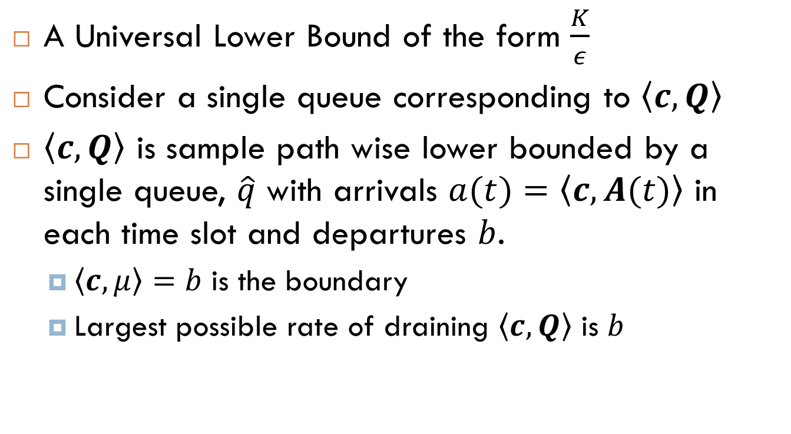
Lower Bound
A Universal Lower Bound of the form $\frac{K}{ε}$
Consider a single queue corresponding to $\left\langle c,Q\right\rangle$
$\left\langle c,Q\right\rangle$ is sample path wise lower bounded by a single queue, $\hat{q}$ with arrivals $a(t)=\left\langle c,A(t)\right\rangle$ in each time slot and departures $b$.
$\left\langle c,μ\right\rangle =b$ is the boundary
Largest possible rate of draining $\left\langle c,Q\right\rangle$ is $b$
$$\left\langle c,λ\right\rangle$$
$$b$$

Slide 16
State Space Collapse - Intuition
In the heavy traffic limit,
For MaxWeight scheduling, Queue length vector – perpendicular to the boundary
So that average service rate is on the boundary
$$Q$$

Slide 17
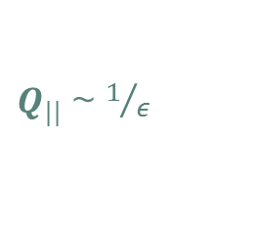
State Space Collapse
We show that perpendicular component is bounded, independent of $ε$, $E\left[Q_{⊥}\right]≤M$
But Parallel component grows as $\frac{1}{ε}$
Perpendicular component is negligible
This is called State space collapse
Works only when approaching a non corner point on the boundary
$Q_{||}$ ~ $1/ε$
$Q_{⊥}$ - bounded
$$Q≈Q_{||}$$
Notes:
Showed using Hajek’s lemma- that the bound on Q_perp has no epsilon

Slide 18
State Space Collapse – Across Servers
Arrival rate vector splits into corresponding arrival rate vectors for each of the servers
Routing policy – JSQ ‘equalizes’ queues at different servers
Identical Servers – same service rate, state space collapse
$$c$$
$$c$$
$$c$$
$$c$$
Notes:
Only JSQ state space collapse is along equal queues
Only MaxWt, along c
Here both

Slide 19

Upper Bound
Because of State Space Collapse, MaxWeight chooses service such that $\left\langle c,μ\right\rangle =b$
Upper bound similar to lower bound
Use Resource pooling
Behaves like a single queue as in the lower bound
$$Q$$
Service rate $\left\langle c,μ\right\rangle =b$
Notes:
Proved only for identical server case. Not sure what happens if servers are not identical.

Slide 20
Key Step for Upper Bound
Main Issue in the proof
To show $E\left[\left\langle c,Q(t+1)\right\rangle \left\langle c,u(t)\right\rangle \right]$ is bounded in steady state
$u$ is unused service
$Q_{i}(t+1)$ $u_{i}(t)$ is zero
Unused service is nonzero only when queue length goes to zero
Need to bound the cross terms $Q_{i}(t+1)$ $u_{j}(t)$
Use State Space Collapse
$\left\langle c,Q(t+1)\right\rangle \left\langle c,u(t)\right\rangle$ = $\left\langle Q\left(t+1\right),u(t)\right\rangle −\left\langle Q_{⊥}\left(t+1\right),u(t)\right\rangle$
First term is zero
Second term is bounded from state collapse

Slide 21
Simple Routing -Power of Two Choices
JSQ routing - Router needs to know the queue lengths at all the servers
In each time slot, for each type of jobs, choose two servers, and route to the one with smaller queue
Well studied in the context of load balancing
Throughput optimal
Heavy Traffic Optimal
Router
Server 1
Server 2
Server 3
Notes:
, and then taking expectation over all possibilities.

Slide 22
Power of Two Choices Routing
$$μ$$
A Simpler problem
Servers – each serve one job at a time
Only one type of job
Just a bunch of simple queues
Special case of the previous problem – only Routing problem
Capacity region is a line segment – One dimensional
Earlier proof does not work – Corner Point
Proved Power of Two Choices is Heavy Traffic Optimal
$$λ$$
$$μ$$
$$μ$$
Notes:
Proof based on conditioning on a random variable corresponding to the two servers that are chosen

Slide 23
Ongoing Work
Non Identical Servers
State space collapse of each server is not clear
Unknown Job Sizes
Throughput Optimal, Heavy-Traffic Optimality?
$$c$$
$$c$$
$$c$$
$$c$$
Notes:
Picture

Slide 24
Other Directions
Sampling queues is expensive
How small can we make the sample complexity?
Smaller than the Power-of-Two choices?
Zero-Delay Service
No queueing is allowed
Either loss or have an infinite number of servers
How much does load balancing using a small number of queue lengths help compared to random routing?
Notes:
Picture

Slide 25
Conclusions
A stochastic model to study resource allocation for Cloud Computing
Throughput Optimal Routing and Scheduling Algorithms
Known/Unknown job sizes, with or without premption
Heavy Traffic Optimal Routing and Scheduling Algorithm
Known jobsizes
Limited Preemption is allowed

