Slide 1
Multivariate Heavy Tails and Structural Properties of Complex Networks
MURI Oct 8 Annual Review
Zhi-Li Zhang & Golshan Golnari
{zhzhang, golnari}@cs.umn.edu
Dept. of Computer Science & Eng.,
University of Minnesota
Reporting Collaborative Research
with Sid, Don, Bo, et al

Slide 2
Outline
Motivation: Central Questions & Overview
Structural Properties of Complex Networks
Multivariate Analysis and Multivariate Heavy Tails
Network Data Analysis: Search for MRVs?
Existing studies focus on univariate heavy tails in one or more metrics (i.e., “power laws” in marginal distributions only)
Developing “visual” analysis tool for uncovering MRVs
MRVs better characterization for complex & diverse structures
Generative & Analytical Models for Growing Networks with Multivariate Heavy Tails (MRVs)
General recursive recipes for constructing networks w/ MRVs
(Stochastic) Kronecker graphs as a specific (but powerful) family of mathematical models for networks with MRVs

Slide 3
Central Questions
Networks are “by nature” multivariate entities
formed by n nodes and m edges connected in various manners
edges may be directed, and/or have weights, signs, …
Objective: bring a “multivariate analysis” perspective to study structural properties of complex networks
In particular, understand roles and impact of multivariate heavy tails
What are (possible) manifestations of multivariate “heavy tail” phenomena in complex networks?
beyond (univariate or multivariate) “heavy-tailed” degree distributions
And what can they tell us about the structural properties of complex networks?

Slide 4
Complex Networks from the Real World
Network datasets arising from many real-world social, natural or engineered systems manifest complex and diverse structures!
Cannot be uniquely or sufficiently characterized by a single metric
e.g., (power law) degree distribution:

Slide 5
Complex Networks from the Real World
Network datasets arising from many real-world social, natural or engineered systems manifest complex and diverse structures!
Cannot be uniquely or sufficiently characterized by a single metric
e.g., (power law) degree distribution:

Slide 6
Complex Networks from the Real World
Network datasets arising from many real-world social, natural or engineered systems manifest complex and diverse structures!
Cannot be uniquely or sufficiently characterized by a single metric
e.g., (power law) degree distribution:
Nor is using multiple metrics independently sufficient to capture such complex and diverse network structures and their formations

Slide 7
Complex Networks from the Real World
Network datasets arising from many real-world social, natural or engineered systems manifest complex and diverse structures!
Cannot be uniquely or sufficiently characterized by a single metric
Nor is using multiple metrics independently sufficient to capture such complex and diverse network structures and their formations
These metrics or “characterizations” (“laws”) include
“scale-free” or power law degree distribution
directed networks: in/out-degree distributions, reciprocal edges & reciprocity
small network diameter (“small world”) & skewed distri. of hop-counts
power-law eigenvalue spectrum & skewed “network value” distri. (eigenvector components assoc. w/ largest eigenvalue of adj. matrix)
node triads or clustering coefficients (network transitivity & communities)

Slide 8
Complex Networks from the Real World
Network datasets arising from many real-world social, natural or engineered systems manifest complex and diverse structures!
Cannot be uniquely or sufficiently characterized by a single metric
Nor is using multiple metrics independently sufficient to capture such complex and diverse network structures and their formations
These metrics or “characterizations” (“laws”) include
“scale-free” or power law degree distribution
directed networks: in/out-degree distributions, reciprocal edges & reciprocity
small network diameter (“small world”) & skewed distri. of hop-counts
power-law eigenvalue spectrum & skewed “network value” distri. (eigenvector components assoc. w/ largest eigenvalue of adj. matrix)
node triads or clustering coefficients (network transitivity & communities)
core-periphery, or hierarchical (“self-similar”) structures
Evolution of networks:
densification power law:
shrinking or stabilizing network diameter, & constant avg. clustering coefficient

Slide 9
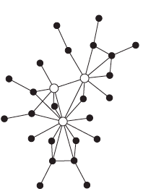
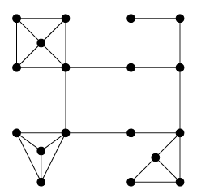
Characterizing Structural Properties of Complex Networks & (Generative) Models?
Existing preferential attachment (PA) types of generative models inadequate in capturing complex, diverse real network structures
produce “power law” degree distribution, but avg. clustering coefficient decays fast as size N grows → mostly components are “tree-like”, not enough # of “triads”
many “real” networks have average clustering coefficients independent of N
Several mostly deterministic, a few stochastic constructive methods or “models” have been proposed in the literature, trying to match two or more metrics of real complex networks, e.g., degree & clustering coeff.
but still focus only on marginal distribution of each metrics!
can’t distinguish complex network structures with the same marginals
We believe multivariate heavy-tail (MRV) analysis provides a better tool to
characterize & distinguish diverse dependence structures in complex networks!

Slide 10
Quest for Multivariate “Heavy Tails” in Complex Networks: Two-Pronged Approach
Two intertwined threads of research:
Empirical network analysis of real-world networks & simulated datasets generated from (generative) network models
Develop (visual) analysis tools that are amenable for network data analysis
a new “visual” bivariate heavy tail analysis tool using a sequence of log-log plots (similar to univariate log-log plot)
Search and devise metrics of interest, compute & plot them to look for (univariate & multivariate) “heavy tails” in network data
Compare real networks w/ simulated data for structural similarity analysis
Constructive, analytical methods to develop “generative” models for growing networks with multivariate heavy tails
explicit construction of growing networks with “interesting” properties
analytical models & proofs for existence of (multivariate) “heavy-tails”
Q: structural properties (e.g., “hierarchical structure”) thus constructed “essential” or “universal” for networks with multivariate “heavy tails”?

Slide 11
Multivariate Heavy Tails in Complex Networks: Empirical Analysis
MRV (of joint metrics distributions) as a distinctive network characterization of complex net structures
e.g., degree-degree, degree-clustering coefficient inverse
Visualization tool for detecting MRV in networks
similar to log-log plot for univariate heavy tails, with a sequence of log-log plots in various scales for bivariate distributions

Slide 12
Multivariate Heavy-Tail (MRV) Definition
Hard to say MRV…

Slide 13
Multivariate Heavy-Tail (MRV) The math for the visualization
Bivariate case (sequential form):

Slide 14
Multivariate Heavy-Tail (MRV) The visualization method
➔

Slide 15
Multivariate Heavy Tail (MRV) The visualization method

Slide 16
Hierarchical Generative Models Empirical Analysis
One intuition: Networks are generated hierarchically
modules/communities recursively combine/connect to each other to form the larger communities
But this “combining” process could happen in many different ways → resulting in different generative models

Slide 17
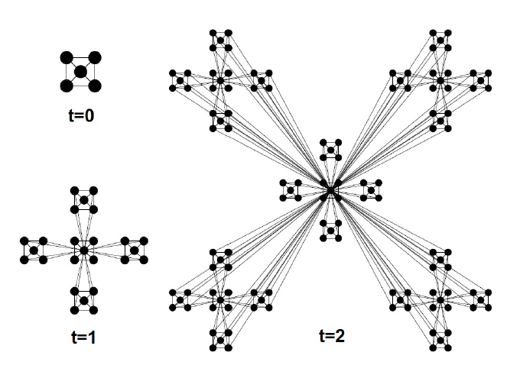
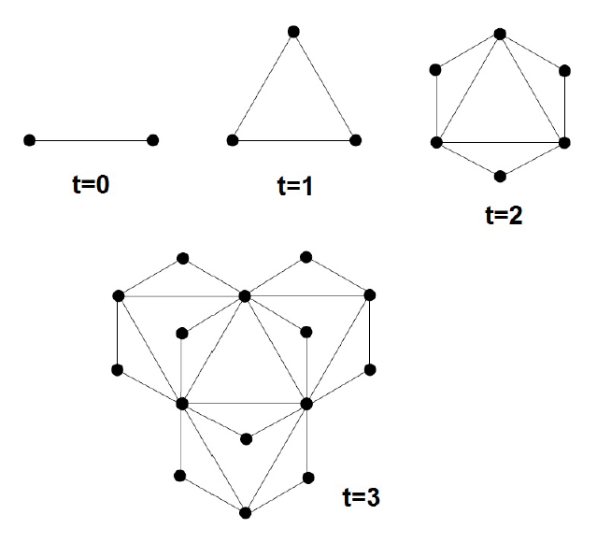
Examples
The modules combine by connecting the central nodes to peripheral nodes (low-degree nodes) of other modules.
Or the modules combine by connecting/merging the central nodes (high-degree nodes) to central nodes of other modules.
Ravasz and Barabasi’s model
Dorogovtsev et al.’s model

Slide 18
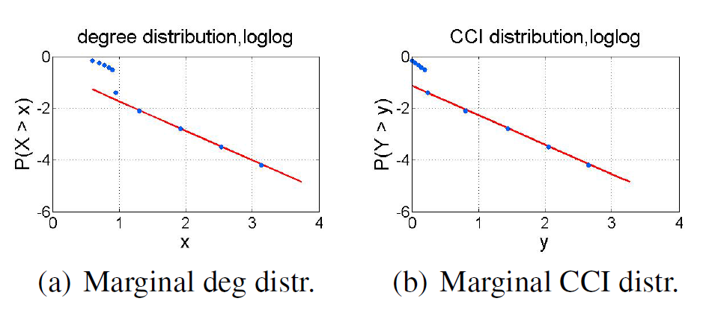
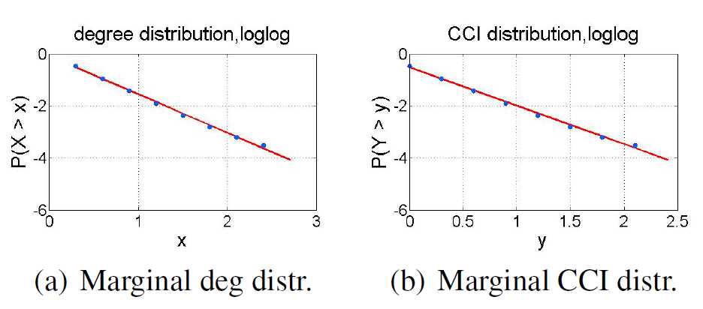
Marginals alone are not Helpful…
Marginals alone cannot distinguish the distinctive network structures generated from these two different generative models.
Ravasz and Barabasi’s model
Dorogovtsev et al.’s model
Notes:
Their correlation/dependenices give us much more information

Slide 19
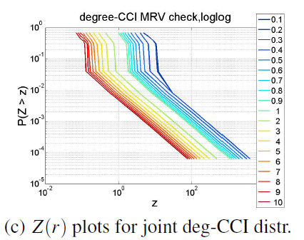
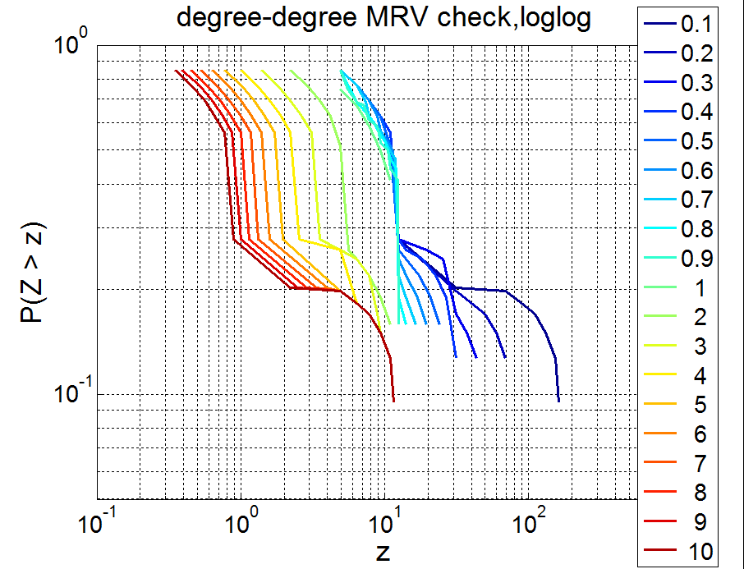
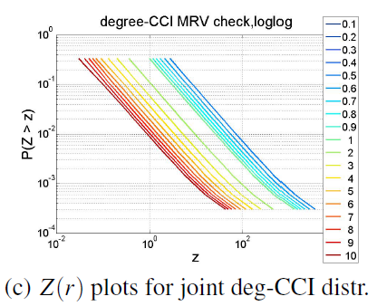
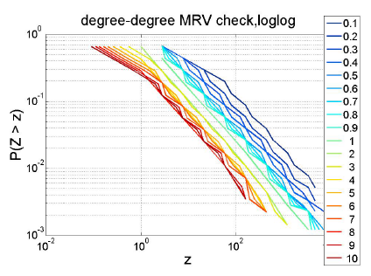
MRVs are more Informative!
MRVs (of different joint metrics distributions) are able to distinguish these networks generated from different generative models.
Ravasz and Barabasi’s model
Dorogovtsev et al.’s model
Notes:
MRV gives us an indication of dependency structures..

Slide 20
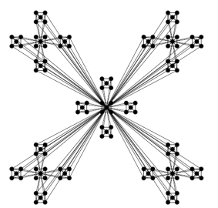
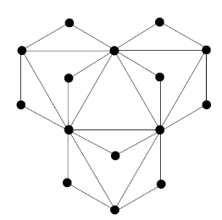
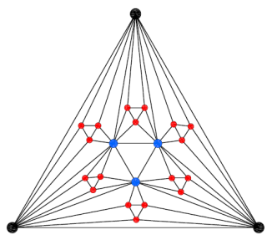
“Self-Similar” Networks?
Many generative models have been proposed to capture “self-similar” structures of networks.
These models are completely different in their structure and the way they are generated:
Ravasz and Barabasi: based on the relation between degree and clustering coefficient:
Dorogovtsev et al.: power-law degree dist. With exponent:
Chen et al.: zero clustering coefficient
Zhongzhi Zhang et al.: based on the relation between the exponent of degree dist. and strength dist.:

Slide 21
“Self-similarity”
But what is “self-similarity”?
Is it a good characterization for networks?
How can it distinguish networks with different generative models from each other?
Among the real networks, Internet (at AS level) and protein interaction network are two popular ones known to have “self-similar” structure.
But is “self-similarity” a sufficient characterization to describe both networks with? How their differences can be captured?

Slide 22
Multivariate Heavy Tails Distinctive characterization for real networks
MRV provides better characterization of real network structures

Slide 23
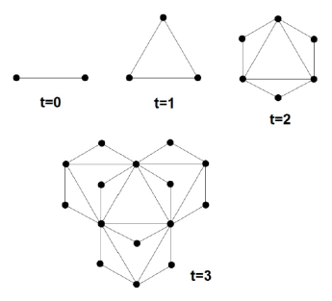
Multivariate Heavy Tails a distinctive characterization for networks
Based on the MRV results, we suggest:
Ravasz’s model as a good generative model for PIN dataset (MRV of deg-CCI)
Dorogovtsev’s model to be a better fit for Internet AS dataset (MRV of deg-CCI and deg-deg)
We speculate that networks with the same MRVs tend to have similar structures and perhaps undergo similar formation process.
Ravasz’s model
Dorogovtsev et al.’s model
By studying different MRVs (using joint distributions of different metrics), we are able to better reveal and distinguish diverse and complex network structures!

Slide 24
Quest for Multivariate “Heavy Tails” in Complex Networks: Two-Pronged Approach
Two intertwined threads of research:
Empirical network analysis of real-world networks & simulated datasets generated from (generative) network models
Develop (visual) analysis tools that are amenable for network data analysis
a new “visual” bivariate heavy tail analysis tool using a sequence of log-log plots (similar to univariate log-log plot)
Search and devise metrics of interest, compute & plot them to look for (univariate & multivariate) “heavy tails” in network data
Compare real networks w/ simulated data for structural similarity analysis
Constructive, analytical methods to develop “generative” models for growing networks with multivariate heavy tails
explicit construction of growing networks with “interesting” properties
analytical models & proofs for existence of (multivariate) “heavy-tails”
Q: structural properties (e.g., “hierarchical structure”) thus constructed “essential” or “universal” for networks with multivariate “heavy tails”?

Slide 25
Growing Networks w/ Multivariate Heavy Tails A General (Deterministic) Recipe
Quick recap of the approach & research started last year
Basic idea: instead of adding one node/edge at a time, growing at network level, via a recursive construction starting with a base graph G₁
properties of G₁ & construction process → whether/what MRVs emerge
Basic Recursive Recipe for “Self-Similar” Growing Networks
Step 1 (t=1): start with a base network G₁
Step t (t=2, …): take c replicas of the network, G_{t-1}, constructed at step t-1, and “glue” them through a sequence of basic operations:
node identification: select one node from two replicas, identify them
edge addition: add an edge between two replicas
Depending on metrics of interest, we can generate “self-similar” growing networks with certain interesting structural properties
e.g., growing networks with “heavy-tailed” distance & betweenness metrics, “heavy-tailed” degree & clustering coefficient distr., …

Slide 26
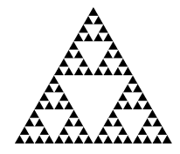
“Toy” Examples: Sierpinksi Gaskets & Variants
Sierpinksi gaskets as a family of growing networks
start with a 3-node triangle (a triad)
self-similar structure: from t to t+1:
replicate itself three times, and
“merge” at two of the three corner nodes
O₁
O₁
O₁
O₂
O₃
O₂
O₃
O₂
O₃
t =1
t =2
t =3
O₁
Properties of Sierpinski Gasket of order t
can be derived analytically thru recursion
…..
……
g₂
g₁
O₂
g₃
O₃
Sierpinksi gaskets of order t

Slide 27
Variants of Sierpinksi Gasket Network Models
From the basic Sierpinksi gasket network construction, we can also construct growing networks with heavy-tail degrees/cluster coeff.’s
start with a 3-node triangle, but at step t (t=2, …), introduce edge additions
step t: take three replicas of the network at step t-1, “merge” at two of the three corner nodes; then add edges from o₁ to all nodes on the bottom line
O₁
O₁
O₁
O₂
t =1
O₃
O₂
O₃
t =2
O₂
O₃
O₁
t =3
MRV in joint degree, CCI and distance metrics
O₁
O₁
……
O₂
O₃
O₃
t =1
O₂
t =2
O₂
O₃
t =3

Slide 28
Key Observations/Insights: Whence come (Multivariate) “Heavy Tails”?
We need to ensure the following properties hold:
Emergence of (univariate & multivariate) “heavy tails”
Justification: “Characterization of Multivariate Heavy-tailed Distribution Families
via Copula” by Chengguo Weng & Yi Zhang

Slide 29
Generalized Deterministic (Probabilistic) Recipes for Growing Networks w/ (Multivariate) Heavy Tails
Generalized Recursive Recipe for “Hierarchical” Growing Networks:
node identification: select one node from two replicas, identify them
edge addition: add an edge between two replicas
Metrics of interest determine how node identification and edge addition operations should be performed operations
e.g., using “preferential attachment” → power law degree distr.
step t from step t-1: conditionally independent; we can derive system “evolutional” equations for metrics of interest recursively
-- can also be applied to generate directed or signed growing networks

Slide 30
Quest for Generative Graph Models for Complex Networks w/ MRVs
The general (deterministic) recursive recipe for growing networks:
Advantages:
flexible and full control of construction process to obtain desired MRVs, useful for generating synthetic network datasets for numerical analysis
analytical results straightforward through recursion
Disadvantages:
hard to handle once we go from deterministic to probabilistic versions
analytical results specific to each explicit construction, hard to use to match against real-world network datasets
Current ongoing research: (stochastic) Kronecker product networks
A specific (& mathematically well-defined) framework for recursive construction of families of growing network models
based on Kronecker product of (adjacency) matrices ← tensor algebra
deterministic Kronecker product graphs has a long history (since 60s)
stochastic Kronecker product graphs: proposed by Leskovec et al ‘05
claimed to match (average & marginal) statistics of many real networks

Slide 31
(Deterministic) Kronecker Graphs
Definition
Recall: Kronecker (tensor) product of matrices:

Slide 32
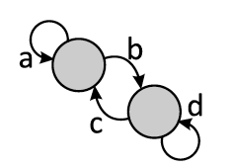
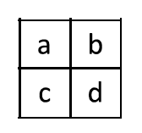
Stochastic Kronecker Graphs
Lesskovec et al: focus on Kronecker power graphs
esp. with a 2-node base graph (thus a 2x2 base matrix with four parameters)
developed ML method for parameter estimation
fitted to a number of real world network datasets
And compared (average & marginal) statistics of real networks with generated Kronecker power graphs
Mathematically proved that (evolution of) Kronecker power graphs
satisfy “edge densification” laws:
have bounded (effective) network diameters

Slide 33
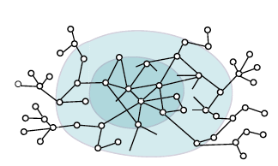
Kronecker Graphs and MRVs?
Kronecker power graphs with 2x2 base graph can help explain & distinguish core-periphery and hierarchical (“community”) structures
with power-law degree distribution
with different b & c values,
degree-degree MRV may also emerge
core-periphery: with
jerry-fish or onion-like structures

Slide 34
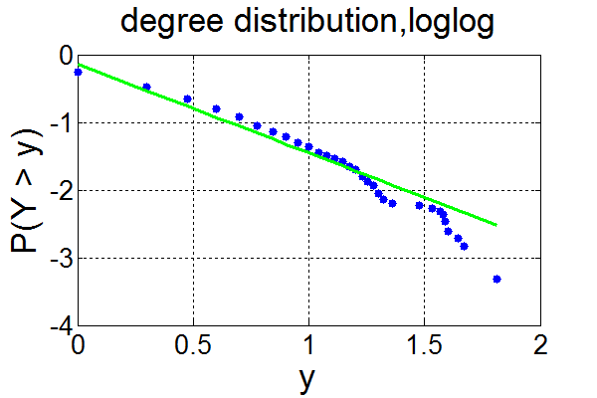
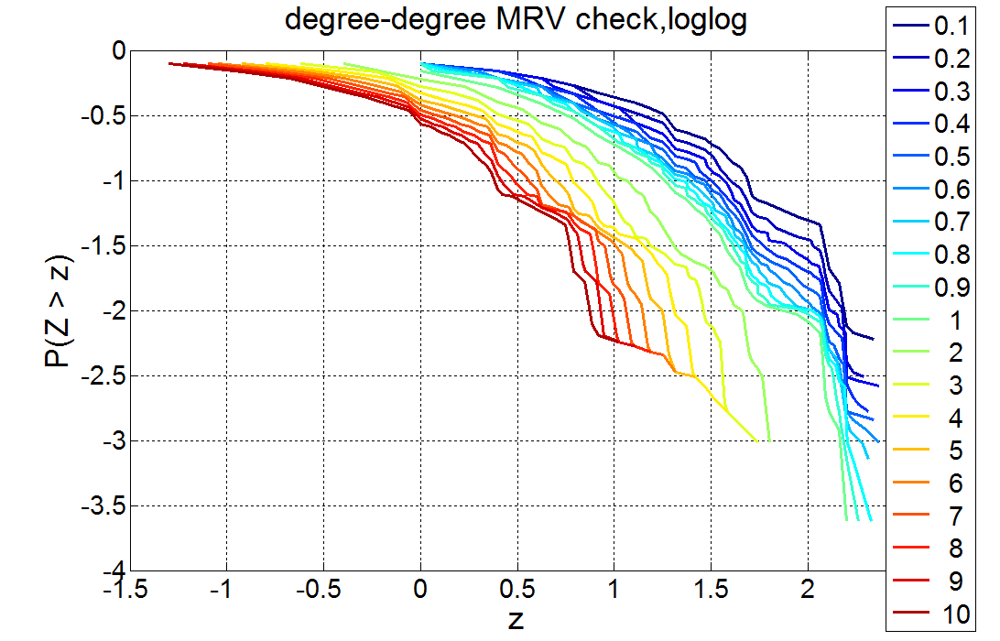
Kronecker Graphs and MRVs?
Kronecker power graphs with 2x2 base graph can help explain & distinguish core-periphery and hierarchical (“community”) structures
with power-law degree distribution
with different b & c values,
degree-degree MRV may also emerge
a
c
d
b

Slide 35
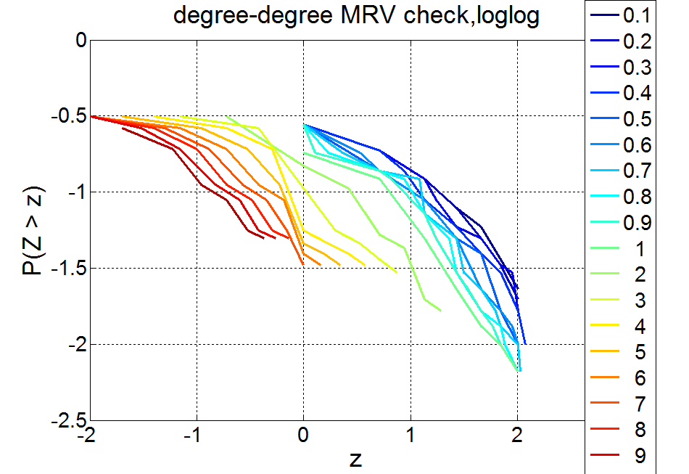
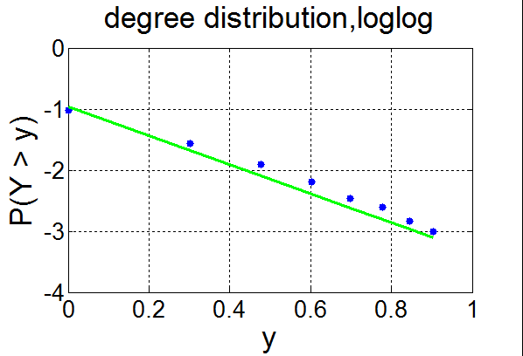
Kronecker Graphs and MRVs?
Kronecker power graphs with 2x2 base graph can help explain & distinguish core-periphery and hierarchical (“community”) structures
with power-law degree distribution
with different b & c values,
degree-degree MRV may also emerge
a
c
d
b

Slide 36
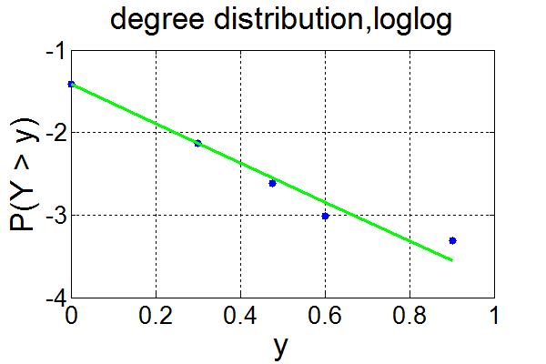
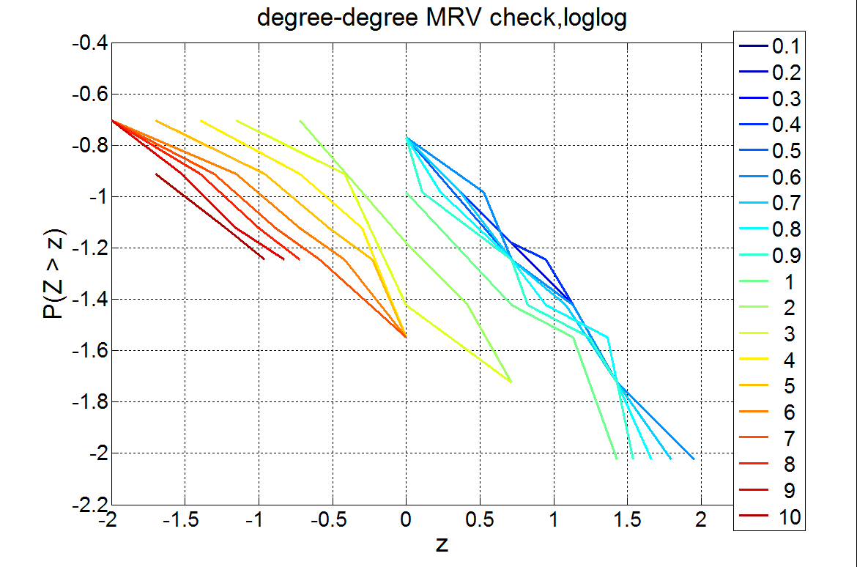
Kronecker Graphs and MRVs?
Kronecker power graphs with 2x2 base graph can help explain & distinguish core-periphery and hierarchical (“community”) structures
with power-law degree distribution
with different b & c values,
degree-degree MRV may also emerge
a
c
d
b

Slide 37
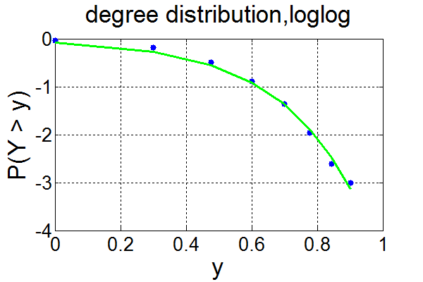
Kronecker Graphs and MRVs?
Kronecker power graphs with 2x2 base graph can help explain & distinguish core-periphery and hierarchical (“community”) structures
with power-law degree distribution
with different b & c values,
degree-degree MRV may also emerge
but we have difficulty in obtaining power-law degree distribution!
base graph with communities

Slide 38
Knonecker Graphs & MRVs Ongoing and Future Work
Investigating Kronecker product graphs of the form:
matrix A: replicate the base graph (and kth-step graph) and add additional edges to inter-connect the replicas => mirror our earlier general recipe
both B and A determine what MRVs may emerge
Tuning the parameters, able to “regenerate” previously mentioned models
e.g., connection between Ravasz & Barabasi’s model & base star shape graph
We are studying what kind of base graphs with what properties result in different MRVs ➔ provide insight to & interpretation of structure formation
Examples: star-shape base graph results in deg-CCI, and triangle-shape base graph results in deg-deg MRV
Attempt to analytically establish stochastic Kronecker network models with MRVs, and quantify the conditions under which they emerge
introduce node identification via “quotient” (or projection) operator?

Slide 39
Summary: Quest for Multivariate “Heavy Tails” in Complex Networks: Two-Pronged Approach
Two intertwined threads of research:
Empirical network analysis of real-world networks & simulated datasets generated from (generative) network models
Develop (visual) analysis tools that are amenable for network data analysis
a new “visual” bivariate heavy tail analysis tool using a sequence of log-log plots (similar to univariate log-log plot)
Search and devise metrics of interest, compute & plot them to look for (univariate & multivariate) “heavy tails” in network data
Compare real networks w/ simulated data for structural similarity analysis
Constructive, analytical methods to develop “generative” models for growing networks with multivariate heavy tails
explicit construction of growing networks with “interesting” properties
analytical models & proofs for existence of (multivariate) “heavy-tails”
Q: structural properties (e.g., “hierarchical structure”) thus constructed “essential” or “universal” for networks with multivariate “heavy tails”?

Slide 40
Thank You!
Questions?

