Slide 1
PCSDE Models for Multivariate Power Law distribution
UMASS Team and UCornell Team
Presenter: Shan Lu
3/6/2015

Slide 2
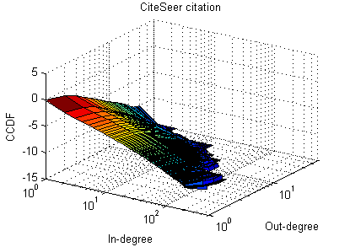
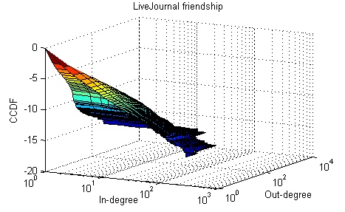
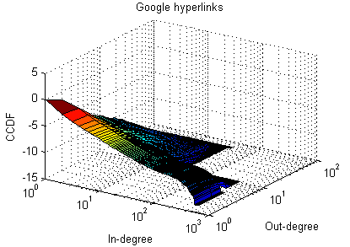
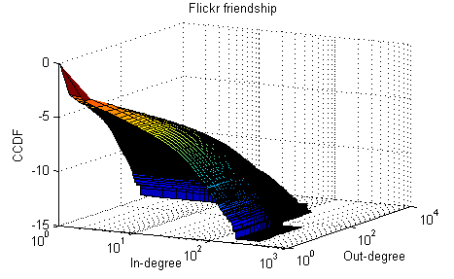
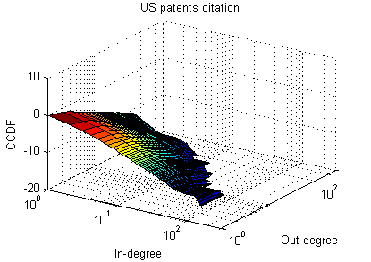
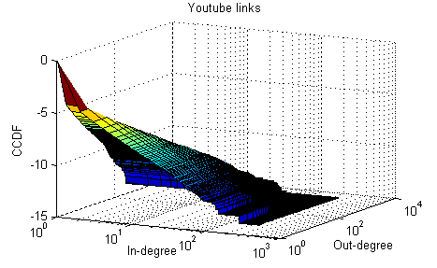
Multivariate Power Law in Real World Data
2-Dimensional data
Power law distributed margins.
Independent or correlated in-degree and out-degree.
Model to fit the real data?
Notes:
The model should be able to generate both independent and correlated bivariate power law distributions; and it should be able to predict the tail behavior in various netowrks.

Slide 3
Multivariate Pareto Distribution
Multivariate Pareto distribution II,
Joint CCDF
Marginal CCDF
Tail dependence coefficient (2D)

Slide 4
Multivariate Pareto Distribution
Classical Pareto
Tail dependence coefficient is not 0;
Same shape parameters for all univariate margins.
MP(II) of Asimit et al¹
Shape parameters are not necessarily the same;
Asymptotically independent.
¹A. V. Asimit, E. Furman, R. Vernic, “On a multivariate Pareto distribution”, Insurance: Mathematics and Economics 46(2010) 308 - 316

Slide 5
PCSDE Model for Multivariate Power law
PCSDE formulation
Exponential Growth with Random Stopping
PCSDE formulation

Slide 6
PCSDE Model for Multivariate Power law
Independency or correlation between variables can be achieved by independent or shared Poisson counters.
Marginal exponents are not necessarily the same.
Monte Carlo Simulation
Relationship to Generative Models
Expected degree growth
Rebuilt generative model for real-world data

Slide 7
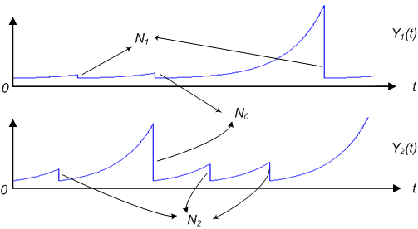
Bivariate PCSDE Model (1)
1. 2D SDE model with Shared Poisson Counter
Independent growth processes.
Life time of the two growth processes are controlled by a shared Poisson counter and two independent Poisson counters.

Slide 8
Bivariate PCSDE Model (1)
Correlated bivariate power law distribution
CCDF:
Asymptotically independent:
Notes:
And we get the CCDF for the marginal and joint too.
For the asymptotic behavior, we compute the conditional probability that y_2 larger than \epsilon_2 t given that y_1 larger than \epsilon_1 t.
Results show that this probability turns to 0 when t goes to infinity.
As we know, this is not true for some real data with bivariate power law distribution. We will show some cases in the experiment part.

Slide 9
Bivariate PCSDE Model (2.1)
2.1 Shared Poisson model with Markov on-off modulation
Makrov on-off process is “on”: original shared Poisson counter model;
Makrov on-off process is “off”: independent Poisson counters are shut off.

Slide 10
Bivariate PCSDE Model (2.1)
2.1 Shared Poisson model with Markov on-off modulation
Tail behavior:

Slide 11
Bivariate PCSDE Model (2.1)
2.1 Shared Poisson model with Markov on-off modulation
With , we have , which implies
If and , then close to 0, the tail dependence coefficient goes to 0 slowly.
Fit data when infinity value does not happen?

Slide 12
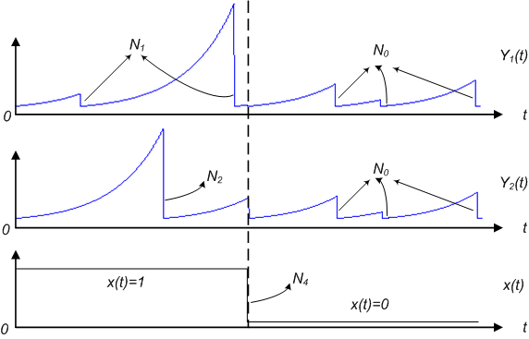
Bivariate PCSDE Model (2.2)
2.2 Shared Poisson model with Markov on-off modulation and resetting
Reset the two variables whenever the state of the Markov on-off process changes

Slide 13
Bivariate PCSDE Model (2.2)
2.2 Shared Poisson model with Markov on-off modulation and resetting
With ,

Slide 14
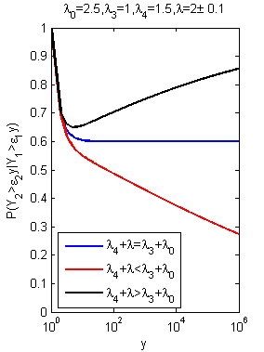
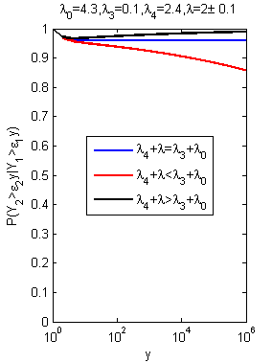
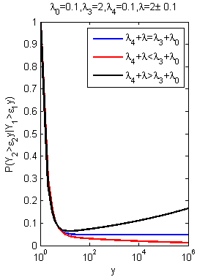
Bivariate PCSDE Model (2.2)
Notes:
Here we plot the conditional probability as a function of y given a small offset for lambda under three different p_off values. The conditional probabilities go to 1 or 0 gradually and slowly, especially for the case when p_on or p_off is quite small. Therefore our model could be used to fit the real data where infinity values do not happen and suggests future conditional probability when the network gets even bigger;

Slide 15
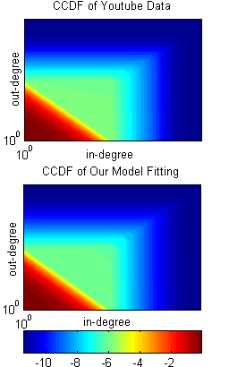
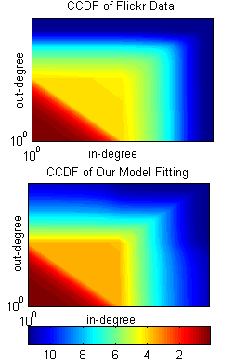
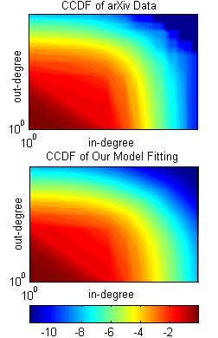
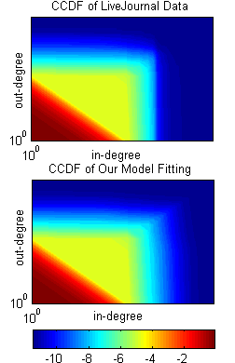
Bivariate PCSDE Model (2.2)
Heat map comparison
Dataset | Youtube | Flickr | arXiv | Live Journal
Tail behavior | Dependent | Independent | Independent | Independent

Slide 16
Bivariate PCSDE Model (3)
PCSDE model with matrix exponentials
, and are independent.
, and are correlated.
Marginal tail power law?
What about the tail dependence?

Slide 17
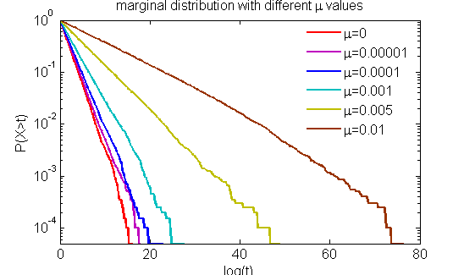
Bivariate PCSDE Model (3)
PCSDE model with matrix exponentials
Simulation result for the marginal distribution

Slide 18
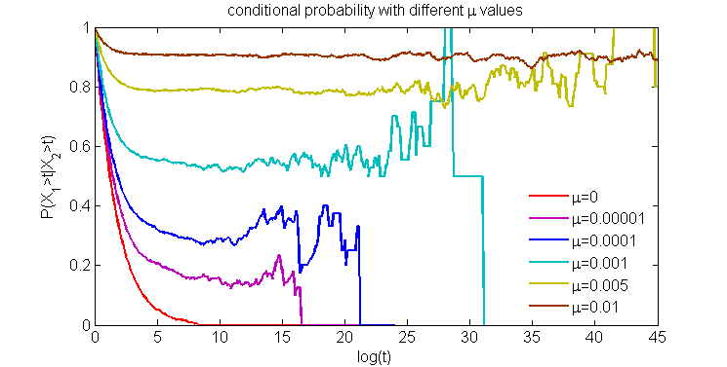
Bivariate PCSDE Model (3)
PCSDE model with matrix exponentials
Simulation result for conditional probability

Slide 19
Bivariate PCSDE Model (3)
PCSDE model with matrix exponentials
On going and future work:
Computing the marginal tail
Computing the joint tail
Computing the tail dependence coefficient

