Slide 1

Analysis and Design of Complex Systems with Multivariate Heavy Tail Phenomena
MURI Meeting
October 16, 2015
Ness B. Shroff
Depts. ECE & CSE, The Ohio State University
E-mail: shroff@ece.osu.edu
Collaborators: R. Srikant (UIUC), Joohyun Lee (OSU), Kyunghan Lee (UNIST), Jaemin Jo (UNIST), Eujin Jeong (UNIST), Irem Korpulu (OSU), Yoora Kim (UNIST), Yin Sun (OSU), Prasun Sinha (OSU), Kyu Han Kim (HP Labs), C. Emre Koksal (OSU)

Slide 2
Overall Outline
Overview of Research Directions
  Analyzing statistical metrics of different mobility models (Lévy, Explore return model, etc.): first exit time, contact time…
  Exploiting opportunities (node mobility, channel variation, predictibility) for resource allocation in wireless nets.
  Modeling and Analyzing Influence Propagation on Evolving Social Networks
  Developing scheduling algorithms for data center/cloud computing systems
Context aware application scheduling for smart devices

Slide 3
Lévy mobility
Analyzing statistical metrics of Lévy mobility: first exit time, contact time, and inter-contact time
  Lévy mobility are class of random walks that are observed in ecology for different animal species (including humans)
  Location is characterized by multivariate heavy tails in two or more dimensions
  Characterized First exit time for Lévy flight model in in R^{n} [Journal of Applied Probability, vol. 52, no. 2, 2015]
Ongoing work:
  Extension to Explore/Return model for more detailed human mobility modeling (FET analysis completed)
  Extension to directional drift model
  First meeting time and inter-contact times

Slide 4
Wireless Resource Allocation/Control
Exploiting various opportunities for resource allocation in wireless networks
Mobile data offloading
  Cellular networks are highly constrained (esp. in military settings)
  Use WiFi LANs, mmWave or direct contact opportunities for delivering data originally targeted for cellular networks (WiFi and cellular network interworking)
  Design of data off-loading schemes: A coupled queueing problem with bi-variate heavy tailed on/off service time distribution
    ON and OFF periods of WiFI service are Pareto and dependent
  Analyzed reneging probability (probability of not using WiFi) and expected waiting time (ACM Mobihoc 2014) in these systems
Ongoing Work:
  Application scheduling in Wireless Networks using context information
  Age of Information in wireless networks with unreliable channels

Slide 5
Data Centers and Cloud Computing/Storage
Developing scheduling algorithms for data center, cloud computing, and storage systems
  Analysis and design of MaP/Reduce type of scheduling algorithms with multi-variate heavy tailed dependency for minimizing flow time
    MaP/Reduce is ubiquitous programming paradigm for data center systems
    # of Map tasks and length of reduce tasks are Pareto and dependent
  Proved that the flow time minimization problem is strongly NP-hard and does not yield a finite competitive ratio [IEEE INFOCOM’13]
  Developed 2-approximation probabilistic competitive ratio pre-emptive scheduler that is independent of the nature of job size distributions [IEEE INFOCOM’13]
  Low-latency algorithms in the large-system limit for both pre-emptive and non-pre-emptive schedulers that are robust to heavy tails and dependencies between Map and Reduce [IEEE INFOCOM’15]
  Ongoing Work (in Cloud systems)
    Load balancing & scheduling: Optimal-latency data retrieval

Slide 6
Context Aware Application Scheduling for Increasing Battery Lifetime and Improving Application Response Times in Smartphones
Collaborators: Joohyun Lee (OSU), Kyunghan Lee (UNIST), Jaemin Jo (UNIST), Eujin Jeong (UNIST)

Slide 7
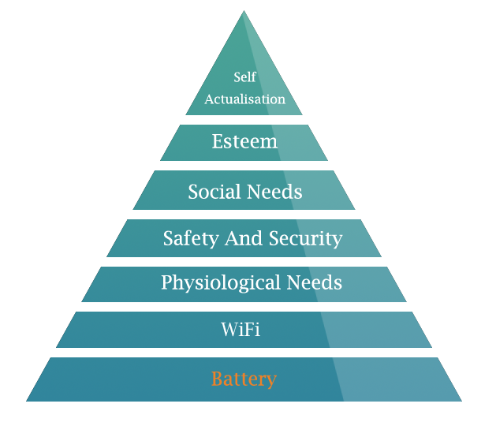
Motivation 1: Battery
Maslow’s Hierarchy of Needs
Theory that models levels of human needs
Humans reveal a certain level of need only if the needs at lower levels are satisfied
Fundamental needs
Notes:
http://www.jdpower.com/press-releases/2012-us-wireless-smartphone-and-traditional-mobile-phone-satisfaction-studies-volume
http://www.digitaltrends.com/mobile/j-d-power-consumers-most-dissatisfied-with-smartphone-battery-life/

Slide 8
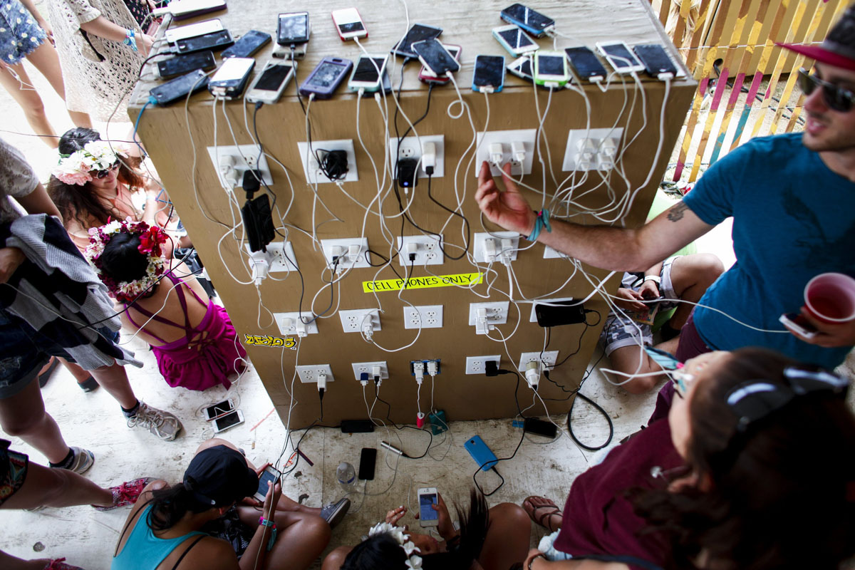
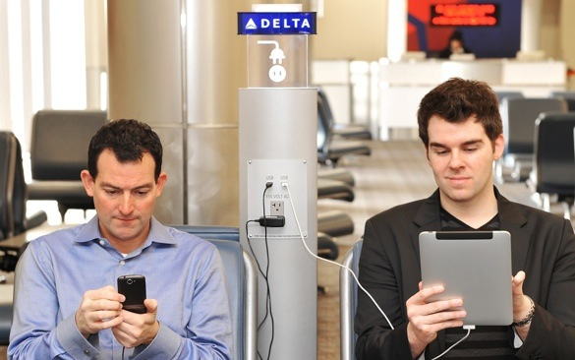
Motivation 1: Battery
New Maslow’s Hierarchy of Needs
Theory that models levels of human needs
Humans reveal a certain level of need only if the needs at lower levels are satisfied
Fundamental needs
9 hours of experienced lifetime
(75% of 4G users are dissatisfied
[J.D. Power])
How can we increase lifetime of these devices and quality of user experience?

Slide 9
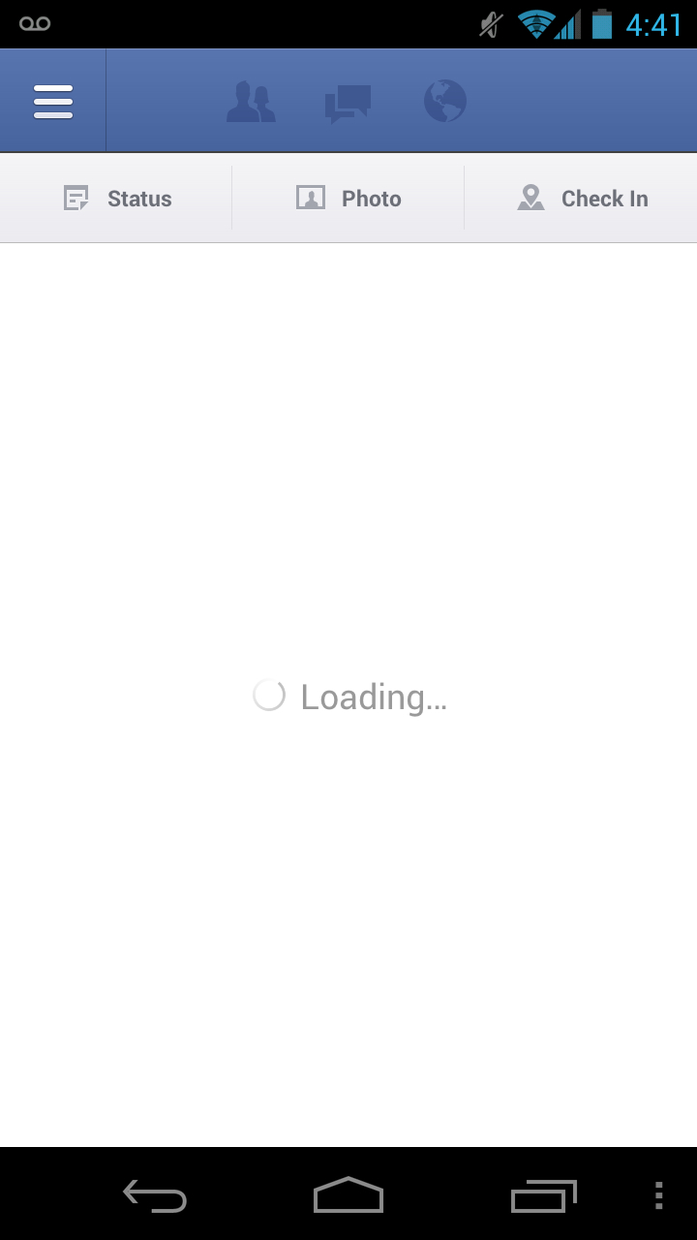

Motivation 2: Latency
Most users are dissatisfied with battery lifetime
Additionally, users want their applications to be very responsive
  Start-up latency is critical
Users are unhappy if the application takes too long to load
  Game apps: 5-22 secs (12.6 on average)
  Social networking apps: 2-4 secs (2.4 on average)
Goal: Taking user behavior into account,
can we develop smart application control strategies
in order to reduce both power consumption and start-up latency?
Notes:
From our measurement on 5 popular game apps and 5 popular social apps, games take 5 to 22 seconds and 12.6 seconds on average, and social apps take 2 to 4 seconds and 2.4 seconds on average

Slide 10



Relation to the project
Computing systems are essential in mobile military entities
  E.g., Soldiers, Tanks, Aircrafts
  Limited battery availability
  Fast response needed for military operations (or other apps soldiers may be interested in)
Aim at resource-efficient control by exploiting the task arrival and service processes (possibly multivariate heavy-tailed)
We focus on mobile app usage based on real smartphone traces
  Main ideas can be applied to many general problems where
  pre-loading may improve user experience, but consumes additional resources (e.g., caching)

Slide 11
Outline
Preliminaries about app usage and power consumption in smart phones
Measurement
  Application usage/contexts of real smartphone users
    103 participants (office workers, students, freelancers…)
Statistical analysis
  Heavy-tail behaviors
  Dependency on contexts
Problem formulation
  Proposed algorithms: Local optimal and Frequently used
Performance evaluation
  Without and with context information
  Comparison with status quo policies

Slide 12
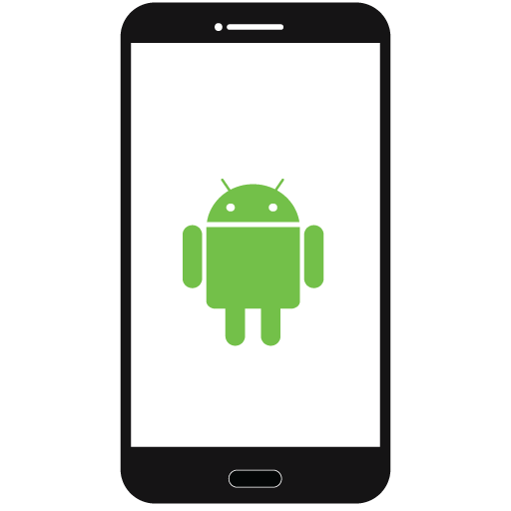
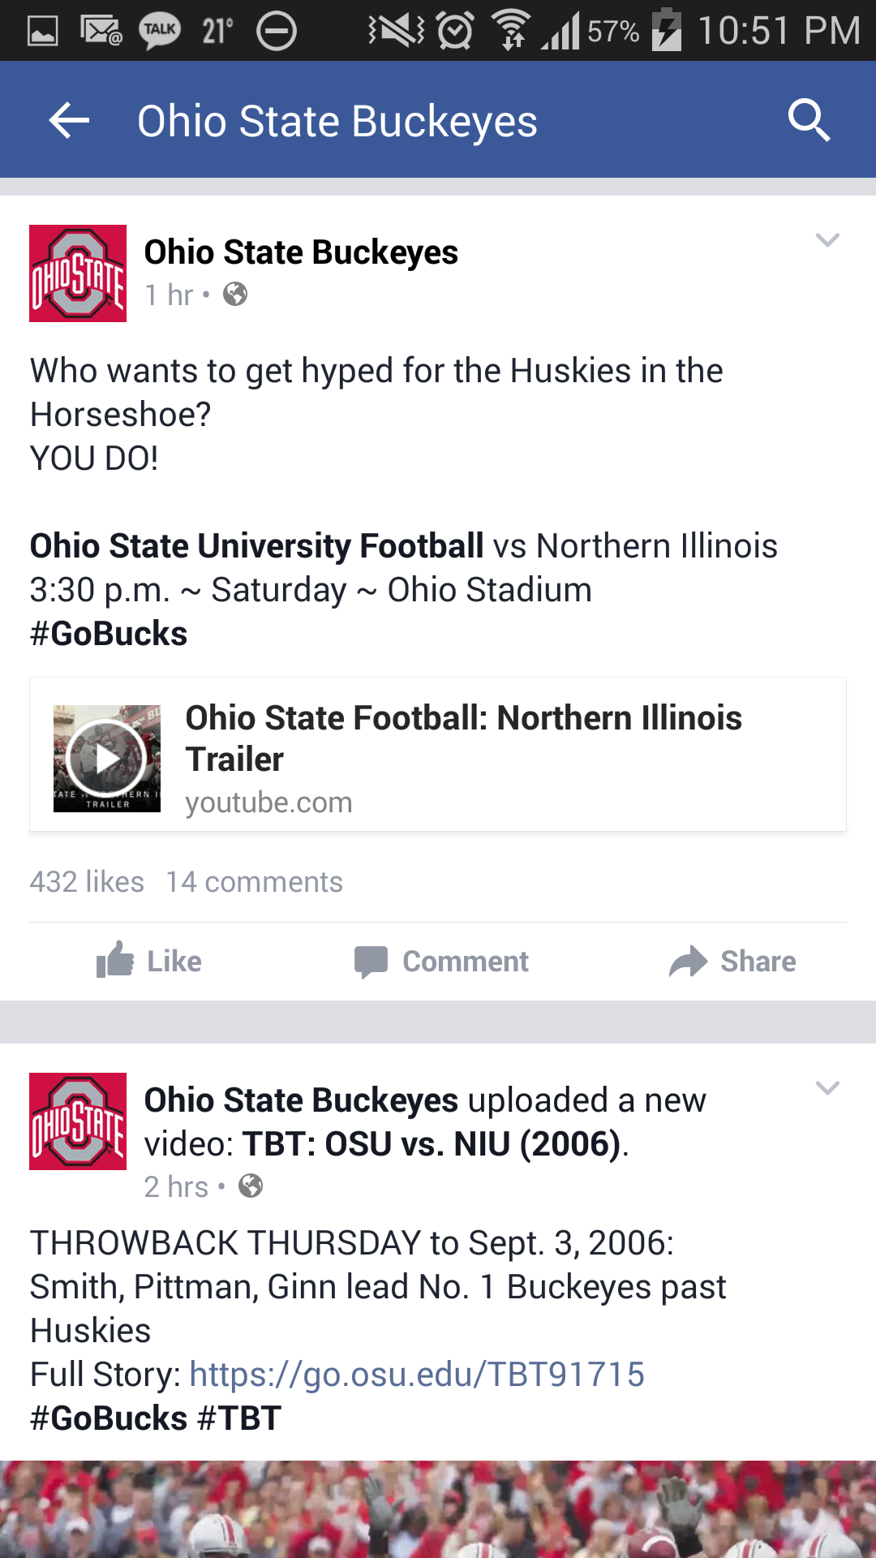
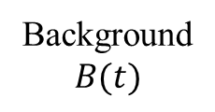
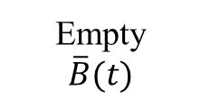

Preliminary: Lifecycle of a mobile application
3-states model for App lifecycle
A process is classified into various states
100
4.5sec
(5x)
0.9sec
(1x)
Foreground (on screen)
Foreground (not on screen)
Perceptible
Visible
Service
Background
Empty / Gone
Foreground
(on screen)
100
Cold launch (longer
start-up latency)
Warm launch (shorter
start-up latency)
130
Home,
power
button
Manual
termination
200
Importance
Preloading
(larger power)
300
Empty
Background
400
Unloading
(smaller power)
500
1000
Android classification
[Source: Android Developers]

Slide 13
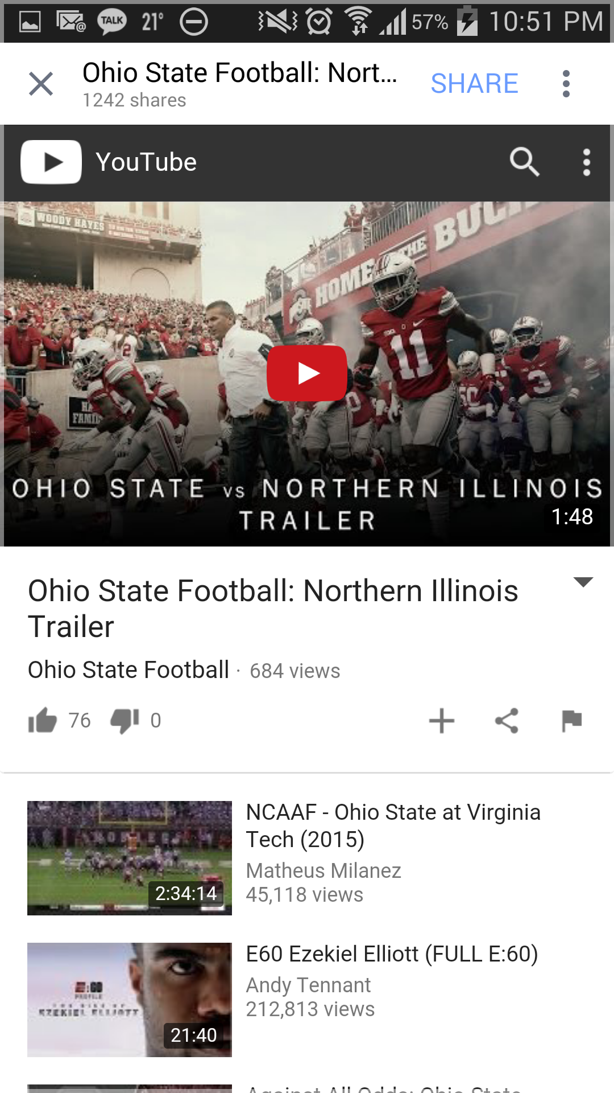





Example: App. State Transition
- Cold launch if YouTube was not in background
- Warm launch if YouTube was in background
click
- Background apps are terminated if the available memory is not sufficient, in the order of LRU
FOREGROUND
BACKGROUND (5 apps on average)

Slide 14
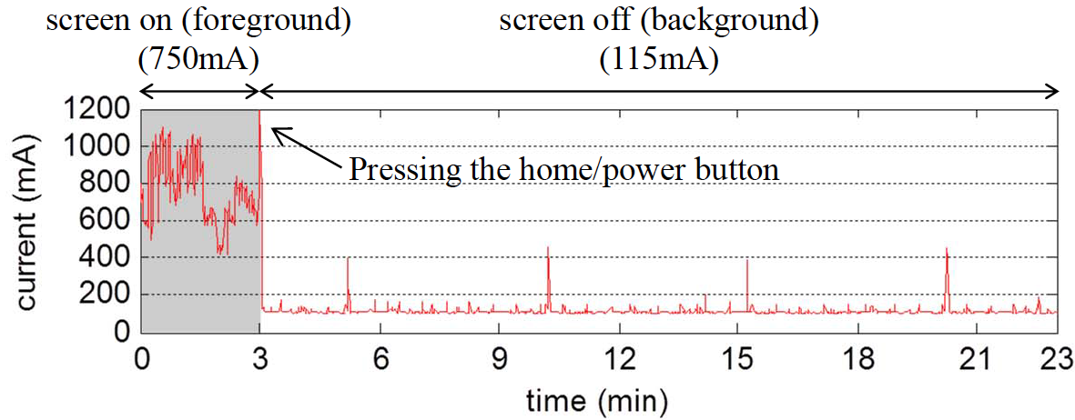



Energy cost due to background apps
Apps in background states significantly reduce relaunch latency since memory and resources are already allocated for the applications
Consume high background power (esp. gaming, navigation, and social apps)
  Background apps consume 115mA on average when screen is off
  while Idle power consumption is only 10mA if all apps are terminated
71% of participants are dissatisfied with battery lifetime (from our survey)
  9 hours of experienced battery lifetime with 2800mAh battery on average
  (c.f. 1810mAh for iPhone 6))
  82% of participants manually terminate applications
  28% of participants use an application killer (e.g., Advanced Task Killer)
Notes:
Background states reduce re-launch latency significantly since memory and resources are already allocated for applications.
But, the problem of having background applications is that they may consume high power.
This figure shows the power measurement of a gaming application in foreground and background.
In foreground, it consumes 750mA. In background, it consumes 115mA, which is much higher than 10mA of idle power.
Since applications can be in background for a much longer than foreground, it may incur significant energy consumption.
We found this high background power in gaming, navigation, and social apps, mainly for content update and shorter re-launch latency.
In our measurement, we found that background apps consume 125mA on average while the idle power consumption is 10mA when all apps are terminated or in empty states.
As a result, 70% of participants are dissatisfied with battery lifetime, where the lifetime is only 9 hours in participants’ smartphones.
So, more than 80% of users manually terminate applications and 28% of users use an application killer software.

Slide 15
Trade-off between background and empty
Trade-off between background and empty states
  Background: high power consumption, short start-up latency
  Empty/Suspended: low power consumption, long start-up latency
Foreground
(on screen)
4.5sec
(5x)
Cold launch (longer
start-up latency)
Warm launch (shorter
start-up latency)
0.9sec
(1x)
Home,
power
button
Manual
termination
Preloading
(larger power)
Empty
Background
What we control
(pre/unloading)
Unloading
(smaller power)
Notes:
From the aforementioned observations, we can see the trade-off between background and empty states.
In background states, apps have shorter latency, but constantly consume some amount of power.
In empty states, apps consume no power, but have high latency when they are re-launched.
Therefore, a resource-efficient controller may put applications that are likely to be launched in background, and put other high power-consuming applications, in empty states.

Slide 16
Status quo: LMK / Ultra power saving mode
Android low memory killer with LRU
  Android LMK (low memory killer) purges background apps in the order of LRU (least recently used) when available memory is below a threshold (typically about 20%)
  Does not consider the re-launching probability and resource consumption of applications
  Results in high background power
Ultra power saving mode (recent Samsung/Sony smartphones)
  Blocks background activities except system processes (e.g., phone, SMS…)
  Degrades multitasking experience of users
  Results in long start-up latency

Slide 17
Outline
Measurement
  Application usage/contexts of real smartphone users
    103 participants (office workers, students, freelancers…)
Statistical analysis
  Heavy-tail behaviors
  Dependency on contexts
Problem formulation
  Overall goal
  Proposed algorithms: Local optimal and Frequently used
Performance evaluation
  Without and with context information
  Comparison with status quo policies

Slide 18
Measurement for app usage pattern
Measurement:
  Who?: 103 Android smartphone users in Korean Internet communities
    Let them install and run our measurement application
  When?: During two weeks (5th to 18th, Feb 2015) took over 10⁷ samples (~20GB)
  Diverse representative devices:
  -Note2 (18), Note3 (12), Note4 (6), S3 (15), S4 (12), S5 (4), G2 (13), …
Log information (collected using our measurement app)
Event name | Associated fields | Periods
Applist | List of all installed apps
Running apps | List, Importance, Memory usage | 10 secs
Battery status | 0-100%, [Full, Charging, Not Charging] | 10 secs
Screen status | On, Off | 10 secs
Available memory | Memory (MB) | 10 secs
Location | Longitude, Latitude, Accuracy, Provider | 5 mins
Notes:
To study application usage pattern, we first conduct measurement from Android smartphone users.
We collected about 100 Android smartphone users in Korea and let them install and run our measurement application during two weeks.
Anonymous participants have diverse representative devices, occupations, and residential areas.
With our measurement app, we record the list of running apps, their importance which tells whether it is in foreground or background, and memory usage.
We also record battery and screen statuses, available memory, and location.

Slide 19
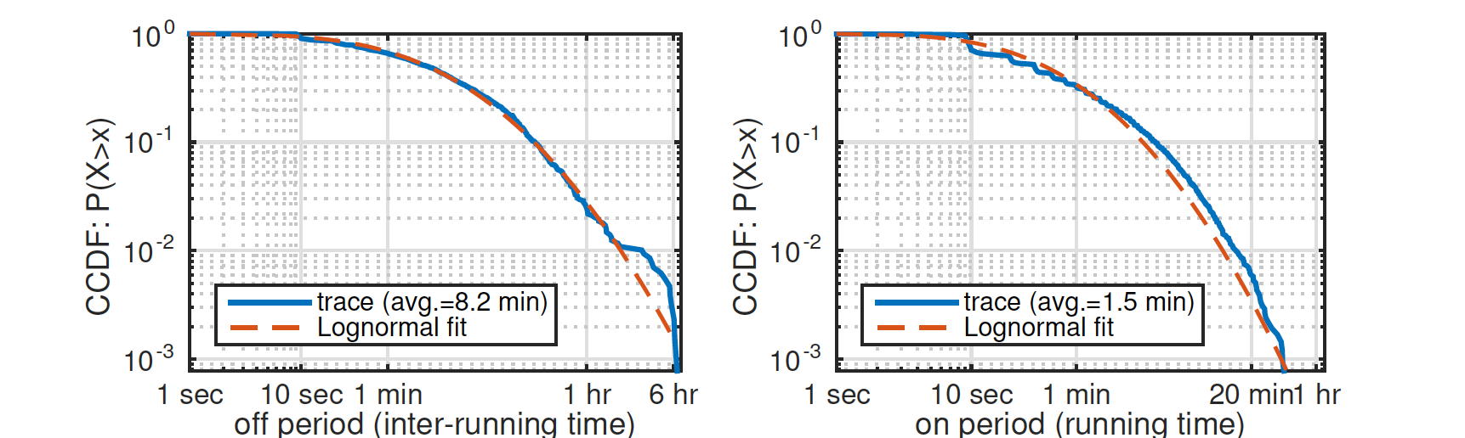
OFF/ON periods: multivariate heavy tailed
T_{k}^{on}=1.4 min
OFF / ON period distributions of a user: dependent lognormal
  OFF (T_{k}^{off}) and ON (T_{k}^{on}) periods are dependent, and
  OFF (T_{k-1}^{off}) and OFF (T_{k}^{off}) periods are also dependent
    Based on correlation coefficients (ranging from -0.09~0.37)
Screen on (668mA)
OFF period
(either in background or empy state)
X_{k}
X_{k+1}
2.5 apps in one
screen on period
ON
ON
Screen off (125mA)
T_{k}^{off} =15 min
3.4
Best fit according to Akaike, CSVM tests
Notes:
Heavy tail definition: Asmussen, S. R. (2003). "Steady-State Properties of GI/G/1". Applied Probability and Queues. Stochastic Modelling and Applied Probability 51. pp. 266–301. doi:10.1007/0-387-21525-5_10. ISBN 978-0-387-00211-8.
Estimated slope for first graph is: 1.127, and second graph is: 1.6657 from paper
Crovella, M. E.; Taqqu, M. S. (1999). "Estimating the Heavy Tail Index from Scaling Properties". Methodology and Computing in Applied Probability 1: 55. doi:10.1023/A:1010012224103.

Slide 20
Context improves prediction
Context information (conditions)
  Time-period, Location, Previous OFF/ON durations, Previously used app
10.5 min
Context information (conditions)
gives more accurate distribution
The length of the next off period
depends on the time of the day
>
6.6 min
35 min
>
>
9am-11pm
11pm-9am

Slide 21
Context improves prediction
Context information (conditions)
  Time-period, Location, Previous OFF/ON durations, Previously used app
10.5 min
The length of the next off period
depends on the previous durations
>
8.1 min
18.6 min
>
>

Slide 22



Context improves prediction
Context information (conditions)
  Time-period, Location, Previous OFF/ON durations, Previously used app
>
Messaging
2.5min
>
Social
34min
>
Game
31min
The length of the next off period depends on the last used app

Slide 23
Launching Probability
So Far …
Studied the inter-running and running time of applications
  Predicts when an application will be launched or stopped
  To determine whether and when an application should be put in the background/empty state
Next …
Characterize the launching probability of the applications
  To determine which application to put in the background or in the empty state

Slide 24
Frequently used applications
Launching probability of App i (where X is r.v. of the next launching app)
➔
Popular apps
  KakaoTalk, Android browser, Facebook, Chrome, Clash of clans, ...
Category | Process name | Launchs (%) | Runtime (s)
Messaging | com.kakao.talk | 27% | 47 sec
Browsing | com.android.browser | 6% | 161 sec
Portal | com.nhn.android.search | 4.4% | 123 sec
Browsing | com.sec.android.app.sbrowser | 3.8% | 129 sec
Social | com.facebook.katana | 3.3% | 126 sec
Contacts | com.android.contacts | 2.7% | 20 sec
Social | com.nhn.android.band | 2.2% | 49 sec
Browsing | com.android.chrome | 2.2% | 119 sec
Setting | com.android.settings | 1.8% | 29 sec
Social | com.nhn.android.navercafe | 1.5% | 82 sec
Game | com.supercell.clashofclans | 1.5% | 281 sec
Messaging | jp.naver.line.android | 1.2% | 29 sec
Notes:
Next, we analyze the launching probability of apps and found that the launching probability of apps is also heavy-tailed.
This table summarizes the popular apps over all participants.
The popular apps are KakaoTalk, the most popular messaging app in Korea, Android browser, Facebook, Chrome, and so on.
In the rightmost column, you can see that the average running time of apps are vastly different depending on the type of the application.
We define L(Y_i) as the launching probability of i-th popular app of a user.
We depict the aggregate launching probability of m popular apps in left and the launching probability of each app in right.
In the left figure, the solid red line indicates the average statistics and the dotted lines are aggregate launching probabilities of individual users.
We found that the launching probability follows Zipf’s law.
It implies that application use is dominated by a few number of frequently used apps, which is intuitive.
As a result, the aggregate launching probability of 10 most freqeuntly used apps is over 80%.
Thus, by putting 10 popular apps in background, we can reduce the cold launch to be less than 20%.
Left figure: Aggregate launching probability
Right figure: launching probability of each application (sorted)

Slide 25
Frequently used applications: Zipf’s law
Launching probability of App i (where X is r.v. of the next launching app)
➔
The launching probability follows Zipf’s law
  Zipf’s law: , where i is the rank
  The aggregate launching probability of 10 most frequently used apps is over 80%
  ➔ Putting 10 popular apps in background can reduce cold launch prob to be < 20%
P[X=i]
The dotted lines are
aggregate launching probabilities
of each individual user
Notes:
We depict the aggregate launching probability of m popular apps in left and the launching probability of each app in right.
In the left figure, the solid red line indicates the average statistics and the dotted lines are aggregate launching probabilities of individual users.
We find that the launching probability follows Zipf’s law.
It implies that application use is dominated by a few number of frequently used apps, which is intuitive.
As a result, the aggregate launching probability of 10 most freqeuntly used apps is over 80%.
Thus, by putting 10 popular apps in background, we can reduce the cold launch to be less than 20%.
Left figure: Aggregate launching probability
Right figure: launching probability of each application (sorted)

Slide 26
Overall goal
Two objectives
  Power consumption (~1/lifetime): submodular function
  Cold launch probability (~latency): modular function
Goal: minimize a weighted sum of the objectives
  [Expected (Energy) + γ (Disutility)] in an OFF or ON period
Control variable: B(t), a set of background applications
Distributional knowledge:
  Conditioned by each context set C (tuple of time, last app, prev. durations)
~ cold launch probability

Slide 27
Failure Rate (Aging Property)
Failure (hazard) rate of a component (OFF/ON period) with lifetime T
Positive aging
  r_{T}(t) is increasing in t (e.g., age of human adults, lifetime of parts)
Constant aging
  r_{T}(t) is constant (e.g., exponentially distributed T)
Negative aging
  r_{T}(t) is decreasing in t (heavy tailed, e.g., WiFi inter-connection/connection time)
- T is the random variable
- t is the elapsed time, or age

Slide 28
Problem formulation: OFF period
Submodular minimization
  Minimize expected energy plus disutility in an OFF period
    Assumption: disutility is proportional to the cold launch probability
    A context set C (tuple of contexts) is given for each OFF period
  Submodularity:
Difficulty
  Combinatorial nature: 2^{N} search space, (N is # of applications (~50 apps))
  O(N⁶) complexity for an optimal unconstrained submodular minimization
 | Set of background apps
 | Set of suspended apps
 | Power consumption of B
 | Trade-off parameter
Memory constraint

Slide 29
Heuristic 1: Local Optimal
Local Optimal (LO) (with complexity O(N²) where N is the # of applications)
  Input: Launching probability,
  Off/On period distributions,
  Trade-off parameter,
  Output: set of background apps at each time slot t in an ON/OFF period
  Choose one locally best background application at each iteration
  [An example of LO background app schedules]
  The # of background apps decreases over time
  because of negative aging (decreasing failure rate)

Slide 30
Local Optimality
Necessary condition
Our LO policy satisfies the necessary condition
Memory constraint
Our objective increases when
(1) excluding any single app, or
(2) including any single app

Slide 31
Heuristic 2: m-Frequently Used
m-Frequently Used (FU)
  Input: Only exploits the launching probability,
  (no period distributions/power function)
  Number of background applications, m
  Preload m most frequently used applications (i.e., static policy)
  Low unloading/preloading control overhead
  Even this simple heuristic performs better than the state-of-the-art

Slide 32
Overall Approach: Context-aware App Scheduler
Learning phase: to compute
  Calculate statistics for each context set C
Pre-computation (LO or FU) phase: to get
  Pre-compute background application schedules
Control phase
  At the start of each period (either OFF or ON):
    Check the given context set C (last app, length of previous period, day/night…)
    Get the pre-computed schedule
    Set alarms when , # of background apps are to be be added or removed.
  Wake the device up and preload/unload apps according to the schedule
Learning phase
(e.g., 2 weeks)
wakeup alarms
OFF
ON
OFF
(15 mins on average)
ON
(3.4mins)
•••

Slide 33
Trace-driven Simulation
Without and with context information
  Three context information (C=(Z_{k}, T_{k-1}^{off}, T_{k-1}^{on}, X_{k-1}))
    Time-period
    Previous off/on duration
    Previously used app
  Use conditional distribution and probability (e.g., X_{k}|C, T_{k} ^{off}|C, T_{k} ^{on}|C)
State-of-the-art
State-of-the-art
~ latency
Benefit from contexts
Benefit from contexts
Heuristic 1: LO
Heuristic 2: FU
~ 1/lifetime
~ 1/lifetime

Slide 34
Comparison
Energy overheads: computation, wakeup alarms, pre/unloading
  11.6mA (5.4mA) on average for the LO (FU) policy
Scheduler | Background power (+overheads) | Cold launch probability | Memory in background | Lifetime | Start-up latency
LMK-LRU (status quo) | 125.5mA | 53.9% | 325MB | 11.5 hr | 2.8 sec
Ultra power saving mode | 10mA | 100% | 0MB | 22 hr | 4.5 sec
ConAS-FU | 56.1mA (↓55%) | 26.2% (↓51%) | 84MB (↓74%) | 16 hr (↑39%) | 1.84 sec (↓34%)
ConAS-LO | 42.7mA (↓66%) | 16.4% (↓30%) | 44MB (↓86%) | 17.4 hr (↑51%) | 1.5 sec (↓46%)
Oracle (infeasible) | 10mA | 0% | 0MB | 22 hr | 0.9 sec

Slide 35
Summary of Results
Two heavy-tail behaviors:
  (1) log-normal off/on periods (multivariate heavy-tailed)
    Better to unload apps as time elapses (because prob. App is launched is decreasing with time)
  (2) Zipfian launching probabilities
    Enough to keep only a small # of popular apps in background
Context-awareness: App usage patterns are dependent on given contexts (e.g., previous ON/OFF time, time-period, last used app)
By exploiting the above application usage patterns,
ConAS-LO increases lifetime by 51% and
reduces cold launch by 46%

Slide 36
Future Work
How to use context information more efficiently?
  Finding energy-efficient contexts that give more accurate info
  How to classify continuous context values (e.g., prev. OFF duration)
Develop provably efficient approx. algorithms
How to choose trade-off parameters (γ in LO and m in FU)
How to learn (changes in) application usage patterns while algorithm is running (Combinatorial multi-armed bandit?)
How to exploit the similarity in app usage patterns of users?
  Peer-assisted learning (using user similarity in app usage)
  Provide better starting point before learning one’s own usage
Android implementation
  Happy to see if there is interest in the military to get volunteers…

Slide 37

Publications
Y. Kim, I. Koprulu and N. B. Shroff, "First Exit Time of a Levy Flight from a Bounded Region,” Advances in Applied Probability, Vol. 52, No. 2, 2015.
Y. Zheng, P. Sinha, and N. B. Shroff, “A New Analytical Technique for Designing Provably Efficient MapReduce Schedulers," IEEE INFOCOM'13, April 2013, Turin, Italy.
H. Cai, I. Koprulu, and N. B. Shroff “Exploiting Double Opportunities for Deadline Based Content Propagation in Wireless Networks,” IEEE INFOCOM’13, April 2013, Turin, Italy (extended version submitted for journal publication).
Y. Kim, K. Lee, and N. B. Shroff, “An Analytical Framework to Characterize the Efficiency and Delay in a Mobile Data Offloading System,” ACM Mobihoc'14, Philadelphia, PA, August 2014.
S. Buccapatnam, A. Eryilmaz, N. B. Shroff, "Stochastic Bandits with Side Observations on Networks," ACM SIGMETRICS'14, June 2014, Austin, Texas.
Y. Sun, Z. Zhang, E. Koksal, K-H. Lee, N. B. Shroff “Provably Delay Efficient Data Retrieving in Storage Clouds,” IEEE INFOCOM’15, April 2015, Hong Kong.
Y. Zheng, N. B. Shroff, R. Srikant, and P. Sinha, “Exploiting Large System Dynamics for Designing Simple Data Center Schedulers,” IEEE INFOCOM’15, April 2015, Hong Kong.
J. Lee, K. Lee, J. Jo, U. Jeong, and N. B. Shroff, “On the Benefit of Context-Aware Application Unloading in Mobile Systems”, submitted for publication, July 2015.

Slide 38
Thank You

Slide 39
Backup Slides

Slide 40
Rearranging the summation

Slide 41
Akaike test
Akaike information criterion
  A measure of the relative quality of statistical models of a given set of data
  L is the maximum value of the likelihood function for the model
  k is the number of estimated parameters in the model
  (e.g., k=1 for exponential, Pareto distributions,
  k=2 for lognormal, Weibull distributions)
Notes:
https://en.wikipedia.org/wiki/Akaike_information_criterion
[30] K. P. Burnham and D. R. Anderson, “Multimodel inference: Understanding
aic and bic in model selection,”

Slide 42


CSVM (Cramer-Smirnov-von Mises) test
Cramer-Smirnov-von Mises criterion
  A criterion used for judging the goodness of fit of a cumulative distribution function F* compared to a given empirical distribution function F_{n}
  Let x₁, x₂, …, x_{n} be the samples in increasing order
  F=F*
Notes:
https://en.wikipedia.org/wiki/Cram%C3%A9r%E2%80%93von_Mises_criterion
[29] W. T. Eadie, M. G. Roos, and F. E. James, Statistical Methods in
Experimental Physics. Elsevier Science and Technology, 1971.

Slide 43
An example of Akaike/CSVM tests
A distribution with smaller AIC/CSVM values is more accurate
 | AIC | CSVM
Exponential | 1.892e+4 | 44e-3
Weibull | 1.774+4 | 1.7e-3
Pareto | 1.882+4 | 23e-3
Lognormal | 1.748+4 | 0.5e-3
 | AIC | CSVM
Exponential | 4.61e+4 | 25e-3
Weibull | 4.49+4 | 6.3e-3
Pareto | 4.73+4 | 22e-3
Lognormal | 4.37+4 | 4e-3

Slide 44




Architecture: Context-aware App Scheduler
Background applist
Arrow | Frequency
 | Once an update interval
 | Once an off/on period
 | Several times in a period
ConAS
preload
unload
Screen off
3. App Controller
4. Alarm Manager
wake
T^{off}
T^{on}
Preload / Unload
setAlarm
Algorithm block
Screen on
decision
update
update
app usage,
contextual
info
2. User Profiler
1. Context Monitor
App usage
pattern
update
Device
characteristics
app usage
off/on duration
time
location
Resource
functions
User
characteristics
Notes:
This is overall architecture of our context-aware application scheduling framework.
1. The context monitor collects various contexts and
2. the user profiler learns distributional information of OFF/ON periods and launching probability and resource functions (power/memory).
3. The application controller runs a scheduling algorithm (FU or LO) and sets alarms when preloading/unloading is needed (i.e., the background app set changes).
4. Then, the alarm manager wakes the smartphone up and the controller preloads/unloads apps according to the schedule.
Note that the profiling and computing app schedules may be run only once in a very long duration (e.g., day, week).
The cloud server may help the system in two aspects:
(1) The cloud server can collect information from a large number of users and share information appropriately.
Especially, the power consumption of background apps is similar across the users who use the same device model.
(2) The cloud server can run a scheduling algorithm and give the results to the user.
The cloud server can run more complex scheduling algorithms.

