Slide 1
Load Balancing with Multivariate Heavy-Tailed Distributions
R. Srikant
University of Illinois at Urbana-Champaign
Students: X. Dong, X. Kang (ASU), Q. Xie, Y. Zheng (OSU)
Post-doc: B. Li
Faculty: Y. Lu, A. Ramamoorthy (ISU), N. Shroff (OSU), P. Sinha (OSU), L. Ying (ASU)

Slide 2
Outline
Problem
What we did till last year
Work done during the last year
Ongoing Work

Slide 3
Outline
Problem
What we did till last year
Work done during the last year
Ongoing Work

Slide 4
Load Balancing
Fundamental to all computer systems and communication networks
Jobs/Tasks/Packets arrive to a set of resources (servers/links/routes), and the goal is to perform routing to minimize queueing delay in the system
In this project, the goal is to understand the impact of multivariate heavy-tailed service times on the performance of such systems
Ideally, one would like the performance of the load-balancing algorithm to be insensitive to the nature of the service-time distribution, or if sensitive, it should be the optimal for each given distribution
Question: Does the above property hold for simple, low-complexity load balancing algorithms?

Slide 5

Model
Each server:
B units of the resource (e.g., CPU)
Job arrival:
Poisson process with rate $Nλ$
Demand 1 unit of the resource
Service time of jobs are i.i.d.
with mean 1
Job arrivals
Router
Server 1
Server 2
Server N

Slide 6
Ideal Load Balancing
Route each arrival to the least-loaded server
In this case, route to server 2
Impossible to implement in practice
When N is large, the complexity is high
Departures requires us to update the status
of the servers, very large overhead
Job arrivals
Router
Server 1
Server 2
Server N

Slide 7
Randomized Routing vs. Power-of-Two-Choices
Randomized Routing: upon each job arrival
Randomly select one server
Forward the job to that server
Job arrivals
Router
Server 1
Server 2
Server N

Slide 8
Randomized Routing vs. Power-of-Two-Choices
Randomized Routing: upon each job arrival
Randomly select one server
Forward the job to that server
Power-of-Two-Choices: upon each job arrival
Randomly sample two servers
Forward the job to the sampled server
with the smaller load
Vvedenskaya, Dobrushin, Karpelevich, 1996
Jobs that cannot be accommodated
are discarded (or queued)
Job arrivals
Router
Server 1
Server 2
Server N

Slide 9
Outline
Problem
What we did till last year
Work done during the last year
Ongoing Work

Slide 10
Story So Far….
Designed low-complexity algorithms for queueing models, with more general job types than in the previous slide
Last year’s review: Answered Harry Chang’s question regarding the heavy-traffic optimality of load balancing policies when queueing is allowed
i.e., whether the load-balancing policies are delay optimal when the load on the system increases
Certain load-balancing policies are heavy-traffic optimal
We proposed to look at zero-delay systems, where a job is discarded if there is no space

Slide 11
Outline
Problem
What we did till last year
Work done during the last year
Ongoing Work

Slide 12
Main Result: Qualitative
Question: Does the system performance depend on service-time distributions. In particular, if we have multiple jobs arrive at each arrival instant, with dependent heavy-tailed service time distributions, do we have poor performance?
Answer: In large systems, the performance is insensitive to both service-time distributions and their dependence (the “proof” assumes an interchange of limits)

Slide 13
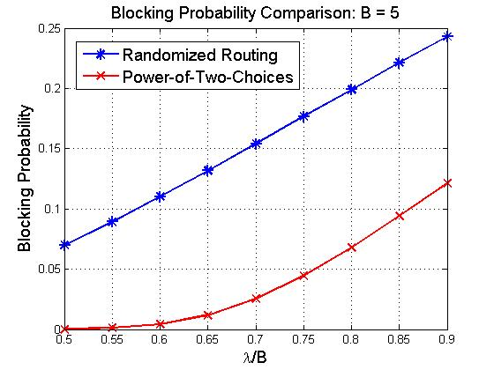

Main Result: Quantitative
Randomized Routing (RR)
Blocking probability $P_{b}^{(RR)}$
$P_{b}^{(RR)}∝λ^{B}$
Power-of-Two-Choices (P2)
Blocking probability $P_{b}^{(P2)}$
$$P_{b}^{(P2)}≤{\tilde{P}}_{b}∝ λ^{2^{B}}$$

Slide 14
Randomized Routing: General Service Times
Single arrival
The arrival to each server is a Poisson process
Insensitivity to service time distribution (well known)
Correlated batch arrivals
In the large system limit, upon each batch arrival, with probability 1, no two tasks join the same server
Insensitivity property still holds

Slide 15
Power-of-Two-Choices: Single Arrival
For any finite systems, servers are correlated
Sample two servers upon each job arrival
Job arrivals
Router
Server 1
Server 2
Server N
Notes:
(8) Power-of-Two-Choices Routing; For finite N, the the number of tasks in each server are not independent because we sample two servers each time.
(9) Power-of-Two-Choices Routing: first consider the case of a single arrival. Explain the branching process argument to illustrate why we have independence.

Slide 16


Power-of-Two-Choices: Single Arrival (Cont’)
In the large system limit (i.e., $N→∞$), any fixed number of servers become independent from each other (Bramson, Lu, Prabhakar, 2011)
Influence set $X_{k}$ of server 1: set of servers correlated with server 1 upon k^{th} arrival
The probability of adding a new server into the influence set $X_{k}$ is
1st arrival
samples (1,3)
2st arrival
samples (4,3)
3st arrival
samples (1,4)
4st arrival
samples (4,8)
1
1
1
1
3
3
3
3
4
4
4
8
$$\frac{\left(\begin{aligned}|X_{k}| \\ 1\end{aligned}\right)\left(\begin{aligned}N−|X_{k}| \\ 1\end{aligned}\right)}{\left(\begin{aligned}N \\ 2\end{aligned}\right)}$$
$$≤\frac{2|X_{k}|}{N}$$
Notes:
(8) Power-of-Two-Choices Routing; For finite N, the the number of tasks in each server are not independent because we sample two servers each time.
(9) Power-of-Two-Choices Routing: first consider the case of a single arrival. Explain the branching process argument to illustrate why we have independence.
Explain the branching process argument to illustrate why we have independence.

Slide 17
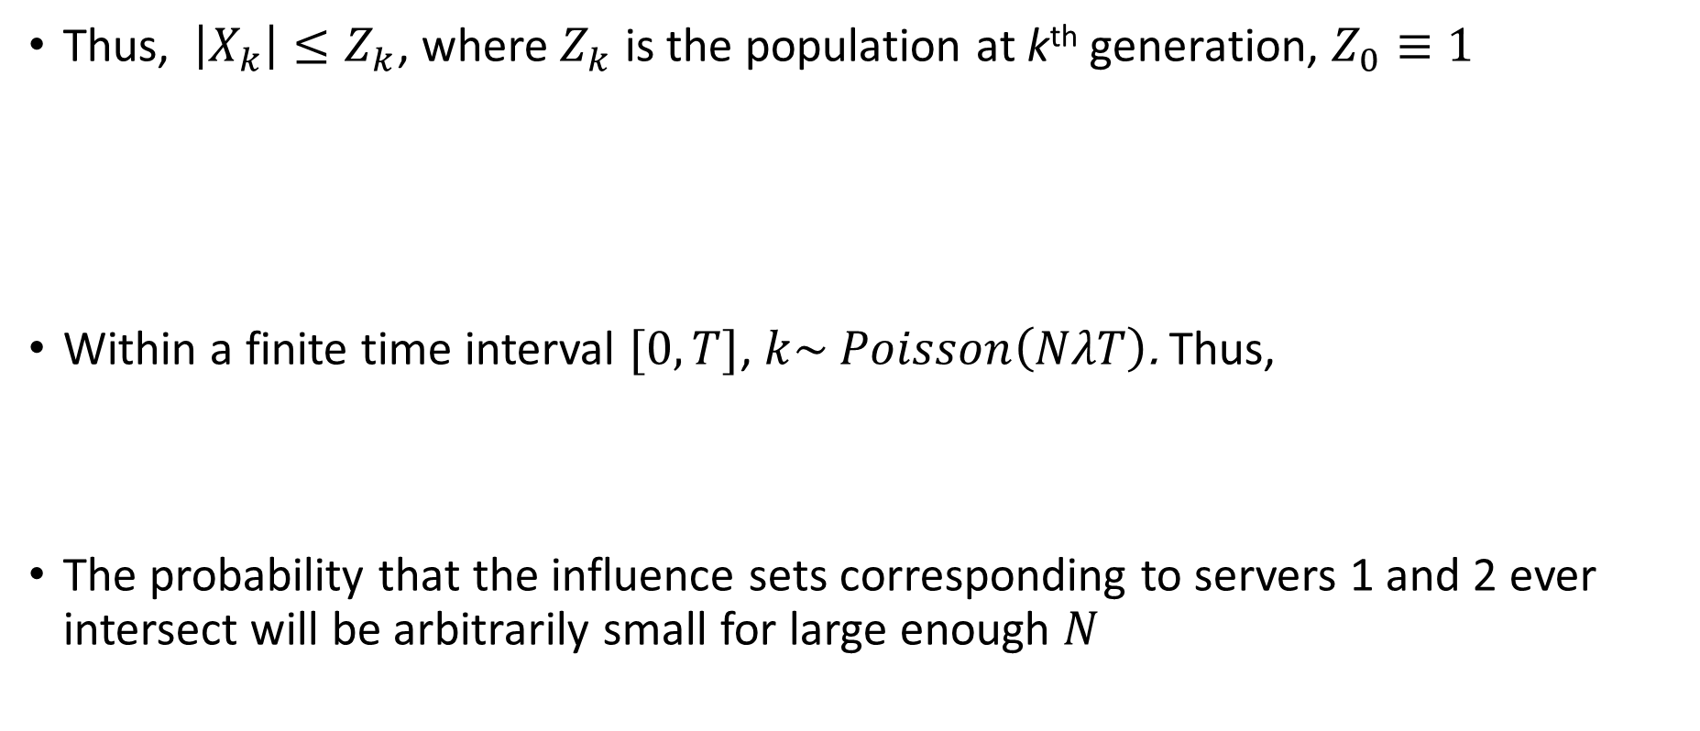

Branching Process Interpretation
Thus, $\left|X_{k}\right|≤Z_{k}$, where $Z_{k}$ is the population at k^{th} generation, $Z_{0}≡1$
Within a finite time interval $[0,T]$, $k\sim Poisson\left(NλT\right)$. Thus,
The probability that the influence sets corresponding to servers 1 and 2 ever intersect will be arbitrarily small for large enough $N$
$$Z_{k+1}=\left\{\begin{aligned}Z_{k}+1, w.p. \frac{2Z_{k}}{N} \\ Z_{k}, w.p. 1−\frac{2Z_{k}}{N}\end{aligned}\right.$$
$$E\left[Z_{k}\right]=E\left[{\left(1+\frac{2}{N}\right)}^{k}\right]=e^{2λT}$$
Notes:
(8) Power-of-Two-Choices Routing; For finite N, the the number of tasks in each server are not independent because we sample two servers each time.
(9) Power-of-Two-Choices Routing: first consider the case of a single arrival. Explain the branching process argument to illustrate why we have independence.
Explain the branching process argument to illustrate why we have independence.

Slide 18

Power-of-Two-Choices: Batch Arrivals
$\left|X_{k}\right|≤Z_{k}$, where $Z_{k}$ is the population at k^{th} generation, $Z_{0}≡1$
where C is the batch size.
Within a finite time interval, $E[Z_{k}]$ is still a constant
In the large system limit, servers are still independent of each other
$$Z_{k+1}=\left\{\begin{aligned}Z_{k}+C, w.p. \frac{2Z_{k}}{N} \\ Z_{k}, w.p. 1−\frac{2Z_{k}}{N}\end{aligned}\right.$$
Notes:
(8) Power-of-Two-Choices Routing; For finite N, the number of tasks in each server are not independent because we sample two servers each time.
(9) Power-of-Two-Choices Routing: first consider the case of a single arrival. Explain the branching process argument to illustrate why we have independence.
In the large system limit, the tasks in the same server are independent from each other
Why? The event that no two tasks join the same server happens almost surely

Slide 19
Mean-Field Analysis
Consider one server in isolation
Assume other servers are in steady-state and independent
The probability that the server will receive an arrival is a function of its state
And the states of the other servers in the system
But this second part is averaged out under the mean-field assumption
Notes:
Draw the mean-field Markov chain and show how it looks similar to the M/M/B/B model. Thus, insensitivity follows from similar arguments

Slide 20

Mean-Field Analysis
L$et x=(x_{1},x_{2},⋯,x_{k})$, where $x_{i}$ is the remaining service of i^{th} task and$x_{1}≤x_{2}≤⋯≤x_{k}$
where$T_{i}x=(x_{1},x_{2},⋯,{x_{i−1,}x_{i+1,}x}_{k})\text{,}$ $g$ and $G$ are the PDF and CCDF of the service time distribution, respectively
Insensitivity follows from standard relationships between forward and reverse Markov chains
$$\frac{g(x_{i})}{\overline{G}(x_{i})}$$
$$x$$
$$T_{i}x$$
$$λ_{k−1}g(x_{i})$$
Notes:
Draw the mean-field Markov chain and show how it looks similar to the M/M/B/B model. Thus, insensitivity follows from similar arguments

Slide 21
Mean-Field Analysis (Continued)
Insensitivity allows us to compute with exponential distributions
Consider a particular server 1 with B units of the resource
where $λ_{k}$and $s_{k}≜\sum_{j≥k}{π_{j}}$
$$λ_{k}$$
k
k+1
k+1
$$=λ\left(s_{k}+s_{k+1}\right)$$
Notes:
Write down the local-balance equation. Cannot solve for these, but can get a bound. Compare the blocking probability under random routing and Power of Two-Choices.

Slide 22
Mean-Field Analysis (Continued)
According to local balance equation, $π_{k}λ_{k}(π)=\left(k+1\right)π_{k+1}$
From these equations, one can solve for the blocking probability
$λ\left(s_{k}^{2}−s_{k+1}^{2}\right)=\left(k+1\right)\left(s_{k+1}−s_{k+2}\right)$, $0≤k≤B−2$
$λ\left(s_{B−1}^{2}−s_{B}^{2}\right)=Bs_{B}$ , $k=B−1$
Notes:
Write down the local-balance equation. Cannot solve for these, but can get a bound. Compare the blocking probability under random routing and Power of Two-Choices.

Slide 23

Loss Model: Heterogeneous Case
Each server:
B units of the resource
Type-j Job arrival:
Poisson process with rate $Nλ_{j}$
Demand $b_{j}$ units of the resource
Service time of jobs are i.i.d.
with mean 1
: type-1 job
: type-2 job
: type-3 job
Job arrivals
Router
Notes:
Draw a figure illustrating vector packing for multidimensional resource

Slide 24
Mean-Field Analysis
Let $r_{k}$ be the steady-state probability that the number of occupied resource units is at least k
Again, one can solve for the blocking probability from these equations
$$\sum_{j=1}^{J}{λ_{j}b_{j}}\left(r_{k−b_{j}}^{2}−r_{k−b_{j}+1}^{2}\right)=k\left(r_{k}−r_{k+1}\right)$$
where $r_{m}=1$ for any $m≤0.$
Notes:
Present the bounds in the multi-dimensional case.

Slide 25
Conclusions
Power-of-2-choices: its performance is insensitive to both job correlation and service-time distribution in the large-system limit
Blocking probability decreases dramatically with power-of-2-choices, compared to random routing
Similar results for power-of-$d$ choices
Improvement from $d=2$ to $d=3$ is not as dramatic
Notes:
Insensitivity. Blocking probability decreases dramatically with power-of-d choices

Slide 26
Outline
Problem
What we did till last year
Work done during the last year
Ongoing Work

Slide 27
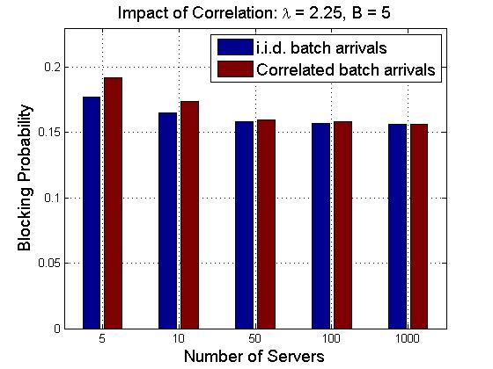
Ongoing Work: Impact of Correlation
How large should the system be for “insensitivity” to hold? i.e., Convergence rate as $N→∞?$ (Can we leverage the recent work by Ying on Kurtz’s theorem, which was in turn motivated by the work of Dai and Braverman?)
Notes:
(6) Simulations: Correlated batch arrivals exponential versus non-exponential, performance is sensitive to correlation for finite N, insensitive to service-time distribution for finite N, and insensitive to both for large N.

Slide 28
Ongoing Work: Mean-Field Limit
We have established “Propagation of Chaos,” i.e., within any finite time interval, any fixed number of servers becomes independent from each other in the large system limit
To complete the proof, we need to establish an “Interchange of limits” result
Need time go to infinity followed by the system size go to infinity
What we done so far is the reverse of the above
Notes:
Interchange of Limits

Slide 29
References
Zheng, Shroff, Srikant, Sinha (IEEE INFOCOM 2015)
Ying, Srikant, Kang (IEEE INFOCOM 2015)
Xie, Dong, Lu, Srikant (ACM SIGMETRICS 2015)
Li, Ramamoorthy, Srikant (Submitted)

