Slide 1
Influence Maximization on Social Networks
MURI Oct 16 Annual Review
Zhi-Li Zhang
zhzhang@cs.umn.edu
Dept. of Computer Science & Eng.,
University of Minnesota

Slide 2
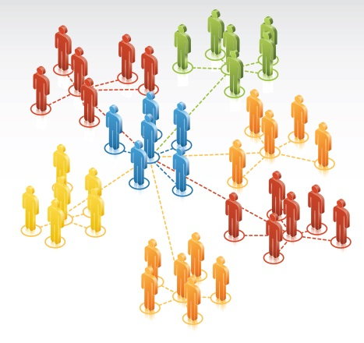

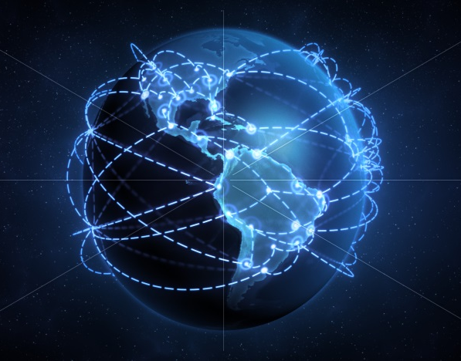
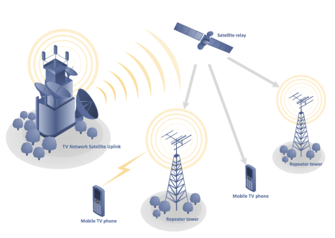
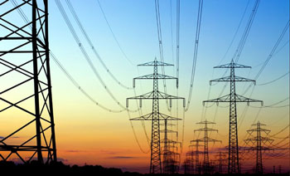
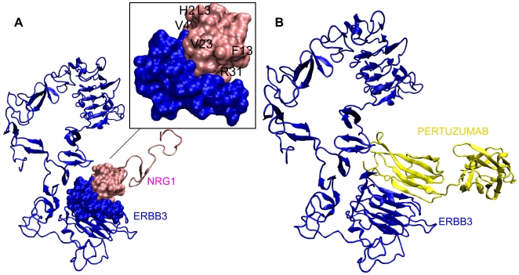
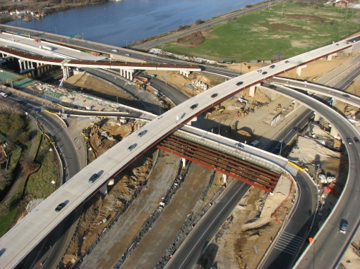
We are surrounded by networks!
Motivation
Networks are “by nature” multivariate entities
  formed by n nodes and m edges connected in various manners
  edges may be directed, and/or have weights, signs, …

Slide 3
Major Activities in Past Year
Prior years: bringing a “multivariate analysis” perspective to study structural properties of complex networks
  In particular, understand roles and impact of multivariate heavy tails
  (univariate) power-law degree distributions not sufficient to capture diverse network structures, e.g., core-periphery, hierarchical, …
This past year: three major directions
  in collaboration with Don, Sid, Richard, et al
Reciprocity in asymmetric (directed) social network
Dynamic processes on complex networks: influence maximization on (directed) social networks; impact of network structures
Applications: a) sampling big trajectory data; b) separating benign & malicious traffic via ICA for accurate malware classification

Slide 4
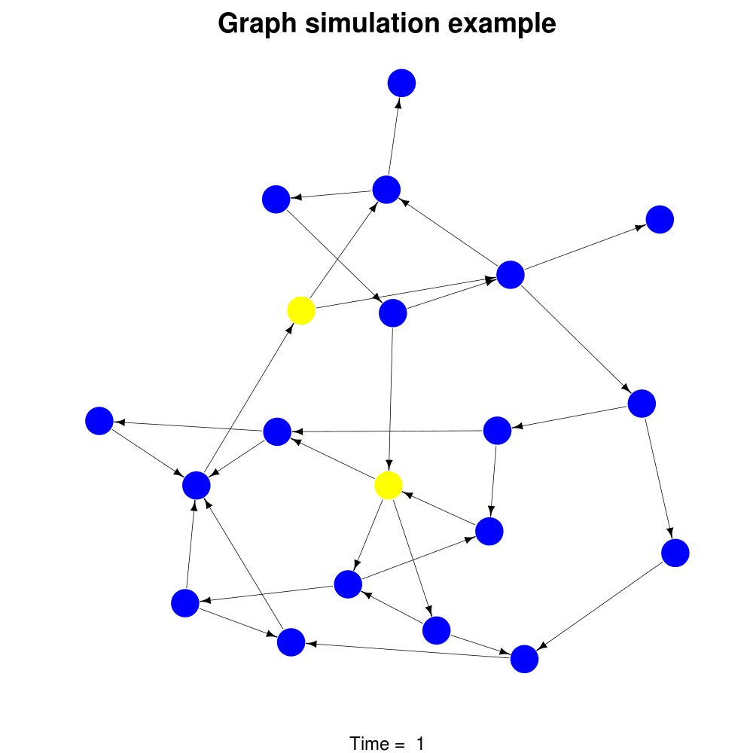
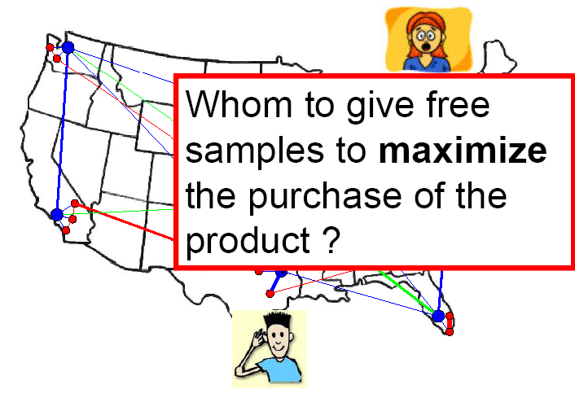
Dynamic Processes on Complex Networks
Cascade problems
Nodes are active entities that can interact with each other
  How does the structure of complex networks affect such dynamic processes on these networks?
Example: “cascades” in complex networks
  How influence or information cascades in a social/data network?
  e.g., who are most influential nodes in a social network that maximize the spread of an idea or meme, via tweets/retweets?
  highest degree nodes?
product recommendation or viral marketing

Slide 5
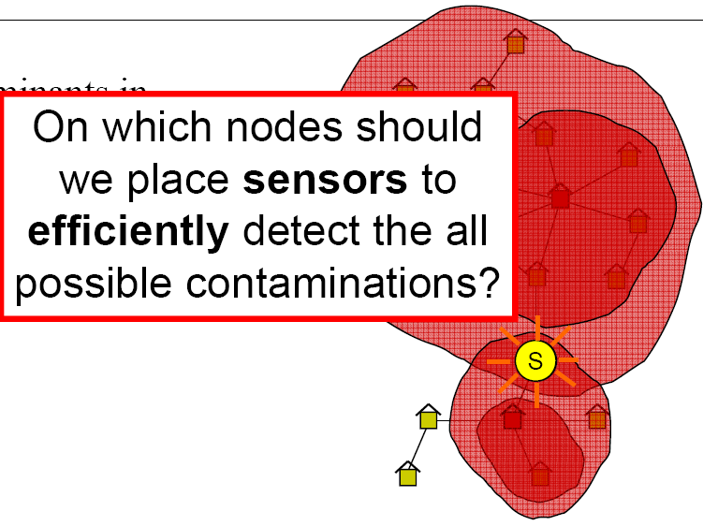
Dynamic Processes on Complex Networks
Cascade problems
Nodes are active entities that can interact with each other
  How does the structure of complex networks affect such dynamic processes on these networks?
Example: “cascades” in complex networks
  Influence/information cascade in social/data networks
  Malware spreading, attacks, or cascading failures in communication, power grid and other infrastructure networks,
  or spread of infectious diseases
  e.g., which are most vulnerable nodes
  that would trigger largest cascading failures?

Slide 6
Influence Maximization Problem
Given
  a network represented as a graph: e.g., a social graph
  a (local) influence propagation or cascade model
Objective: find the K most influence nodes (“seeds”) that maximizes the influence spread
an “activated” node stays active!
Non-progressive
an “activated” node may become inactive!
Progressive
Progressive Models
Independent Cascade
Linear Threshold
e.g. tweets, free sample ads
Non-Progressive Models
Voter
Non-progressive LT
e.g., adoption of an idea or product, subscription to a service, computer crash

Slide 7
Influence Maximization Problem: General Optimization Formulation
Unfortunately, the (Progressive) Influence Maximization Problem is NP-hard!
Good approximation algorithms can be found, which rely on
Greedy algorithm reaches within 63% of the optimum:
  starting with the “most influential” node (i.e., |S|=1), at each iteration adding the next “most influential” node until |S|=K.

Slide 8
Influence Maximization Problem: Prior Studies
Cascade problems
Focus primarily on the progressive models;
few consider the non-progressive models
Under progressive models, no closed form solutions to the influence function
Greedy algorithms for progressive models are slow:
  Influence function computation: slow Monte Carlo simulation
  All need to be tested in each iteration
Non-progressive influence maximization problem: reduced to solving the progressive version by replicating a version of the network at each time step

Slide 9
Contributions of Our Work
Introduce the Heat Conduction (HC) model
  Non-progressive
  Generalizes and unifies Voter, non-progressive LT, etc.
Support more flexible (social or other) interpretations
  “out of network” activation of nodes (e.g., global influence) is possible.
  resistance to global or peer influence can be modeled.
C2Greedy: Efficient and scalable influence maximization algorithm
  is sub-modular under HC.
  has closed form (1st closed form)
  Greedy seed selection has closed form (2nd closed form)
First to develop an efficient approximation algorithm to solve influence maximization problem under a general unifying non-progressive model
-- with applications to non-social network settings, e.g., cybersecurity, power grid
-- first to demonstrate impact of network structures on influence maximization

Slide 10
Non-Progressive Influence Maximization
Cascade problems
Given a directed (social influence) graph
Edge weight amount of trust i has on j
Influence cascade is a binary process: at a given time t, node i either adopts a product or an idea (“active”), or rejects/abandons it (“inactive”)
(Non Progressive) Influence Maximization Problem (with budget K):

Slide 11
(Non-Progressive) HC Influence Model
Cascade problems
We introduce the Heat Conductance (HC) Influence Model
  which unifies existing non-progressive models (e.g., voter, non-progressive LT) in the literature
  more importantly, incorporates “non-social” (“non-local”) global influence (e.g., media influence) as well as node resistance
intrinsic bias
(resistance)
(probability of) global influence

Slide 12

HC Influence Model & Heat Equation
Cascade problems
We introduce the Heat Conductance (HC) Influence Model
Global influence can be modeled by adding a special node (node 0) into the social influence, where each node i is influenced by it (“follows” it)
HC dynamics can be compactly represented as:
node 0
or as discrete heat equation:
where

Slide 13
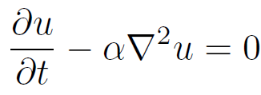
HC Influence Spread
Cascade problems
Given an initial seed set S, at influence spread (or function) at time t:
HC dynamics as as the Dirichlet boundary problem for heat equation
Can be solved using the (Absorbing) Markov Chain Theory

Slide 14
HC Influence Spread & Markov Chain
Cascade problems
Given a seed set S, the boundary set (“absorbing states”) is
The HC dynamics at time t is given by
where
The influence function or spread at infinite time horizon is given by
where Q is the absorption probability matrix, Q=FB
and

Slide 15
Influence Maximization for K=1
Cascade problems
also known as the Most Influential Person (MIP) Problem
Is the solution to the following optimization
which has a closed form solution!

Slide 16
Influence Maximization for K > 1
Cascade problems
Non-progressive influence maximization problem under the HC model with K > 1 is NP-hard!
But the influence spread under the HC model is non-negative, monotone sub-modular function
    closed-form solution for |S|=1
Greedy algorithm achieves (1-1/e) factor of the optimal solution:
The (k+1)th seed is the node with maximum marginal gain:
Again has a closed-form solution:

Slide 17
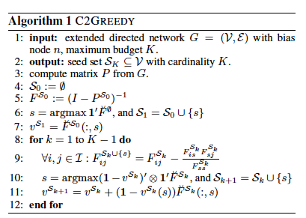
C2GREEDY Algorithm
Cascade problems

Slide 18
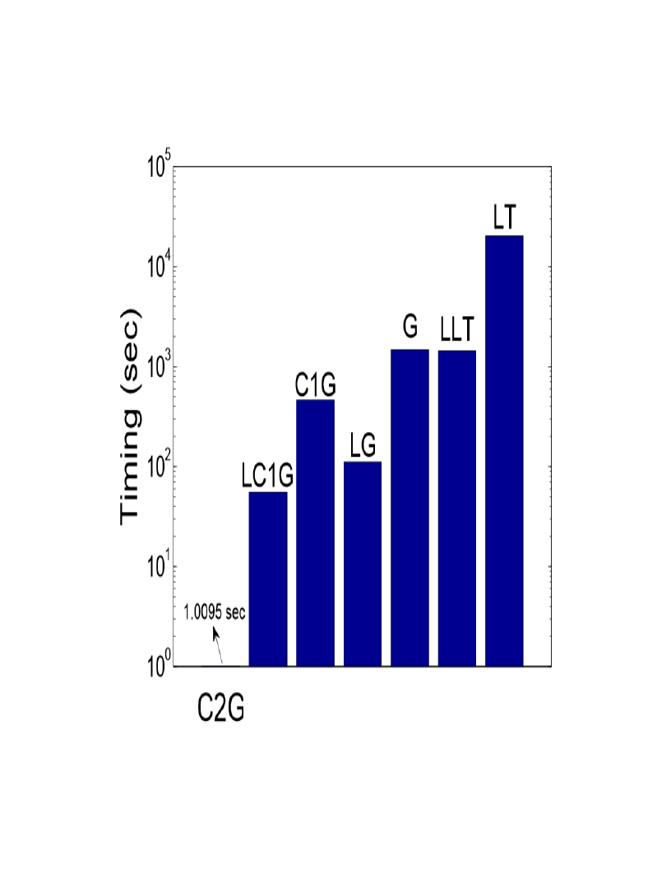
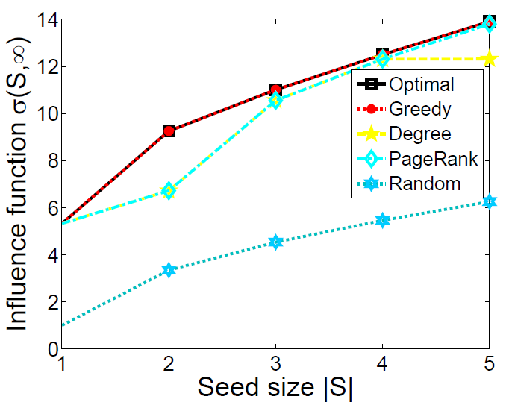
Performance of C2GREEDY
Cascade problems
  Zachary’s karate club network with 34 nodes and 501 edges
  Pblogs dataset with K=10
C2GREEDY
  Our algorithm (C2Greedy) performs very close to optimal solution and outperforms all of the baselines
  MPI code running on 400 cores of 2.8 GHz each

Slide 19
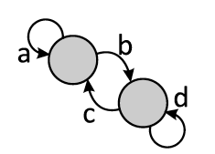
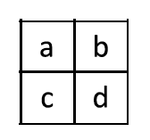

Impact of Network Structures on
Influence Maximization Problem
Cascade problems
Consider three types of networks: ER random, core-periphery (“scale-free”) and hierarchical (“community”) networks
Generated using the Knonecker power graph method we have developed in the previous year

Slide 20
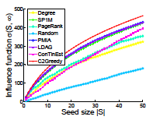
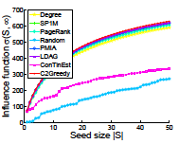
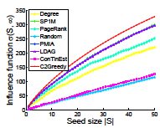
Impact of Network Structures on
Influence Maximization Problem
Cascade problems
Network structure does matter!
  Simple degree-based (“yellow”) or page rank (“electric blue”) method works reasonably well for “scale-free” (core-periphery) networks
  But it doesn’t work as well for networks with other structures
Network structure also affects how far influence can spread in the network
ER-random
core-periphery
hierarchical
Most influential nodes selected by progressive models may not be the most influential nodes when nodes can change their minds (i.e., non-progressive)!

Slide 21
Influence Maximization under Non-Progressive Models using Real Network Data
Case Study: Research Topic Propagation
Question: Who can popularize a research topic most effectively?
Focus on Machine Learning (ML) and Data Mining (DM) communities
  Researchers’ interests are mostly in either ML or DM
Influence Graph: who-follows-whom (WFW) network construction
  inferred from collaboration and citation networks.
Change of interest or research focus?
  inferring yearly change of interests based on published work in conferences and journals.

Slide 22
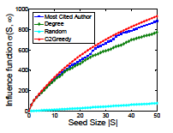
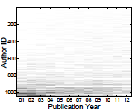
Influence Maximization under Non-Progressive Models using Real Network Data
Influence maximization 𝐾= 6
  What are the best 6 researches to bring into ML for making it popular?
1. Michael I. Jordan
2. John D. Lafferty
3. Henry Markram
4. Jason Weston
5. Andrew Y. Ng
6. Emery N. Brown

Slide 23
Contributions of Our Work
Introduce the Heat Conduction (HC) model
  Non-progressive
  Generalizes and unifies Voter, non-progressive LT, etc.
Support more flexible (social or other) interpretations
  “out of network” activation of nodes (e.g., global influence) is possible.
  resistance to global or peer influence can be modeled.
C2Greedy: Efficient and scalable influence maximization algorithm
  is sub-modular under HC.
  has closed form (1st closed form)
  Greedy seed selection has closed form (2nd closed form)
First to develop an efficient approximation algorithm to solve influence maximization problem under a general unifying non-progressive model
-- with applications to non-social network settings, e.g., cybersecurity, power grid
-- first to demonstrate impact of network structures on influence maximization

Slide 24


Sampling Big Trajectory Data
Proliferation of mobile devices, GPS devices, various sensors generate huge volume of “trajectory” data
  especially in urban environments
Key to our nation’s new “Smart City/Smart Community” Initiatives
Taxi GPS Trajectory
Mobile User Trajectory

Slide 25
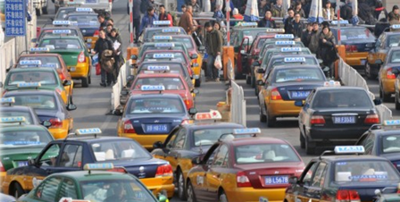

Sampling Big Trajectory Data
Proliferation of mobile devices, GPS devices, various sensors generate huge volume of “trajectory” data
  especially in urban environments
Trajectory Aggregate Query: retrieves statistics of distinct trajectories passing a user-specified spatio-temporal region
Examples:
  # of taxi trips with average speed of > 15 mph in New York City in 2014;
  # of mobile drivers with iPhone in downtown MPLS between 9am -5pm
Due to huge data volume, exact answers are often not feasible nor necessary ➔ how to sample big trajectory data w/ error bounds?

Slide 26
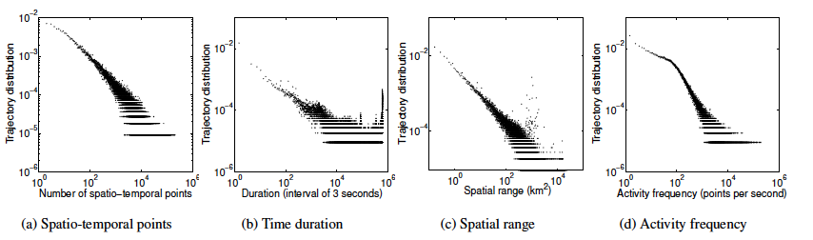
Trajectory Data: Multivariate Heavy Tailed?
Correlation or dependency structures across spatial and temporal dimensions create problems for “naïve” sampling methods
Using state-of-art spatio-temporal trajectory data indexing techniques (e.g., ST R-tree, multi-version R-tree, quad-tree),
aggregate trajectory query reduced to unique value estimation problem
➔ estimation errors under standard random sampling can’t be bounded

Slide 27
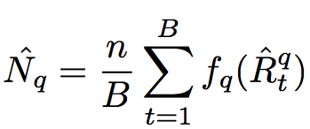


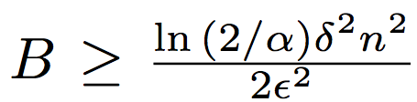
Our Contributions
Key Idea: introduce an inverted index to correct “biases”
Random Index Sampling
uniformly at random sample B index leaf nodes w/ replacement
unbiased estimator
inverted index
estimation error can be bounded when
Concurrent Random Index Sampling
for large # of concurrent aggregate queries
  sampling reuse & stratified sampling
First sampling algorithms with provable error bounds for aggregate queries in big spatio-temporal data

Slide 28
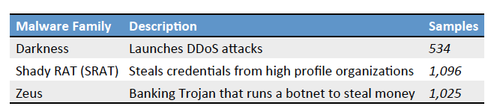
Separating Benign & Malicious Network Events for Accurate Malware Classification
Malware adapts and constantly evolves to evade detection
Classifying malware to a malware family helps track evolution of malware with similar origins, & improves defense, forensics and attribution
  e.g.,

Slide 29



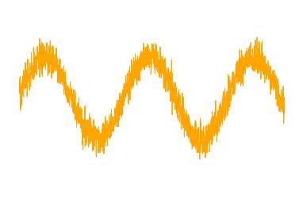
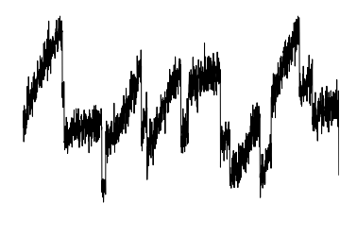
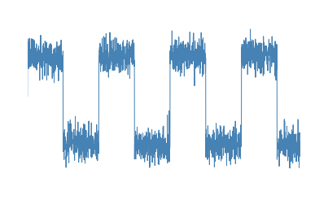
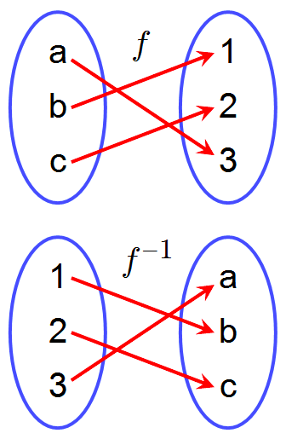
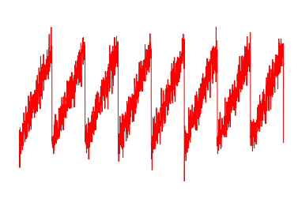
Separating Benign & Malicious Network Events for Accurate Malware Classification
Malware adapts and constantly evolves to evade detection
Classifying malware to a malware family helps track evolution of malware with similar origins, & improves defense, forensics and attribution
It is not too hard to capture “pure” malware samples, e.g., via honey farm, and from which obtain statistics, e.g., about their network behavior
In real networks, however, observed traffic from a host of suspected malware infection contains a mixture of benign and malicious activities
➔ need to separate benign & malicious traffic before malware classification
Observed Traffic

Slide 30
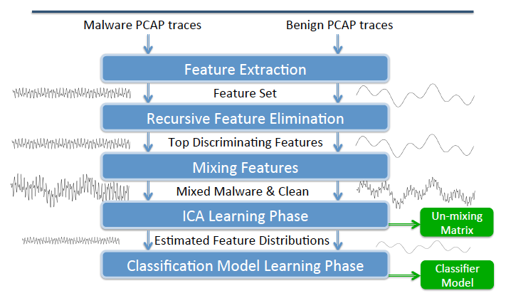
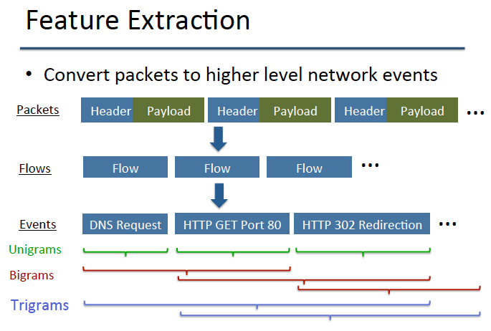
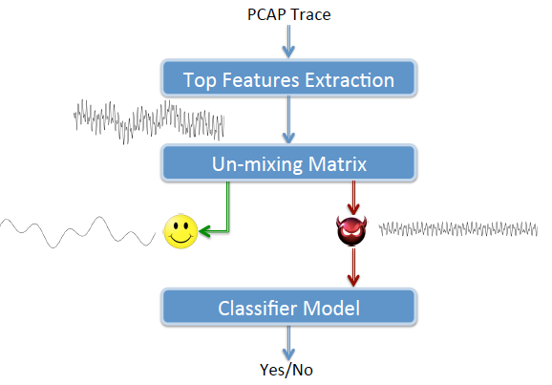
Separating Benign & Malicious Network Events for Accurate Malware Classification
We apply ICA (independent component analysis) to tackle this problem
  taking advantage of the fact that benign & malicious traffic often must exhibit different (multivariate) distributions in certain feature space!
Key challenges: what discriminating features to use?
Our approach: a learning phase, then ICA separation & classification

Slide 31
2D Scatter Plot for Malware vs. Background
F1 (unigram feature): outbound HTTT POST on port 80 with large payload
  C&C communication between infected host and master server
F2 (tri-gram feature): three consecutive HTTP GET requests in same TCP over port 80
  HTTP pipelining in modern web browsers

Slide 32
Summary
This past year: three major directions
  in collaboration with Don, Sid, Richard, et al
Reciprocity in asymmetric (directed) social network
Dynamic processes on complex networks: influence maximization on (directed) social networks, w/ applications to non-social nets
Applications: a) sampling big trajectory data – addressing challenging created by heavy-tailed data; b) separating benign & malicious traffic via ICA for accurate malware classification – exploiting heavy-tailed malware statistics from normal traffic statistics
Ongoing Work and Future Plan
Reciprocity and Evolution of Networks: Google+ as case study
Multivariate heavy tailed data analysis & modeling, with
Applications to big mobile network and urban network data, as well as cybersecurity and other problem domains

Slide 33
Thank You!
Questions?

