Slide 1
Multivariate Heavy Tails and Structural Properties of Complex Networks
MUR 2016 Apr Team Meeting
Zhi-Li Zhang
zhzhang@cs.umn.edu
Dept. of Computer Science & Eng.,
University of Minnesota

Slide 2
Outline
Three main thrusts of research
Analysis of a Reciprocal Network using Google+: Structural Properties and Evolution
K-shell Decomposition Analysis of Directed Networks
  Goal: understand how networks are connected and the roles of (high-degree) nodes in network connectivity
Random Walks in a (parametrized) Evaporation Network and Shortest Path Replacement Problems

Slide 3

Analysis of a Reciprocal Network using Google+:
Structural Properties and Evolution
Google+ Overview and Dataset
Methodology & Basic Notations
  Node and Edge Categorization
Reciprocal Networks: Characteristics & Evolution
  Growth of Nodes & Edges
  Growth of Mutual Edges
  Network Density Evolution
  Degree Distributions and Edge Category Evolution

Slide 4
Motivation
Many Online Social Networks are fundamentally directed (e.g: reciprocal and parasocial edges): Twitter, Facebook, Google+, YouTube, etc
Reciprocity has been widely studied in the literature:
  Reciprocal or anti-reciprocal classification of directed networks
  Maximum achievable reciprocity in directed networks
Little attention is given to understand the connectivity or network formed by the reciprocal edges (reciprocal network), its structural properties and evolution
We perform a comprehensive measurement-based characterization of the connectivity and evolution of the reciprocal edges in Google+ (G+):
  Understanding how the reciprocal network evolves over time as new users (nodes) join the social network
  Analyzing how reciprocal edges are created, e.g: whether they are formed mostly among extant nodes already in the system or by new nodes joining the network

Slide 5

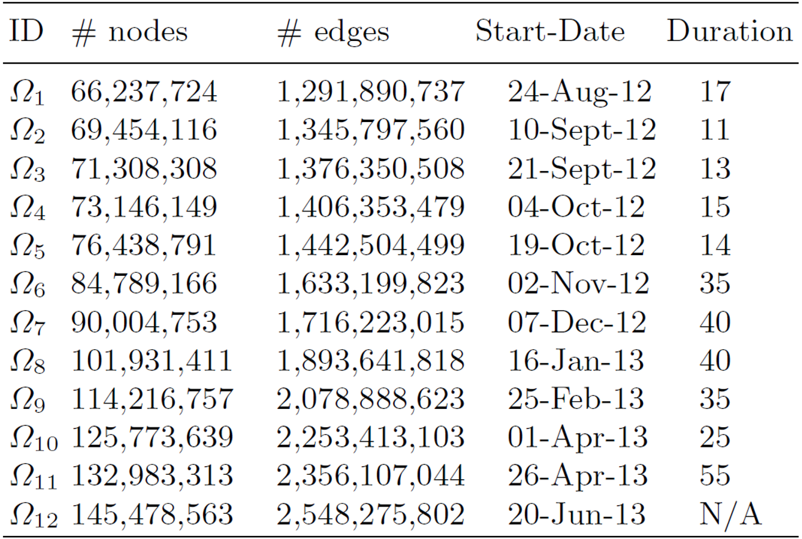
Google+ Overview and Dataset
Google +: Hybrid Online Social Network
  launched on June 28th 2011
  Sept. 20th, 2011 G+ became open to the public
  Nov. 11th, 2011 the registration process was integrated with other Google services (e.g., Gmail, YouTube)
Dataset:
  collected from August 2012 to June 2013
  12 directed graphs of the social links of users
  extracted the Largest Weakly Connected Component (Ω) using BFS

Slide 6
Methodology & Basic Notation
Methodology to extract the reciprocal networks of G+:
  i: ith snapshot
Construct the
subgraph by just
keeping the
“mutual” edges
Remove all the
nodes that
departure
from last snapshot
Extract
LWCC of L^{i}
Ω^{i} (V^{Ω}, E ^{Ω}) ----------> G^{i} (V^{G}, E^{G}) ----------> L^{i} (V^{L}, E^{L}) ----> H^{i}(V^{H}, E^{H})
Directed Graph
Undirected Graph
Reciprocal Networks (of G+): we refer to H^{i} as the ith (stable) reciprocal networks of G+: formed by reciprocal edges between nodes that stay in the last snapshot of the reciprocal network
  i.e., removing all nodes that have left G+, or have “unfollowed” another node (no longer forming an reciprocal edge)

Slide 7
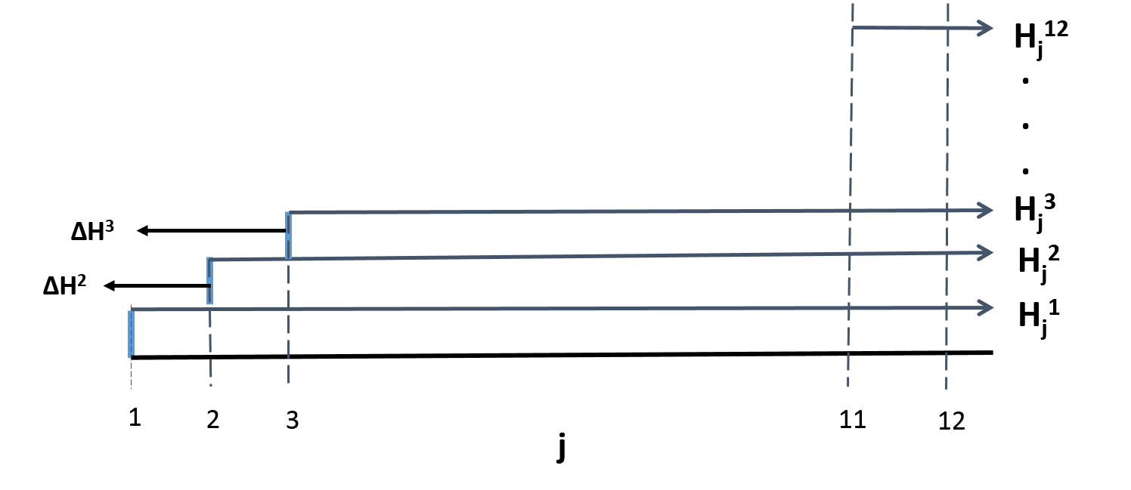
Methodology & Basic Notation
Methodology to extract the reciprocal network of G+:
Ω^{i} (V^{Ω}, E ^{Ω}) ----------> G^{i} (V^{G}, E^{G}) ----------> L^{i} (V^{L}, E^{L}) -------> H^{i}(V^{H}, E^{H})
Directed Graph
Undirected Graph
H^{i} : ith reciprocal network of G+;
H^{i}_{j}: “evolution” of at H^{i} the time snapshot j (j >i), with new edges
In particular, as node set,
and

Slide 8
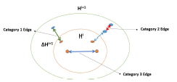
Methodology & Basic Notation
Methodology to extract the reciprocal network of G+:
Ω^{i} (V^{Ω}, E ^{Ω}) ----------> G^{i} (V^{G}, E^{G}) ----------> L^{i} (V^{L}, E^{L}) -------> H^{i}(V^{H}, E^{H})
Directed Graph
Undirected Graph
H^{i} : ith reciprocal network of G+;
H^{i}_{j}: “evolution” of at H^{i} the time snapshot j (j >i), with new edges
In particular, as node set,
and
Edge categorization:
category 1 edge:
category 2 edge:
category 3 edge:

Slide 9
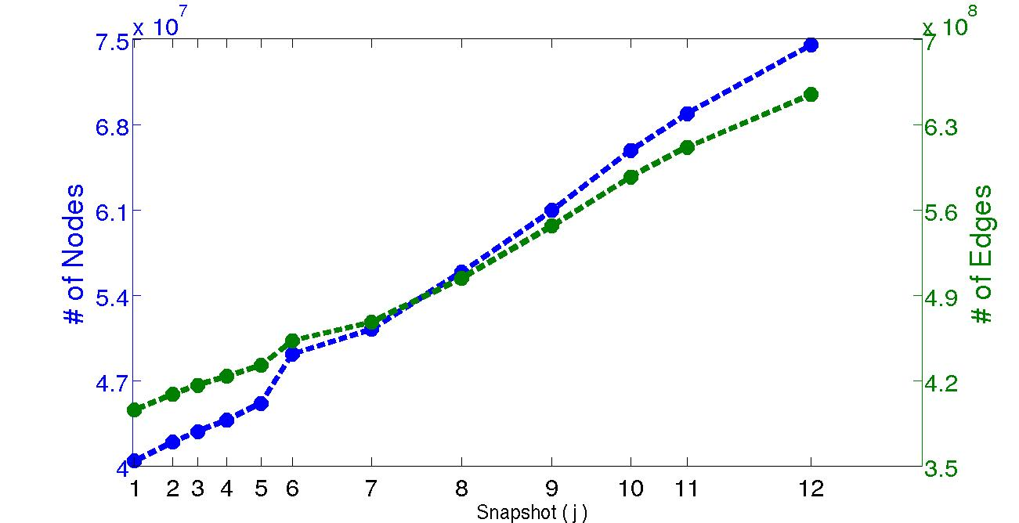
Reciprocal Networks:
Growth of Nodes & Edges
Evolution of Nodes & Edges in Reciprocal Networks of G+:
  number of nodes and edges increase almost (linearly) as H^{i} evolves
  significant increase between snapshots 5-6 (19.Oct.12 – 02.Nov.12)
  addition of a new feature to G+ on 31.Oct.12 that allows users to share contents created and stored in Google Drive directly into G+ stream
Observation:
  Our analysis shows that the addition of the Google Drive feature into G+ attracted more users to join G+; facilitating more “mutual” relations to be formed

Slide 10
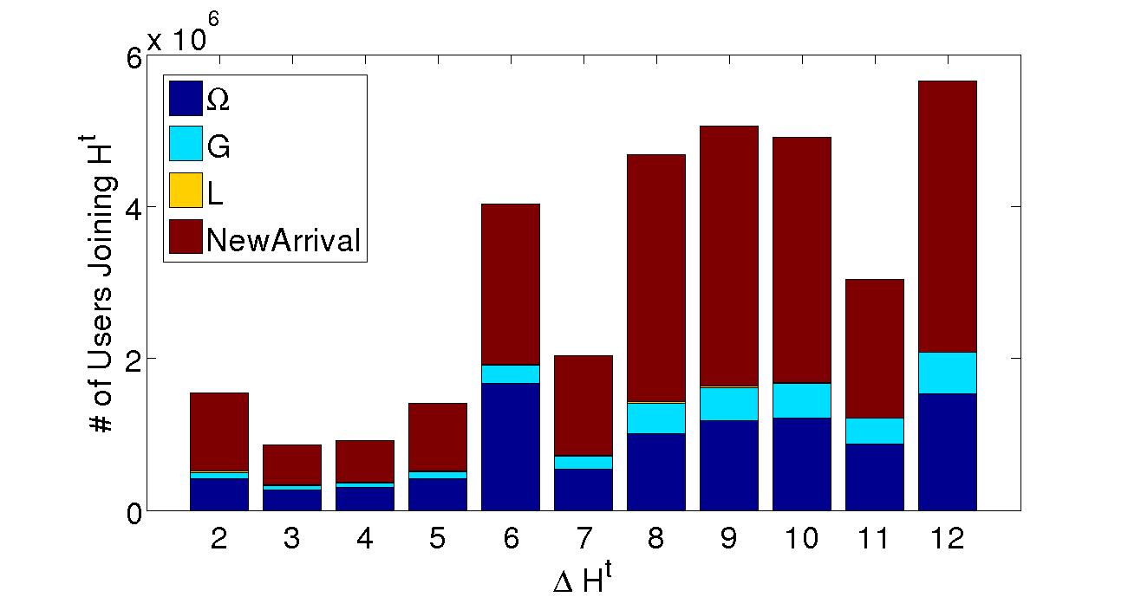
Reciprocal Networks: In-depth Look at Growth of Nodes
Nodes Categories:
  Ω: node “x” exist in subgraph Ω at snapshot j-1 and joins H at snapshot j
  G: node “x” exist in subgraph G at snapshot j-1 and joins H at snapshot j
  L: node “x” exist in subgraph L at snapshot j-1 and joins H at snapshot j
  NewArrival: node “x” does not exist in the system at snapshot j-1 and joins both Ω and H at snapshot j
Ω^{i} (V^{Ω}, E ^{Ω}) ----------> G^{i} (V^{G}, E^{G}) ----------> L^{i} (V^{L}, E^{L}) -------> H^{i}(V^{H}, E^{H})
Directed Graph
Undirected Graph

Slide 11
Reciprocal Networks: In-depth Look at Growth of Nodes
Nodes Categories:
  Ω: node “x” exist in subgraph Ω at snapshot j-1 and joins H at snapshot j
  G: node “x” exist in subgraph G at snapshot j-1 and joins H at snapshot j
  L: node “x” exist in subgraph L at snapshot j-1 and joins H at snapshot j
  NewArrival: node “x” does not exist in the system at snapshot j-1 and joins both Ω and H at snapshot j
Observations:
  The majority of users that are joining the reciprocal networks of G+ are new users in the system – they “quickly” form mutual connections w/ others;
  If a user does not create a reciprocal edge when he/she joins G+, there is a lower chance that he/she will create one later

Slide 12
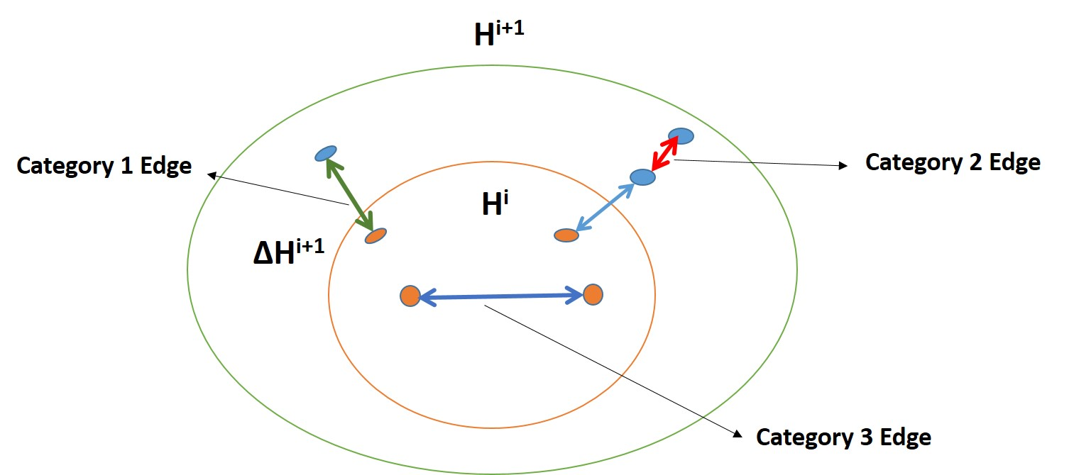
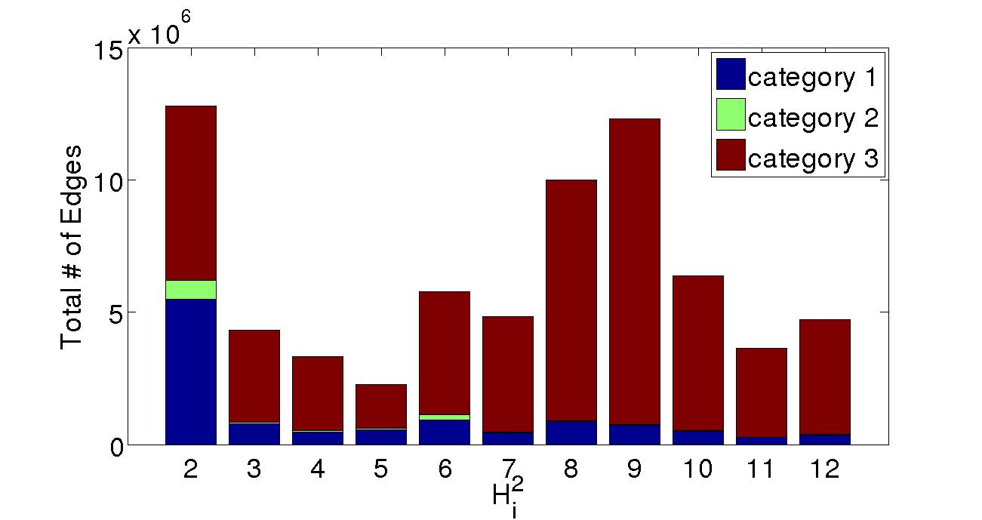
Reciprocal Networks:
Evolution of Mutual Edges
Edge categorization:
category 1 edge:
category 2 edge:
category 3 edge:
Observations
Except for snapshot 2, most new mutual edges belong to category 3 (new mutual connections among existing nodes)
New nodes form some mutual connections with existing nodes, but few mutual connections among themselves
“Early adopters” of G+ seem to play a key structural role in reciprocal network & its evolutions

Slide 13
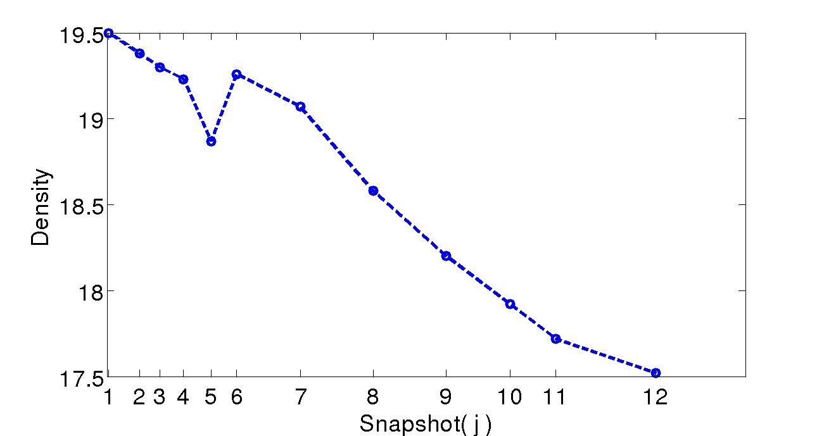
G+ vs. Reciprocal Networks:
Network Density Evolution
Prior study by Leskovec et al [1]: Densification Power Law:
  real (undirected?) networks tend to densify as they grow, e.g: Facebook, affiliation networks, email networks, etc.
But the network density of Google+ as a whole seems to “sparsify” over time: nodes joining faster than edge creation
Density Evolution H
Density Evolution Ω
[1] Leskovec, J. et al, “Kronecker graphs: An approach to modeling networks”, The journal of Machine Learning Research 11, 9851042 (2010)

Slide 14
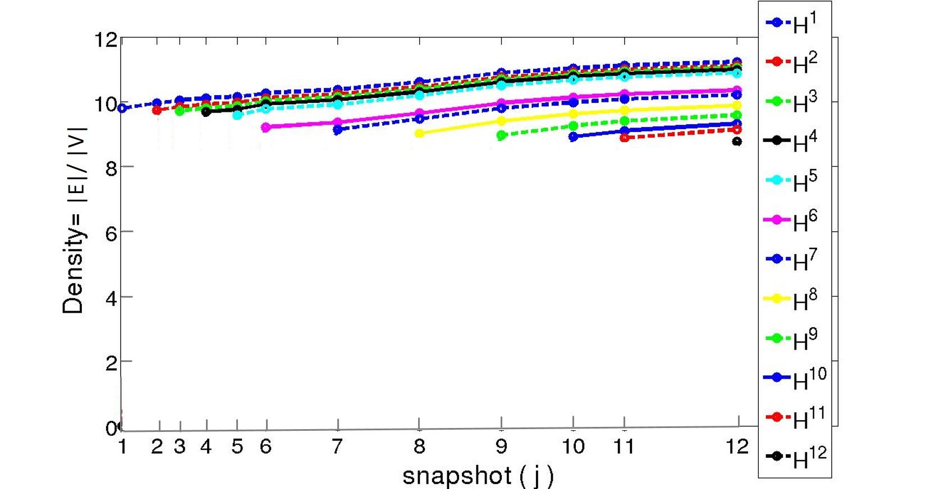
Reciprocal Networks:
Network Density Evolution
    Network density of G+ decreases rapidly over time period under study
    Furthermore, the density of the reciprocal network (H) also decreases, but less rapidly
      percentage of users creating at least one reciprocal edge decreases from 66.7% to 54.1% as the network evolves
    Densification vs. sparsification? rate of node joining vs. edge creation
Density Evolution H^{i}
  The new users joining the reciprocal network are creating fewer edges than the users in the previous generation

Slide 15
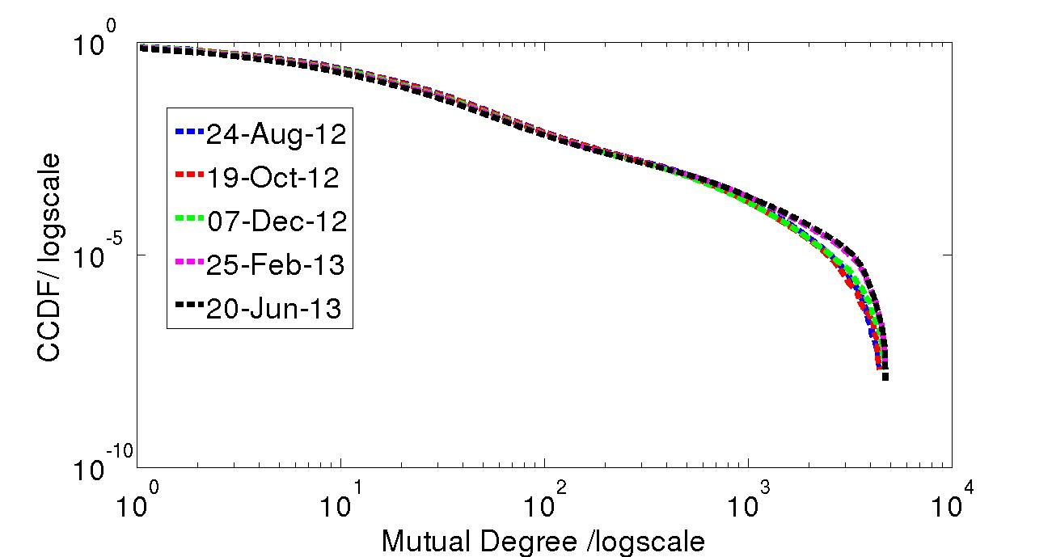
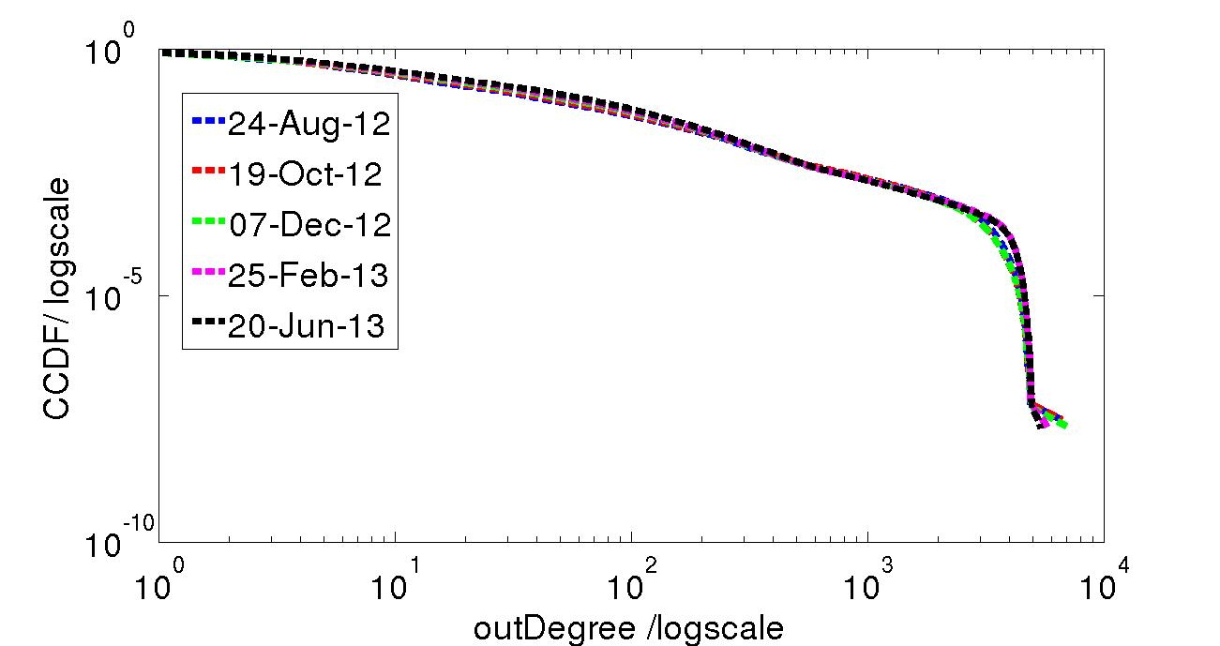
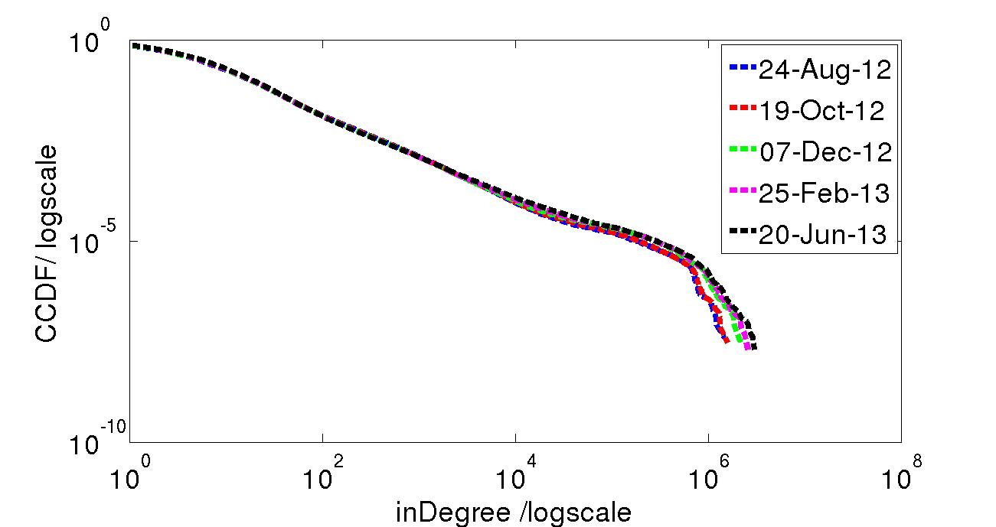
Reciprocal Networks:
Degree Distributions & Evolution
Degree Distributions of nodes in H and in G+:
Observations:
  a small fraction of users have disproportionally large number of (mutual) connections, while most users have a small number of (mutual) connections
  Scale of in-degrees is far larger than those of out-degree & mutual degrees
  Out-degree distribution tapers out more rapidly, in-degree distribution has slowest drop-off, and mutual degree distribution in-between

Slide 16
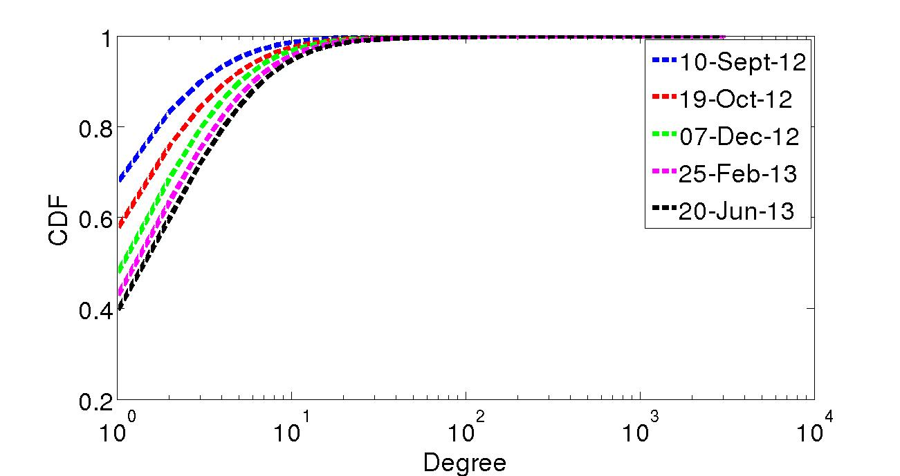
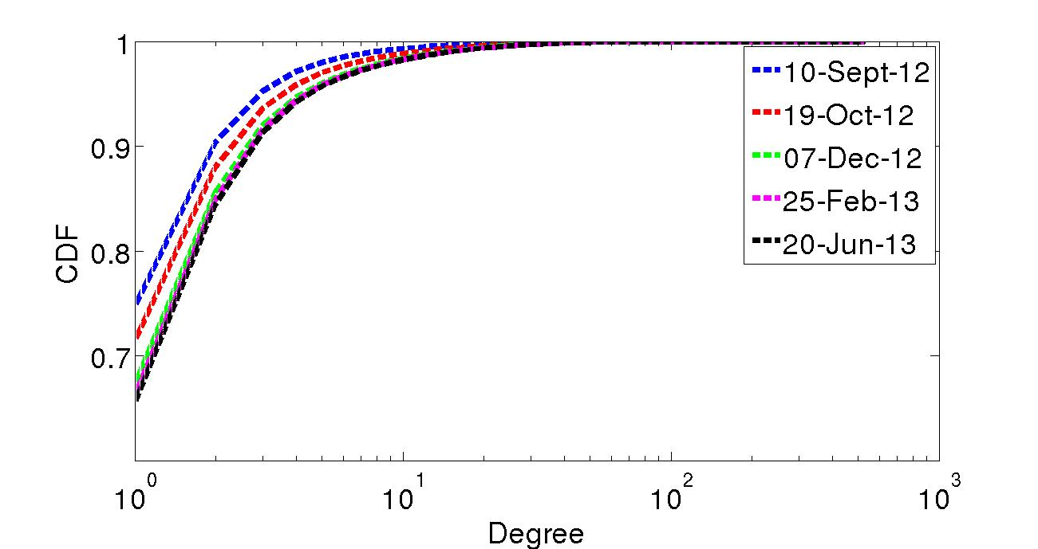
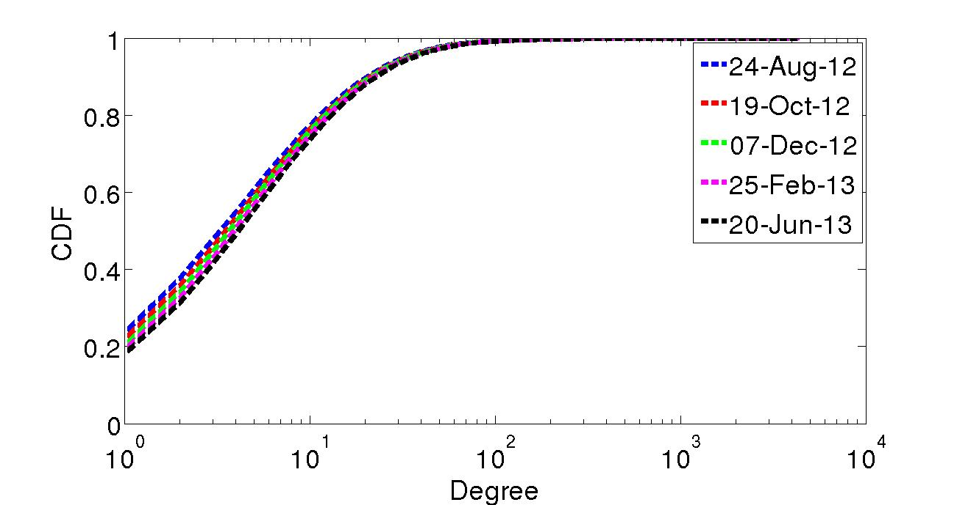
Reciprocal Networks: Edge Categories & Node Degree Evolution
Category 1
Category 2
Category 3
Observations:
Initially, when new nodes join H¹, they create few connections, but the longer they stay the system, their connections increase (cold start phenomenon)
72% of the new nodes have only connections to nodes already in time slot 1

Slide 17
K-shell Decomposition Analysis of Directed Networks
Partially follow-up the work by Bo Jiang et al on maximum reciprocity graph
Goal: Better understand how a network is connected
  roles of high (in-/out-) degree nodes in network connectivity
  network (sub-)structures of “k-crusts” and “k-cores”
Questions: does a network contain a (densely) connected core, or a (sparse) collection of (denser) “communities”?
K-shell decomposition: an old graph analysis technique
  developed for undirected graphs
  used by Carmi et al [1] for studying or “modeling” Internet topology
Extended to directed networks: currently performing data analysis, with some basic graph analysis; hope to develop some mathematical models
  [1] “A model of Internet Topology using K-Shell Decomposition”,
  Shami Carmi, Shiomo Havlin, Scott Kirkpatrick, Yuval Shavitt and Eran Shir
  PNAS, July 2007, vol. 105., no 27

Slide 18
K-Shell Decomposition
Given an undirected graph G=(V,E), k-shell decomposition works in a series of steps iteratively:
k=1: we start by removing all nodes with degree 1 and the associated edges; assign these nodes to 1-shell
k=2: we remove all nodes of (remaining) degrees of 2 or less, and the associated edges; assign these nodes to 2-shell
….
k-shell: we remove all nodes of (remaining) degrees of k or less, and the associated edges; these nodes are k-shell nodes
…
The process stops when no nodes are left. The last k is k_{max}
k-core: the graph formed by the nodes that have not been removed at step k
k-crust: the graph formed by all the nodes in k’-shells, k’=1, …,k

Slide 19
K-Shell Decomposition: k-Shell Index & Network Structures
Besides its degree, now each node is also assigned a k-shell index
  denote by shell(v) for a node v; let deg(v) denotes v’s degree
  give us another “bivariate” (or “multivariate”) distribution <deg(v),shell(v)>
Some simple facts:
shell(v) <= deg(v) for all v; and clearly if deg(v)=1, shell(v)=1
however, a high degree node may have low k-shell index: for any v w/ arbitrary deg(v)>1, its k-shell index can be as low as 2
for v, if the largest degree of its neighbor is d, then shell(v)<=d+1
If v is part of s-clique (and thus deg(v)>=s), then shell(v) >= s.
Connected components in 1-crust: singleton nodes and isolated edges
Connected components in 2-crust: stars and stars connected via a path
……

Slide 20
K-Shell Decomposition for Directed Networks
Several Possibilities: give us different information regarding how the network is connected!
Treat the directed network as an undirected graph, using the total degree (in-degree + out-degree)
Perform k-shell decomposition based on out-degree only: at step k, remove all nodes of (remaining) out-degree <= k
Perform k-shell decomposition based on in-degree only: at step k, remove all nodes of (remaining) in-degree <= k
Perform k-shell decomposition based on “mutual-degree” only:
at step k, remove all nodes of (remaining) “mutual degree” <= k

Slide 21
Dataset Overview
Dataset | Category | # Nodes | # Edges | % nodes with indegree >= 1 | max indegree | % nodes with outdegree >= 1 | max outdegree | Reciprocity
Stanford | web | 281,903 | 2,312,497 | 0.93 | 38,606 | 0.99 | 255 | 0.28
ego-Twitter | social | 81,306 | 2,420,766 | 0.99 | 8,660 | 0.86 | 3,373 | 0.35

Slide 22
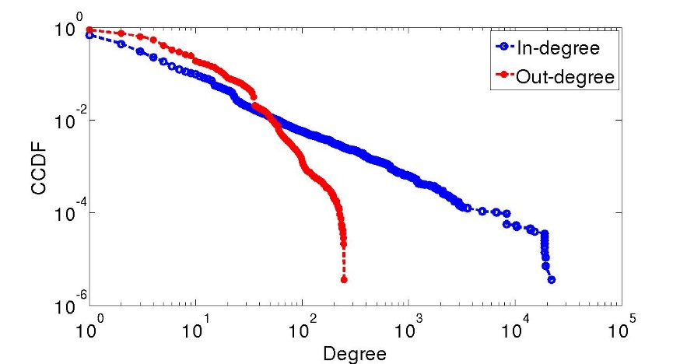
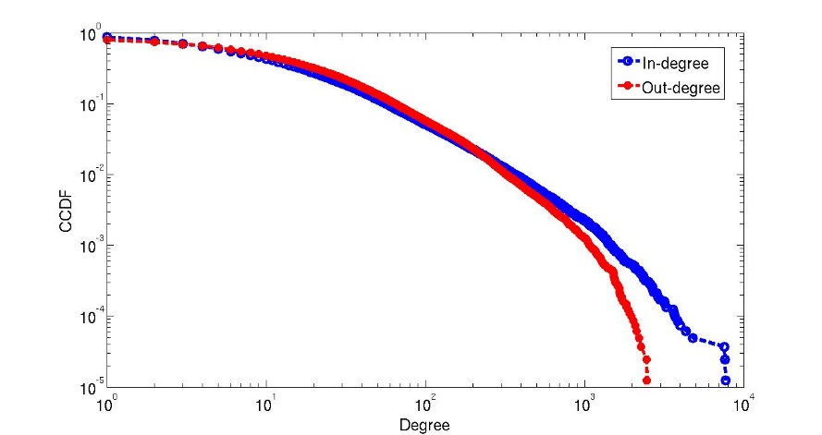
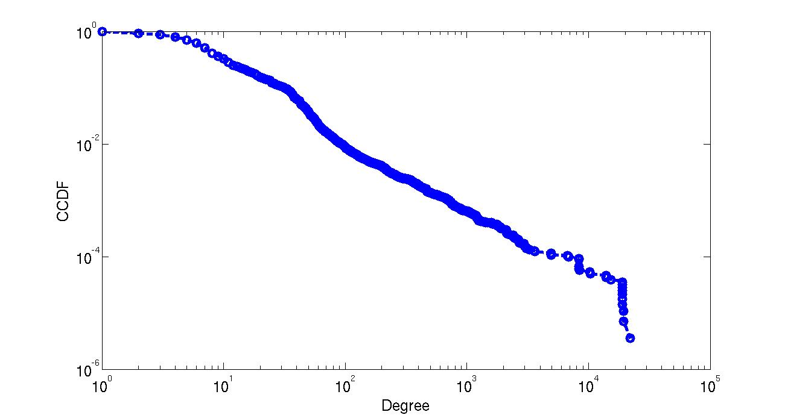
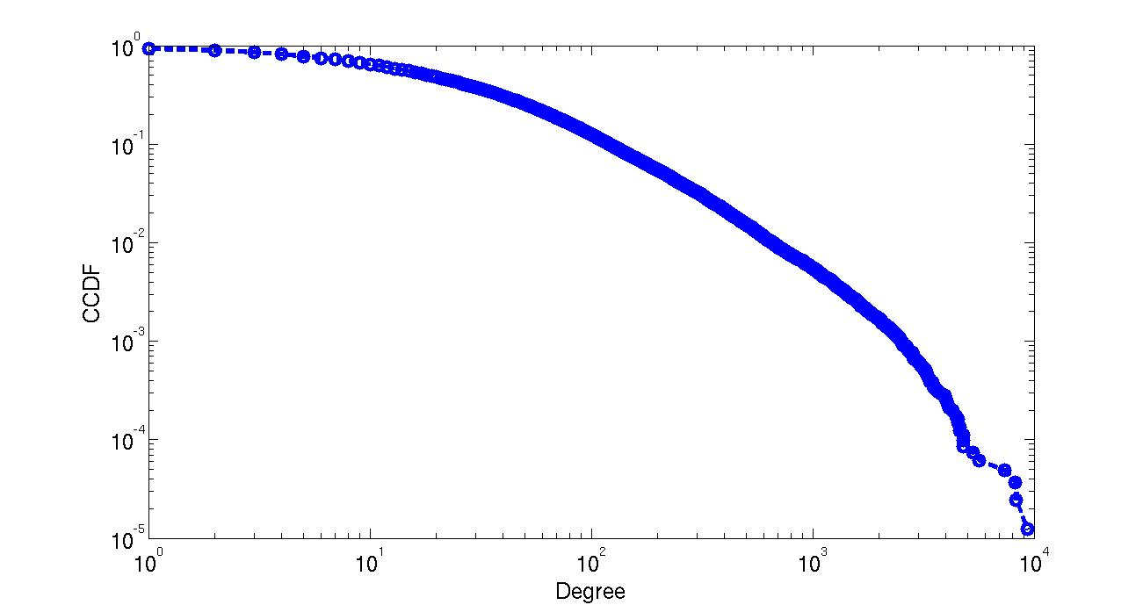
Degree Distributions
Stanford
ego-Twitter
in-degree
&
out-degree
Total degree

Slide 23
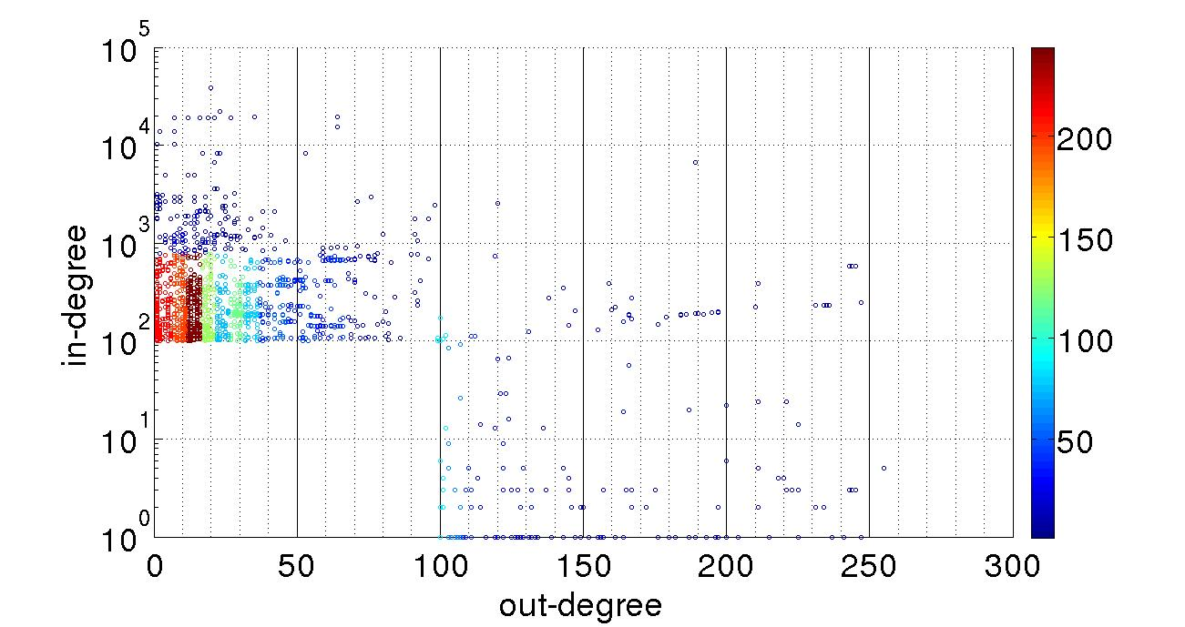
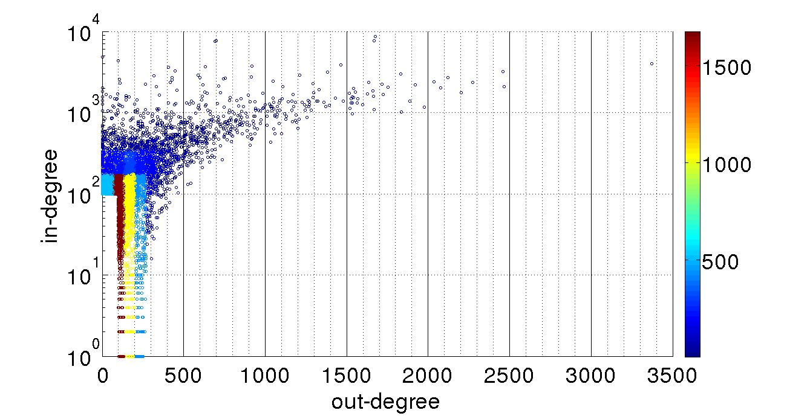
In-degree & Out-degree Dependency
Degree dependencies for top nodes only:
  Nodes that have either in-degree >= 100 or out-degree >= 100
    Stanford web data: 1,961 nodes
    Ego-twitter: 6,021 nodes
Stanford
ego-Twitter

Slide 24
K-shell Decomposition Analysis

Slide 25
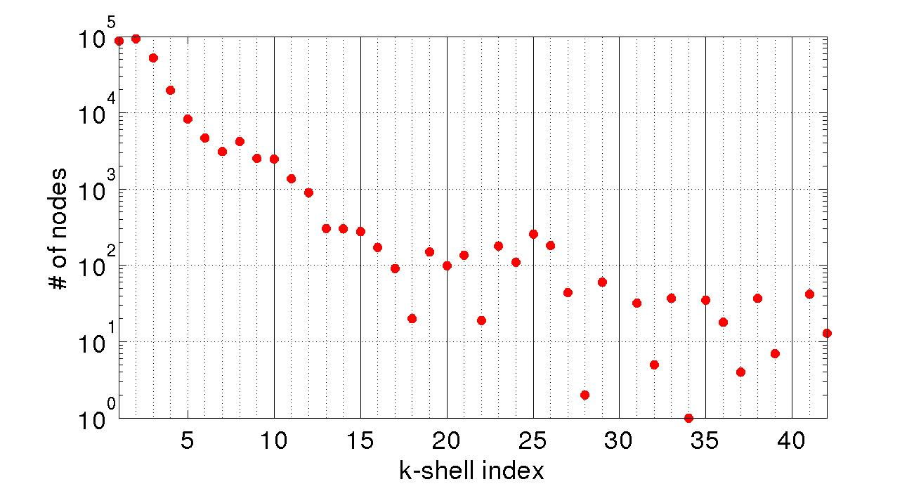
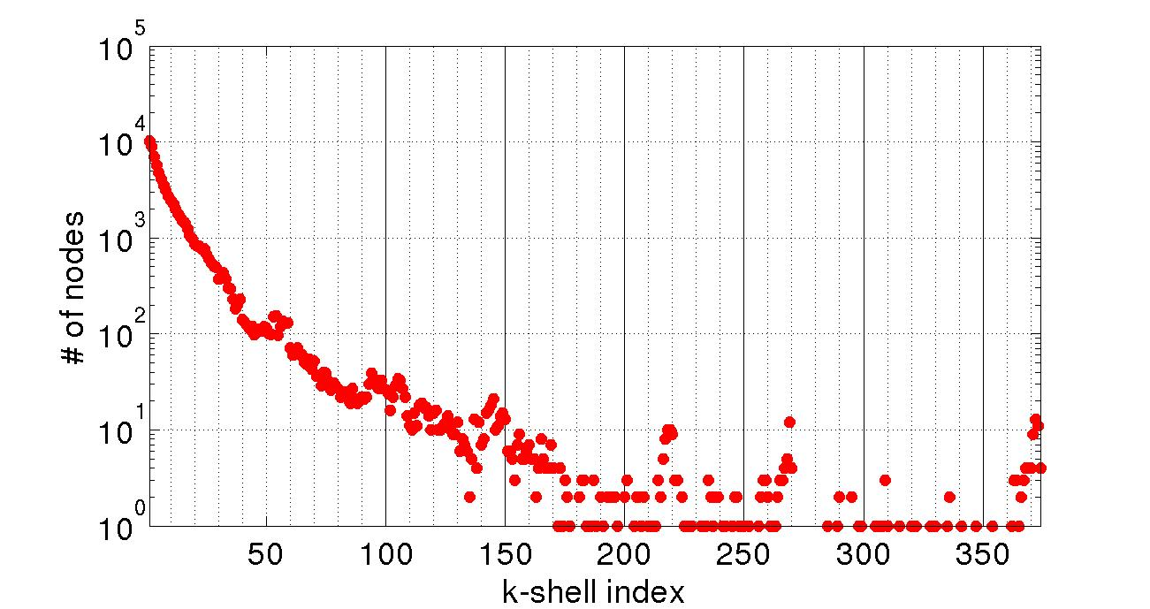
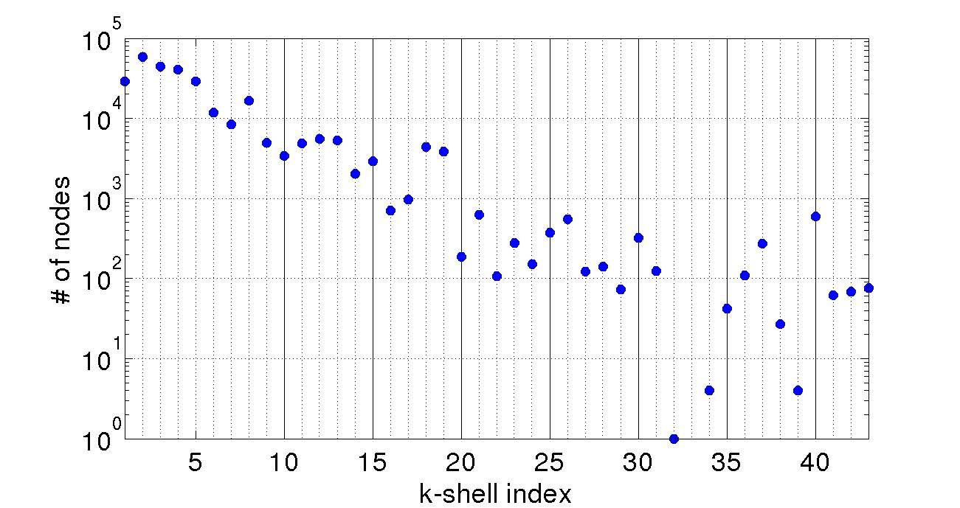
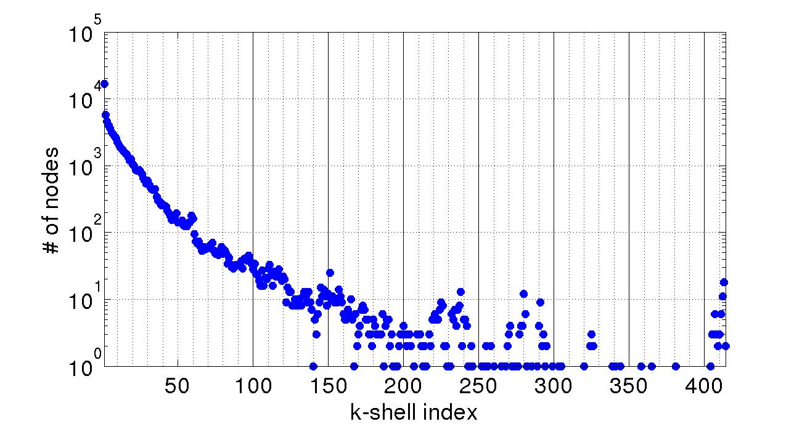
Total Number of Nodes per k-shell
K-shell in-degree
K-shell out-degree
Standford
ego-Twitter

Slide 26
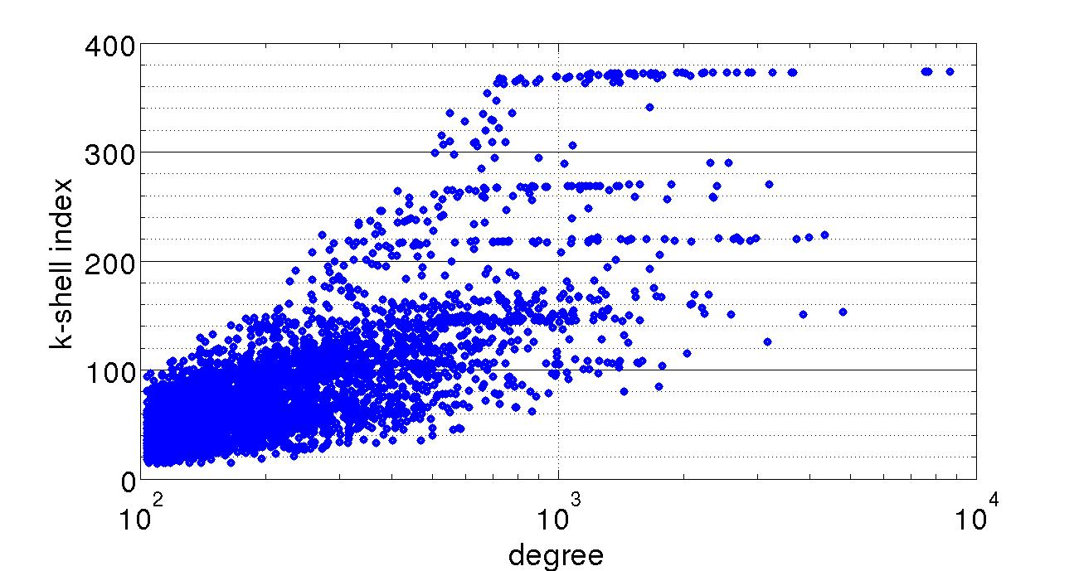
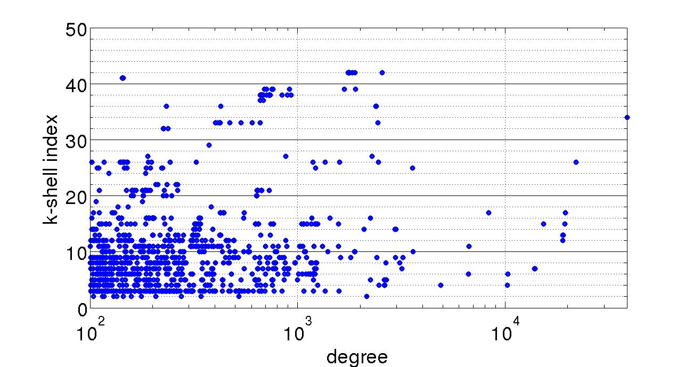
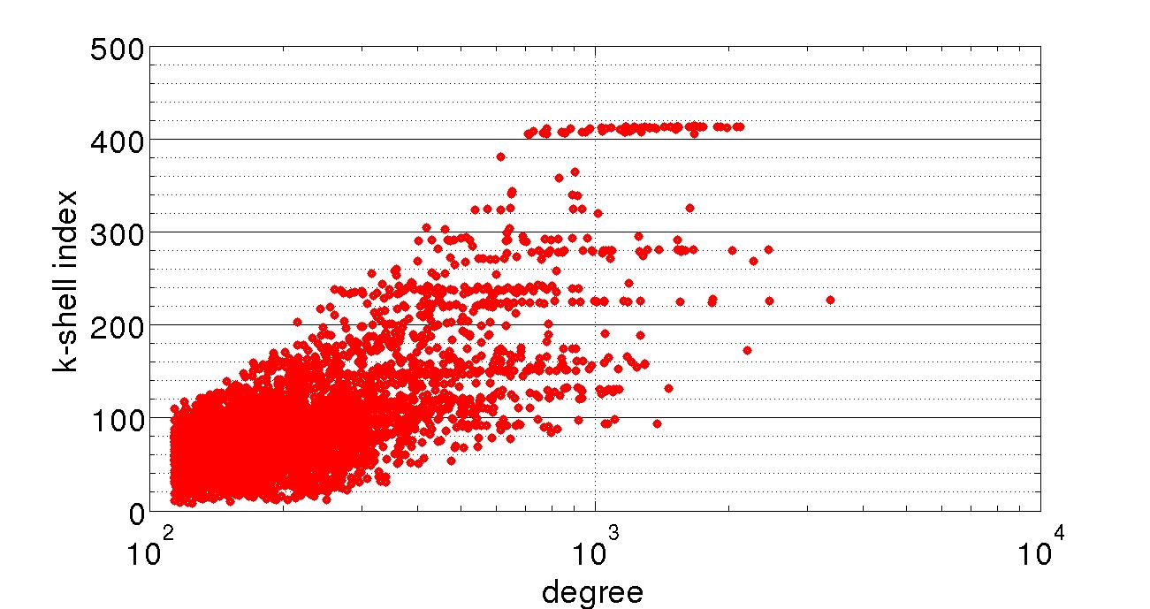
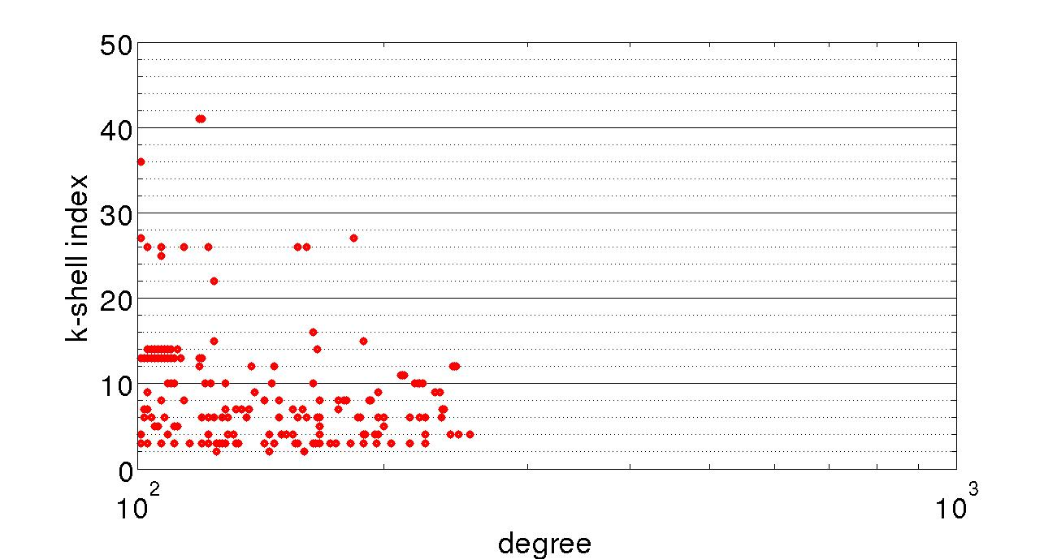
In-degree & Out-degree K-shell Decomposition: Dependencies
K-shell in-degree
For top-degree nodes (in-degree=>100)
K-shell out-degree
For top-degree
nodes (out-degree=>100)
Standford
ego-Twitter

Slide 27
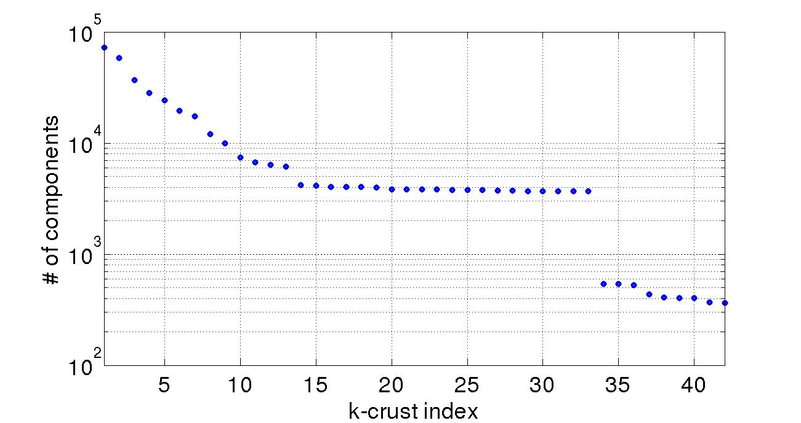
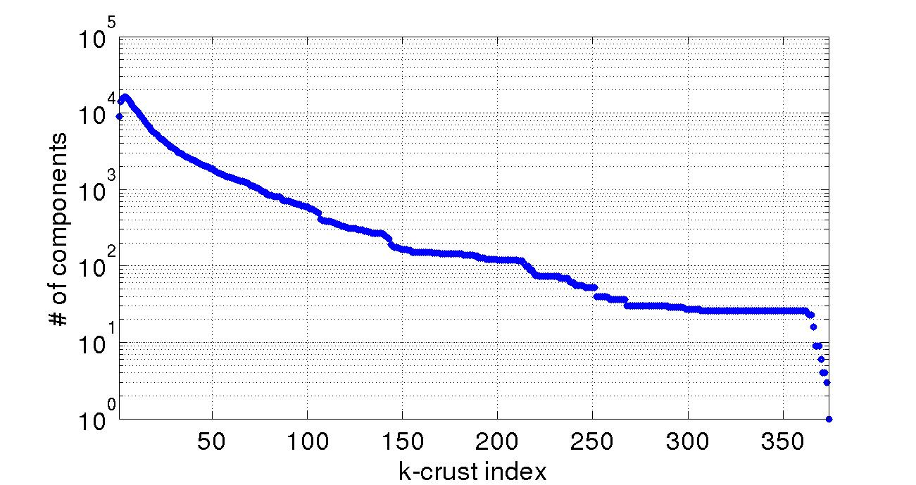
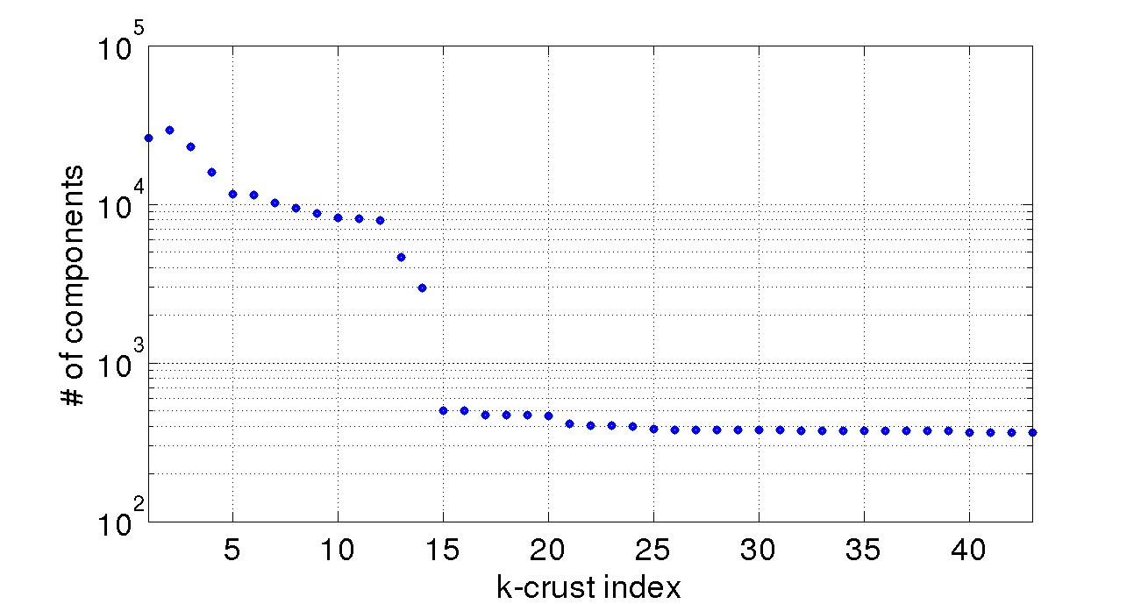
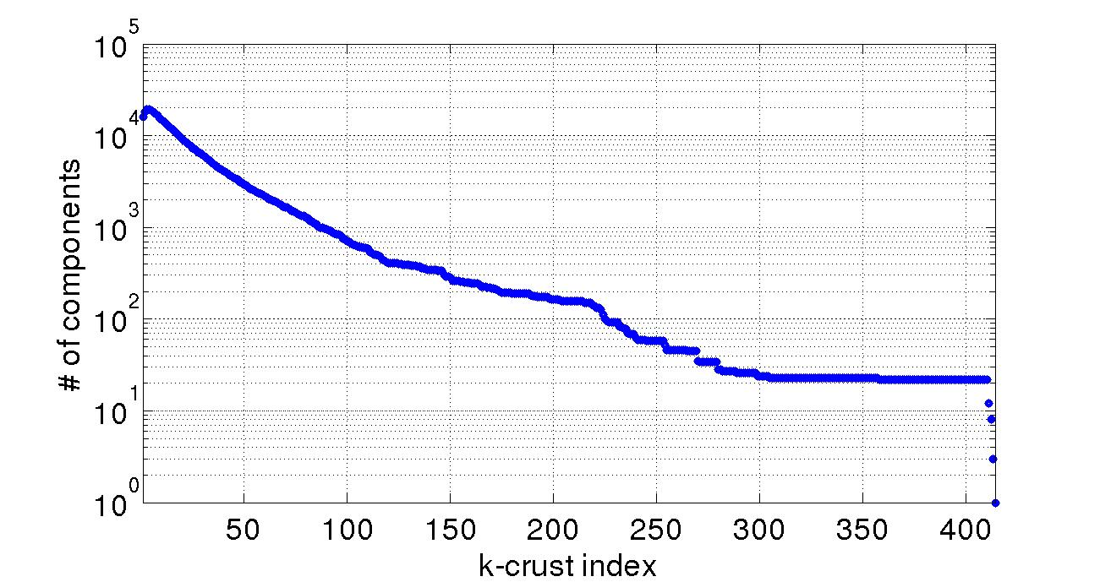
K-Crust: # of Connected Components (CC)
K-shell in-degree
K-shell out-degree
Standford
ego-Twitter

Slide 28
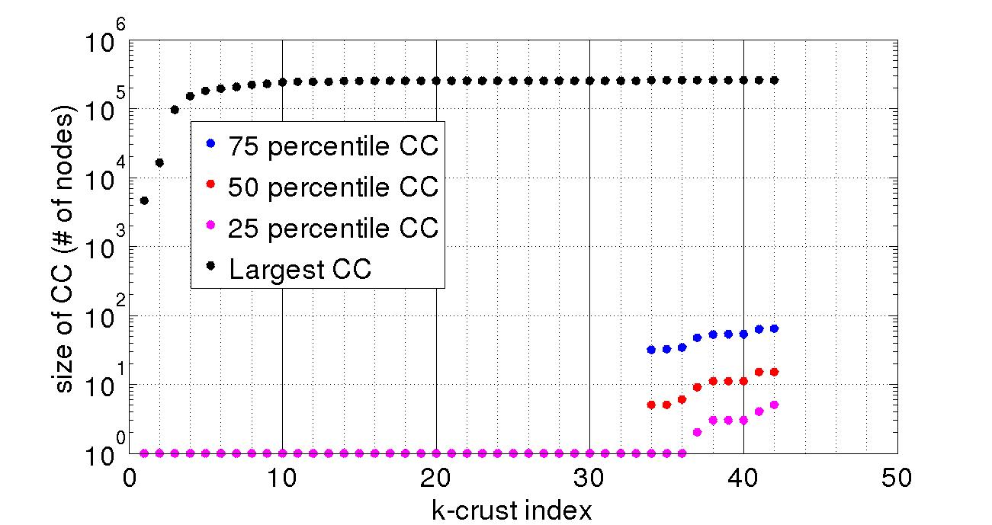
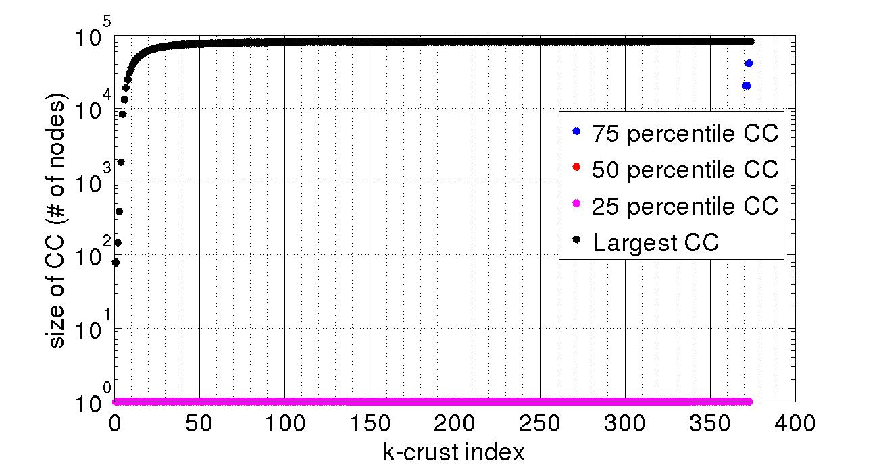
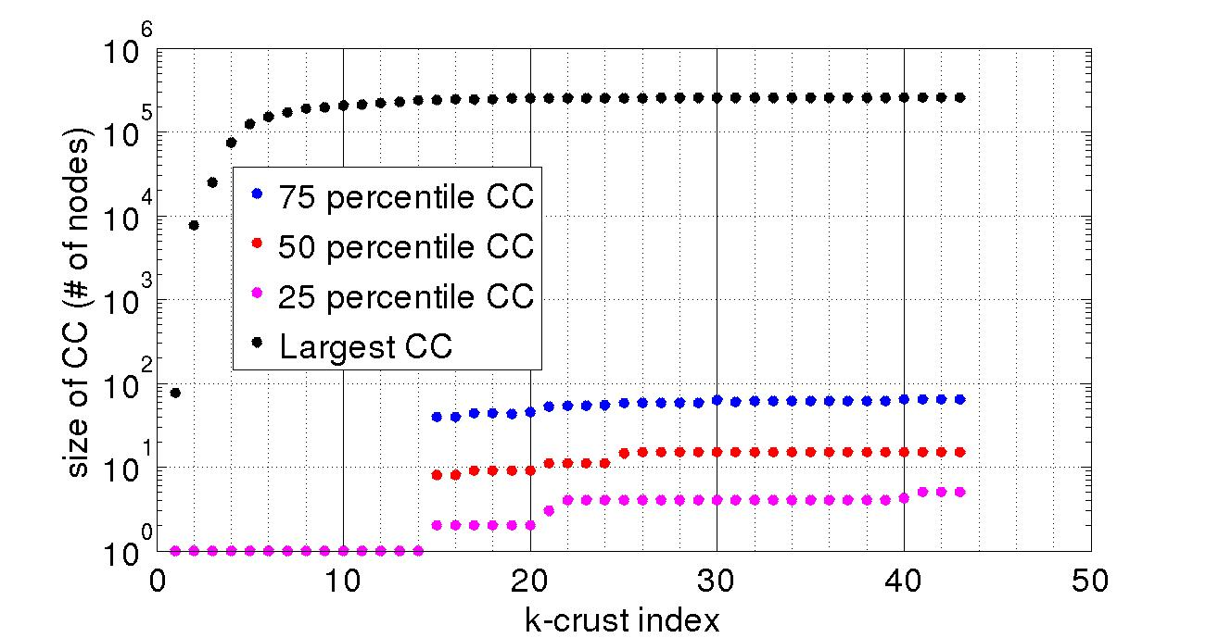
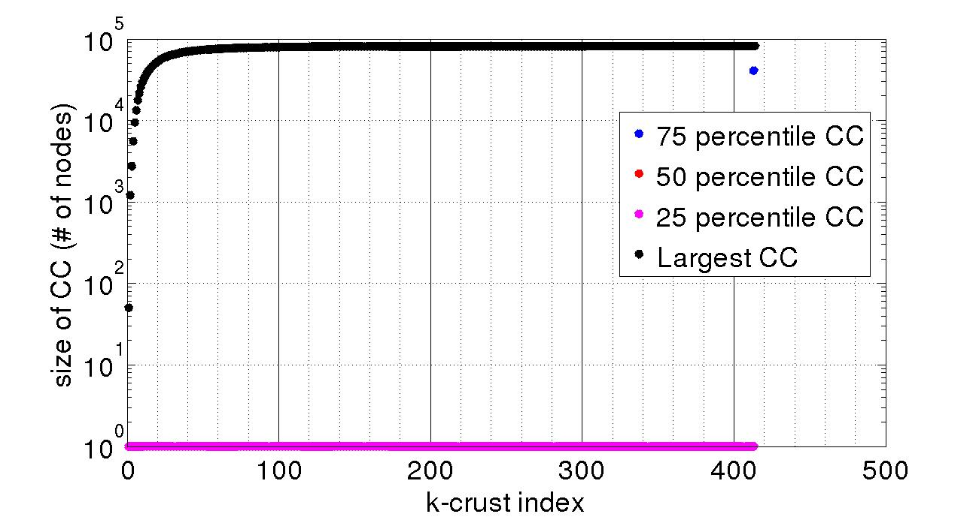
K-Crust: size of Connected Components (CC)
K-shell in-degree
K-shell out-degree
Standford
ego-Twitter

Slide 29
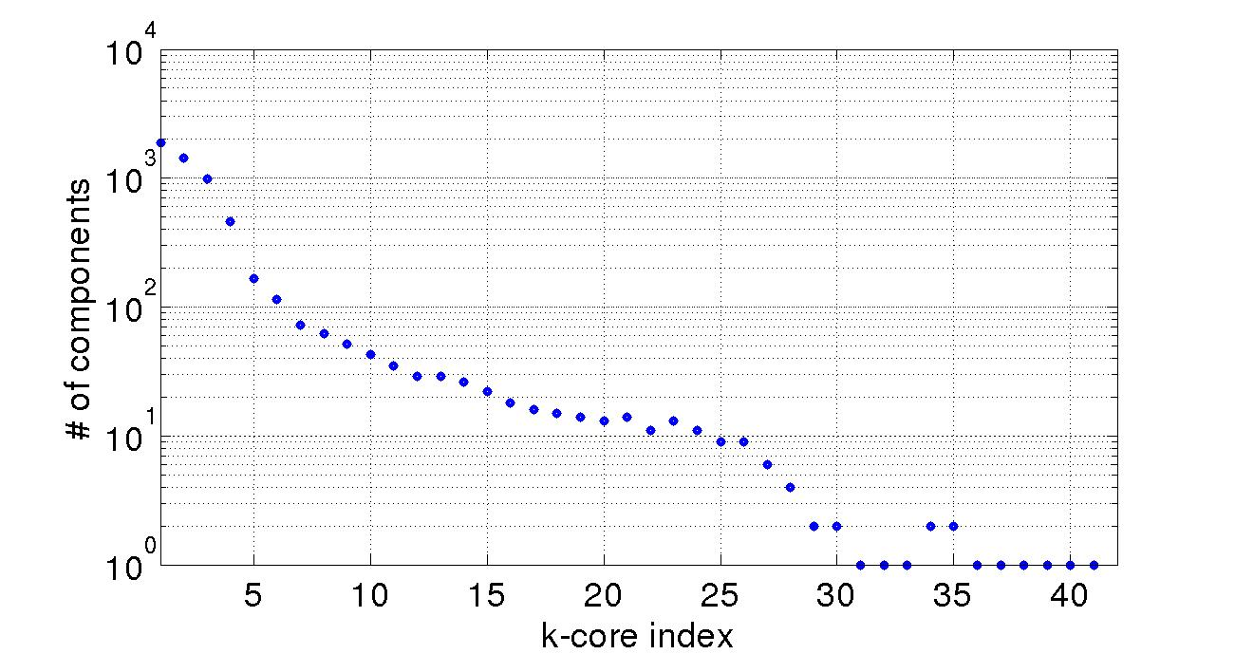
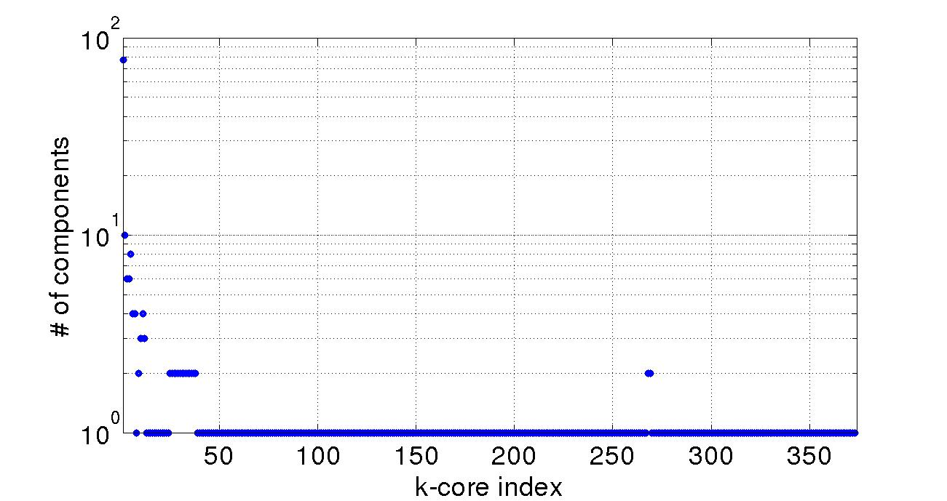
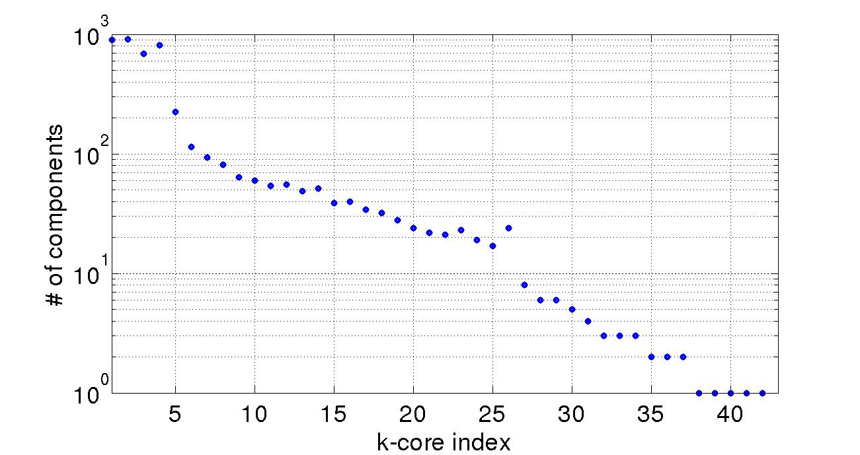
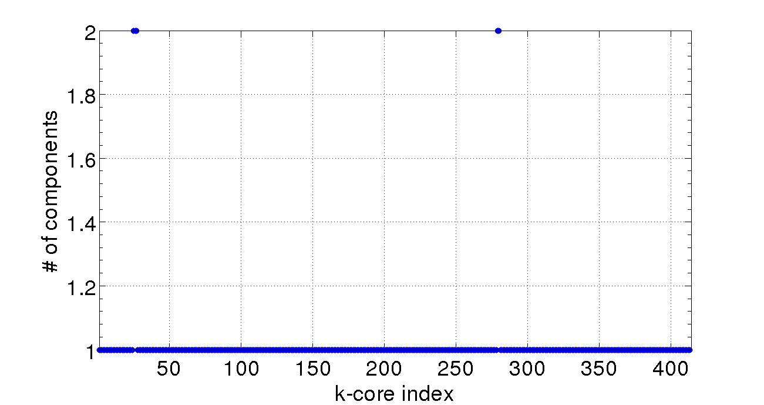
K-Core: # of Connected Components
(CC)
K-shell in-degree
K-shell out-degree
Standford
ego-Twitter

Slide 30
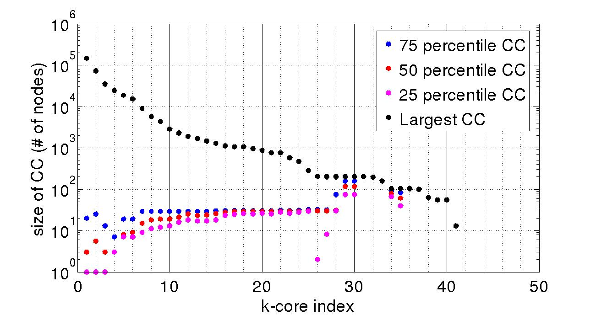
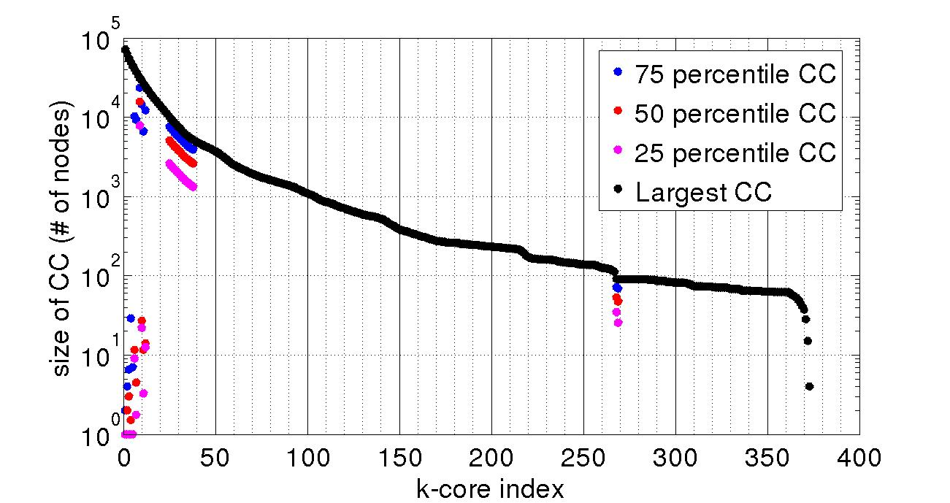
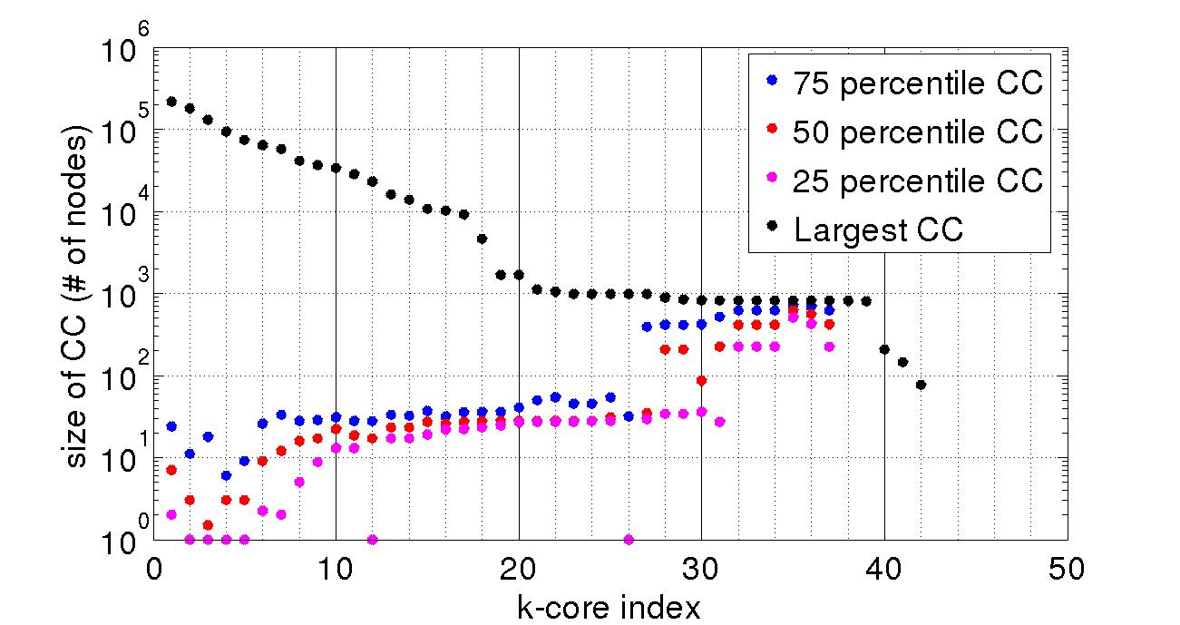
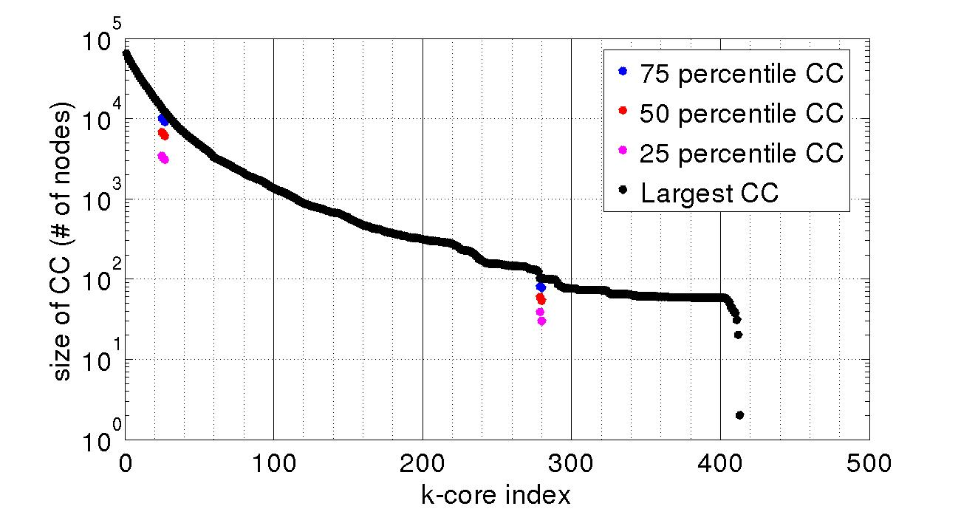
K-Core: size of Connected Components (CC)
K-shell in-degree
K-shell out-degree
Standford
ego-Twitter

Slide 31
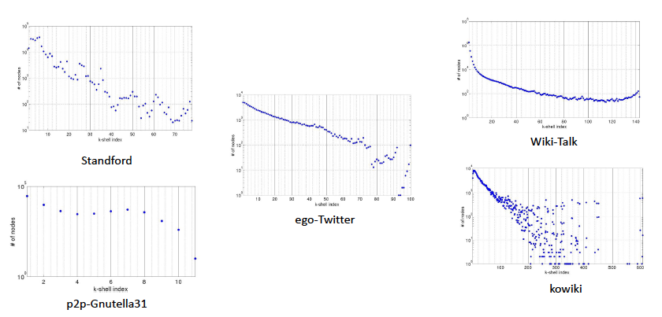
Degree vs. K-Shell Index
(using total-degree k-shell decomposition)

Slide 32
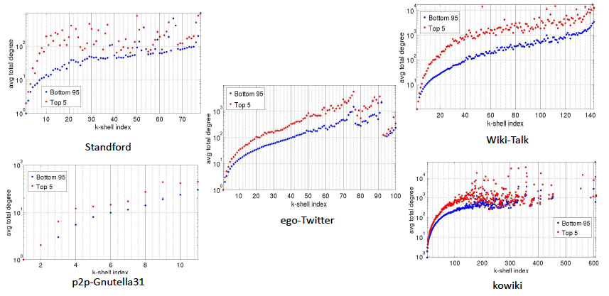
Degree vs. K-Shell Index
(using total-degree k-shell decomposition)

Slide 33
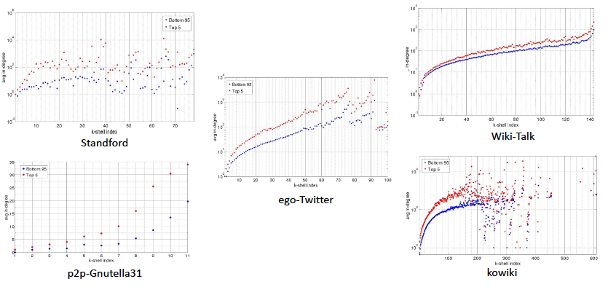
Degree vs. K-Shell Index
(using total-degree k-shell decomposition)

Slide 34
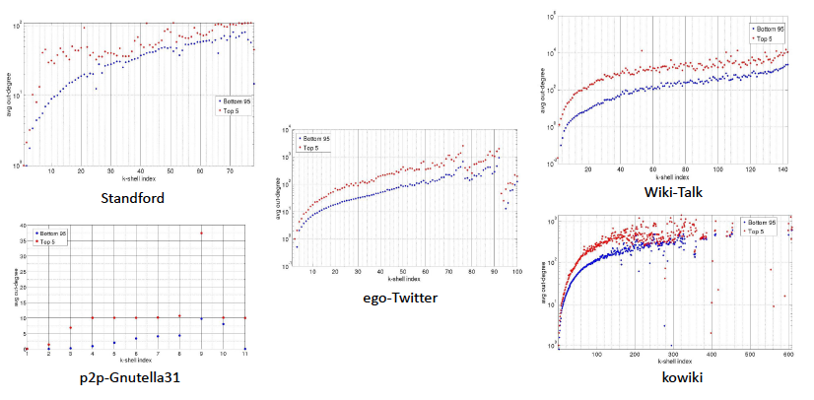
Degree vs. K-Shell Index
(using total-degree k-shell decomposition)

Slide 35
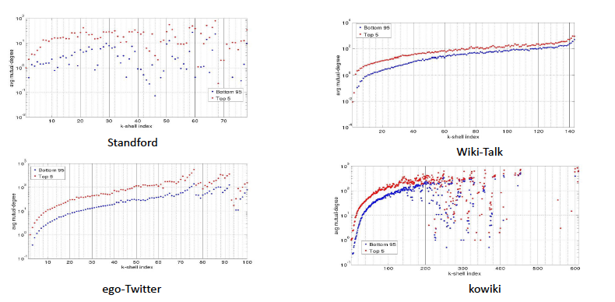
Degree vs. K-Shell Index
(using total-degree k-shell decomposition)

Slide 36
Random Walks on (Parametrized) Evaporation Networks and
Shortest Path Problems and Beyond

Slide 37


Random Walks and
Evaporation Networks
Given a (directed) network G=(V,E): not necessarily strongly connected
Evaporation Network Paradigm: introduce a new node e
For each
e
e

Slide 38

Random Walks on Evaporation Networks: Routing Continuum

Slide 39

Random Walks on Evaporation Networks: Routing Continuum

Slide 41



Replacement Paths and Distance Sensitivity Oracles (Ongoing work)
Routing problems
Replacement Path: finding the shortest (replacement) path efficiently in the case of node failure
Distance Sensitivity Oracles: a compact
data structure capable of reporting
P(,,) and d(,,) efficiently.
  P(,,): shortest path from s to t in
  d(,,): distance from s to t in
Trivial solution is to compute the shortest
path for every new query → not efficient!
$$t$$
$$s$$

Slide 42

Replacement Paths and Distance Sensitivity Oracles (Ongoing work)
The objective is to minimize the following factors:
  required for storing the pre-processed oracle
  computational complexity
  or the pre-processing time
  the time required to return
  the answer to the query
Many work done for single failure, but
multiple failure still an open problem
Developing an efficient method for
supporting multiple failure case, using
the avoidance metrics in evaporating paradigm
$$t$$
$$s$$

Slide 43
Thank You!
Questions?

Slide 44

Continuum from shortest path to all path
Routing problems
A range from the shortest path to all path
  All path is the trace of the random walker before hitting the destination.
[Li et al., 2011]: mixed continuum
  is obtained from mixed and norm flow optimization
    Undirected, O(n^5), finds the paths
[Kivimaki et al., 2012]: Randomized shortest path
  considers a distribution of random paths between two nodes that minimizes the expected cost subject to a relative entropy constraint.
    Undirected, O(n^3), finds only the length of the paths

