Slide 1
Sampling and Classification of Large Networks
D. Towsley

Slide 2
Why study networks?
network fundamental abstraction for many real systems
Examples:
  Web
  social networks
  scientific collaboration
impossible to understand from isolated components
many multivariate heavy-tailed statistics
  in-/out-/reciprocated degree distributions
How do we study?
Notes:
Start following question: why is it important study networks? Well, network/graph fundamental abstraction that allows us to study many important real systems, such as… It is impossible to understand these systems and answer fudamental questions related to them without considering the way their components are connected. their topology.

Slide 3
Outline
sampling large networks
finding target nodes in large networks
node classification in large networks
other results

Slide 4
Characterizing Networks via Multidimensional RWs with jumps
How to estimate node label distributions
from samples?
Notes:
The essential question that concerns the first chapter is how can we estimate vertex label distributions?

Slide 5
How to sample networks?
sampling crucial to characterizing large-scale data
sampling strategy depends on API
  traceroute: computer networks
  uniform vertex sampling: social networks
  feasible when
    Id space not sparsely populated or
    specific API exists
  random walks: web graphs, social networks
    undirected graphs: samples nodes in proportion to degree
    non-trivial if in-edges not directly observable
?
?
Notes:
PLURAL? first we have to understand how a network can be sampled.
LEIA SLIDE
a couple of techniques have been proposed to sample directed networks. a much larger set of techniques have been proposed for undirected networks. as the first contribution of this thesis, we propose a sampling method that is suitable to undirected networks and directed networks regardless of the in-edges visibility.

Slide 6
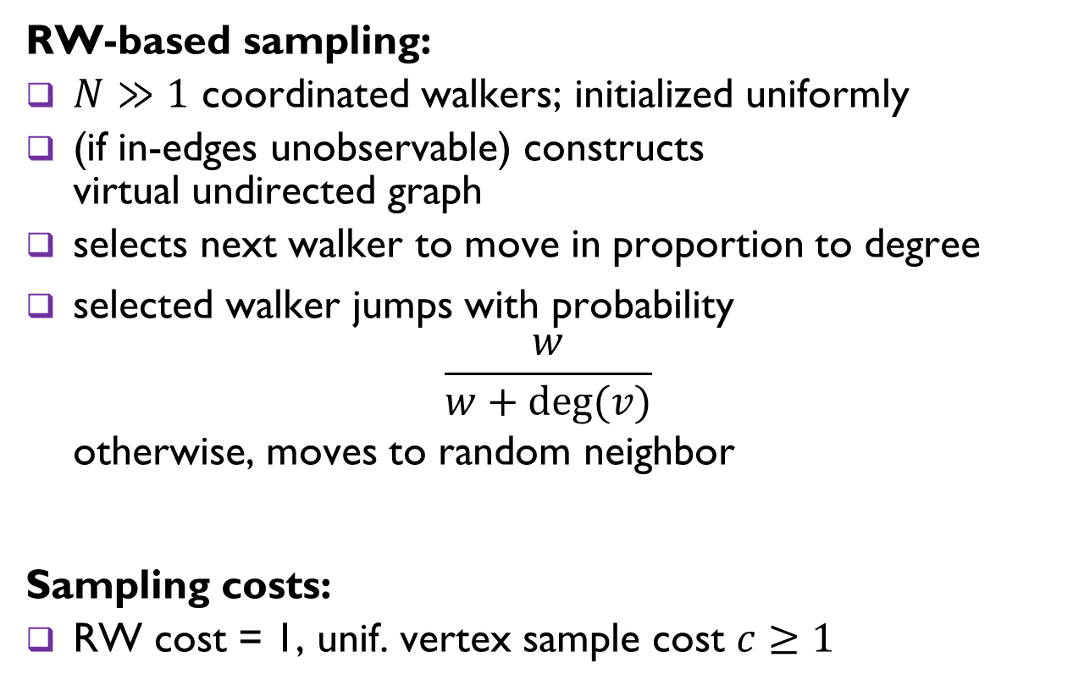
Directed Unbiased Frontier Sampling (DUFS)
RW-based sampling:
$N≫1$ coordinated walkers; initialized uniformly
(if in-edges unobservable) constructs
virtual undirected graph
selects next walker to move in proportion to degree
selected walker jumps with probability
$\frac{w}{w+deg⁡(v)}$
otherwise, moves to random neighbor
Sampling costs:
RW cost = 1, unif. vertex sample cost $c≥1$
degree in virtual graph
jump weight
Notes:
at each step, it selects the next walker to move in proportion to the degree.
part of it is borrowed from FS and part is from DURW
if you don't jump, what do you do

Slide 7
Directed Unbiased Frontier Sampling (DUFS)
Estimation:
RW samples
initial walker locations
(unif. vertex samples)
Hybrid estimator
(H-DUFS)
node label distribution estimates
✓ Asymptotically unbiased
Degree distribution estimates, when average degree known
✓ Minimum Variance Unbiased Estimator
Notes:
MAKE CLEAR WHAT A RW SAMPLE IS

Slide 8
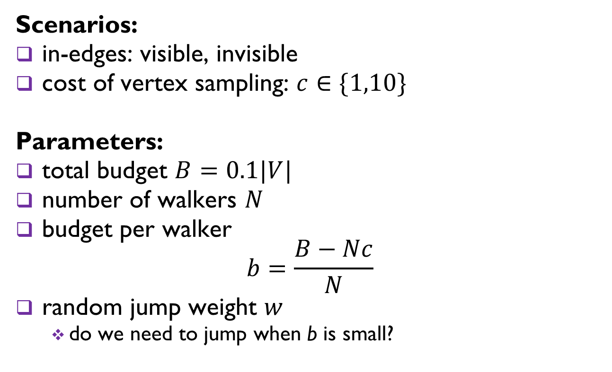
Parameter sensitivity
Scenarios:
in-edges: visible, invisible
cost of vertex sampling: $c∈\{1,10\}$
Parameters:
total budget $B=0.1|V|$
number of walkers $N$
budget per walker
$$b=\frac{B−Nc}{N}$$
random jump weight $w$
  do we need to jump when b is small?

Slide 9
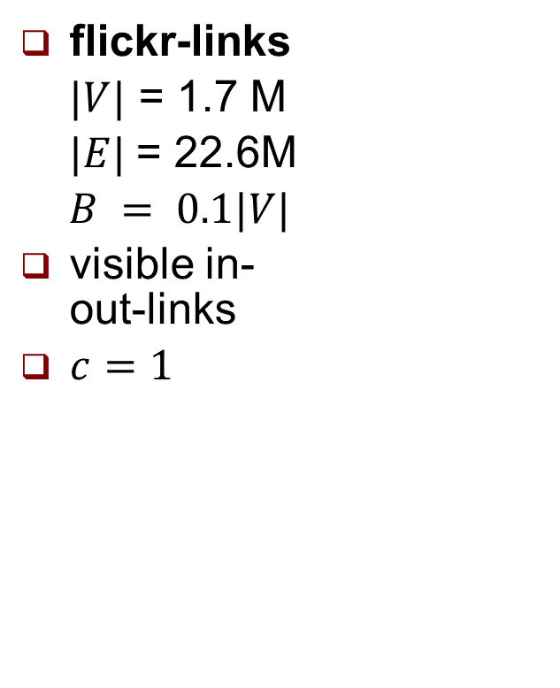
Out-degree distribution estimation
flickr-links
$|V|$ = 1.7 M
$|E|$= 22.6M
$B = 0.1|V|$
visible in- out-links
$c=1$
w=0.1
w=1.0
w=10.0
b=1
b=10
b=100
jumps help estimation in both head, tail

Slide 10
Why is NRMSE linear?
flickr-links
Notes:
To answer this question, we investigate two basic processes that compose DUFS. Vertex Sampling, used to determine initial walker locations. And Edge Sampling, used as an approximation for RW sampling.

Slide 11

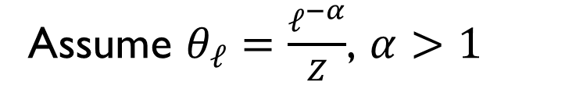

Why is NRMSE linear?
Assume $θ_{ℓ}=\frac{ℓ^{−α}}{Z}$, $α>1$
$$y=\frac{α}{2}x+C$$
Vertex Sampling
$$y=\frac{α−1}{2}x+C$$
Edge Sampling

Slide 12
Gain from hybrid estimator?
E-DUFS: original estimator
  only uses RW samples
H-DUFS: hybrid estimator
  uses initial walker locations (vertex samples) + RW samples
Intuition: H-DUFS should be better at estimating labels associated with small in-degree and outdegree nodes
Notes:
Intuitively, better at estimating labels associated with low in-degree and low out-degree nodes

Slide 13
Hybrid estimator gains
soc-Slashdot0902
|V| = 82 K
|E| = 948 K
B=0.1|V|, w=1, b=10
new estimator improves estimation in head w/o hurting tail

Slide 14
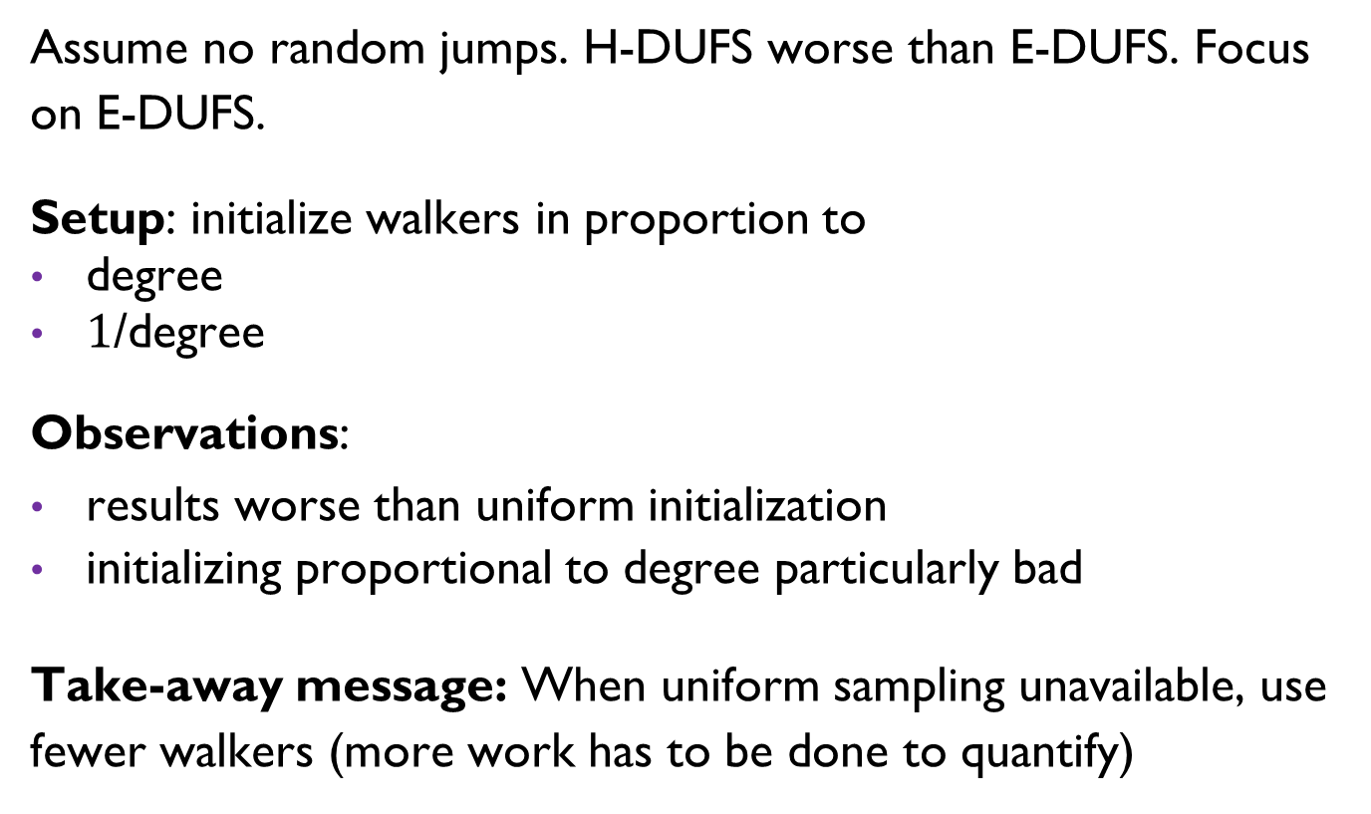
Effect of uniform vertex sampling
Assume no random jumps. H-DUFS worse than E-DUFS. Focus on E-DUFS.
Setup: initialize walkers in proportion to
degree
$1$/degree
Observations:
results worse than uniform initialization
initializing proportional to degree particularly bad
Take-away message: When uniform sampling unavailable, use fewer walkers (more work has to be done to quantify)

Slide 15
Selective Harvesting over Networks
How to find target nodes efficiently?

Slide 16
Network search example
How to find researchers cited [a,b] times in last 5 years?
BFS/DFS inefficient for this problem
✓
✗
✗
✓
✗
Border nodes
Other applications: fraud investigation
✓
Unknown nodes
Notes:
Other applications for this type of search include investigating people suspected of frauding the IRS. Look at this person's connections and decide who to investigate next.

Slide 17
Existing methods
based on topological structure + target labels
  naïve Bayes
  social network UCB1
  maximum observed degree
  active search
data driven – uses node attributes
  regression models
  random forests
✗
✗
✓
✗
✓
Attributes: advisor, alma matter, age

Slide 18
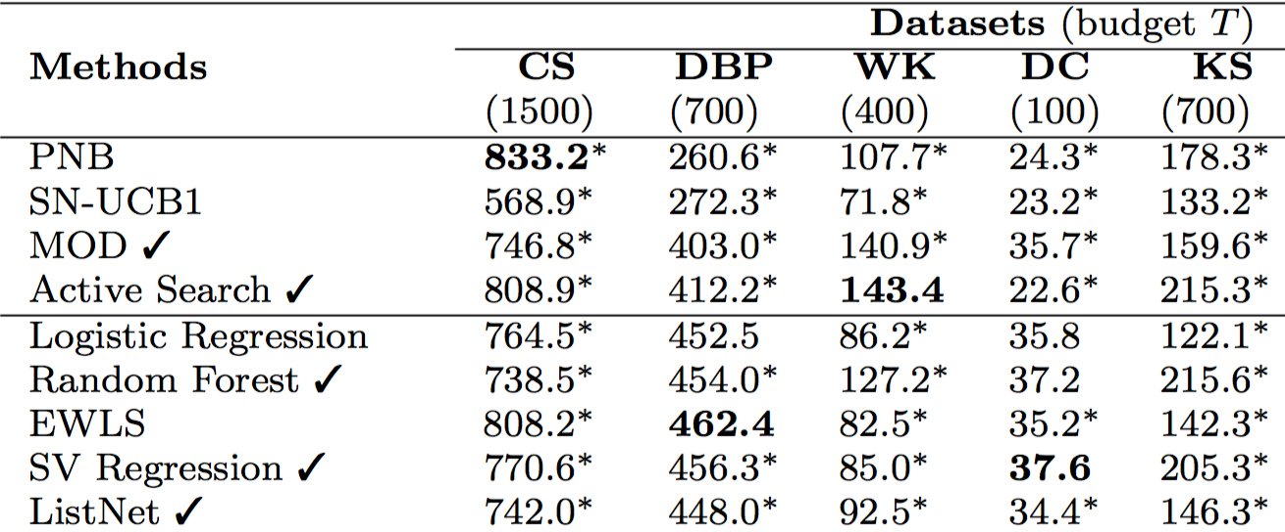
Simulation results
Structural
models
Best method on one dataset can be worst on another!
Data driven
models
Best method not optimal!

Slide 19









Combining methods
Strategy: Round-Robin
Methods
✓
$θ^{(t)}$
$θ^{(t+1)}$
$θ^{(t+2)}$
✗
✗
$γ^{(t)}$
$γ^{(t+1)}$
$γ^{(t+2)}$
✓
✗
$φ^{(t)}$
$φ^{(t+1)}$
$φ^{(t+2)}$
✓
✓

Slide 20
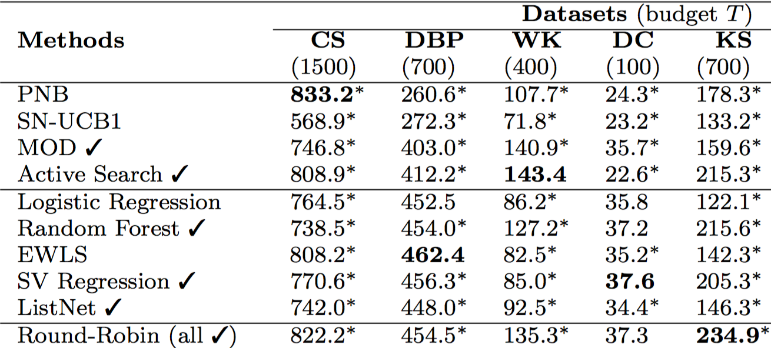
Round-Robin performance
Heuristics
Models
Round-Robin can be better than
best individual method!

Slide 21
Power of diversity
experiments show
  RR explores wider range of regions likely to contain more targets
  RR generates more diverse training data causing models to generalize better
diversity key to better performance
cannot be obtained through random queries
diversity must be directed
Can RR be improved on?
Notes:
Clearly, RR is not the best we can do. The generalization is to allow us to choose any method at each step. To some extent, we want to choose best methods more often. At the same time, we want to keep using the other ones. And we have to learn that.

Slide 22
Selective Harvesting as
Multi-Armed Bandit (MAB)
MABs: player chooses one of K actions (arms), during each of n turns. At each turn:
reward drawn from unknown distribution associated with each arm (hidden)
player pulls an arm, observes reward
goal: maximize cumulative reward (converges to best arm)

Slide 23
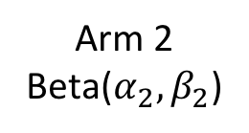
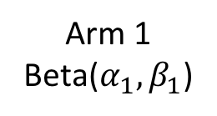
Differences w.r.t. classic MAB
in selective harvesting, actions (border nodes) change at each step
  Model: methods as arms
  (action uniquely determined by arm choice)
reward distribution changes over time.
  non-stationary MABs
goal not to converge to best method!
  solution: prevent variance of distribution associated with arms from shrinking too much
Thompson Sampling
Arm 1
Beta($α_{1},β_{1}$)
Arm 2
Beta($α_{2},β_{2}$)
Dynamic Thompson Sampling
Directed Diversity Dynamic Thompson Sampling (D³TS)

Slide 24
D³TS performance
D³TS matches or exceeds performance of all other classifiers
Notes:
methods

Slide 25
Diffusion-Convolutional
Neural Networks*
How to classify nodes in a network?
* NIPS 2016

Slide 26
Main idea
Extend idea of convolution
to general graph-structured data
through diffusion

Slide 27
Convolutional Neural Networks

Slide 28
Convolutional Neural Networks

Slide 29
Convolutional Neural Networks

Slide 31
Diffusion works with general graphs!

Slide 32
Diffusion works with general graphs!

Slide 33
Diffusion works with general graphs!

Slide 36



Representation learning
back propagation
$$X$$
$$Z$$
$$Y$$
features
latent
representation
targets
Examples: convolutional neural nets, deep belief nets, ...

Slide 37
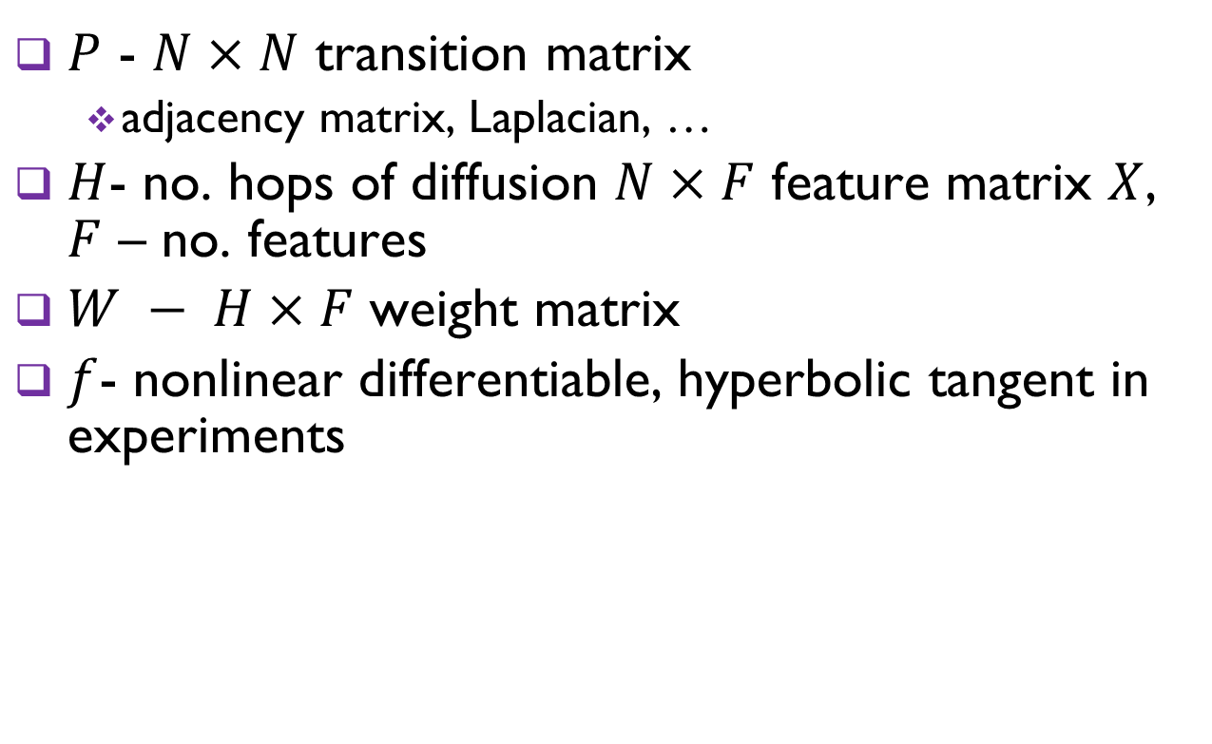
Diffusion convolution definition
$P$ - $N×N$ transition matrix
  adjacency matrix, Laplacian, …
$H$- no. hops of diffusion $N×F$ feature matrix $X$, $F$ – no. features
$W − H×F$ weight matrix
$f$- nonlinear differentiable, hyperbolic tangent in experiments
$$Zk = f\left(Wk∗Pk X\right), k=1,…,H$$

Slide 38
Training
fully connected layer from diffusion convolution to label
trained by minimizing backpropagated error
non-convex optimization problem
use early stopping: learning ceases when validation error increases

Slide 39

Properties
diffusion-convolutional activation invariant to permutations
predictions expressed as tensor operations $⇒$ algorithm can be implemented on GPU

Slide 40
Application to document classification

Slide 41
Summary
designed new sampling algorithm, Hybrid DUFS
developed MAB D³TS algorithm for finding target nodes
developed new node classification algorithm, DCNN, for graphs

Slide 42
Other work
competition models
Sigmetrics 2016 – Best paper award
mobile walkers on graphs as models for computing differential equations

Slide 43
Thanks!

