Slide 1
Multivariate Power Laws in Social Networks and Image Searching
Natick, Massachusetts
November 21, 2016
Weibo Gong
University of Massachusetts, Amherst

Slide 2
Challenges in long tail and rare event data:
National Research Council Report on Frontiers in Massive Data Analysis (2013)
“There are many sources of potential error in massive data analysis, many of which are due to the interest in ‘long tails’ that often accompany the collection of massive data. Events in the “long tail” may be vanishingly rare even in a massive data set;”
“In general, data analysis is based on assumptions, and the assumptions underlying many classical data analysis methods are likely to be broken in massive data sets;”
Response: the causes behind the rare data may not be rare ---generative models are important;
For example when confronting 2D tails we might base our analysis of the observation data on asymptotic independence;
Investigations lead to important applications in (1) social network understanding and (2) hidden object searching in large collection of images, among others.

Slide 3
outline
Part I: Generative models for multivariate power law distributions observed in social networks;
Part II: Power laws in images for guiding object searching.

Slide 4
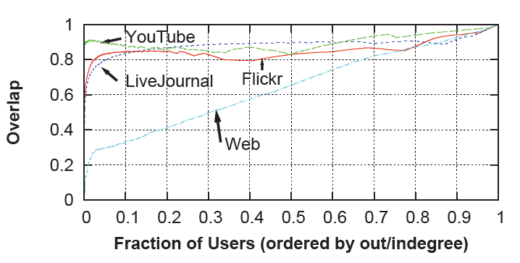
Social network in-out degree extreme value dependence
Social network nodes with very high out-degree also tend to have very high in-degree [Mislove, 2007].
Tail Dependence Coefficient (TDC): dependence between extreme values,
Generative models ?

Slide 5
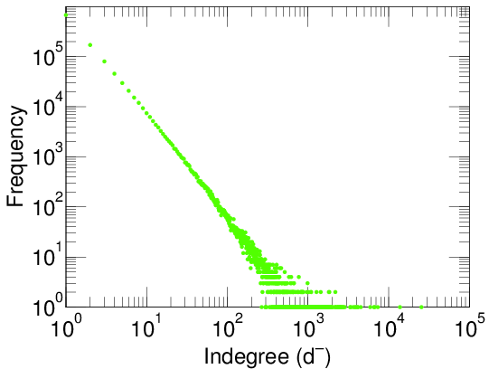
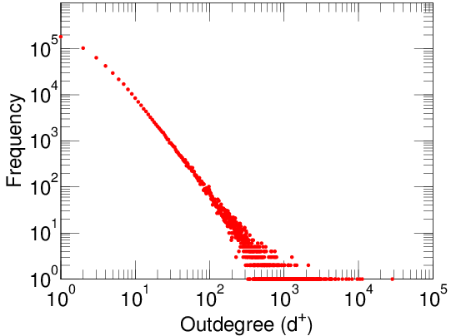
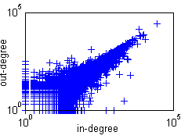
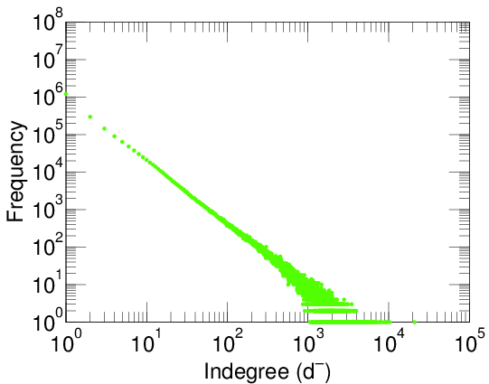
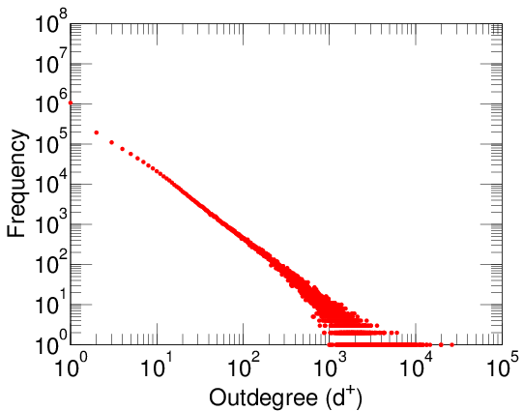
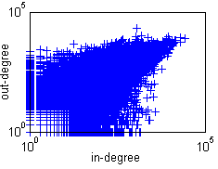
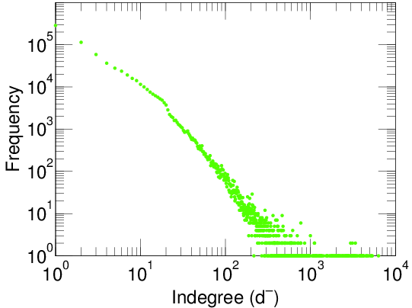
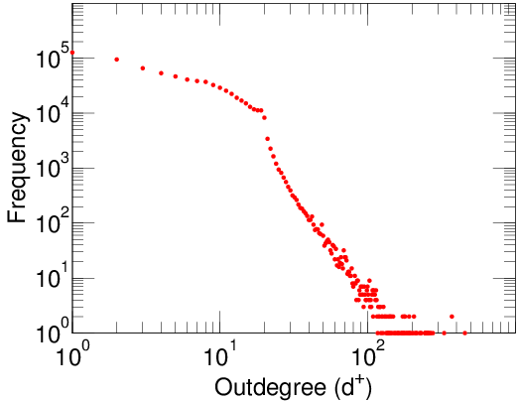
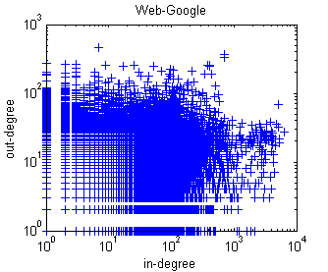
Youtube
In-out degree distributions of some social networks
Flickr
Web-Google

Slide 6
2D Poisson Counter driven SDE Models
Basic model
X1: in-degree; X2: out-degree.
Attempt to introduce dependence between X1 and X2:
  Type 1 Shared Poisson Counter (PC part)
  Type 2 Coupled Growth (Growth part)

Slide 7
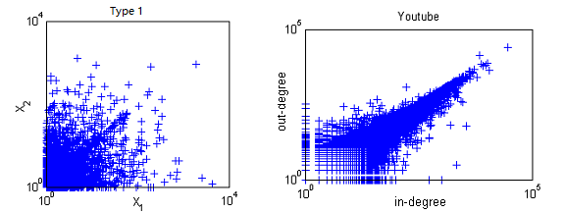
Type 1: Shared and Independent Poisson Counters
N0, N1 and N2 are independent PCs with rates , and .
Marginal density:
Joint density:
Tail dependence coefficient (TDC):
tails asymptotically independent

Slide 8
Type 1: Shared and Independent Poisson Counters
Markov On-Off Modulation:
Markov On-off Process:
M1 and M2: independent PCs with rates and .
  Use Markov on-off process Y to modulate the original Type 1 model.
  Separate the effective time of shared and independent Poisson counters.

Slide 9
Type 1: Shared and Independent Poisson Counters
Modulation 1:
  Shared PC N0 is effective when Y (t) = 0 ;
  Independent PC N1 and N2 are effective when Y(t) = 1.
Modulation 2:
  Effective time is the same as Modulation 1;
  Xi resets when Y changes its state.

Slide 10
Type 1: Shared and Independent Poisson Counters
Marginal and joint density: characteristic function.
TDC ( ):
  Modulation 1:
    Easy to check ;
    Still asymptotically independent.

Slide 11
Type 1: Shared and Independent Poisson Counters
  Modulation 2:
    The case when TDC is fractional is not stable.
    Mixture of two models.

Slide 12

Type 2: Coupled Growth and Independent PCs
Stationary state of X1 and X2 both satisfy a stochastic recursion:
Let i.i.d. independent of ,
with .

Slide 13
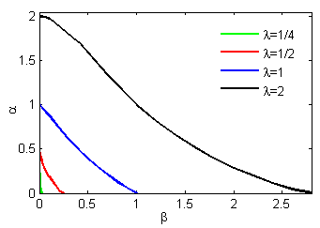
Type 2: Coupled Growth and Independent PCs
Marginal tail:
where is such that .
Solved numerically using MATLAB.
Exponent decreases with the increasing of .

Slide 14
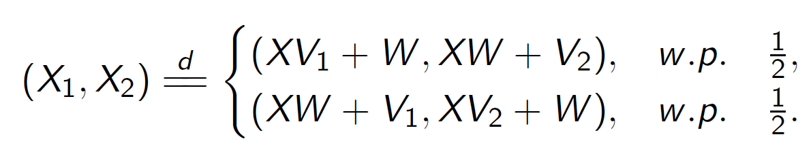
Type 2: Coupled Growth and Independent PCs
Joint distribution: , given , ,
Let and ,

Slide 15
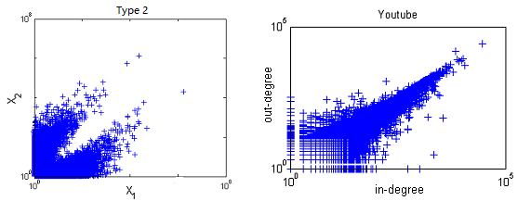
Type 2: Coupled Growth and Independent PCs
Synthetic data ( )

Slide 16
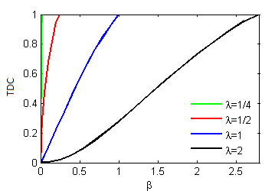
Type 2: Coupled Growth and Independent PCs
Using Breiman's lemma. When ,
TDC increases with the increasing .

Slide 17
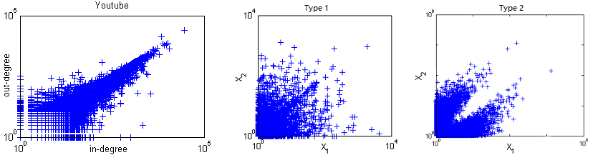
These do not fit well with real social network data
Synthetic data of the two models do not fit the real data in social networks.
The extreme values in real data either be independent or aligned;
``Rare events occur in the most likely way” --- multivariate rare events occurring simultaneously is likely due to the same cause.

Slide 18
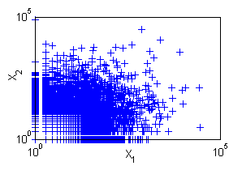
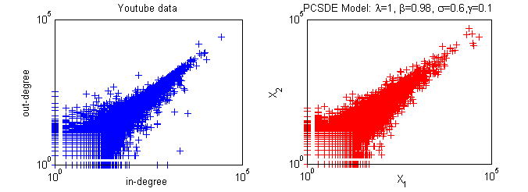
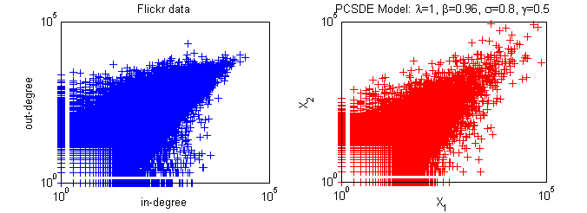
Fitting data with constant elasticity of variance (CEV) model and a shared Poisson counter
W: standard Brownian motion; N: shared PC,

Slide 19
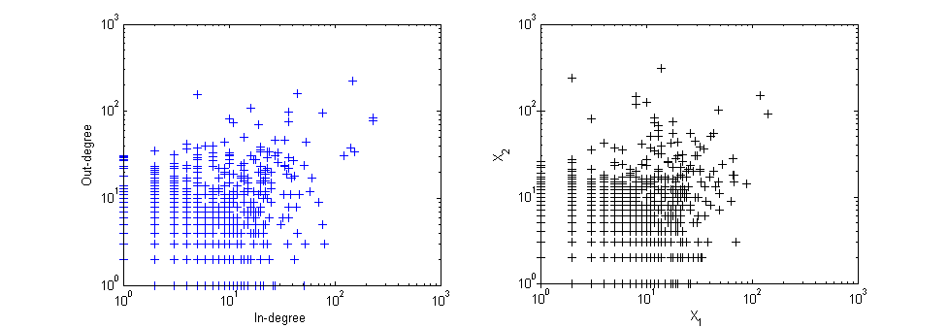
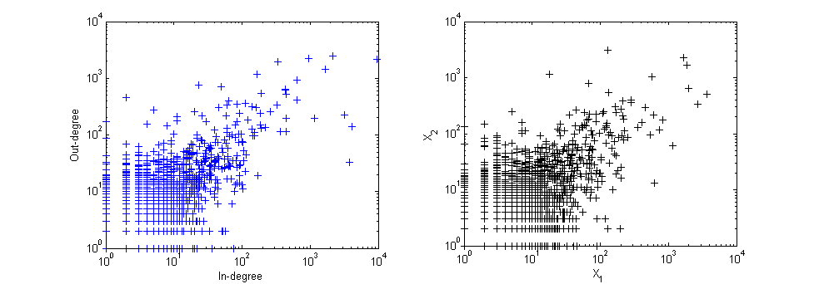
CEV model with independent PCs for Bollobas network (black vs blue in figure)
  X1: in-degree; X2: out-degree; N1 and N2: independent PCs with rates and ,

Slide 20
Power laws in images and Boston marathon bombing image search (April 15 2013)
as the painstaking work of investigators in Boston clearly shows, the technology is far from perfect. Beyond the difficulties presented by low-resolution images typical of CCTV and phone captures, it gets confused by differences in subjects’ posture and in varying illumination situations.
Boston Police Commissioner Edward Davis: "The technology came up empty even though both Tsarnaevs’ images exist in official databases: Dzhokhar had a Massachusetts driver’s license; the brothers had legally immigrated; and Tamerlan had been the subject of some FBI investigation."
Key tip: "He woke up under so many drugs, asked for a paper and pen and wrote, 'bag, saw the guy, looked right at me'," his brother Chris Bauman said in an interview Wednesday. He identified suspect number one - a man wearing a black jacket with a hooded sweatshirt underneath, a cap and sunglasses.

Slide 21
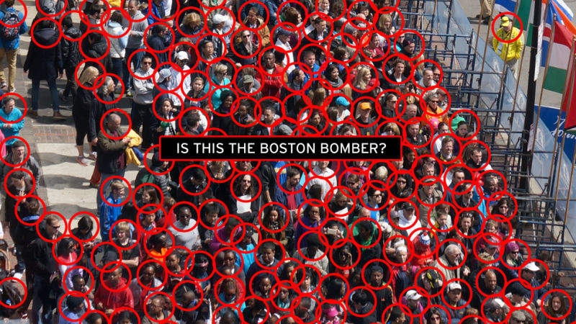

Slide 22
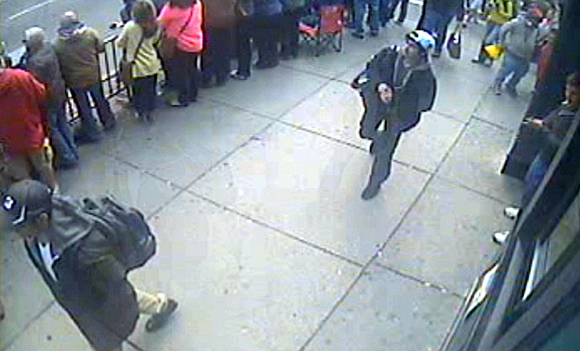
'bag, saw the guy, looked right at me’.
a man wearing a black jacket with a hooded sweatshirt underneath, a cap and sunglasses

Slide 23


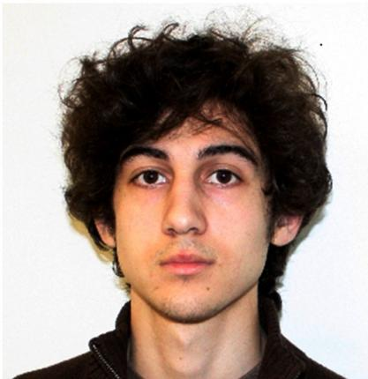
How to find multiscale invariants from images?

Slide 24
This happened before in physics when studying the percolation model relating to self-organized criticality, scaling, and power law of cluster size distribution
“As we can see, the transformation preserves most of the large-scale structure of the configuration, although a lot of the small detail is lost. BUT do we know what level we are looking for?”

Slide 25
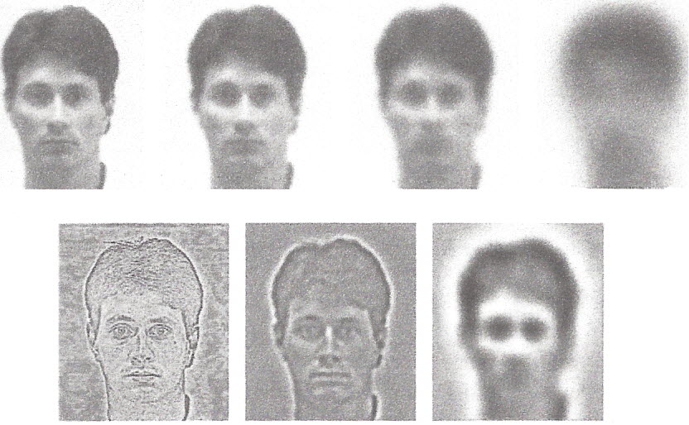
In these models multiscale analysis is crucial. For example it’s the relations across resolutions ( the heat flow or differences) that helps face recognition (from Mumford book from Yullie book)

Slide 26
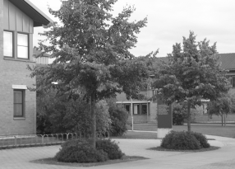

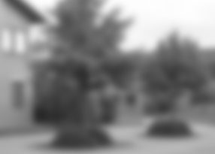
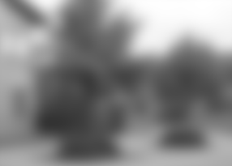

Scale invariance of objects in images is the base for the scale invariant feature transformation (SIFT) widely used. It is related to the self-focused criticality of human visual system and useful in object searching.

Slide 27
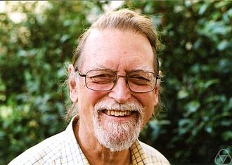
David Mumford (1974 Fields Medal winner):
Self-similarity of image statistics and image models
One of the earliest discoveries about the statistics of images
I was that their power spectra tend to obey power laws
, where λ varies somewhat from image to image but clusters around the value 2. This has a very provocative interpretation: this power law is implied by self-similarity!
In the language of lattice field theory, if I(i, j), i, j ∈ Z is a random lattice field and is the block averaged field then we say the field is a renormalization fixed point if the distributions of I and of are the same. The hypothesis that natural images of the world, treated as a single large database, have renormalization invariant statistics has received remarkable confirmation from many quite distinct tests.

Slide 28

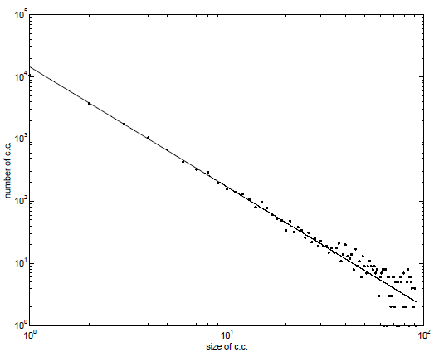
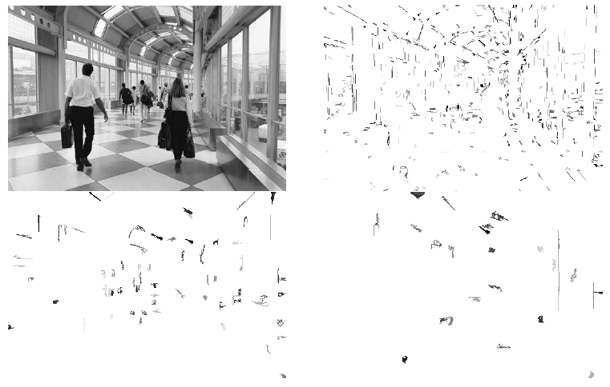

distribution of bilevels in natural images show power law

Slide 29
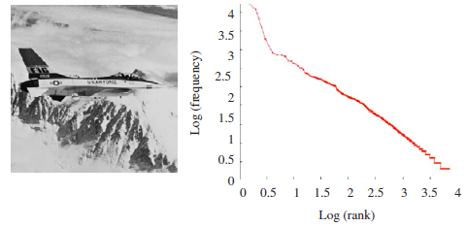
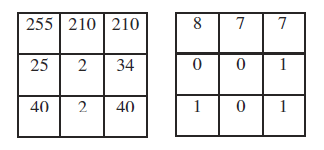
pixel words show power law in natural images
“Word” in Image

Slide 30
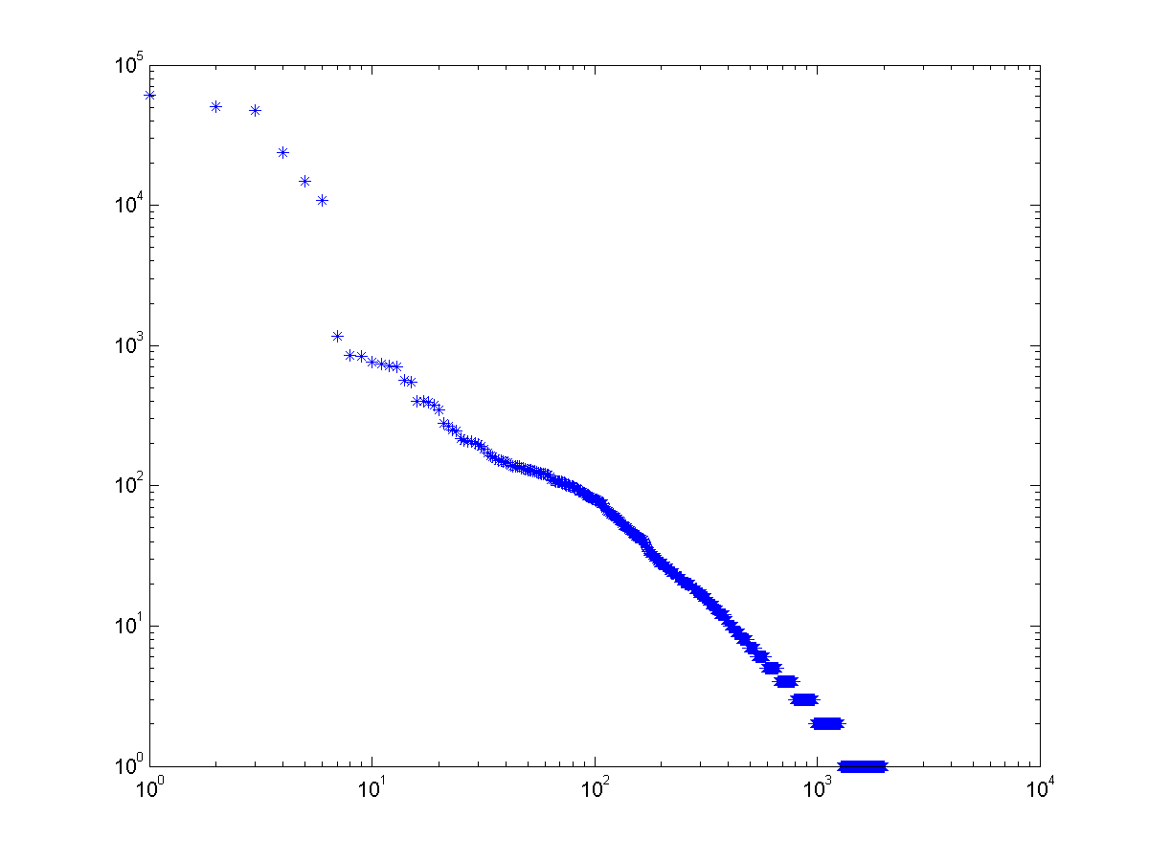
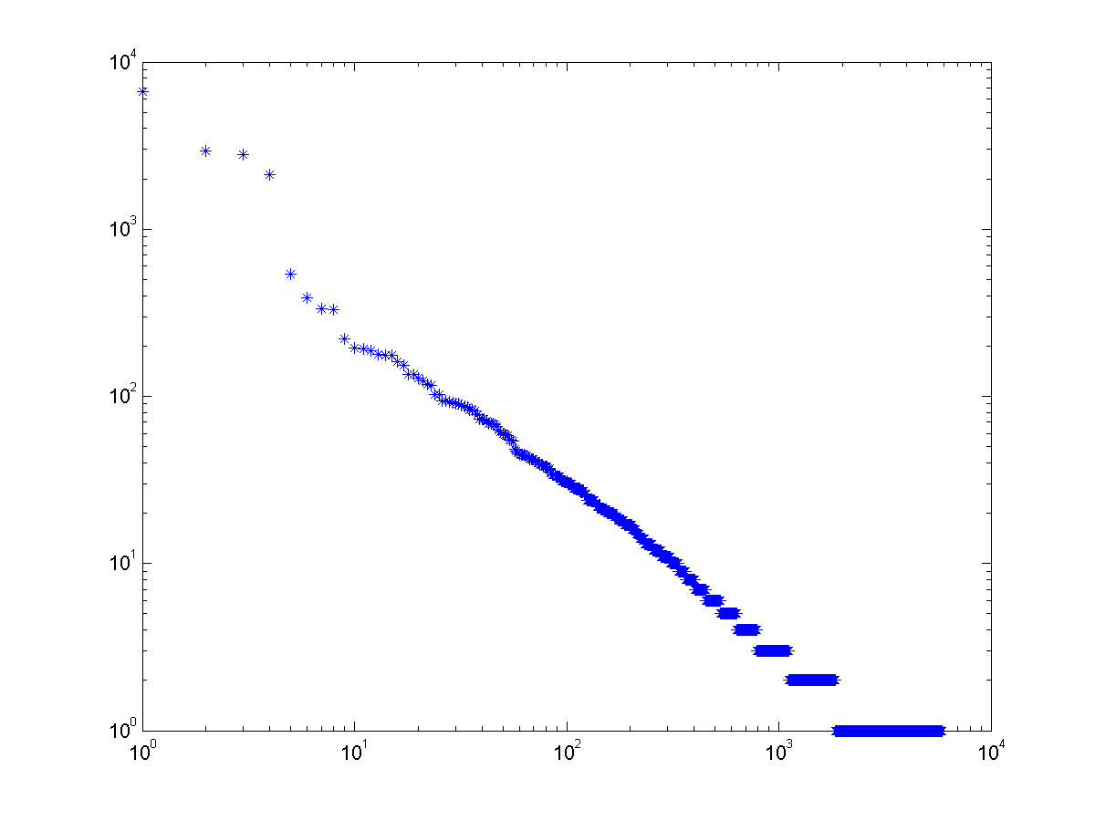


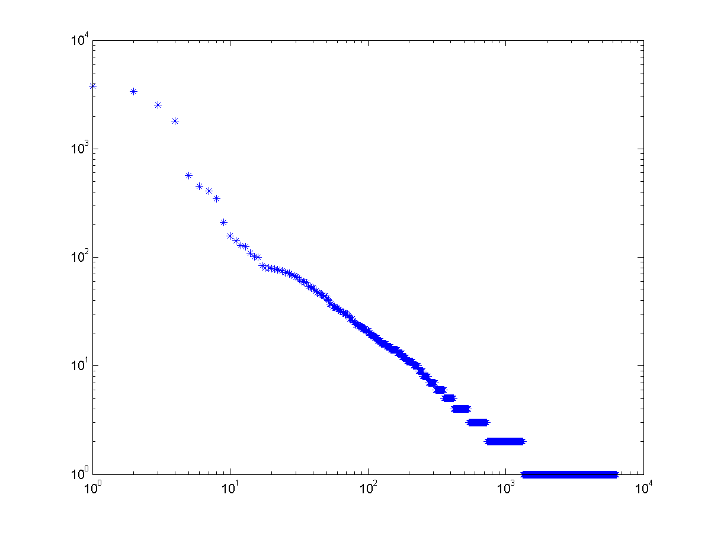
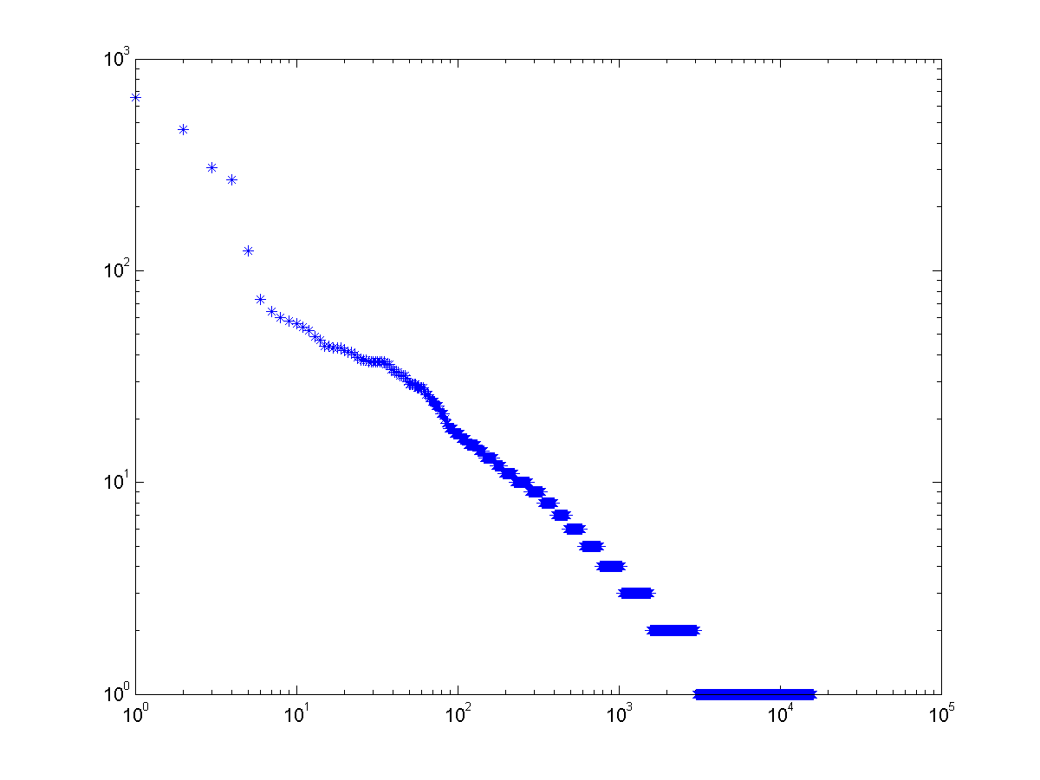



Slide 31
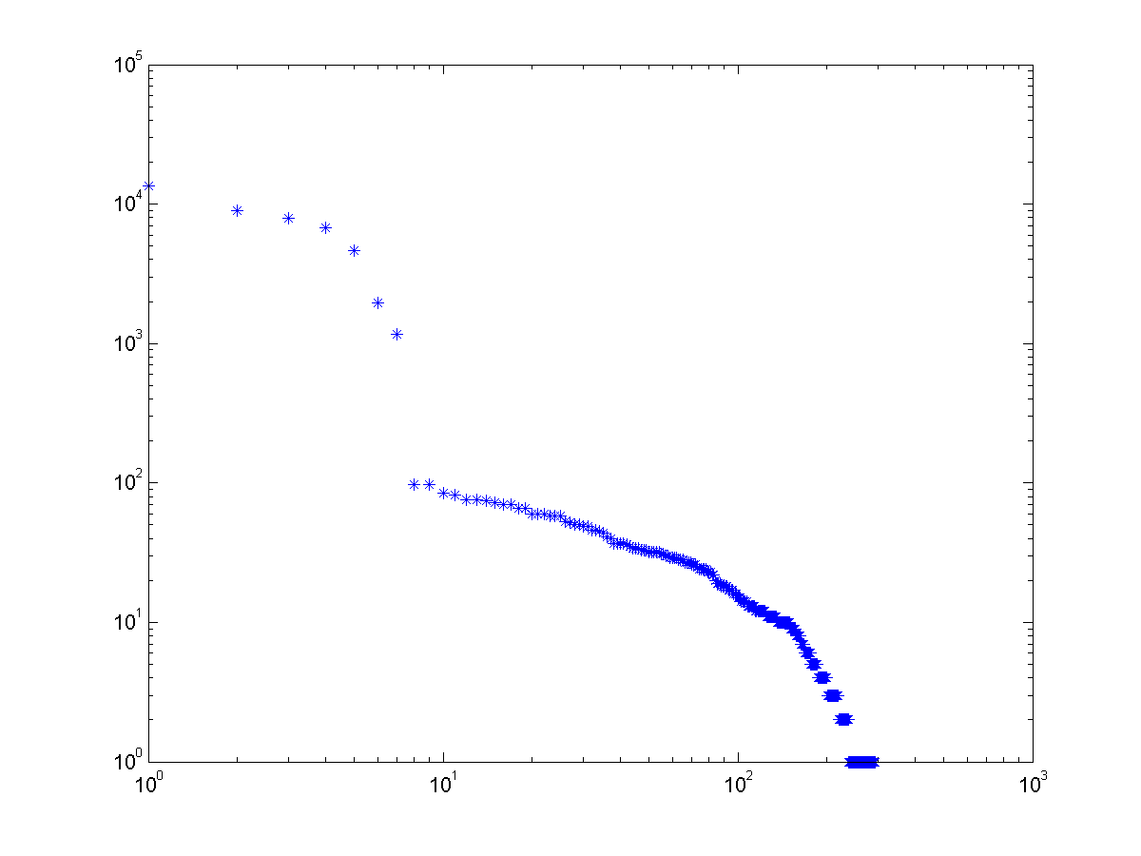


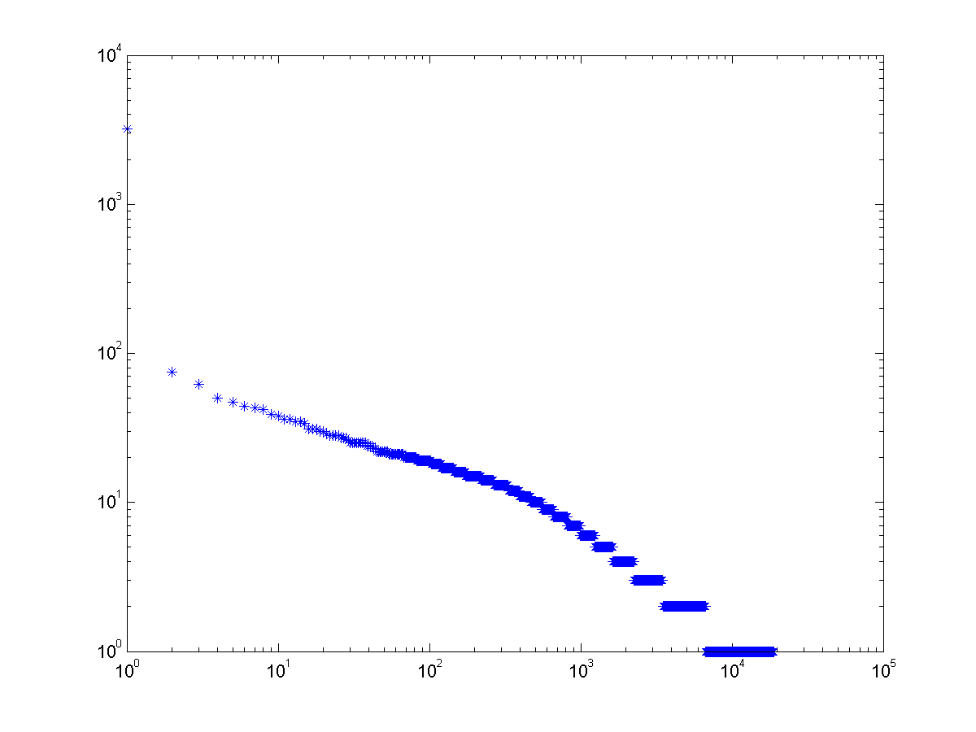
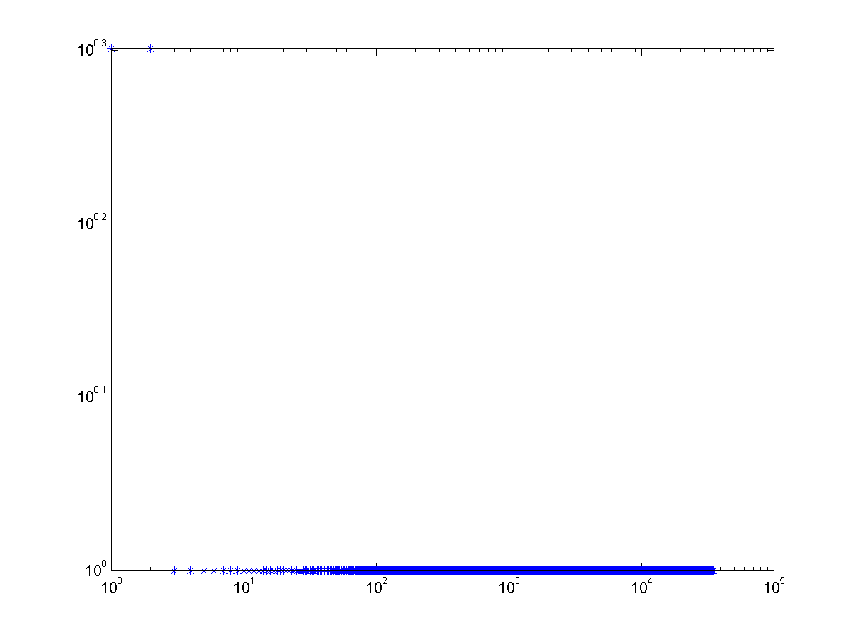
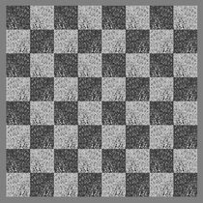
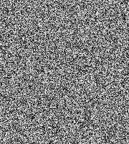

Slide 32
Sources of power laws in natural images: hierarchical multiplication processes
Daniel L. Ruderman, Origins of Scaling in Natural Images: One of the most robust qualities of our visual world is the scale invariance of natural images which are collages of regions corresponding to statistically independent "objects". These objects have a power-law distribution of sizes within images,
David Mumford, Pattern Theory: the world is viewed from a random viewpoint, this scales the image; the world is not merely made up of objects but it is cluttered with them. a suitable function space supports a probability measure which is invariant under both translations and scalings (x, y) → (σx, σy), whose samples are ‘natural images’.
Sidney Resnick and Gennady Samorodnitsky, Limits of on/off Hierarchical Product Models for Data Transmission, 2003.
Vishal Misra and Weibo Gong, A Hierarchical Model for Teletraffic, 1998.
To view such images and search for hidden objects our visual system evolves to constant jiggling eye movements that has long jumps and short tremors,

Slide 33
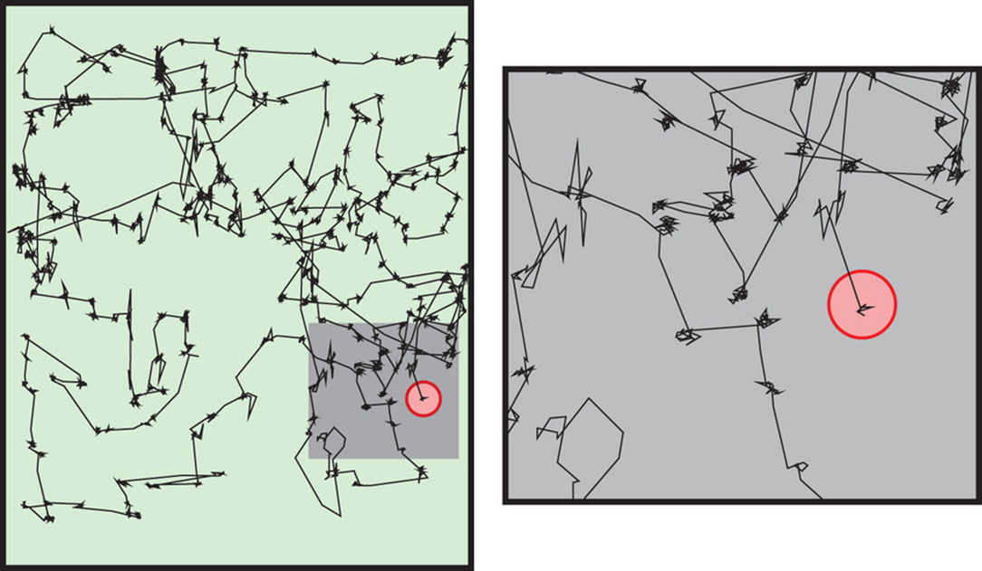
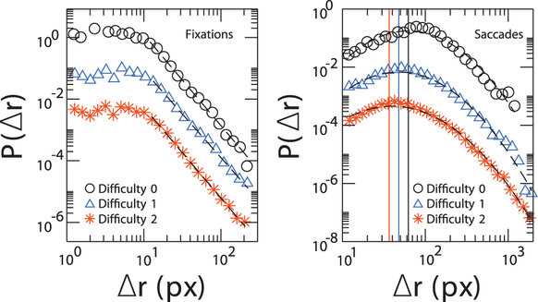
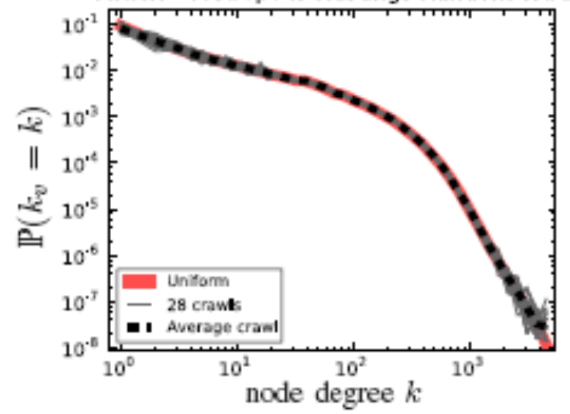
Statistical patterns of visual search for
hidden objects Heitor F. Credidio et al, Nature, 2012

Slide 34
Old slide on OSN model: Does this model explain OSN data?
Transition region determined by , which cannot be large.
34
Notes:
34
Transition region is determined by x0, which cannot be very large.
If head exponent is negative, tail exponent cannot be smaller than -3.

Slide 35
Geometric Brownian motion with exponential restart
where is constant.
Steady state density – Double Pareto
where
35

Slide 36
Ongoing work
Develop search schemes mimicking human eye movements consisted of two alternating actions (power law for short range and lognormal for longer range searches);
Power law and self-similar phenomena in images guide us in finding invariants for relations at multiples scales;
For colored images the power law is multivariate; Tail behavior is important guide;

Slide 37
Publications
J. Kang, S. Lu, W. Gong, P. Kelly, Image Feature Extraction Based on Spectral Graph Information, International Conference on Image Processing (ICIP), Phoenix, Arizona, September 2016.
S. Lu, G. Samorodnitsky, W. Gong, B. Jiang, J. Kang, D. Towsley, Poisson Process Driven Stochastic Differential Equations for Bivariate Heavy Tailed Distributions, American Control Conference (ACC), June 2016
S. Lu, B. Jiang, J. Kang, W. Gong, G. Samorodnitsky, D. Towsley, Multivariate Heavy Tailed Distribution Generator for Complex Network Analysis, International Conference on Network Science (NetSci), October 2015
J. Kang, S. Lu, W. Gong, P. Kelly: A Complex Network Based Feature Extraction for Image Retrieval, International Conference on Image Processing (ICIP), Paris, France, September 2014
S. Lu, J. Kang, W. Gong, D. Towsley, Complex Network Comparison Using Random Walks, World Wide Web Conference (WWW), Seoul, Korean, 2014

Slide 38
Thanks

